Slide 1
PHYS 1444 – Section 001
Lecture #17
Tuesday, July 2, 2019
Dr. Jaehoon Yu
Chapter 29:EM Induction & Faraday’s Law
  Generation of Electricity & Transformer
  Mutual and Self Inductance
  Energy Stored in Magnetic Field
Chapter 30: Inductance
  Mutual and Self Inductance
  Energy Stored in Magnetic Field
Chapter 31: Maxwell’s Equations
  Production of EM Waves
  Light as EM Waves

Slide 2
Announcements
Reading Assignments: CH29.5, 29.8, 30.10 and CH30.11
Final Exam
  In the class for 120min tomorrow Wednesday, July 3
  Covers CH21.1 – What we finish today + Maxwell’s equations (?)
  BYOF: You may prepare one 8.5x11.5 sheet (front and back) of handwritten formulae and values of constants for the exam
  No derivations, word definitions, setups or solutions of any problems!
  No additional formulae or values of constants will be provided!
Be sure to bring your planetarium extra credit and submit at the beginning of the exam this Wednesday, July 3
  Tape one side of the ticket stub on a sheet of paper with your name on
Term 2 results
  Class average: 61.1/100
  Equivalent to: 60.5/100, previous results: 56.4/100 and 65.8/100
  Top score: 85/101
Quiz 4 results
  Class average: 42.1/80
  Equivalent to: 52.6/100, previous results: 44.3/100, 52.2/100 and 68.2/100
  Top score: 76

Slide 3
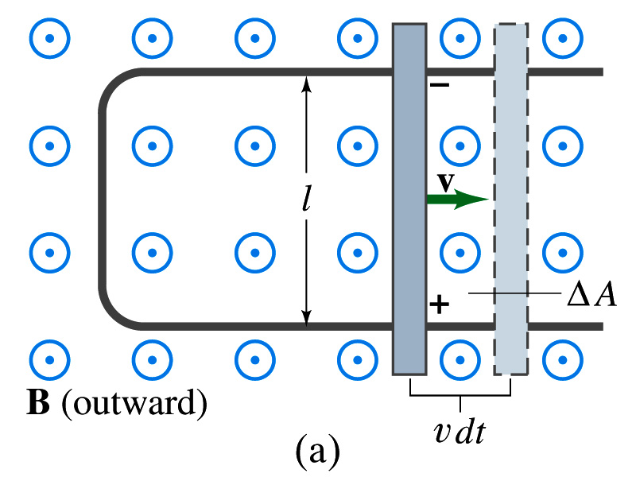
EMF Induced on a Moving Conductor
Another way of inducing emf is using a U shaped conductor with a movable rod resting on it.
As the rod moves at a speed v, it travels vdt in time dt, changing the area of the loop by dA=lvdt.
Using Faraday’s law, the induced emf for this loop is
  This equation is valid as long as B, l and v are perpendicular to each other. What do we do if not?
    Use the scalar product of vector quantities
An emf induced on a conductor moving in a magnetic field is called a motional emf

Slide 4
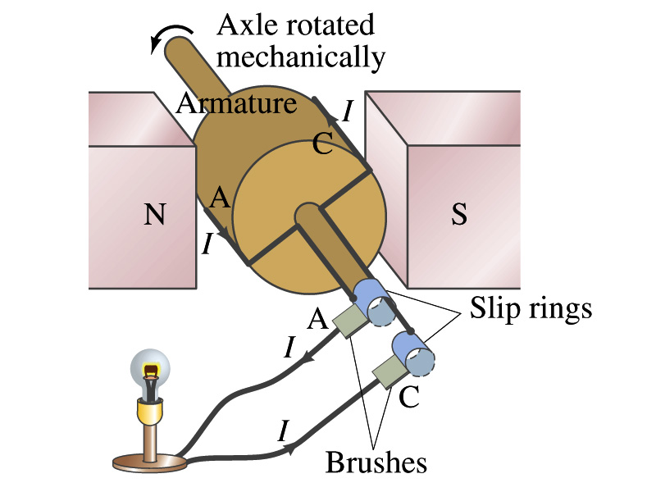
Electric Generators
What does a generator do?
  Transforms mechanical energy into the electrical energy
  What does this look like?
    An inverse of an electric motor which transforms electrical energy to mechanical energy
  An electric generator is also called a dynamo
Whose law does the generator based on?
  Faraday’s law of induction

Slide 5
How does an Electric Generator work?
An electric generator consists of
  Many coils of wires wound on an armature that can rotate by mechanical means in a magnetic field
An emf is induced in the rotating coil
Electric current is the output of a generator
Which direction does the output current flow when the armature rotates counterclockwise?
  The conventional current flows outward on wire A toward the brush
  After half the revolution the wire A will be where the wire C is and the current flow on A is reversed
Thus the current produced is alternating its direction

Slide 6
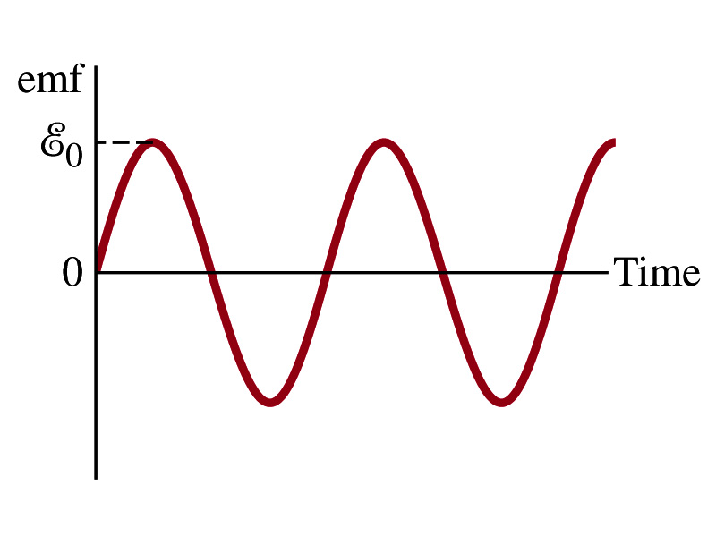

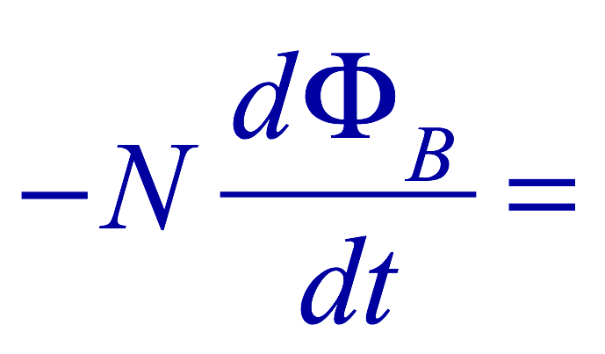
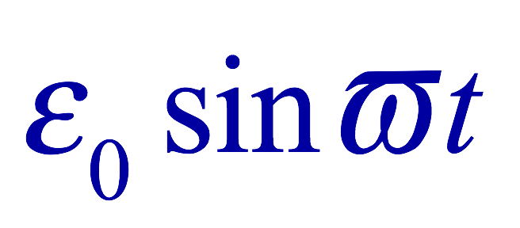
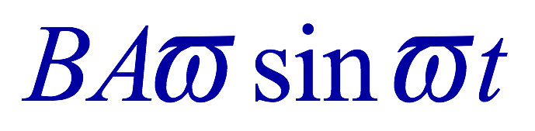
How does an Electric Generator work?
Let’s assume the loop is rotating in a uniform B field w/ a constant angular velocity ω. The induced emf is
What is the variable that changes above?
  The angle θ. What is dθ/dt?
    The angular speed ω.
  So θ=θ₀+ωt
  If we choose θ₀=0, we obtain
  If the coil contains N loops:
  What is the shape of the output?
    Sinusoidal w/ the amplitude ε₀=NBAω
USA frequency is 60Hz. Europe is at 50Hz
  Most the U.S. power is generated at steam plants

Slide 7
Example 29 – 9
An AC generator. The armature of a 60-Hz AC generator rotates in a 0.15-T magnetic field. If the area of the coil is 2.0x10⁻²m², how many loops must the coil contain if the peak output is to be ε₀=170V?
The maximum emf of a generator is
Solving for N
Since
We obtain

Slide 8
US Electricity Sources

Slide 9
US Electric E Consumption by Users
US Energy Information Administration http://www.eia.gov/electricity/

Slide 10
The World Energy Consumption
In 2016, total worldwide energy consumption was 567 EJ (567×10¹⁸ J=157 PWh)➔ expected >1000EJ by 2050
  Equivalent to an average energy consumption rate of 18 terawatts (1.8×10¹³ W)
  US uses 39.1 PWh (1.38kWh/person, as of 2014)
The potential for renewable energy
  solar energy 1600 EJ (444,000 TWh)
  wind power 600 EJ (167,000 TWh)
  geothermal energy 500 EJ (139,000 TWh),
  biomass 250 EJ (70,000 TWh)
  hydropower 50 EJ (14,000 TWh) an
  ocean energy 1 EJ (280 TWh)
  Read this paper if you want to learn more

Slide 11
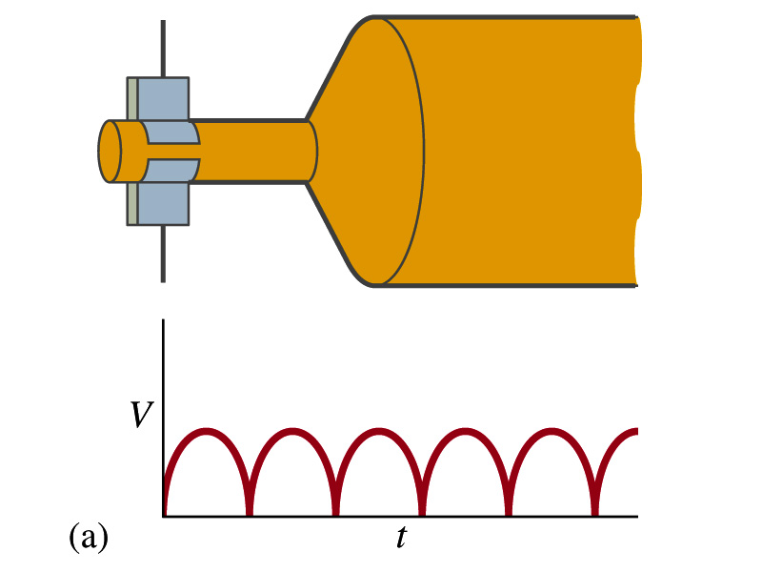
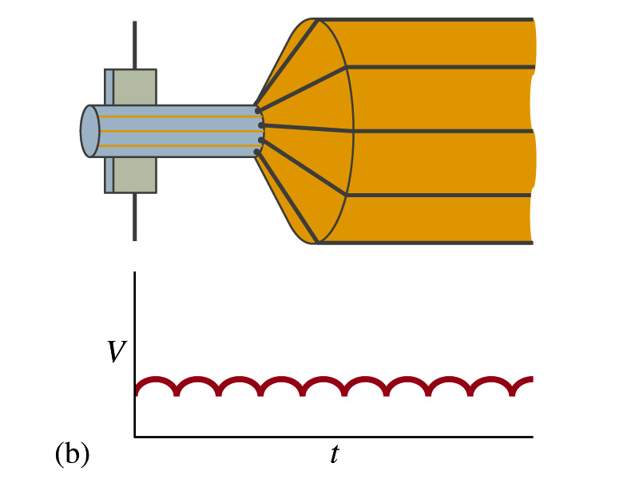
A DC Generator
A DC generator is almost the same as an AC generator except the slip rings are replaced by split-ring commutators
Output can be smoothed out by placing a capacitor in parallel to the output
  More commonly done using many armature windings
Smooth output using many windings

Slide 12
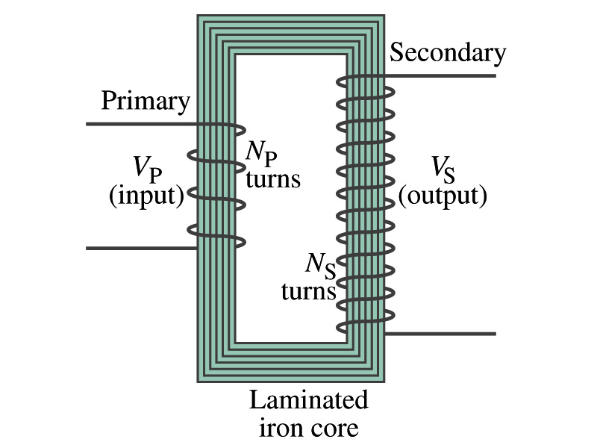
Transformer
What is a transformer?
  A device for increasing or decreasing an AC voltage
  A few examples?
    TV sets to provide the high voltage to picture tubes, portable electronic device converters, transformers on the pole, etc
A transformer consists of two coils of wires known as the primary and the secondary
  The two coils can be interwoven or linked by a laminated soft iron core to reduce losses due to Eddy current
Transformers are designed so that all magnetic flux produced by the primary coil pass through the secondary

Slide 13
How does a transformer work?
When an AC voltage is applied to the primary, the changing B it produces will induce voltage of the same frequency in the secondary wire
So how would we make the voltage different?
  By varying the number of loops in each coil
  From Faraday’s law, the induced emf in the secondary is
  The input primary voltage is
  Since dΦ_{B}/dt is the same, we obtain
Transformer Equation

Slide 14
Transformer Equation
The transformer equation does not work for DC current
  Since there is no change of magnetic flux!!
If N_{S}>N_{P}, the output voltage is greater than the input so it is called a step-up transformer while N_{S}<N_{P} is called step-down transformer
Now, it looks like energy conservation is violated since we can get more emf from smaller ones, right?
  Wrong! Wrong! Wrong! Energy is always conserved!
  A well designed transformer can be more than 99% efficient
  The power output is the same as the input:
The output current for a step-up transformer will be lower than the input, while it is larger for a step-down x-former than the input.

Slide 15
Example for A Transformer
Portable radio transformer. A transformer for home use of a portable radio reduces 120-V AC to 9.0V AC. The secondary contains 30 turns, and the radio draws 400mA. Calculate (a) the number of turns in the primary (b) the current in the primary and (c) the power transformed.
(a) What kind of a transformer is this?
A step-down x-former
Since
We obtain
We obtain
(b) Also from the transformer equation
(c) Thus the power transformed is
How about the input power?
The same assuming 100% efficiency.

Slide 16
Example 29 – 13: Power Transmission
Transmission lines. An average of 120kW of electric power is sent to a small town from a power plant 10km away. The transmission lines have a total resistance of 0.4Ω. Calculate the power loss if the power is transmitted at (a) 240V and (b) 24,000V.
We cannot use P=V²/R since we do not know the voltage along the transmission line. We, however, can use P=I²R.
(a) If 120kW is sent at 240V, the total current is
Thus the power loss due to transmission line is
(b) If 120kW is sent at 24,000V, the total current is
Thus the power loss due to transmission line is
The higher the transmission voltage, the smaller the current, causing less loss of energy. This is why power is transmitted w/ HV, as high as 170kV.

Slide 17
Electric Field due to Magnetic Flux Change
When the electric current flows through a wire, there is an electric field in the wire that moves electrons
We saw, however, that changing magnetic flux induces a current in the wire. What does this mean?
  There must be an electric field induced by the changing magnetic flux.
In other words, a changing magnetic flux produces an electric field
This results apply not just to wires but to any conductor or any region in space

Slide 18
Generalized Form of Faraday’s Law
Recall the relationship between the electric field and the potential difference
Induced emf in a circuit is equal to the work done per unit charge by the electric field
So we obtain
The integral is taken around a path enclosing the area through which the magnetic flux Φ_{Β} is changing.

Slide 19
Inductance
Changing magnetic flux through a circuit induce an emf in that circuit
An electric current produces a magnetic field
From these, we can deduce
  A changing current in one circuit must induce an emf in a nearby circuit ➔ Mutual inductance
  Or induce an emf in itself ➔ Self inductance

Slide 20
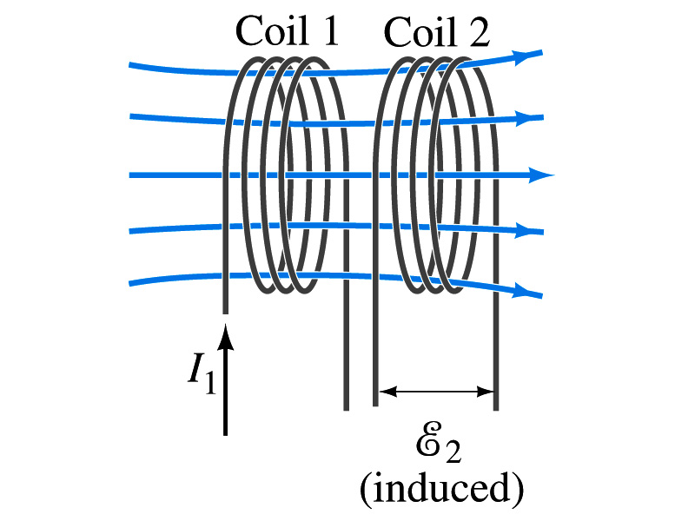
Mutual Inductance
If two coils of wire are placed near each other, a changing current in one will induce an emf in the other.
What is the induced emf, ε₂, in coil2 proportional to?
  Rate of the change of the magnetic flux passing through it
This flux is due to current I₁ in coil 1
If Φ₂₁ is the magnetic flux in each loop of coil2 created by coil1 and N₂ is the number of closely packed loops in coil2, then N₂Φ₂₁ is the total flux passing through coil2.
If the two coils are fixed in space, N₂Φ₂₁ is proportional to the current I₁ in coil 1, .
The proportionality constant for this is called the Mutual Inductance and defined as .
The emf induced in coil2 due to the changing current in coil1 is

Slide 21
Mutual Inductance
The mutual induction of coil2 with respect to coil1, M₂₁,
  is a constant and does not depend on I₁.
  depends only on “geometric” factors such as the size, shape, number of turns and relative position of the two coils, and whether a ferromagnetic material is present
    The farther apart the two coils are the less flux can pass through coil, 2, so M₂₁ will be less.
  In most cases the mutual inductance is determined experimentally
Conversely, the changing current in coil2 will induce an emf in coil1
  M₁₂ is the mutual inductance of coil1 with respect to coil2 and M₁₂ = M₂₁
  We can put M=M₁₂=M₂₁ and obtain
  SI unit for mutual inductance is henry (H)
What? Does this make sense?

Slide 22
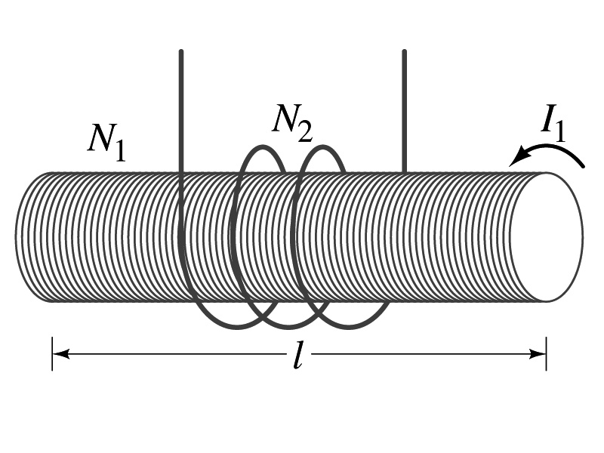
Example 30 – 1
Solenoid and coil. A long thin solenoid of length l and cross-sectional area A contains N₁ closely packed turns of wire. Wrapped around it is an insulated coil of N₂ turns. Assuming all the flux from coil 1 (the solenoid) passes through coil 2, calculate the mutual inductance.
First we need to determine the flux produced by the solenoid.
What is the magnetic field inside the solenoid?
Since the solenoid is closely packed, we can assume that the field lines are perpendicular to the surface area of the coils. Thus the flux through coil 2 is
Thus the mutual inductance of coil 2 is
Note that M₂₁ only depends on geometric factors!

Slide 23
Self Inductance
The concept of inductance applies to a single isolated coil of N turns. How does this happen?
  When a changing current passes through a coil
  A changing magnetic flux is produced inside the coil
  The changing magnetic flux in turn induces an emf in the same coil
  This emf opposes the change in flux. Whose law is this?
    Lenz’s law
What would this do?
  When the current through the coil is increasing?
    The increasing magnetic flux induces an emf that opposes the original current
    This tends to impedes its increase, trying to maintain the original current
  When the current through the coil is decreasing?
    The decreasing flux induces an emf in the same direction as the current
    This tends to increase the flux, trying to maintain the original current

Slide 24
Self Inductance
Since the magnetic flux Φ_{B} passing through N turn coil is proportional to current I in the coil,
We define self-inductance, L:
The induced emf in a coil of self-inductance L is
  What is the unit for self-inductance?
What does magnitude of L depend on?
  Geometry and the presence of a ferromagnetic material
Self inductance can be defined for any circuit or part of a circuit
Self Inductance

Slide 25
So what in the world is the Inductance?
It is an impediment onto the electrical current due to the existence of changing flux
So what?
In other words, it behaves like a resistance to the varying current, such as AC, that causes the constant change of flux
But it also provides means to store energy, just like the capacitance

Slide 26
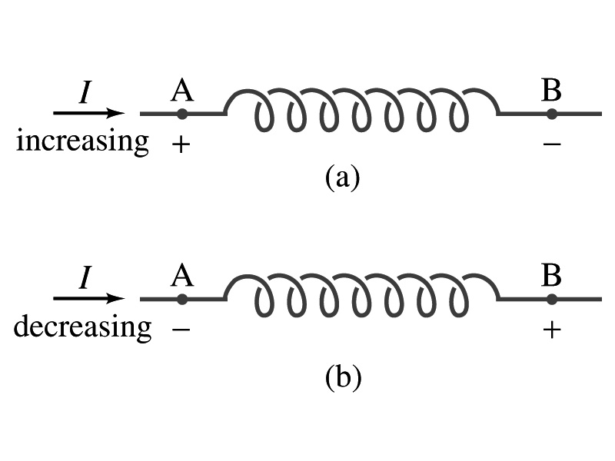
Inductor
An electrical circuit always contains some inductance but is normally negligibly small
  If a circuit contains a coil of many turns, it could have large inductance
A coil that has significant inductance, L, is called an inductor and is express with the symbol
  Precision resisters are normally wire wound
    Would have both resistance and inductance
    The inductance can be minimized by winding the wire back on itself in opposite direction to cancel magnetic flux
    This is called a “non-inductive winding”
If an inductor has negligible resistance, inductance controls the changing current
For an AC current, the greater the inductance the less the AC current
  An inductor thus acts like a resistor to impede the flow of alternating current (not to DC, though. Why?)
  The quality of an inductor is indicated by the term reactance or impedance

Slide 27
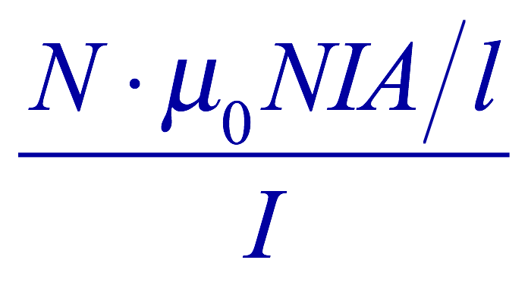
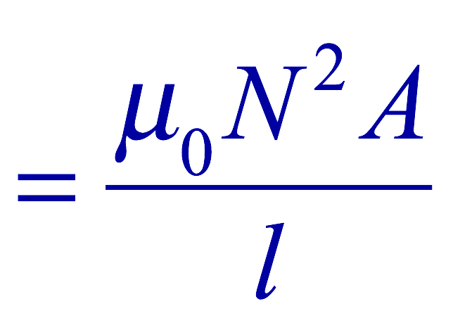
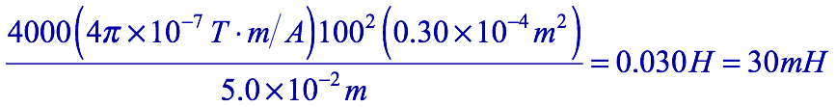
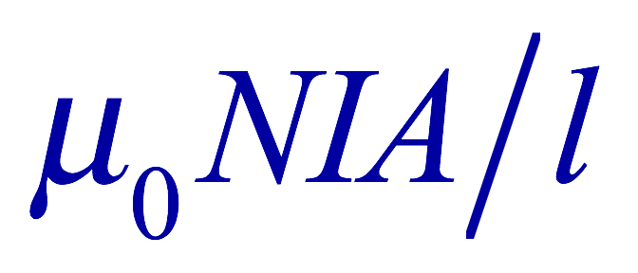
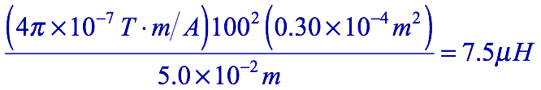
Example 30 – 3
Solenoid inductance. (a) Determine the formula for the self inductance L of a tightly wrapped solenoid ( a long coil) containing N turns of wire in its length l and whose cross-sectional area is A. (b) Calculate the value of L if N=100, l=5.0cm, A=0.30cm² and the solenoid is air filled. (c) calculate L if the solenoid has an iron core with μ=4000μ₀.
What is the magnetic field inside a solenoid?
The flux is, therefore,
Using the formula for self inductance:
(b) Using the formula above
(c) The magnetic field with an iron core solenoid is

Slide 28
Energy Stored in the Magnetic Field
When an inductor of inductance L is carrying current I which is changing at a rate dI/dt, energy is supplied to the inductor at a rate
What is the work needed to increase the current in an inductor from 0 to I?
  The work, dW, done in time dt is
  Thus the total work needed to bring the current from 0 to I in an inductor is

Slide 29
Energy Stored in the Magnetic Field
The work done to the system is the same as the energy stored in the inductor when it is carrying current I
  This is compared to the energy stored in a capacitor, C, when the potential difference across it is V:
  Just like the energy stored in a capacitor is considered to reside in the electric field between its plates
  The energy in an inductor can be considered to be stored in its magnetic field
Energy Stored in a magnetic field inside an inductor

Slide 30
Stored Energy in terms of B
So how is the stored energy written in terms of magnetic field B?
  Inductance of an ideal solenoid without a fringe effect
  The magnetic field in a solenoid is
  Thus the energy stored in an inductor is
  Thus the energy density is
  This formula is valid in any region of space
  If a ferromagnetic material is present, μ₀ becomes μ.
E
What is this?
E density
Volume V
What volume does Al represent?
The volume inside a solenoid!!

Slide 31
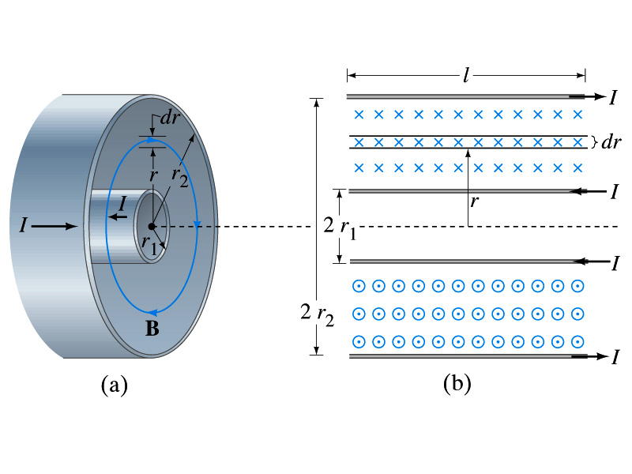
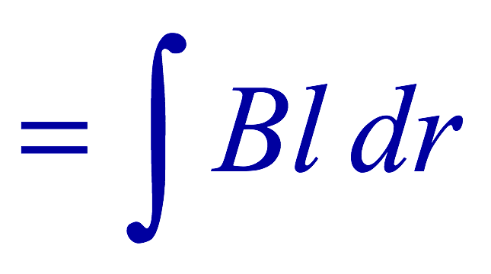
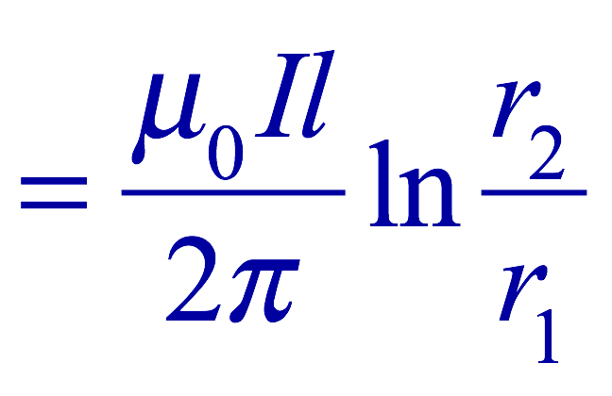

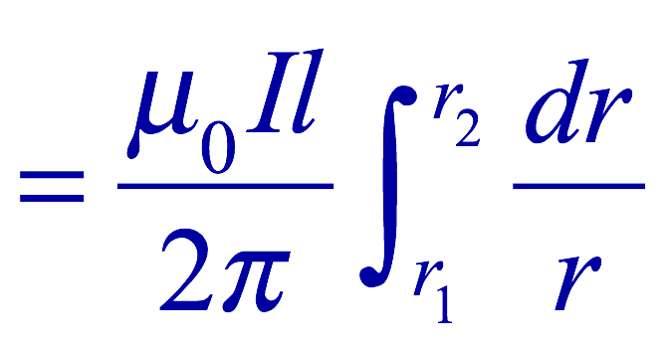
Example 30 – 5
Energy stored in a coaxial cable. (a) How much energy is being stored per unit length in a coaxial cable whose conductors have radii r₁ and r₂ and which carry a current I? (b) Where is the energy density highest?
(a) The total flux through l of the cable is
Thus inductance per unit length for a coaxial cable is
Thus the energy stored per unit length is
(b) Since the magnetic field is
The energy density is highest where B is highest. Since B is highest close to r=r₁, near the surface of the inner conductor.
And the energy density is

Slide 32
Example 30 – 9
Reactance of a coil. A coil has a resistance R=1.00Ω and an inductance of 0.300H. Determine the current in the coil if (a) 120 V DC is applied to it; (b) 120 V AC (rms) at 60.0Hz is applied.
Is there a reactance for DC?
Nope. Why not?
Since ω=0,
So for DC power, the current is from Kirchhoff’s rule
For an AC power with f =60Hz, the reactance is
Since the resistance can be ignored compared to the reactance, the rms current is

Slide 33
Maxwell’s Equations
The development of EM theory by Oersted, Ampere and others was not done in terms of EM fields
  The idea of fields was introduced somewhat by Faraday
Scottish physicist James C. Maxwell unified all the phenomena of electricity and magnetism in one theory with only four equations (Maxwell’s Equations) using the concept of fields
  This theory provided the prediction of EM waves
  As important as Newton’s law since it provides dynamics of electromagnetism
  This theory is also in agreement with Einstein’s special relativity
The biggest achievement of 19th century electromagnetic theory is the prediction and experimental verifications that the electromagnetic waves can travel through the empty space
  What do you think this accomplishment did?
    Open a new world of communication
    It also yielded the prediction that the light is an EM wave
Since all of Electromagnetism is contained in the four Maxwell’s equations, this is considered as one of the greatest achievements of human intellect

Slide 34
Maxwell’s Equations
In the absence of dielectric or magnetic materials, the four equations developed by Maxwell are:
Gauss’ Law for electricity
A generalized form of Coulomb’s law relating electric field to its sources, the electric charge
Gauss’ Law for magnetism
A magnetic equivalent of Coulomb’s law relating magnetic field to its sources. This says there are no magnetic monopoles.
Faraday’s Law
An electric field is produced by a changing magnetic field
Ampére’s Law
A magnetic field is produced by an electric current or by a changing electric field

Slide 35
Maxwell’s Amazing Leap of Faith
According to Maxwell, a magnetic field will be produced even in an empty space if there is a changing electric field
  He then took this concept one step further and concluded that
    If a changing magnetic field produces an electric field, the electric field is also changing in time.
    This changing electric field in turn produces the magnetic field that also changes.
    This changing magnetic field then in turn produces the electric field that changes.
    This process continues.
  With the manipulation of the equations, Maxwell found that the net result of this interacting changing fields is a wave of electric and magnetic fields that can actually propagate (travel) through the space

