Slide 1
PHYS 1441 – Section 001 Lecture #1
Monday, June 8, 2020
Dr. Jaehoon Yu
Who am I?
How is this class organized?
What is Physics?
What do we want from this class?
Brief history of physics
Standards and units
Today’s homework is homework #1, due 11pm, this Thursday, June11!!

Slide 2
Basic Rules of the Online Classes
I will take attendance as if we are in the class room!
Mute your mic when joining the class, ready to unmute
Unmute the mic when your name is called then mute after answering
All mics must be muted unless you have a question
If you have a question, “raise your hand” and turn on your mic, pronounce your name and ask your question, when you’re called
Use only the appropriate languages on mic and in chat!
Lecture recordings will be attempted and made available!
You, however, are not allowed to record the lecture!
Polls will be used to engage you in the class and thus you are strongly encouraged to participate in the poll

Slide 3
Announcements
Plea to you: Please turn off all your other electronic devices, including cell-phones and all types of computers before the start of all classes, except for the one used for the class!
Keep only the class zoom session on your computer!
Reading assignment #1: Read and follow through all sections in appendix A by tomorrow, June 9
A-1 through A-7
There will be a quiz on this and what we have learned on Ch. 21 on this Wednesday, June 10.

Slide 4
Why do we do science?
Anything and everything we do must be built upon the fundamental HUMANITY and Human Decency!!
Science without humanity will be harmful to us all!
Policies without solid, sound science base will damage the entire humanity!
US COVID – 19 response (>2M confirmed cases, >112k deaths!)
SK COVID – 19 responses (>11.8k cases, 273 deaths!!)
https://coronaboard.com
I want to teach you in this class
Physics knowledge you need for maximize your career and life
But more importantly help you become an independent thinker with a deep sense of fundamental humanity and human decency!

Slide 5
What is the human decency?
Compassion and empathy to fellow human beings!
Respect and care for other human beings
Listen and give efforts to understand
Put aside one’s own greed
Help others when others are in need
True sense of courage
Be able to own one’s mistakes and correct for them
Capable of acknowledging that others could be better than oneself
Capable of thank others for their efforts
Be able to stand up for the whole human race!

Slide 6
Who am I?
Name: Dr. Jaehoon Yu (You can call me Dr. Yu)
Office: Rm 342, Chemistry and Physics Building
Extension: x22814, E-mail: jaehoonyu@uta.edu
My profession: High Energy Particle Physics (HEP)
Collide particles (protons on anti-protons or electrons on anti-electrons, positrons) at the energies equivalent to 10,000 Trillion degrees
To understand
Fundamental constituents of matter
Fundamental forces between the constituents
Origin of Mass
Search for Dark Matter and Making of Dark Matter Beams
The creation of the Universe
A pure scientific research endeavor
Direct use of the fundamental laws we find may take longer than we want but
Indirect product of research contribute to every day lives; eg. WWW
Why do we do with this in the first place?
Make everyday lives better and help the whole humanity live well as an integral part of the universe

Slide 7
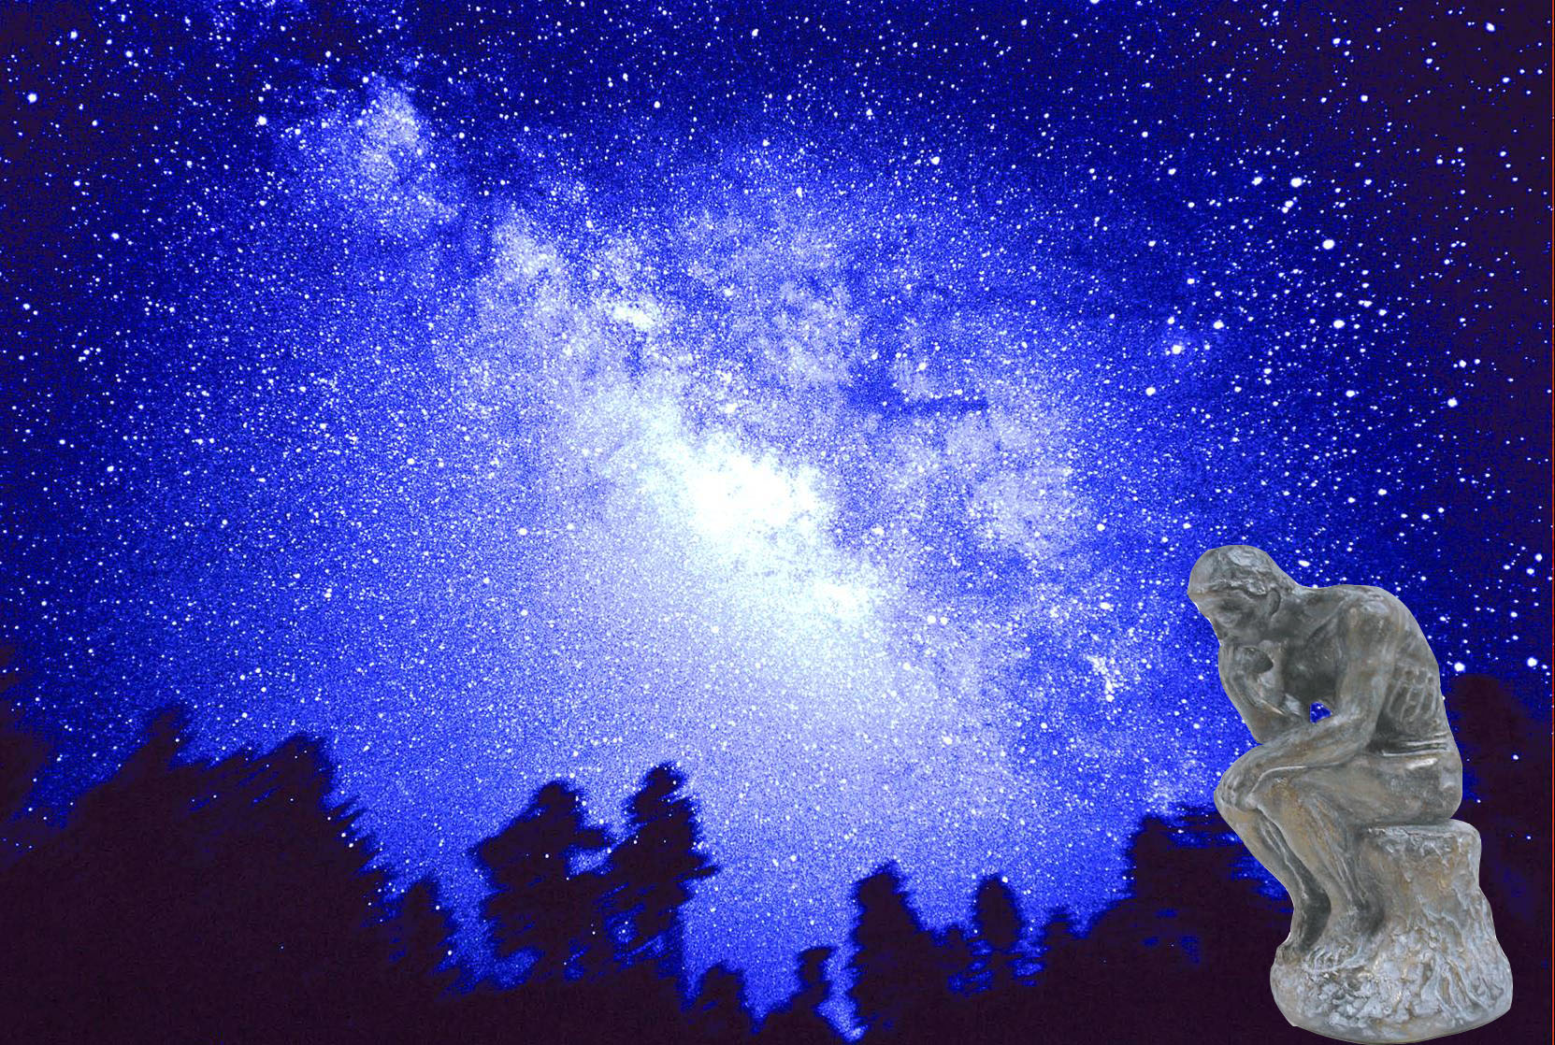
We always wonder…
What makes up the universe?
How does the universe work?
What holds the universe together?
How can we live in the universe well?
Where do we all come from?

Slide 8
High Energy Physics
Definition: A field of physics that pursues understanding the fundamental constituents of matter and basic principles of interactions between them.
Known interactions (forces):
Gravitational Force
Electromagnetic Force
Weak Nuclear Force
Strong Nuclear Force
Current theory: The Standard Model of Particle Physics

Slide 10
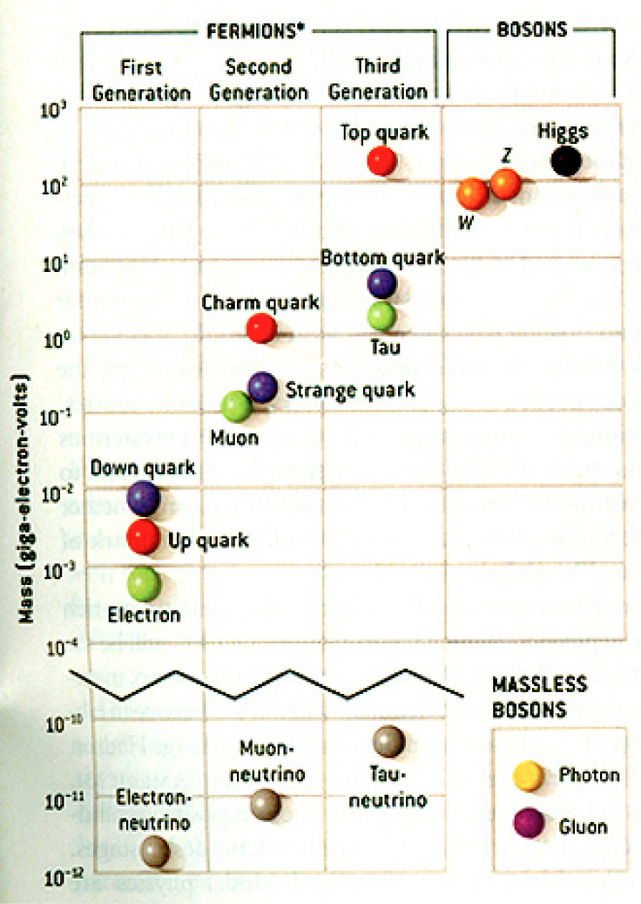
HEP and the Standard Model
Total of 16 particles (12+4 force mediators) make up all the visible matter in the universe! ➔ Simple and elegant!!!

Slide 11
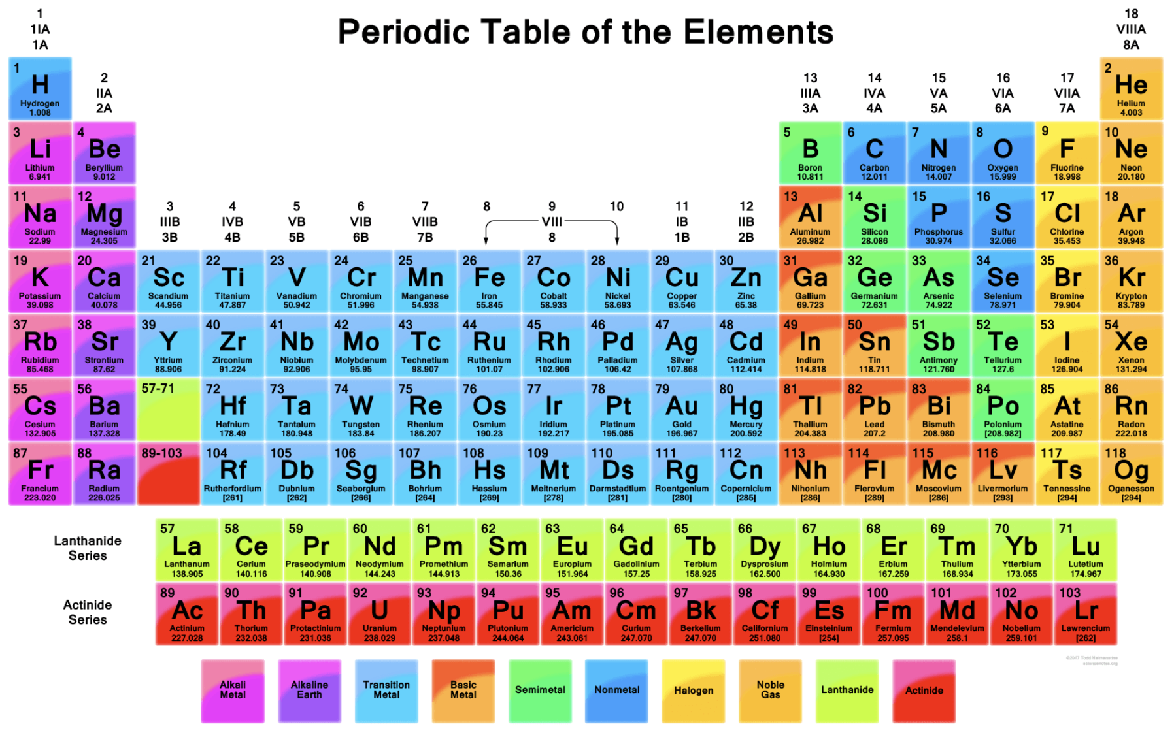

Slide 12
HEP and the Standard Model
Discovered in 1995, ~175m_{p}
Make up most ordinary matters ~0.1m_{p}
Total of 16 particles (12+4 force mediators) make up all the visible matter in the universe! ➔ Simple and elegant!!!
Tested to a precision of 1 part per million!

Slide 13
What are some issues in HEP?
Why is the mass range so large (0.1m_{p} – 175 m_{p})?
Is the particle discovered at the LHC really the Higgs particle?
Why is the matter in the universe made only of particles?
Neutrinos have mass!! (OMG!! The SM is broken!!! )
What are the mixing parameters, particle-anti particle asymmetry and the neutrino mass ordering?
Why are there only four apparent forces?
Were they all unified at the Big Bang?
Me!
Notes:
----- Meeting Notes (2/12/14 10:16) -----

Slide 14
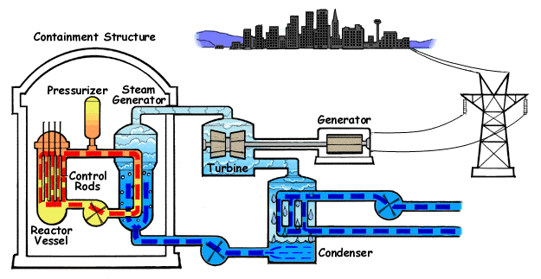
How does a nuclear power plant work?
Duke Energy
My 1000 year dream: Skip the whole thing!
Make electricity directly from nuclear force!

Slide 15
So what’s the problem?
Why is the mass range so large (0.1m_{p} – 175 m_{p})?
Is the particle we discovered really the Higgs particle?
Why is the matter in the universe made only of particles?
Neutrinos have mass!! What are the mixing parameters, particle-anti particle asymmetry and mass ordering?
Why are there only four apparent forces?
Were they all unified at the Big Bang?
Is the picture we present the real thing?
Notes:
----- Meeting Notes (2/12/14 10:16) -----

Slide 16
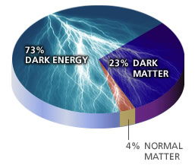
What makes up the universe?
~95% unknown!!
Notes:
----- Meeting Notes (2/12/14 10:16) -----

Slide 17
So what’s the problem?
Why is the mass range so large (0.1m_{p} – 175 m_{p})?
Is the particle we discovered really the Higgs particle?
Why is the matter in the universe made only of particles?
Neutrinos have mass!! What are the mixing parameters, particle-anti particle asymmetry and mass ordering?
Why are there only four apparent forces?
Were they all unified at the Big Bang?
Is the picture we present the real thing?
What makes up the remaining ~95% of the universe?
Are there any other particles we don’t know of?
Big deal for the new LHC Run and in the new experiment in the US!
Where do we all come from?
How can we live well in the universe as an integral partner?
Notes:
----- Meeting Notes (2/12/14 10:16) -----

Slide 18
Accelerators are Powerful Microscopes.
They make high energy particle beams
that allow us to see small things.
seen by
low energy beam
(poorer resolution)
seen by
high energy beam
(better resolution)

Slide 19
Accelerators are also Time Machines.
They make particles last seen
in the earliest moments of the universe.
Energy
particle beam
energy
anti-particle beam
energy
Particle and anti-particle annihilate.
E = mc²

Slide 20
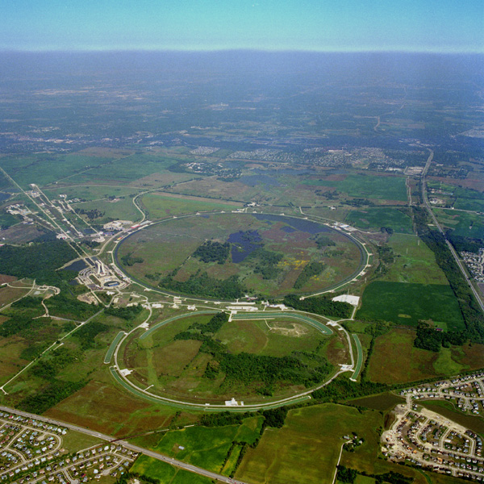
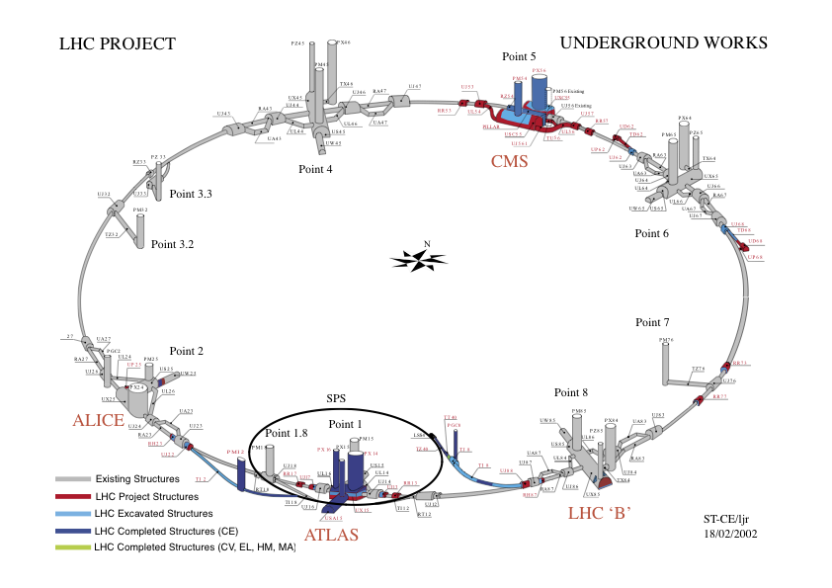
Fermilab Tevatron and LHC at CERN
World’s Highest Energy proton-anti-proton collider
4km (2.5mi) circumference
E_{cm}=2 TeV (=6.3x10⁻⁷J/p➔ 13M Joules on the area smaller than 10⁻⁴m²)
Equivalent to the kinetic energy of a 20t truck at the speed 130km/hr
~100,000 times the energy density at the ground 0 of the Hiroshima atom bomb
Tevatron was shut down in 2011
New frontiers with high intensity proton beams including the search for dark matter with beams!!
World’s Highest Energy p-p collider
27km (17mi) circumference, 100m (300ft) underground
Design E_{cm}=14 TeV (=44x10⁻⁷J/p➔ 362M Joules on the area smaller than 10⁻⁴m²)
Equivalent to the kinetic energy of a B727 (80tons) at the speed 310km/hr
~3M times the energy density at the ground 0 of the Hiroshima atom bomb
Discovered a new heavy particle that looks Higgs in 2012
Search for new particles has been ongoing!!
Shut down for two years ongoing for high stat. upgrade!
Chicago
CDF
p
DØ
Tevatron
p

Slide 21
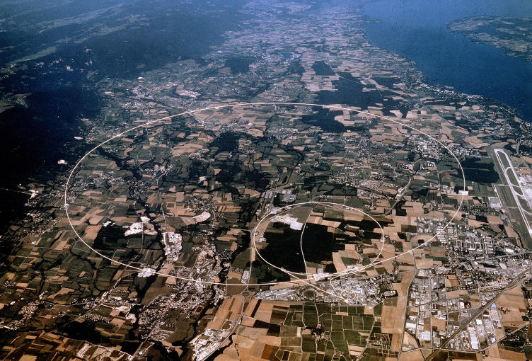
LHC @ CERN Aerial View
CMS
France
Geneva Airport
ATLAS
Swizerland

Slide 22
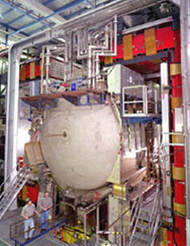
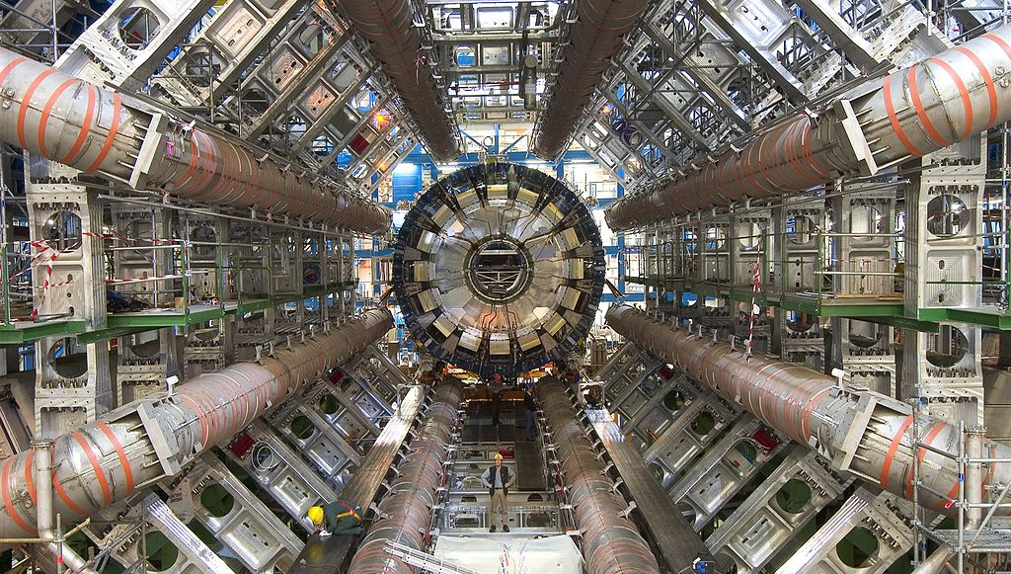
DZero Detector at Fermilab near Chicago
ATLAS Detector in Geneva Switzerland

Slide 23
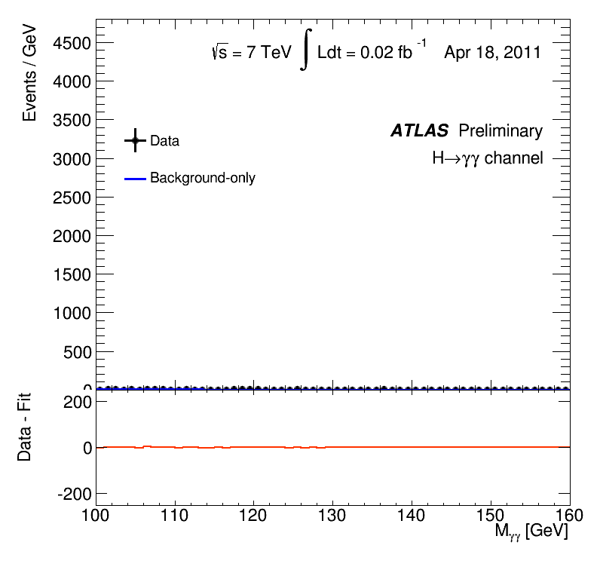
What did statistics do for Higgs→ γγ?

Slide 24
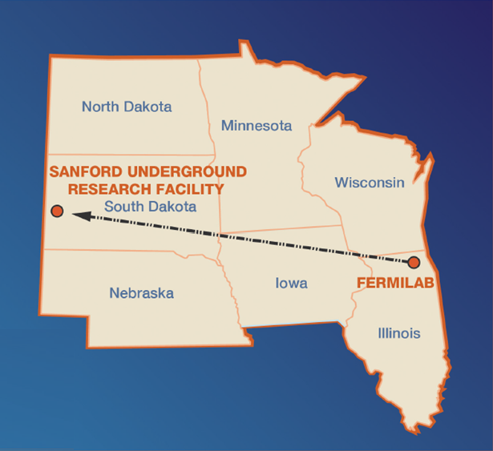
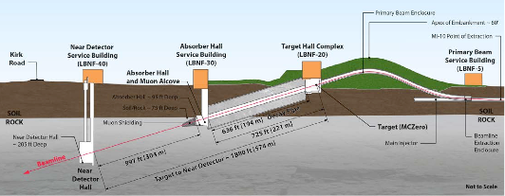
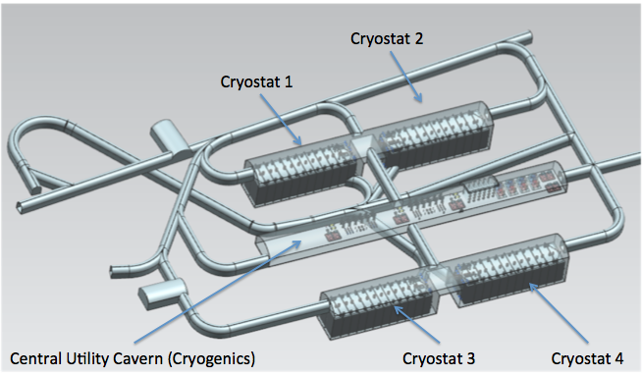
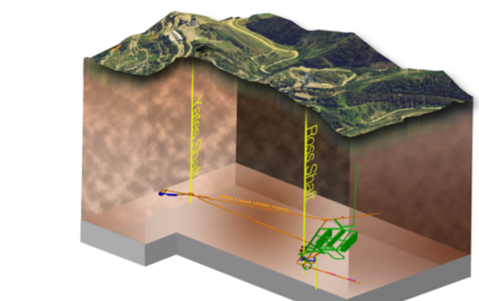
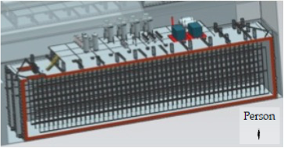
The Next Big Thing - DUNE Experiment
Stands for Deep Under Ground Neutrino Experiment
The $1.5B flagship long baseline (1300km) ν experiment
1500m underground in South Dakota
1300km (800 miles)
4 caverns with ~80,000t of Liquid Argon total
15m
66m
15m

Slide 25
The Map of the DUNE Experiment
1106 collaborators
184 institutions
31 countries

Slide 26
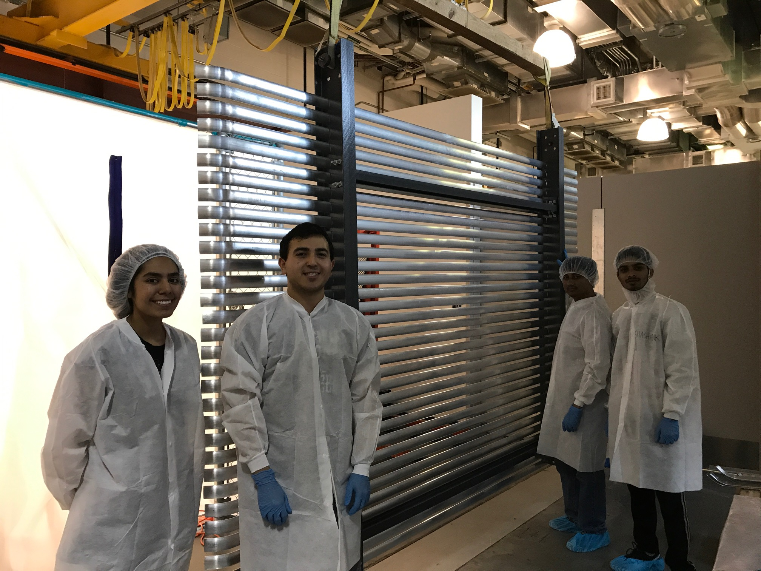
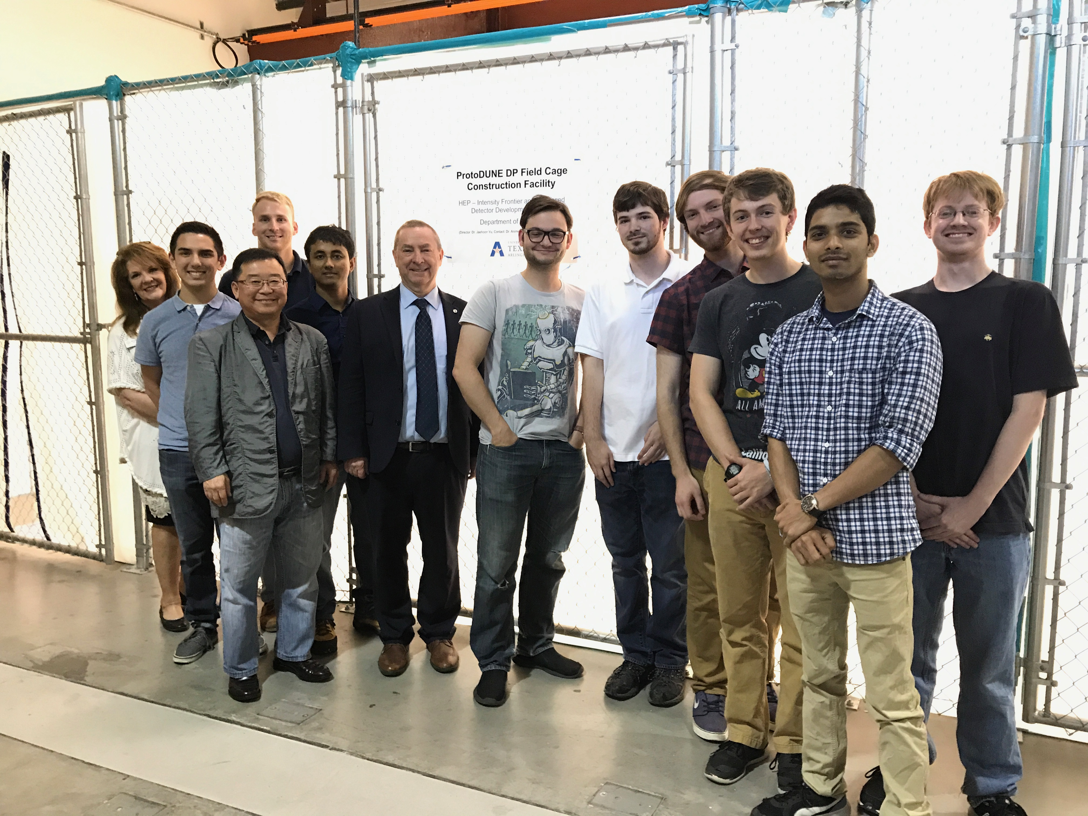
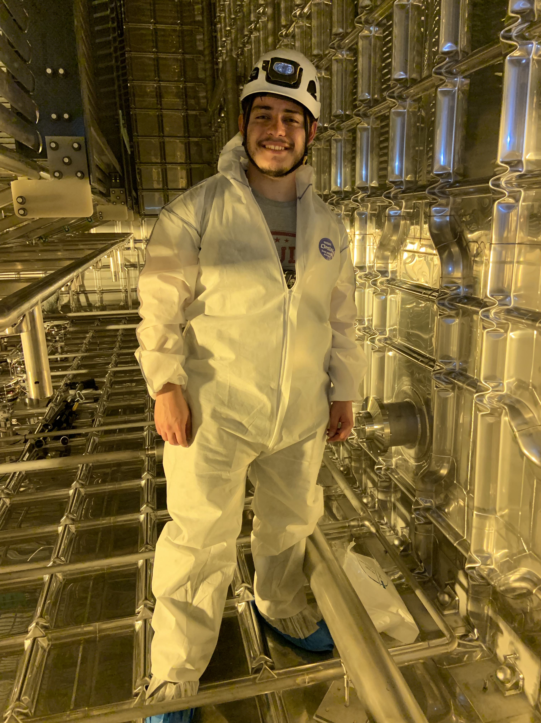
The UTA Field Cage Team
Hector Carranza @ CERN

Slide 27
DUNE Prototype Detector @ CERN
6m
6m

Slide 28
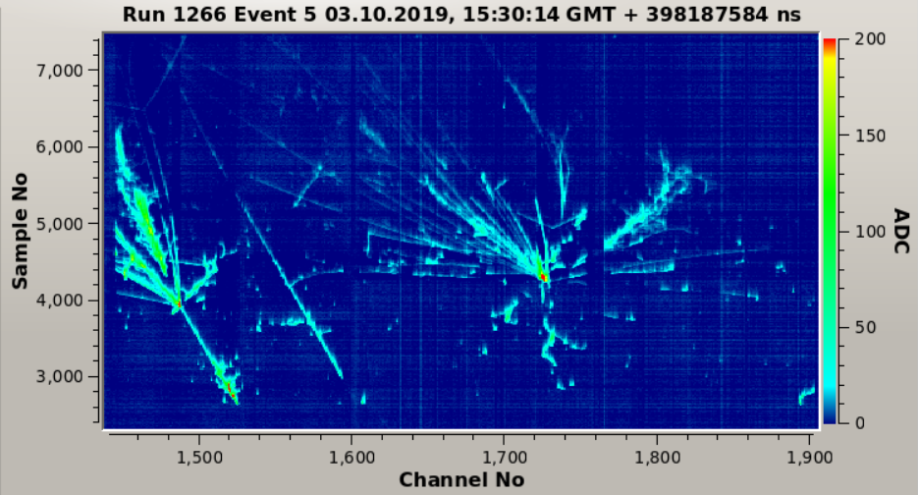
ProtoDUNE Event
Beam halo (high energy) muon with bremsstrahlung initiated E.M. shower
Collection plane view

Slide 29
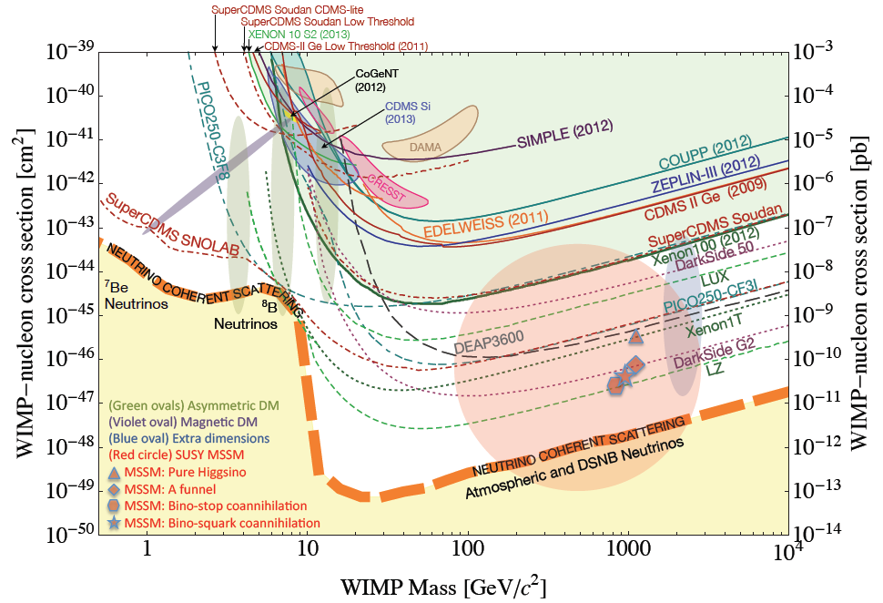
Let’s Look for Dark Matter!!
No DM
LHC
DUNE potential

Slide 30
So why is HEP relevant to me?
HEP explores the most fundamental nature of the Universe!
Discoveries will realize our 1000 year dreams
The discovery of the dark matter and making of dark matter beams will take us to the next Quantum level
Outcome and bi-products of HEP research improves our daily lives directly and indirectly
WWW came from HEP

Slide 31
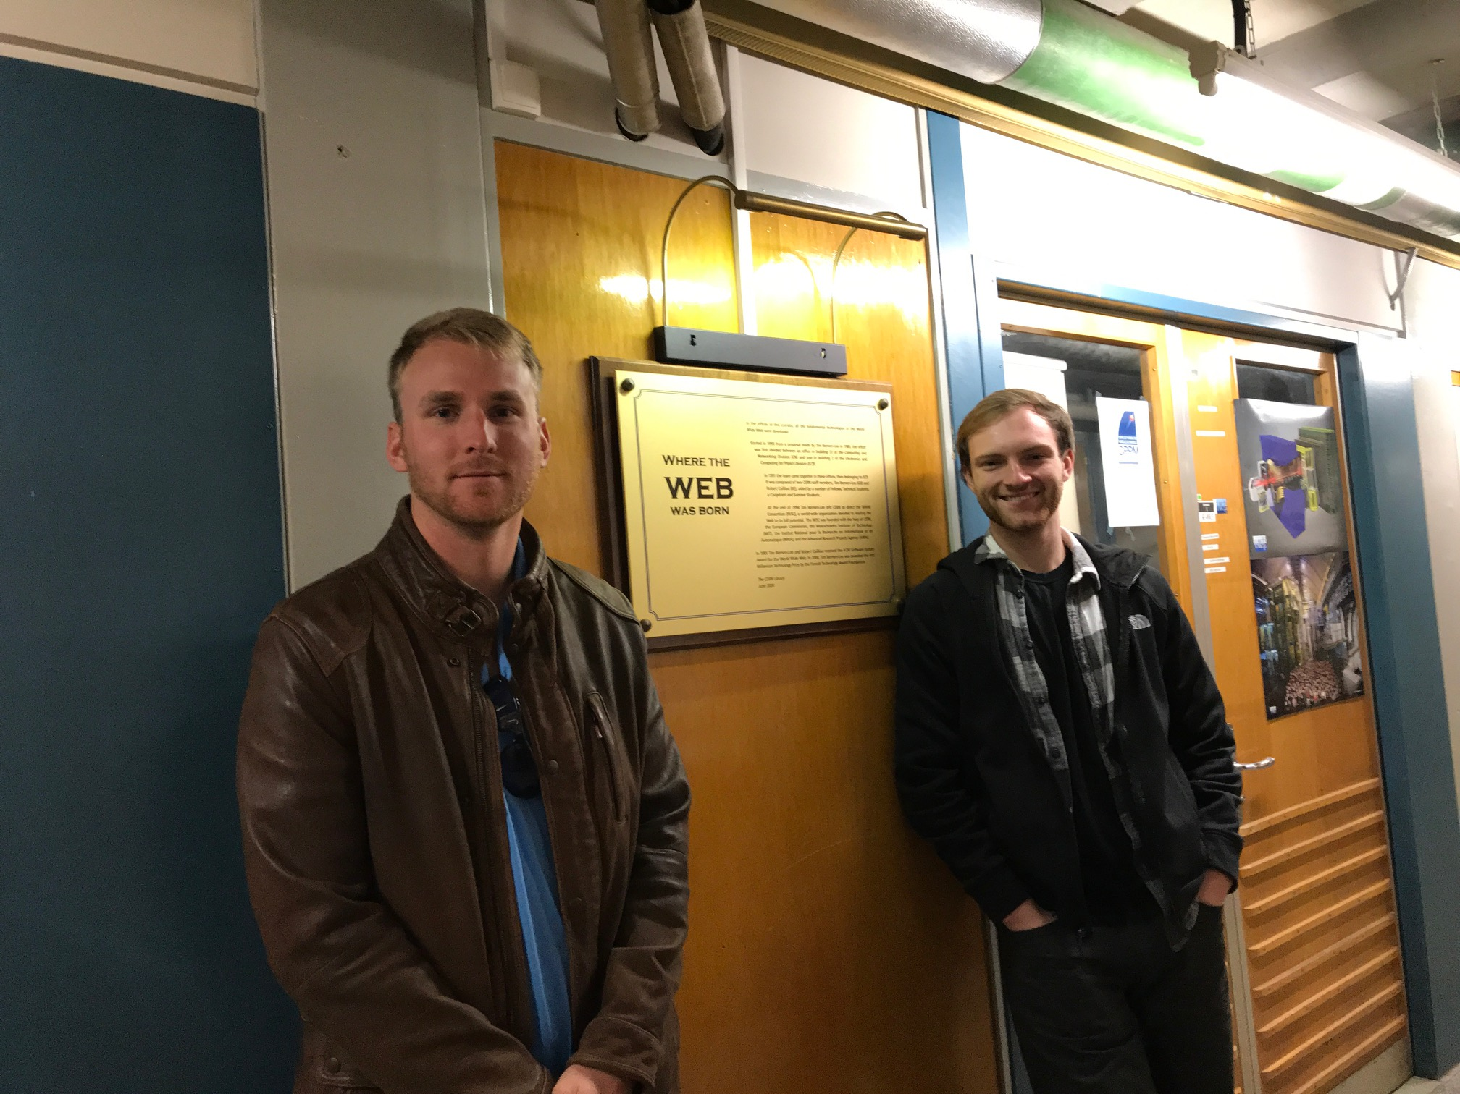

Slide 32
So why is HEP relevant to me?
HEP explores the most fundamentals of the Universe!
Discoveries will realize our 1000 year dreams
The discovery of the dark matter and making of dark matter beams will take us to the next Quantum level
Outcome and bi-products of HEP research improves our daily lives directly and indirectly
WWW came from HEP
Advanced detector technologies like GEM will make a large screen low dosage X-ray imaging possible

Slide 33
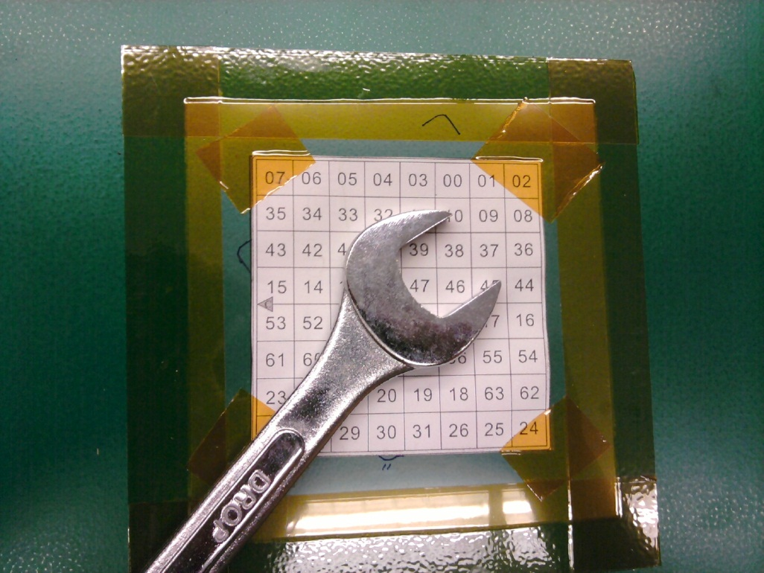
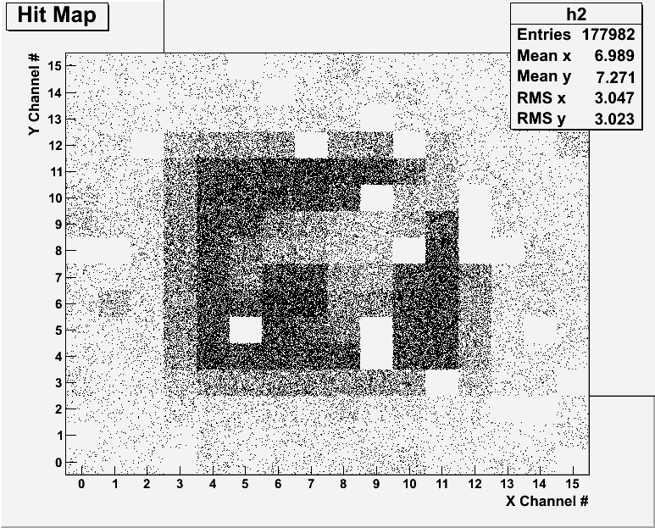
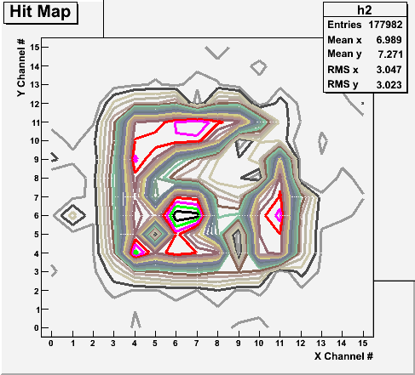
Bi-product of High Energy Physics Research
Can you see what the object is?
(GEM Detector X-ray Image)

Slide 34
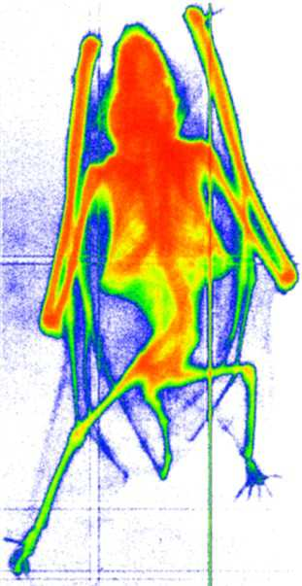
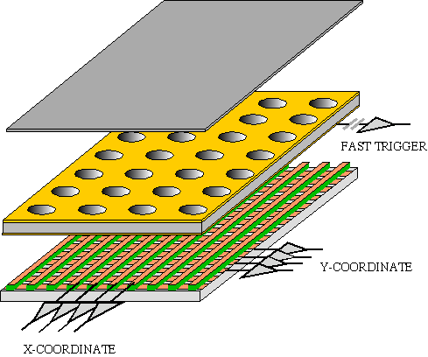
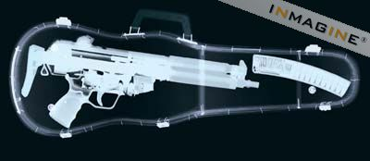
GEM Application Potential
FAST X-RAY IMAGING
Using the lower GEM signal, the readout can be self-triggered with energy discrimination:
9 keV absorption radiography of a small mammal (image size ~ 60 x 30 mm²)
A. Bressan et al,
Nucl. Instr. and Meth. A 425(1999)254
F. Sauli, Nucl. Instr. and Meth.A 461(2001)47

Slide 35
not just for tomorrow,
Let’s all dream,
not just for the next year,
but for 1000 years into the future for the whole humanity!!

Slide 36
Textbook
Title: Physics for Scientists and Engineers with Modern Physics
4th edition
Authors: D.C. Giancoli
ISBN13: 978-0132273596
ISBN10: 9780132273596

Slide 37
Information & Communication Source
Course web page: http://www-hep.uta.edu/~yu/teaching/summer20-1444-001/summer20-1444-001.html
Contact information & Class Schedule
Syllabus
Homework
Holidays and Exam days
Evaluation Policy
Class Style & Communication
Other information
Primary communication tool is e-mail: Make sure that your e-mail at the time of course registration is the one you most often read!!
Office Hours: 12:30 – 1:30pm, M-Th or by appointments on zoom

Slide 38
Evaluation Policy
Homework: 25%!!!
Exams
Final Comprehensive Exam (7/9/20): 23%
Mid-term Comprehensive Exam (6/23/20): 20%
One better of the two term Exams (6/15/20 and 7/1/20): 12%
Missing an exam is not permissible unless pre-approved
No makeup test
You will get an F if you miss any of the exams without a prior approval no matter how well you’ve been doing in class!
Lab score: 10%
Pop-quizzes: 10%
Extra credits: 10% of the total
Random attendances
Strong participation in the class discussions
Special projects (BIGGGGG!!!)
Planetarium shows and Other many opportunities
Grading will be done on a sliding scale
100%

Slide 39
Homework
Solving homework problems is the only way to comprehend class material ➔ 2 homeworks per week
An electronic homework system has been setup for you
Details are in the material distributed today and on the web
https://quest.cns.utexas.edu/student/courses/list
Choose the course PHYS1444-Summer20, unique number 44020
Download homeworks, solve the problems and submit them online
Multiple unsuccessful tries will deduct points
Roster will close at 11pm this Wednesday, June 10
You need a UT e-ID (NOT the UTA NetID): Go and apply at the URL https://idmanager.its.utexas.edu/eid_self_help/?createEID&qwicap-page-id=EA027EFF7E2DA39E if you don’t have one.
Each homework carries the same weight
Home work problems will be slightly ahead of the class and tough!
No homework will be dropped from the final grade!!
Home work will constitute 25% of the total ➔ A good way of keeping your grades high
Strongly encouraged to collaborate ➔ Does not mean you can copy

Slide 40
Attendances and Class Style
Attendances:
Will be taken everyday
Will be used for extra credits
Class style:
Lectures will be on electronic media
The lecture notes will be posted on the web AFTER each class
Active participation through questions and discussions are STRONGLY encouraged ➔ Extra credit….
Communication between you and me is extremely important
If you have problems, please do not hesitate talking to me

Slide 41
Extra credit
10% addition to the total
Could boost a B to A, C to B or D to C
What constitute for extra credit?
Special projects (biggest!!)
Attendances
Strong participation in the class discussions
Many other opportunities ➔Special seminars

Slide 42
What can you expect from this class?
All A’s?
This would be really nice, wouldn’t it?
But if it is too easy it is not fulfilling or meaningful….
This class is not going to be a stroll in the park!!
You will earn your grade in this class.
You will need to put in sufficient time and sincere efforts
Exams and quizzes will be tough!!
Sometimes problems might not look exactly like what you learned in the class
Show your work! Just putting the right answer for free response problems does not work!
But you have a great control (up to 45%) of your grade in your hands
Homework is 25% of the total grade!!
Means you will have many homework problems
Sometimes much more than any other classes
Some homework problems will be something that you have yet to learn in class
Exam problems will be easier than homework problems but the same principles!!
Lab 10%
Extra credit 10%
I will work with you so that your efforts, despite COVID –19 related hardship are properly rewarded

Slide 43
What do we want to learn in this class?
Physics is everywhere around you.
Skills to understand the fundamental principles that surrounds you in everyday lives…
Skills to identify what laws of physics applies to what phenomena and use them appropriately
Understand the impact of physical laws and apply them
Learn skills to think, research and analyze observations.
Learn skills to express observations and measurements in mathematical language
Learn skills to express your research in a systematic manner in writing
But most importantly the confidence in your physics ability and to take on any challenges laid in front of you!!
Even more importantly, let us have a lot of FUN!!

Slide 44
Specifically, in this course, you will learn…
Concept of Electricity and Magnetism
Electric charge and magnetic poles
Electric and Magnetic Forces and fields
Electric and magnetic potential and energies
Propagation of electric and magnetic fields
Relationship between electro-magnetic forces and light
Behaviors of light and optics
Special relativity and quantum theories

Slide 45
How to study for this course?
Keep up with the class for comprehensive understanding of materials
Come to the class and participate in the discussions and problems solving sessions
Follow through lecture notes
Work out example problems in the book yourself without looking at the solution
Have many tons of fun in the class, asking lots of questions!!!!!
Keep up with the homework to put the last nail on the coffin
One can always input the answers as you solve problems. Do NOT wait till you are done with all the problems.
Form a study group and discuss how to solve problems with your friends, then work the problems out yourselves!
Prepare for upcoming classes
Read the textbook for the material to be covered in the next class
The extra mile
Work out additional problems in the back of the book starting the easiest problems to harder ones

