Slide 1
PHYS 1441 – Section 001 Lecture #2
Tuesday, June 9, 2020
Dr. Jaehoon Yu
Brief history of physics
Standards and units and other basics
CH21
Static Electricity and Charge Conservation
Charges in Atom
Insulators and Conductors & Induced Charge
Coulomb’s Law

Slide 2
Announcements
38/51 of you have registered in the homework system.
22/38 submitted the homework!
Fantastic job!!
You need my enrollment approval… So move quickly…
Remember, the deadline for the first homework is 11pm, Thursday, June 11
You MUST submit the homework to obtain 100% credit!
Also please be sure to make the payment in time otherwise your access as well as my access to the site for grading is cut.
Reading assignments: CH21 – 7
Quiz at the beginning of the class tomorrow, Wed. June 10
Appendix A1 – A7 and what we’ve learned today (CH21 – 5 or 6?)!
BYOF: You may bring a one 8.5x11.5 sheet (front and back) of handwritten formulae and values of constants for the exam
No derivations, word definitions or setups or solutions of any problems!
No additional formulae or values of constants will be provided!
Must send me the photos of front and back of the formula sheet, including the blank!

Slide 3
Extra Credit Special Project #1
Compare the Coulomb force to the Gravitational force in the following cases by expressing Coulomb force (F_{C}) in terms of the gravitational force (F_{G})
Between the two protons separated by 1m
Between the two protons separated by an arbitrary distance R
Between the two electrons separated by 1m
Between the two electrons separated by an arbitrary distance R
Five points each, totaling 20 points
BE SURE to show all the details of your own work, including all formulae, proper references to them and explanations
Must be handwritten and submit all pages in a single PDF file
File name must be: SP1-First-Last-summer20.pdf
Due at the beginning of the class Monday, June 15

Slide 4
Why do Physics?
Exp.{
To understand nature through experimental observations and measurements (Research)
Establish limited number of fundamental laws, usually with mathematical expressions
Predict the nature’s course
Theory and Experiment work hand-in-hand
Discrepancies between experimental measurements and theory are good for improvements
The general principles formulated through theory is used to improve our everyday lives, even though some laws can take a while till we see them amongst us
Theory {
4

Slide 5
Brief History of Physics
AD 18th century:
Newton’s Classical Mechanics: A theory of mechanics based on observations and measurements
AD 19th Century:
Electricity, Magnetism, and Thermodynamics
Late AD 19th and early 20th century (Modern Physics Era)
Einstein’s theory of relativity: Generalized theory of space, time, and energy (mechanics)
Quantum Mechanics: Theory of atomic phenomena
Physics has come very far, very fast, and is still progressing, yet we’ve got a long way to go
What is matter made of?
How does matter get mass?
How and why do matters interact with each other?
How is the universe created?
5

Slide 6
Terminology: Models, Theories and Laws
Models: An analogy or a mental image of a phenomena in terms of something we are familiar with
Thinking light as waves that behave just like water waves
Often provide insights for new experiments and ideas
Theories: More systematically improved version of models
Can provide quantitative predictions that are testable and more precise
Laws: Certain concise but general statements about how nature behaves
Energy & momentum conservations, charge conservation, etc
The statement must be found experimentally valid to become a law
Principles: Less general statements of how nature behaves
Has some level of arbitrariness
6

Slide 7
Uncertainties
Physical measurements have limited precision, however good they are, due to:
Number of measurements (Normally scales by )
Quality of the instruments (meter stick vs micro-meter)
Experience of the person doing measurements
Etc
In many cases, uncertainties are more important and difficult to estimate than the central (or mean) values
Stat.{
{
Syst.
7

Slide 8
Significant Figures
Denote the precision of the measured values
The number 80 implies precision of +/- 1, between 79 and 81
If you are sure to +/-0.1, the number should be written 80.0
Significant figures: non-zero numbers or zeros that are not place-holders
34, 34.2, 0.001, 34.100
34 has two significant digits
34.2 has 3
0.001 has one because the 0’s before 1 are place holders to position “.”
34.100 has 5, because the 0’s after 1 indicate that the numbers in these digits are indeed 0’s.
When there are many 0’s, use scientific notation for simplicity:
31400000=3.14x10⁷ (on Quest 3.14E7 format is used)
0.00012=1.2x10⁻⁴
8

Slide 9
Significant Figures
Operational rules:
Addition or subtraction: Keep the smallest number of decimal place in the result, independent of the number of significant digits: 12.001+ 3333.1=
Multiplication or Division: Keep the smallest number of significant digits in the result: 12.001 x 3.1 = , because the smallest significant figures is ?.
3345.1
37
What does this mean?
The worst precision ditermines the precision the overall operation!!
In English?
Can’t get any better than the worst of the measurements!
9

Slide 10
SI Base Quantities and Units
Quantity | Unit | Unit Abbrevation
Length | Meter | m
Time | Second | s
Mass | Kilogram | kg
Electric current | Ampere | A
Temperature | Kelvin | K
Amount of substance | Mole | mol
Luminous Intensity | Candela | cd
There are prefixes that scales the units larger or smaller for convenience (see pg. 7)

Slide 11
Prefixes, expressions and their meanings
Larger
Smaller
deca (da): 10¹
hecto (h): 10²
kilo (k): 10³
mega (M): 10⁶
giga (G): 10⁹
tera (T): 10¹²
peta (P): 10¹⁵
exa (E): 10¹⁸
zetta (Z): 10²¹
yotta (Y): 10²⁴
deci (d): 10⁻¹
centi (c): 10⁻²
milli (m): 10⁻³
micro (μ): 10⁻⁶
nano (n): 10⁻⁹
pico (p): 10⁻¹²
femto (f): 10⁻¹⁵
atto (a): 10⁻¹⁸
zepto (z): 10⁻²¹
yocto (y): 10⁻²⁴
11

Slide 12
How do we convert quantities from one unit to another?
Unit 1 =
Conversion factor X
Unit 2
1 inch | 2.54 | cm
1 inch | 0.0254 | m
1 inch | 2.54x10⁻⁵ | km
1 ft | 30.3 | cm
1 ft | 0.303 | m
1 ft | 3.03x10⁻⁴ | km
1 hr | 60 | minutes
1 hr | 3600 | seconds
And many | More | Here….
12

Slide 13
What does the Electric Force do?
Electric force is the bases of modern technology
Virtually everything we use every day uses the electric force
Can you give a few examples?
But this force also affects many others
Making up materials with atoms and molecules
Biological metabolic processes
Nerve signals, heart pumping, etc
Virtually all the forces we have learned in Physics I:
Friction, normal force, elastic force and other contact forces are the results of electric forces acting at the atomic level

Slide 14
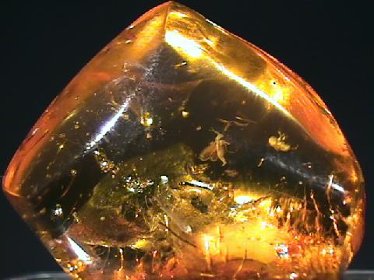
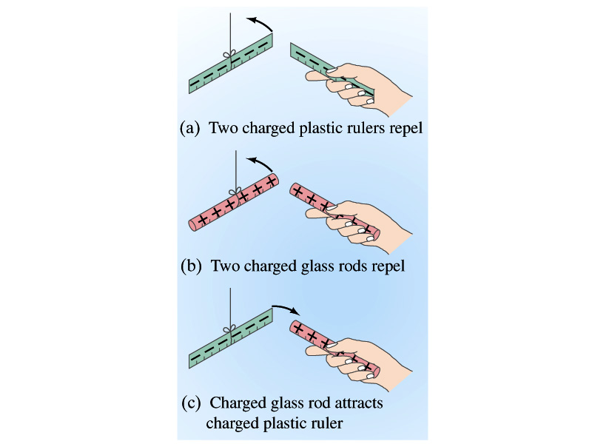
Static Electricity; Electric Charge and Its Conservation
Electricity is from Greek word elecktron=amber, a petrified tree resin that attracts matter if rubbed
Static Electricity: an amber effect
An object becomes charged or “posses a net electric charge” due to rubbing
Can you give some examples?
Two types of electric charge, positive/negative
Like charges repel while unlike charges attract
Benjamin Franklin referred the charge on glass rod as the positive, arbitrarily. Thus the charge that attracts glass rod is negative. ➔ This convention is still used.

Slide 15
Static Electricity; Electric Charge and Its Conservation
Franklin argued that when a certain amount of charge is produced on one body in a process, an equal amount of opposite type of charge is produced on another body.
The positive and negative are treated algebraically so that during any process the net change in the amount of produced charge is 0.
When you comb your hair with a plastic comb, it acquires the negative charge and the hair an equal amount of positive charge.
This is the law of conservation of electric charge.
The net amount of electric charge produced in any process is ZERO!!
If an object or one region of space acquires a positive charge, then an equal amount of negative charge will be found in neighboring areas or objects.
No violations have ever been observed.
This conservation law is as firmly established as that of energy or momentum.

Slide 16
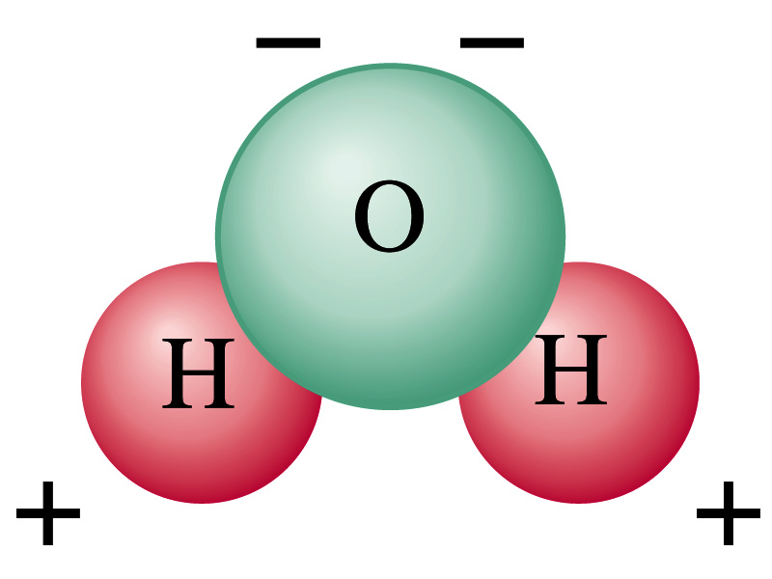
Electric Charge in an Atom
It has been understood through the past century that an atom consists of
A positively charged heavy core ⬅ What is the name?
This core is called the nucleus and consists of neutrons and protons.
Many negatively charged particles with small mass surround the core ⬅ What is the name of these light particles?
These are called the electrons
How many of these in an atom?
So what is the net electrical charge of an atom?
Zero!!! Electrically neutral!!!
Can you explain what happens when a comb is rubbed on a towel?
The electrons from the towel get transferred to the comb, making the comb negatively charged while leaving positive ions on the towel.
These charges eventually get neutralized primarily by water molecules in the air.
As many as the number of protons in the nucleus!!

Slide 17
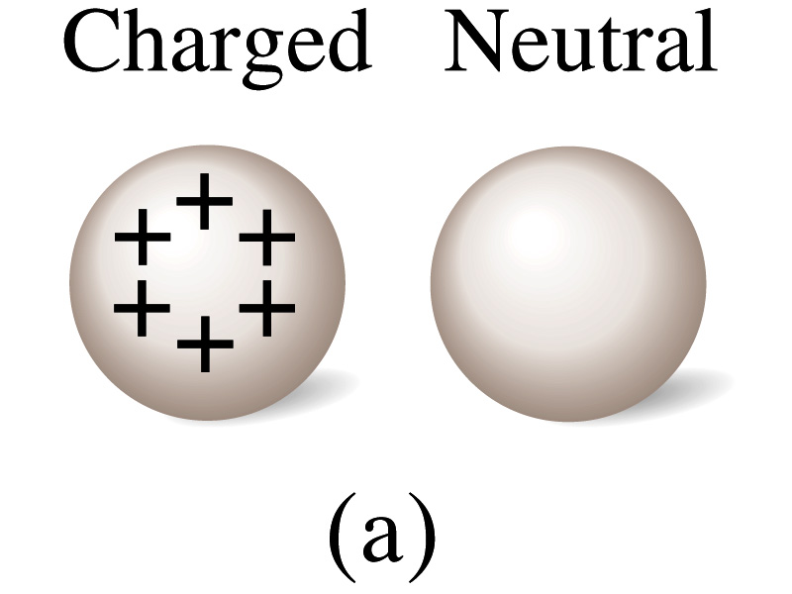
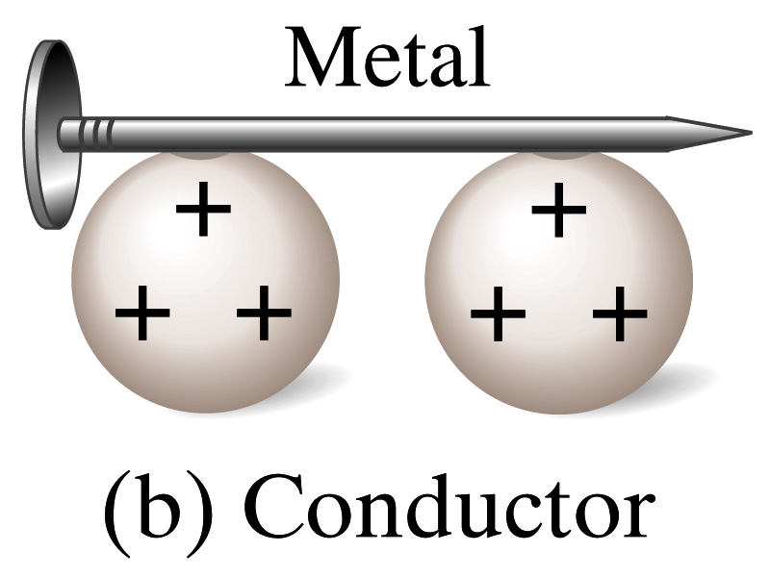
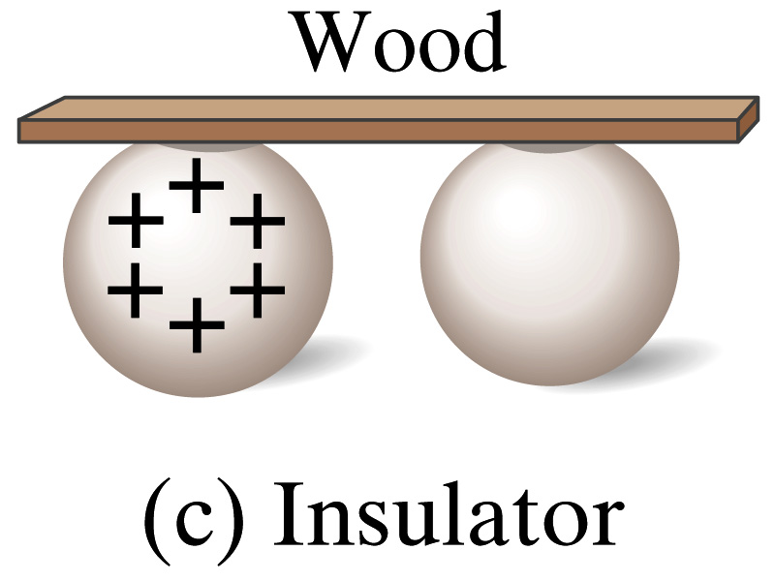
Insulators and Conductors
Let’s imagine two metal balls of which one is charged
What will happen if they are connected by
A metallic object?
Some charge is transferred through this object.
These objects are called the conductors of electricity.
An wooden object?
No charge is transferred
These objects are called the nonconductors or insulators.
Metals are generally a good conductor whereas most other materials are insulators.
There are third kind of materials called, semi-conductors, like silicon or germanium ➔ conduct only in certain conditions
Atomically, conductors have loosely bound electrons while insulators have them tightly bound!

Slide 18
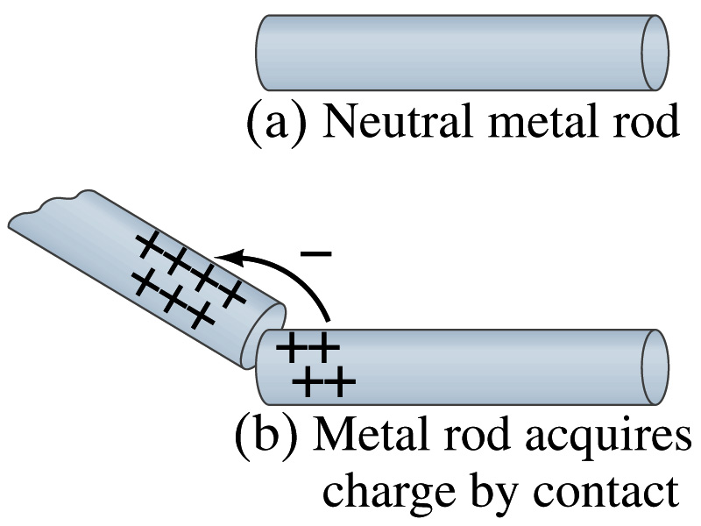
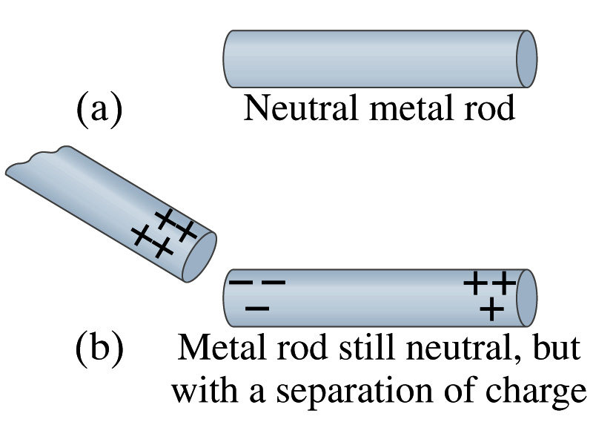
Induced Charge
When a positively charged metallic object is brought close to an uncharged metal object
If two objects touch each other, the free electrons in the neutral one are attracted to the positively charged object and some will pass over to it, leaving the neutral object positively charged ➔ Charging by conduction
If the objects get close, the free electrons in the neutral one still move within the metal toward the charged object leaving the opposite side of the object positively charged.
The charges have been “induced” in the opposite ends of the object.

Slide 19
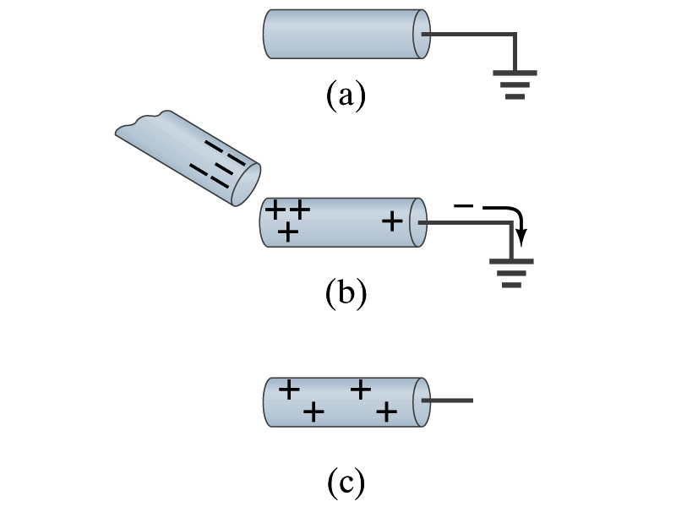
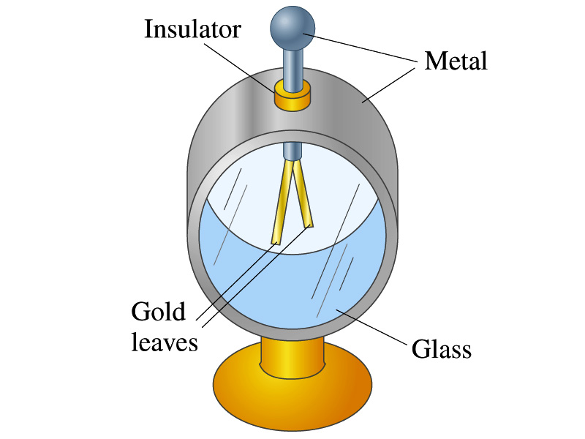
Induced Charge
ground
We can induce a net charge on a metal object by connecting a wire to the ground.
The object is “grounded” or “earthed”.
Since the Earth is so large and conducts, it can give or accept charge.
The Earth acts as a reservoir of electric charge.
If negative charge is brought close to a neutral metal
Positive charge will be induced toward the negatively charged metal.
The negative charges in the neutral metal will be gathered on the opposite side, transferring through the wire to the Earth.
If the wire is cut, the metal bar has net positive charge.
An electroscope is a device that can be used for detecting charge and signs.
How does this work?

Slide 20
Coulomb’s Law
Charges exert force to each other. What factors affect the magnitude of this force?
Any guesses?
Charles Coulomb figured this out in 1780’s through an experiment using a torsion balance
Coulomb found that the electric force is
Proportional to the multiplication of the two charges
If one of the charges doubles, the force doubles.
If both the charges double, the force quadruples.
Inversely proportional to the square of the distances between them.
Electric charge is the fundamental property of matter, just like mass.
How would you put the above into a formula?

Slide 21
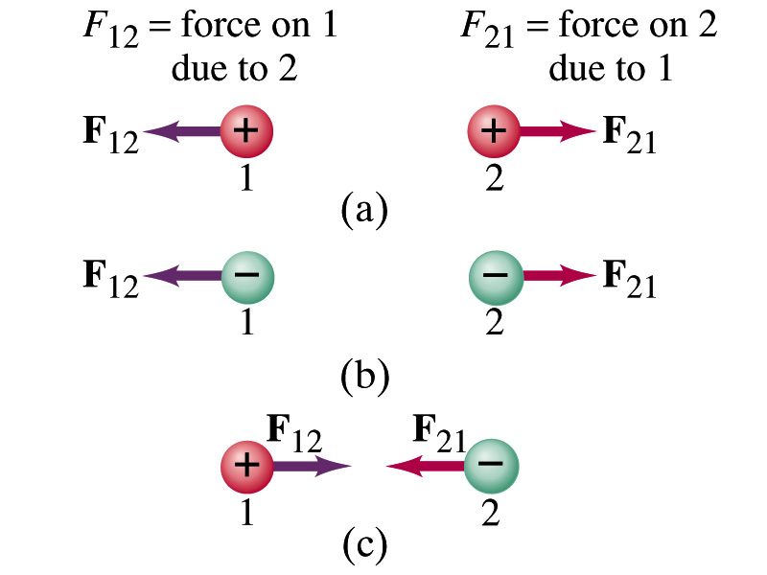
Coulomb’s Law – The Formula
Formula
Is Coulomb force a scalar quantity or a vector quantity? Unit?
A vector quantity. The unit is Newtons (N)!
The direction of electric (Coulomb) force is always along the straight line joining the two objects.
If the two charges are the same: forces are directed away from each other.
If the two charges are the opposite: forces are directed toward each other.
Coulomb force is precise to 1 part in 10¹⁶.
Unit of charge is called Coulomb, C, in SI.
The value of the proportionality constant, k, in SI unit is
Thus, 1C is the charge that gives F~9x10⁹N of force when placed 1m apart from each other.

Slide 22
Electric Force
and Gravitational Force
Extremely
Similar
Does the electric force look similar to another force? What is it?
Gravitational Force
What are the sources of the forces?
Electric Force: Electric charges, fundamental properties of matter
Gravitational Force: Masses, fundamental properties of matter
What else is similar?
Inversely proportional to the square of the distance between the sources of the force ➔ What is this kind law called?
Inverse Square Law
What is the difference?
Gravitational force is always attractive.
Electric force depends on the type of the two charges. (must pay good attention to the signs due to the sign of the charge and the vector force directions!!)

Slide 23
The Elementary Charge and Permittivity
The elementary charge, the smallest unit charge, is that of an electron:
Since electron is a negatively charged particle, its charge is –e.
Object cannot gain or lose fraction of an electron.
Electric charge is quantized.
Charge of an object changes always in an integer multiples of e.
What kind of quantity is the electric charge?
The proportionality constant k is often written in terms of another constant, ε₀, the permittivity* of free space. They are related and .
Thus the electric force can also be written as:
Note that this force is for “point” charges at rest.
Scalar!!
*Mirriam-Webster, Permittivity: The ability of a material to store electric potential energy under the influence of an electric field

Slide 24
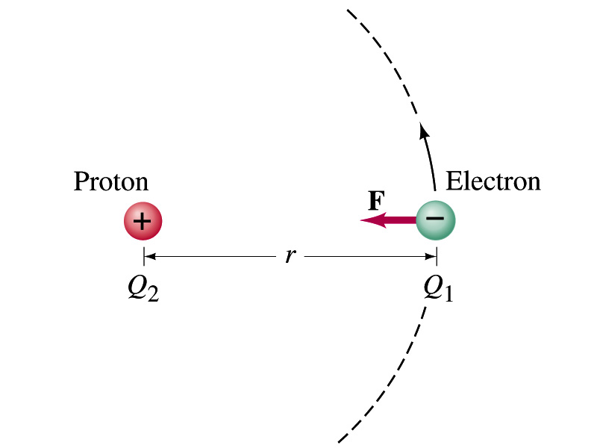
Example on the Coulomb Force
Electric force on electron by proton. Determine the magnitude of the electric force on the electron of a hydrogen atom exerted by the single proton (Q₂=+e) that is its nucleus. Assume the electron “orbits” the proton at its average distance of r=0.53x10⁻¹⁰m. What is the orbital speed of the electron (m_{e}=9.12x10⁻³¹kg)?
Using Coulomb’s law
Each charge is
and
So the magnitude of the force is
Which direction?
Toward each other…
Orbital speed of the election?

Slide 25
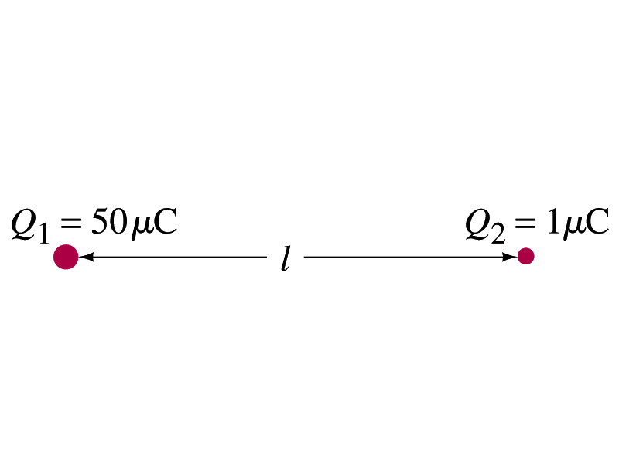
Example 21 – 1
Which charge exerts a greater force? Two positive point charges, Q₁=50μC and Q₂=1μC, are separated by a distance L. Which is larger in magnitude, the force that Q₁ exerts on Q₂ or the force that Q₂ exerts on Q₁?
What is the force that Q₁ exerts on Q₂?
What is the force that Q₂ exerts on Q₁?
Therefore the magnitudes of the two forces are identical!!
Well then what is different?
The direction.
Which direction?
Opposite to each other!
What is this law?
Newton’s third law, the law of action and reaction!!

