Slide 1
PHYS 1441 – Section 001
Lecture #3
Wednesday, June 10, 2020
Dr. Jaehoon Yu
Chapter 21
  The Electric Field & Field Lines
  Electric Fields and Conductors
  Motion of a Charged Particle in an Electric Field
  Electric Dipoles
Chapter 22
  Electric Flux
Today’s homework is homework #2, due 11pm, Monday, June15!!

Slide 2
Announcements
44/48 of you have registered in the homework system.
  35/44 submitted the homework!
  You MUST submit your answer to obtain 100% credit!
Virtual Physics Clinic: (M: 9am – 1pm, TuWTh: 9am – 5pm) https://teams.microsoft.com/l/channel/19%3ae5b118c00e8d4baa8c0b2b4be09bbcd5%40thread.tacv2/General?groupId=a272a438-e2fd-42e7-8c18-1a8166647940&tenantId=5cdc5b43-d7be-4caa-8173-729e3b0a62d9
Term Exam 1
  In class, coming Monday, June 15: DO NOT MISS THE EXAM!
  CH21.1 to what we learn on tomorrow, Thursday, June 11 + Appendices A1 – A8
  BYOF: You may bring a one 8.5x11.5 sheet (front and back) of handwritten formulae and values of constants for the exam
  No derivations, word definitions or setups or solutions of any problems!
  No additional formulae or values of constants will be provided!
  Must send me the photos of front and back of the formula sheet, including the blank, no later than 10am Monday morning
    Once submitted, you cannot change, unless I ask you to delete some part of the sheet!

Slide 3
Reminder: Extra Credit Special Project #1
Compare the Coulomb force to the Gravitational force in the following cases by expressing Coulomb force (F_{C}) in terms of the gravitational force (F_{G})
  Between the two protons separated by 1m
  Between the two protons separated by an arbitrary distance R
  Between the two electrons separated by 1m
  Between the two electrons separated by an arbitrary distance R
Five points each, totaling 20 points
BE SURE to show all the details of your own work, including all formulae, proper references to them and explanations
Must be handwritten and submit all pages in a single PDF file
  File name must be: SP1-First-Last-summer20.pdf
Due at the beginning of the class Monday, June 15

Slide 4
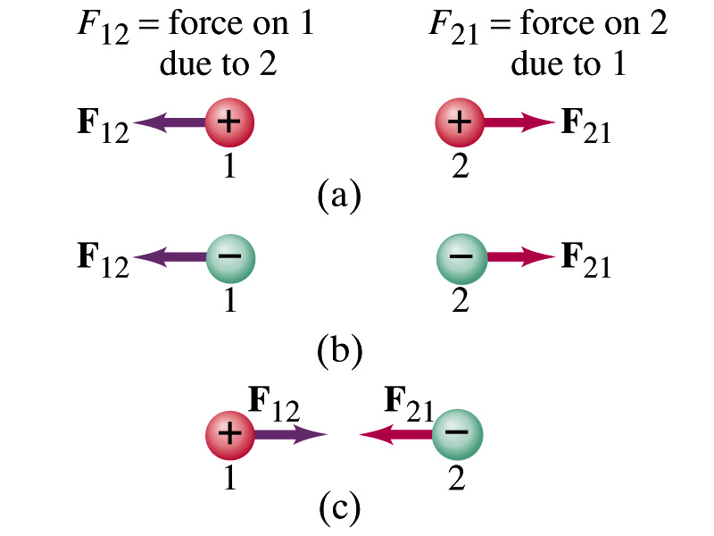
Coulomb’s Law – The Formula
Formula
Is Coulomb force a scalar quantity or a vector quantity? Unit?
  A vector quantity. The unit is Newtons (N)!
The direction of electric (Coulomb) force is always along the straight line joining the two objects.
  If the two charges are the same: forces are directed away from each other.
  If the two charges are the opposite: forces are directed toward each other.
Coulomb force is precise to 1 part in 10¹⁶.
Unit of charge is called Coulomb, C, in SI.
The value of the proportionality constant, k, in SI unit is
Thus, 1C is the charge that gives F~9x10⁹N of force when placed 1m apart from each other.

Slide 5
The Elementary Charge and Permittivity
The elementary charge, the smallest unit charge, is that of an electron:
  Since electron is a negatively charged particle, its charge is –e.
Object cannot gain or lose fraction of an electron.
  Electric charge is quantized.
    Charge of an object changes always in an integer multiples of e.
    What kind of quantity is the electric charge?
The proportionality constant k is often written in terms of another constant, ε₀, the permittivity* of free space. They are related and .
Thus the electric force can also be written as:
Note that this force is for “point” charges at rest.
Scalar!!
*Mirriam-Webster, Permittivity: The ability of a material to store electric potential energy under the influence of an electric field

Slide 6
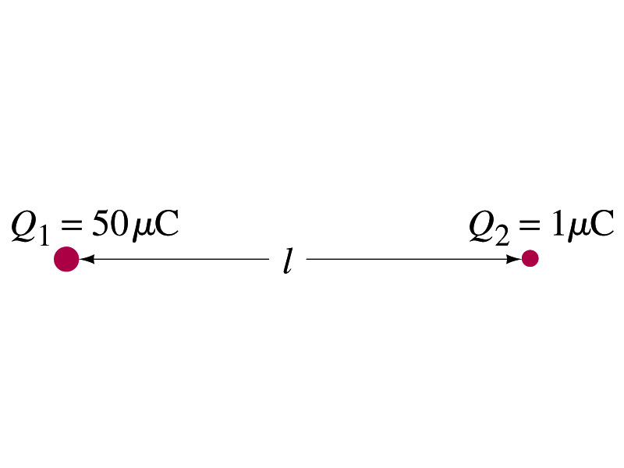
Example 21 – 1
Which charge exerts a greater force? Two positive point charges, Q₁=50μC and Q₂=1μC, are separated by a distance L. Which is larger in magnitude, the force that Q₁ exerts on Q₂ or the force that Q₂ exerts on Q₁?
What is the force that Q₁ exerts on Q₂?
What is the force that Q₂ exerts on Q₁?
Therefore the magnitudes of the two forces are identical!!
Well then what is different?
The direction.
Which direction?
Opposite to each other!
What is this law?
Newton’s third law, the law of action and reaction!!

Slide 7
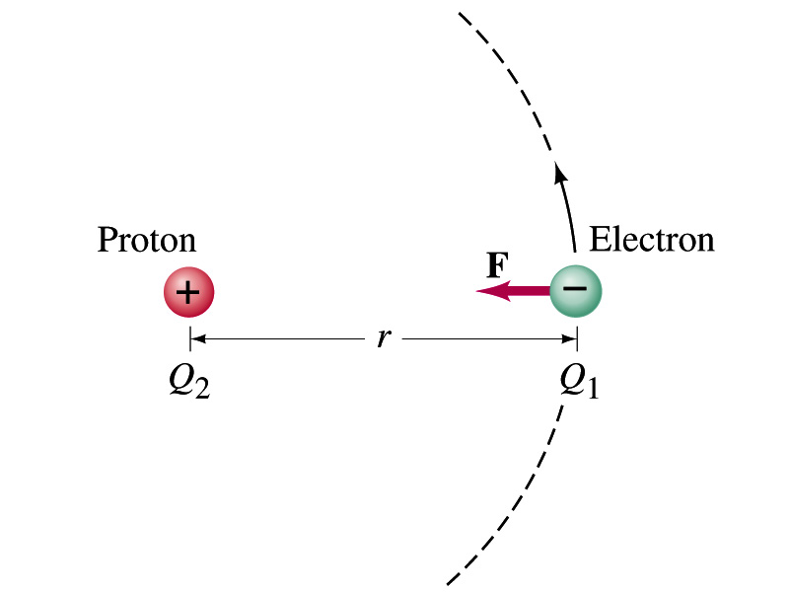
Example on the Coulomb Force
Electric force on electron by proton. Determine the magnitude of the electric force on the electron of a hydrogen atom exerted by the single proton (Q₂=+e) that is its nucleus. Assume the electron “orbits” the proton at its average distance of r=0.53x10⁻¹⁰m. What is the orbital speed of the electron (m_{e}=9.12x10⁻³¹kg)?
Using Coulomb’s law
Each charge is
and
So the magnitude of the force is
Which direction?
Toward each other…
Orbital speed of the election?

Slide 8
Vector Additions and Subtractions
Addition:
  Triangular Method: One can add vectors by connecting the head of one vector to the tail of the other (head-to-tail)
  Parallelogram method: Connect the tails of the two vectors and extend
  Addition is commutative: Changing order of operation does not affect the results A+B=B+A, A+B+C+D+E=E+C+A+B+D
A+B
A
A+B
B
=
OR
B
A+B
B
A
A
Subtraction:
  The same as adding a negative vector:A - B = A + (-B)
A
-B
Since subtraction is equivalent to adding a negative vector, subtraction is also commutative!!!
A-B
Multiplication by a scalar is increasing the magnitude A, B=2A
A
B=2A

Slide 9
Example for Vector Addition
A force of 20.0N applies to north while another force of 35.0N applies in the direction 60.0º west of north. Find the magnitude and direction of resultant force.
F₂sin60^{ο}
N
F₂
60^{ο}
F₂cos60^{ο}
20
F
θ
F₁
E
Find other ways to solve this problem…

Slide 10
Components and Unit Vectors
Coordinate systems are useful in expressing vectors in their components
y
(+,+)
F_{y}
(F_{x},F_{y})
}Components
F
(-,+)
θ
x
} Magnitude
(-,-)
(+,-)
F_{x}

Slide 11
Unit Vectors
A unit vector is the vector that indicates only the directions of the components
Dimensionless
Magnitudes are exactly 1
Unit vectors are usually expressed in i, j, k or (⬅preferred method in this class!)
So the vector F can be re-written as

Slide 12
Examples of Vector Operations
Find the resultant force which is the sum of F1=(2.0i+2.0j)N and F2 =(2.0i-4.0j)N.
Find the resultant force of the sum of three forces: F₁=(15i+30j +12k)N, F₂=(23i+14j -5.0k)N, and F₃=(-13i+15j)N.
Magnitude

Slide 13
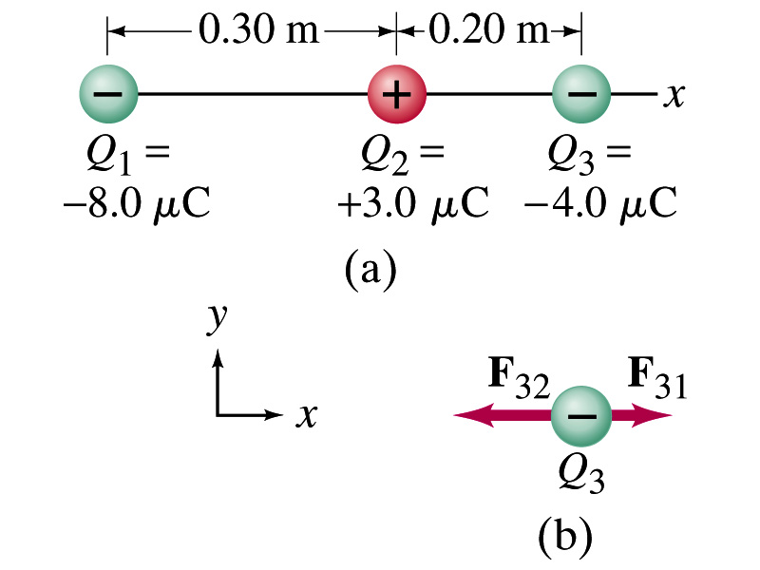
Example 21.2
Three charges on a line. Three charged particles are arranged in a line as shown in the figure. Calculate the net electrostatic force on particle 3 (the -4μC on the right) due to other two charges.
What is the force that Q₁ exerts on Q₃?
What is the force that Q₂ exerts on Q₃?
Using the vector sum of the two forces

