Slide 1
PHYS 1441 – Section 001
Lecture #4
Thursday, June 11, 2020
Dr. Jaehoon Yu
Chapter 21
  The Electric Field & Field Lines
  Electric Fields and Conductors
  Motion of a Charged Particle in an Electric Field
  Electric Dipoles
Chapter 22
  Electric Flux

Slide 2
Announcements
Virtual Physics Clinic: (M: 9am – 1pm, TuWTh: 9am – 5pm) https://teams.microsoft.com/l/channel/19%3ae5b118c00e8d4baa8c0b2b4be09bbcd5%40thread.tacv2/General?groupId=a272a438-e2fd-42e7-8c18-1a8166647940&tenantId=5cdc5b43-d7be-4caa-8173-729e3b0a62d9
Term Exam 1
  In class, coming Monday, June 15: DO NOT MISS THE EXAM!
  CH21.1 to CH21.10 + Appendices A1 – A8, the math refresher
  BYOF: You may bring a one 8.5x11.5 sheet (front and back) of handwritten formulae and values of constants for the exam
  No derivations, word definitions or setups or solutions of any problems!
  No additional formulae or values of constants will be provided!
  Must send me the photos of front and back of the formula sheet, including the blank, no later than 10am Monday morning
    Once submitted, you cannot change, unless I ask you to delete some part of the sheet!
Quiz 1 results
  Class average: 36/60
    Equivalent to 60/100
  Stop score: 60/60

Slide 3
Reminder: Extra Credit Special Project #1
Compare the Coulomb force to the Gravitational force in the following cases by expressing Coulomb force (F_{C}) in terms of the gravitational force (F_{G})
  Between the two protons separated by 1m
  Between the two protons separated by an arbitrary distance R
  Between the two electrons separated by 1m
  Between the two electrons separated by an arbitrary distance R
Five points each, totaling 20 points
BE SURE to show all the details of your own work, including all formulae, proper references to them and explanations
Must be handwritten and submit all pages in a single PDF file
  File name must be: SP1-First-Last-summer20.pdf
Due at the beginning of the class Monday, June 15

Slide 4
SP#2 – Angels & Demons
Compute the total possible energy released from an annihilation of x-grams of anti-matter and the same quantity of matter, where x is the last two digits of your SS# or DL#. (20 points)
  Use the famous Einstein’s formula for mass-energy equivalence
Compute the power output of this annihilation when the energy is released in x ns, where x is again the first two digits of your SS# or DL#. (10 points)
Compute how many cups of gasoline (8MJ) this energy corresponds to. (5 points)
Compute how many months of world electricity usage (3.6GJ/mo) this energy corresponds to. (5 points)
Due by the beginning of the class Wednesday, June. 12
  All pages must be in one PDF file with the name SP2-first-last-summer20.pdf in an email with the subject “Special Project 2, PHYS1444”

Slide 5
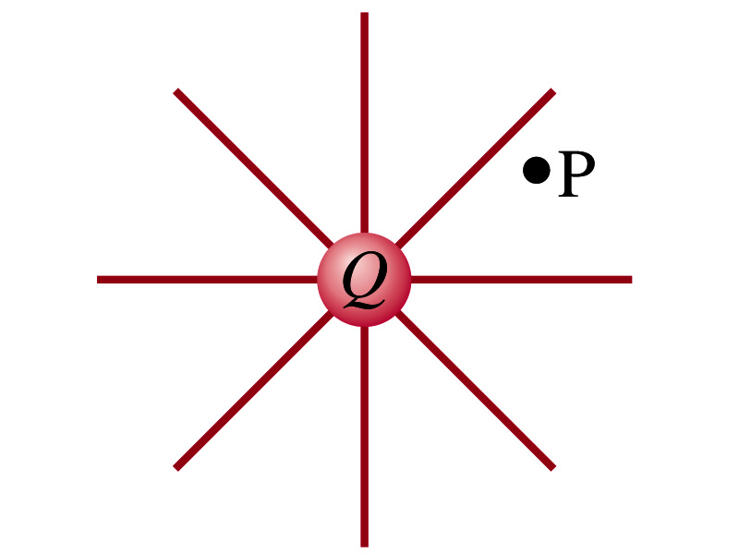
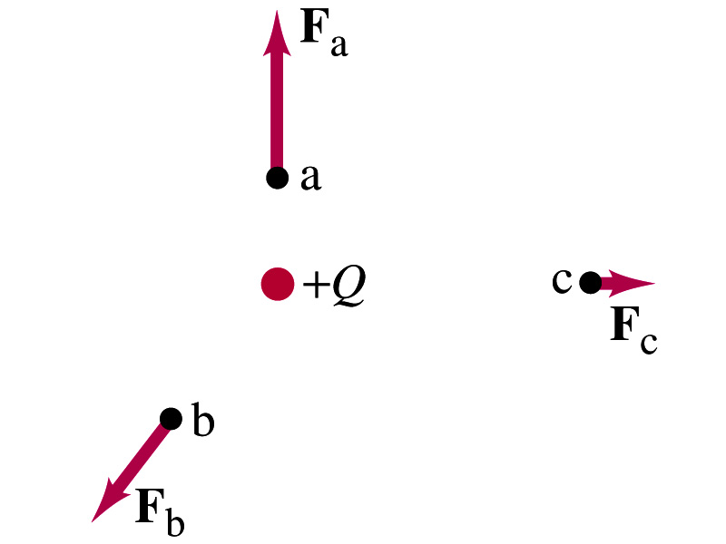
The Electric Field
Both gravitational and electric forces act over a distance without contacting objects ➔ What kind of forces are these?
  Field forces
Michael Faraday developed the idea of the field.
  Faraday (1791 – 1867) argued that the electric field extends outward/inward from every charge and permeates through all of space
Field by a charge or a group of charges can be inspected by placing a small positive test charge in the vicinity and measuring the force on it.
  You imagine what would happen to the test charge!
  E due to a charge is independent of the other charge

Slide 6
What are the directions of the field?
E
+
+
+
+
E
E
-
E
+

Slide 7
What are the directions of the field vs F?
+
+
E
F
-
F
E

Slide 8
The Electric Field
The electric field at any point in space is defined as the force exerted on a tiny positive test charge divide by magnitude of the test charge
  Electric force per unit charge
What kind of quantity is the electric field?
  Vector quantity. Why?
What is the unit of the electric field?
  N/C
What is the magnitude of the electric field at a distance r from a single point charge Q?

Slide 9
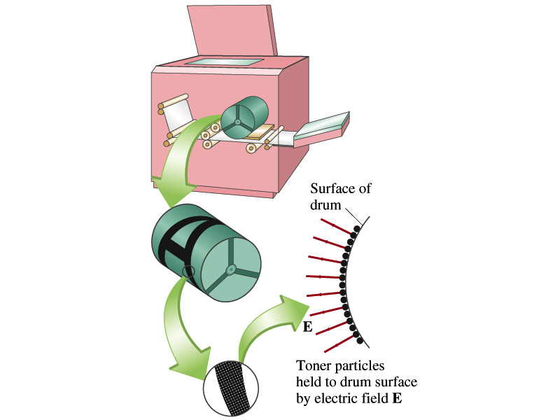
Example 21 – 5
Electrostatic copier. An electrostatic copier works by selectively arranging positive charges (in a pattern to be copied) on the surface of a non-conducting drum, then gently sprinkling negatively charged dry toner (ink) onto the drum. The toner particles temporarily stick to the pattern on the drum and are later transferred to paper and “melted” to produce the copy. Suppose each toner particle has a mass of 9.0x10⁻¹⁶kg and carries the average of 20 extra electrons to provide an electric charge. Assuming that the electric force on a toner particle must exceed twice its weight in order to ensure sufficient attraction, compute the required electric field strength near the surface of the drum.
The electric force must be the same as twice the gravitational force on the toner particle.
So we can write
Thus, the magnitude of the electric field is

Slide 10
Direction of the Electric Field
If there are more than one charge present, the individual fields due to each charge are added vectorially to obtain the total field at any point.
This superposition principle of electric field has been verified by experiments.
For a given electric field E at a given point in space, we can calculate the force F on any charge q, F=qE.
  What happens to the direction of the force and the field depending on the sign of the charge q?
  The F and E are in the same directions if q > 0
  The F and E are in the opposite directions if q < 0

Slide 11
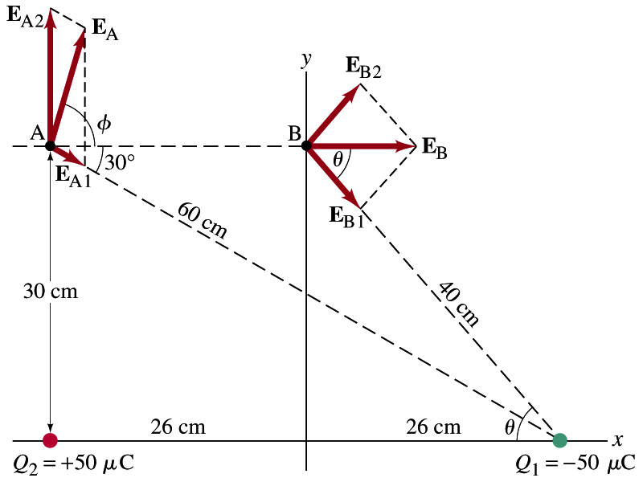
Example 21 – 8
E above two point charges: Calculate the total electric field (a) at point A and (b) at point B in the figure on the right due to both the charges Q₁ and Q₂.
How do we solve this problem?
First, compute the magnitude of fields at each point due to each of the two charges.
Then add them at each point vectorially!
First, the electric field at point A by Q₁ and then Q₂.

Slide 12
Example 21 – 8, cnt’d
Now the components of the electric field vectors by the two charges at point A.
So the electric field at point A is
The magnitude of the electric field at point A is
Now onto the electric field at point B

Slide 13
Example 21 – 8, cnt’d
Electric field at point B is easier due to symmetry!
Since the magnitude of the charges are the same and the distance to point B from the two charges are the same, the magnitude of the electric field by the two charges at point B are the same!!
Now the components!
First, the y-component!
Now, the x-component!
So the electric field at point B is
The magnitude of the electric field at point B

Slide 14
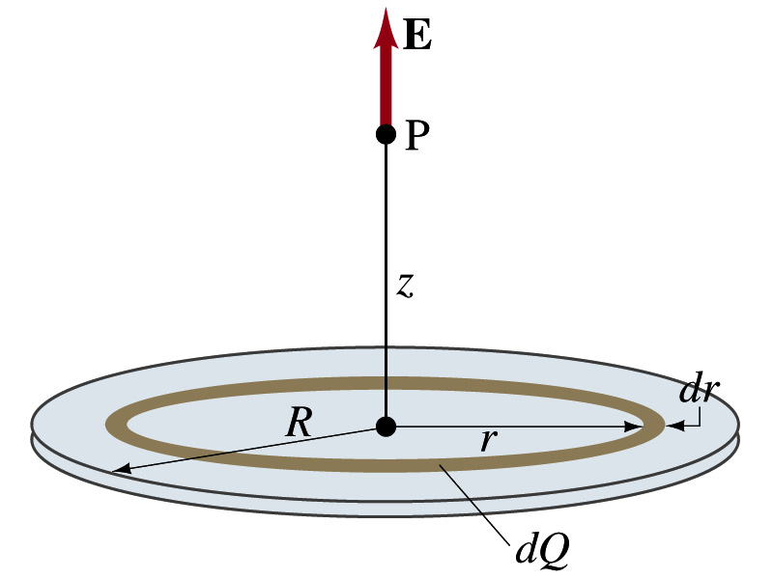
Example 21 – 12
Uniformly charged disk: Charge is distributed uniformly over a thin circular disk of radius R. The charge per unit area (C/m²) is σ. Calculate he electric field at a point P on the axis of the disk, a distance z above its center.
How do we solve this problem?
First, compute the magnitude of the field (dE) at point P due to the charge (dQ) on the ring of infinitesimal width dr.
From the result of example 21 – 11 (please do this problem yourself)
Since the surface charge density is constant, σ, and the ring has an area of 2πrdr, the infinitesimal charge of dQ is
So the infinitesimal field dE can be written

Slide 15
Example 21 – 12 cnt’d
Now integrating dE over 0 through R, we get
What happens if the disk has infinitely large area?
So the electric field due to an evenly distributed surface charge with density, σ, is

Slide 16
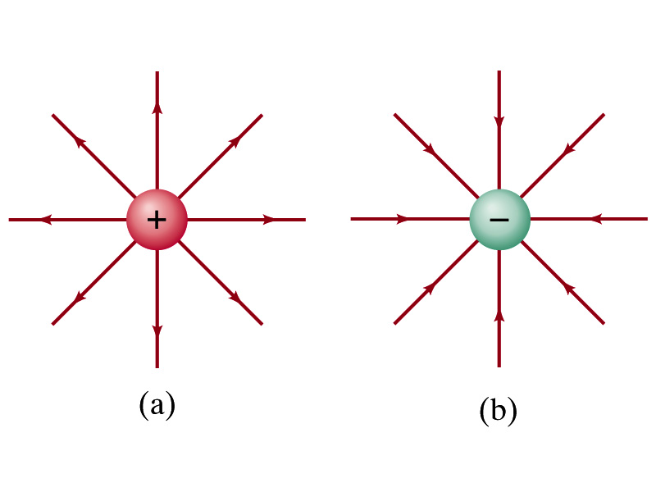
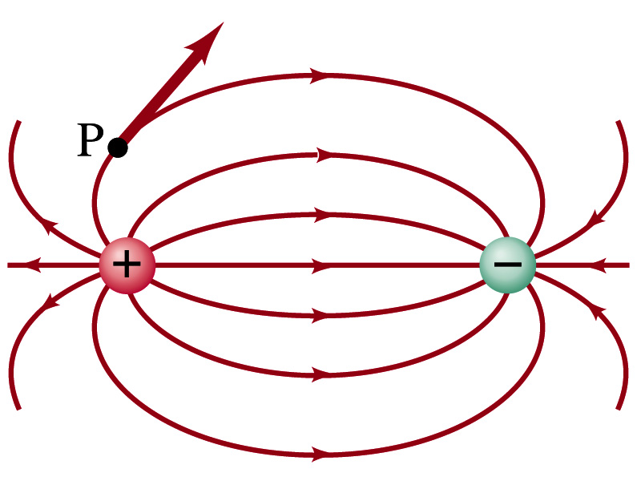
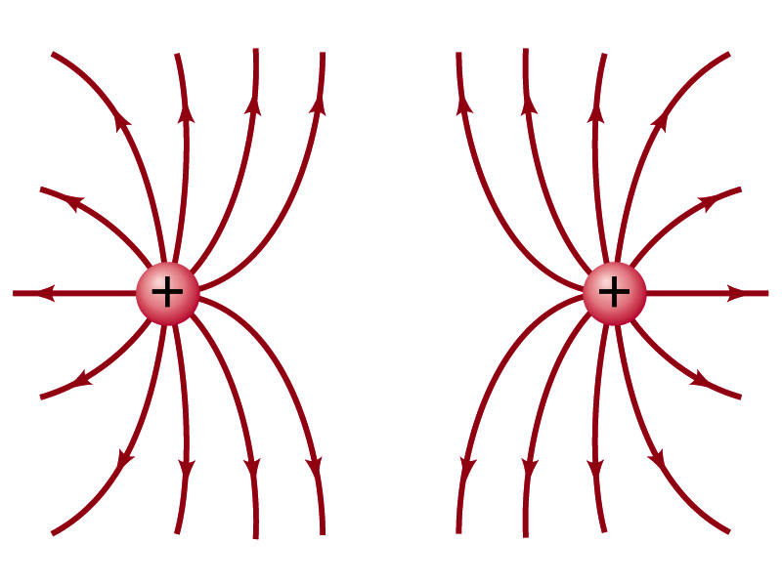

Field Lines
The electric field is a vector quantity. Thus, its magnitude can be expressed by the length of an arrow and the direction by the direction the arrowhead points.
Since the field permeates through the entire space, drawing vector arrows is not a good way of expressing the field.
Electric field lines are drawn to indicate the direction of the force due to the given field on a positive test charge.
  Number of lines crossing unit area perpendicular to E is proportional to the magnitude of the electric field.
  The closer the lines are together, the stronger the electric field in that region.
  Start on positive charges and end on negative charges.
Earth’s G-field lines

Slide 17
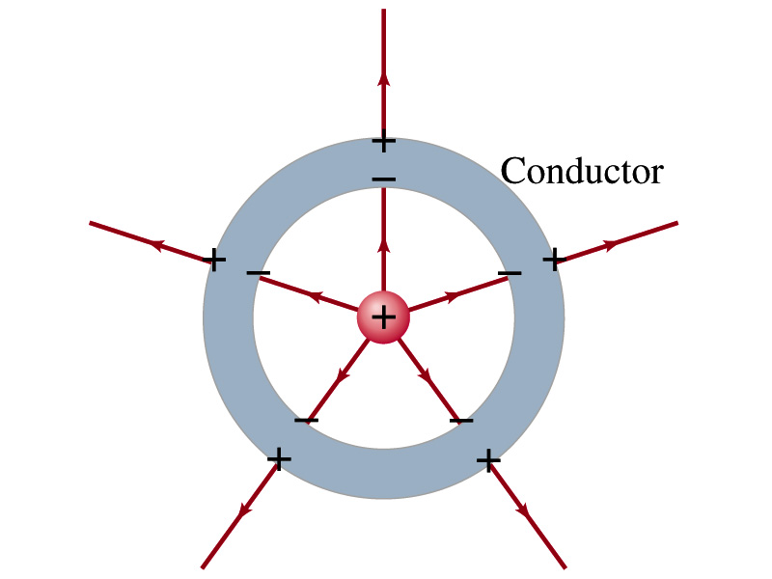
Electric Field and Conductors
The electric field inside a conductor is ZERO in static situation. (If the charge is at rest.) Why?
  If there were an electric field within a conductor, there would be a force on its free electrons.
  The electrons will move until they reached the position where the electric field becomes zero.
  Electric field inside a non-conductor, however, CAN exist.
Consequences of the above
  Any net charge on a conductor distributes itself on the surface.
  Although no E field exists inside a conductor, the field can exist outside the conductor due to induced charges on the surface
  The electric field is always perpendicular to the surface outside of a conductor.

Slide 18
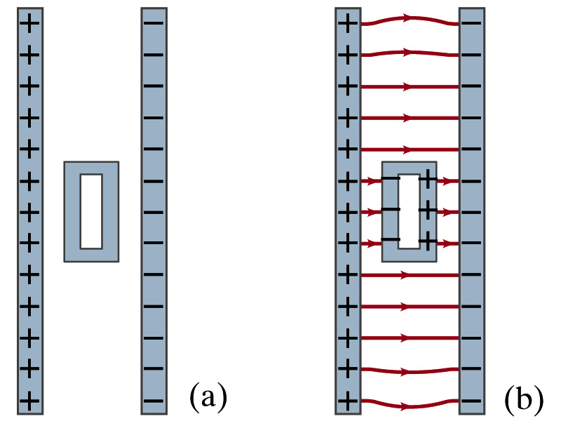
Example 21-13
Shielding, and safety in a storm. A hollow metal box is placed between two parallel charged plates. What is the field like in the box?
If the metal box were solid
  The free electrons in the box would redistribute themselves along the surface so that the field lines would not penetrate into the metal.
The free electrons do the same in hollow metal boxes just as well as it did in a solid metal box.
Thus a conducting box is an effective device for shielding. ➔ Faraday cage
So what do you think will happen if you were inside a car when the car was struck by a lightening?

Slide 19
Motion of a Charged Particle in an Electric Field
If an object with an electric charge q is at a point in space where the electric field is E, the force exerting on the object is .
What do you think will happen to the charge?
  Let’s think about the cases like these on the right.
  The object will move along the field line…Which way?
    Depends on the sign of the charge
  The charge gets accelerated under the electric field.

Slide 20
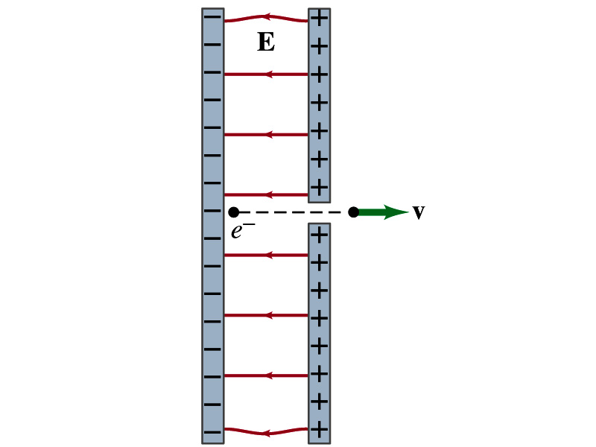
Example 21 – 14
Electron accelerated by electric field. An electron (mass m = 9.1x10⁻³¹kg) is accelerated in a uniform field E (E=2.0x10⁴N/C) between two parallel charged plates. The separation of the plates is 1.5cm. The electron is accelerated from rest near the negative plate and passes through a tiny hole in the positive plate. (a) With what speed does it leave the hole? (b) Show that the gravitational force can be ignored. Assume the hole is so small that it does not affect the uniform field between the plates.
The magnitude of the force on the electron is F=qE and is directed to the right. The equation to solve this problem is
The magnitude of the electron’s acceleration is
Between the plates the field E is uniform, thus the electron undergoes a uniform acceleration

Slide 21
Example 21 – 14
Since the travel distance is 1.5x10⁻²m, using one of the kinetic eq. of motions,
Since there is no electric field outside the conductor, the electron continues moving with this speed after passing through the hole.
(b) Show that the gravitational force can be ignored. Assume the hole is so small that it does not affect the uniform field between the plates.
The magnitude of the electric force on the electron is
The magnitude of the gravitational force on the electron is
Thus the gravitational force on the electron is negligible compared to the electromagnetic force.

