Slide 1
PHYS 1441 – Section 001 Lecture #5
Monday, June 15, 2020
Dr. Jaehoon Yu
Chapter 22
Gauss’ Law
Electric Flux
Gauss’ Law with Multiple Charges
Chapter 23
Electric Potential Energy
Electric Potential due to Point Charges
Today’s homework is #3, due 11pm, Thursday, June 18!!

Slide 2
Announcements
Reading assignment: CH23.9

Slide 3
Reminder: SP#2 – Angels & Demons
Compute the total possible energy released from an annihilation of x-grams of anti-matter and the same quantity of matter, where x is the last two digits of your SS# or DL#. (20 points)
Use the famous Einstein’s formula for mass-energy equivalence
Compute the power output of this annihilation when the energy is released in x ns, where x is again the first two digits of your SS# or DL#. (10 points)
Compute how many cups of gasoline (8MJ) this energy corresponds to. (5 points)
Compute how many months of world electricity usage (3.6GJ/mo) this energy corresponds to. (5 points)
Due by the beginning of the class Wednesday, June. 17
All pages must be in one PDF file with the name SP2-first-last-summer20.pdf in an email with the subject “Special Project 2, PHYS1444”

Slide 4
Gauss’ Law
Gauss’ law states the relationship between the electric charge and the electric field.
More generalized and elegant form of Coulomb’s law.
The electric field by the distribution of charges can be obtained using Coulomb’s law by summing (or integrating) over the charge distributions.
Gauss’ law, however, gives an additional insight into the nature of electrostatic field and a more general relationship between the charge and the field

Slide 5
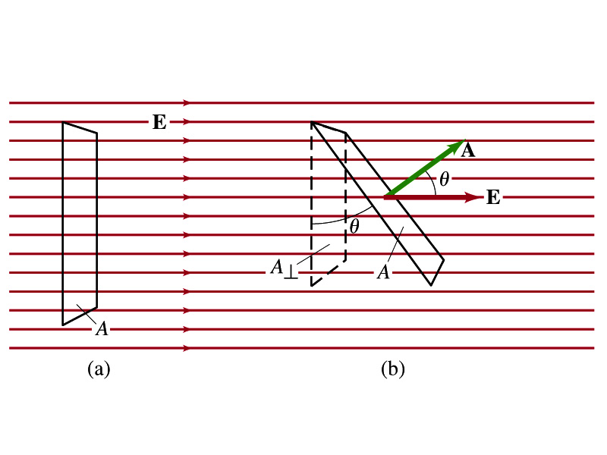
Electric Flux
Let’s imagine a surface of area A through which a uniform electric field E passes
The electric flux Φ_{E} is defined as
Φ_{E}=EA, if the field is perpendicular to the surface
Φ_{E}=EAcosθ, if the field makes an angle θ to the surface
So the electric flux is defined as .
How would you define the electric flux in words?
The total number of field lines passing through the unit area perpendicular to the field.

Slide 6
Example 22 – 1
Electric flux. (a) Calculate the electric flux through the rectangle in the figure (a). The rectangle is 10cm by 20cm and the electric field is uniform with magnitude 200N/C. (b) What is the flux if the angle is 30 degrees?
The electric flux is defined as
So when (a) θ=0, we obtain
And when (b) θ=30 degrees, we obtain

Slide 7
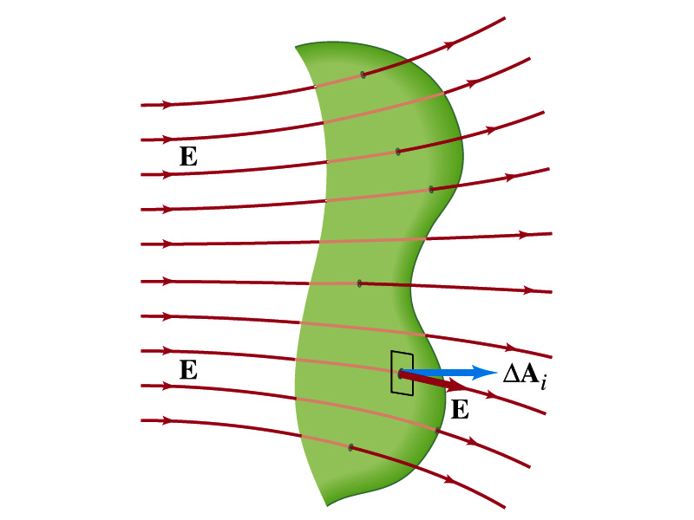
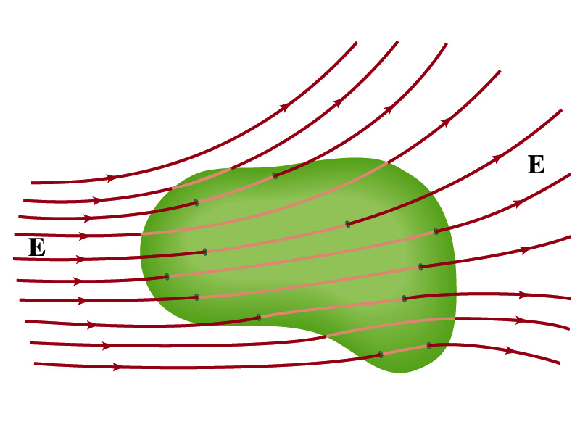
Generalization of the Electric Flux
Let’s consider a surface of area A that is not a square or flat but in some random shape, and that the field is not uniform.
The surface can be divided up into infinitesimally small areas of ΔA_{i} that can be considered flat.
And the electric field through this area can be considered uniform since the area is very small.
Then the electric flux through the entire surface is approximately
In the limit where ΔA_{i} → 0, the discrete summation becomes an integral.
open surface
enclosed surface

Slide 8
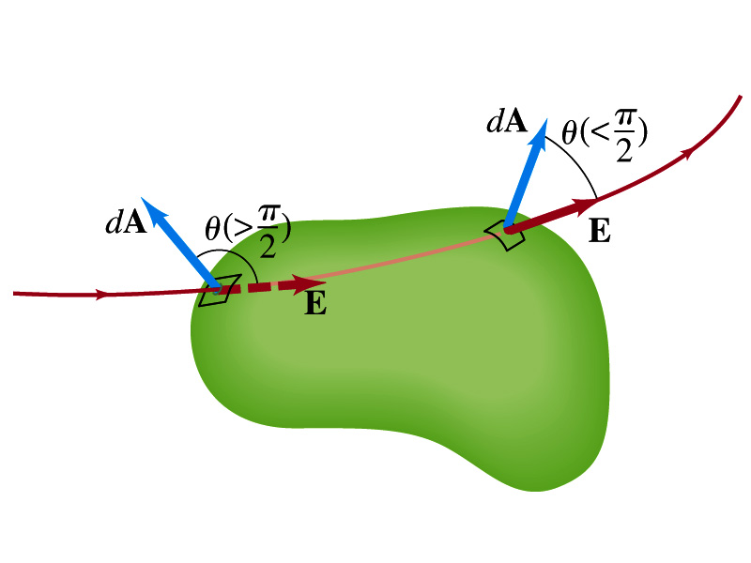
Generalization of the Electric Flux
We arbitrarily define that the area vector points outward from the enclosed volume.
For the line leaving the volume, |θ|<π/2 and cosθ>0. The flux Φ_{E} is positive.
For the line coming into the volume, |θ|>π/2 and cosθ<0. The flux Φ_{E} is negative.
If Φ_{E}>0, there is net flux out of the volume.
If Φ_{E}<0, there is flux into the volume.
In the above figures, each field line that enters the volume also leaves the volume, so
The flux is non-zero only if one or more lines start or end inside the surface.

Slide 9
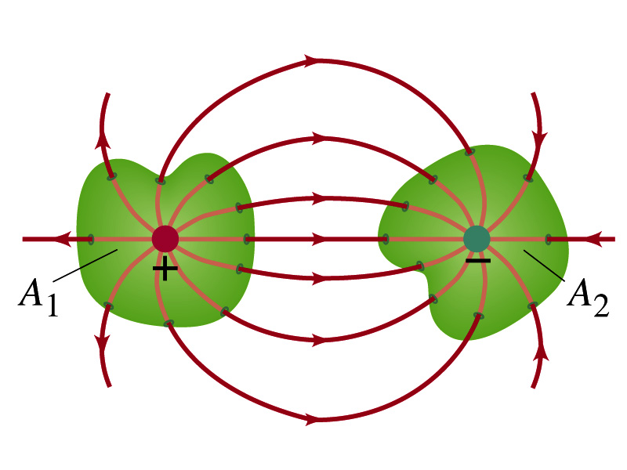
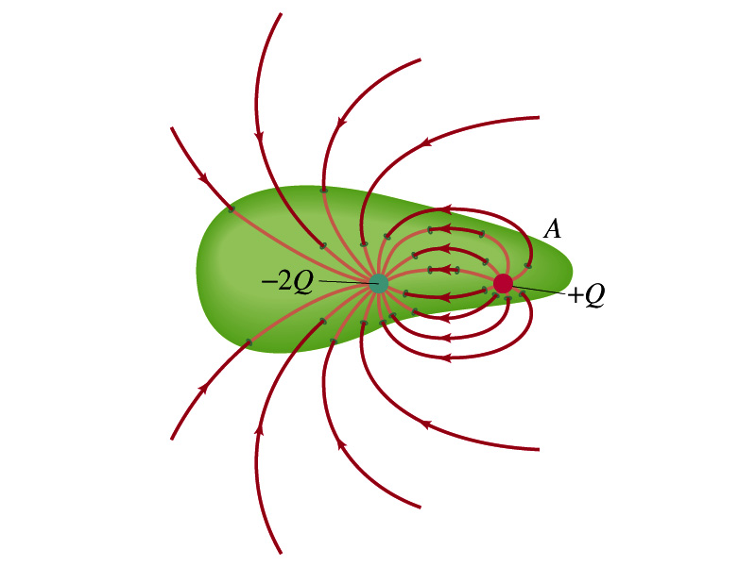
Generalization of the Electric Flux
The field line starts or ends only on a charge.
Sign of the net flux on the surface A₁?
Net outward flux (positive flux)
How about A₂?
Net inward flux (negative flux)
What is the flux in the figure bottom right?
There should be a net inward flux (negative flux) since the total charge inside the volume is negative.
The net flux that crosses an enclosed surface is proportional to the total charge inside the surface. ➔ This is the crux of Gauss’ law.

