Slide 1
PHYS 1441 – Section 001 Lecture #6
Tuesday, June 16, 2020
Dr. Jaehoon Yu
Chapter 22
Electric Flux
Gauss’ Law with Multiple Charges
Chapter 23
Electric Potential Energy
Electric Potential due to Point Charges

Slide 2
Announcements
Online Quiz #2 on Quest
Beginning of class this Thursday, June 18
Covers: CH22.1 through what we finish tomorrow, Wed., 6/17
BYOF: You may bring a one 8.5x11.5 sheet (front and back) of handwritten formulae and values of constants for the exam
No derivations, word definitions or setups or solutions of any problems!
No additional formulae or values of constants will be provided!
Must send me the photos of front and back of the formula sheet, including the blank, no later than 10am Monday morning
Once submitted, you cannot change, unless I ask you to delete some part of the sheet!
Term 1 results
Class average: 60/96
Equivalent to 62.5/100
Stop score: 90/96

Slide 3
Reminder: SP#2 – Angels & Demons
Compute the total possible energy released from an annihilation of x-grams of anti-matter and the same quantity of matter, where x is the last two digits of your SS# or DL#. (20 points)
Use the famous Einstein’s formula for mass-energy equivalence
Compute the power output of this annihilation when the energy is released in x ns, where x is again the first two digits of your SS# or DL#. (10 points)
Compute how many cups of gasoline (8MJ) this energy corresponds to. (5 points)
Compute how many months of world electricity usage (3.6GJ/mo) this energy corresponds to. (5 points)
Due by the beginning of the class Wednesday, June. 17
All pages must be in one PDF file with the name SP2-first-last-summer20.pdf in an email with the subject “Special Project 2, PHYS1444”

Slide 4
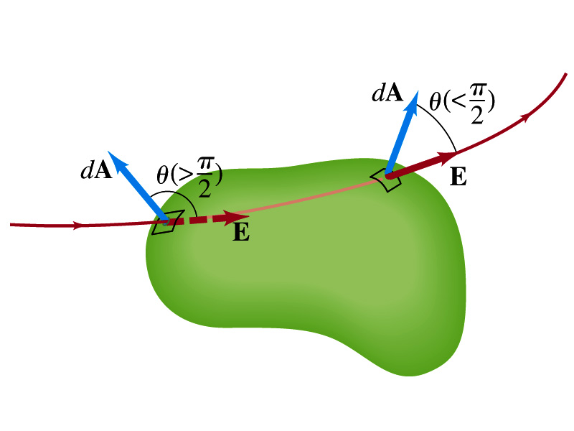
Electric Flux Recap
The electric flux is defined as . (What kind? poll 1)
Electric flux can be interpreted as the total amount of field that passes through the area perpendicular to the field and is proportional to the field strength for the given surface area.
Then the electric flux through the surface are defined as
For the line coming into the volume, |θ|>π/2 and cosθ<0. The flux Φ_{E} is negative.
For the line leaving the volume, |θ|<π/2 and cosθ>0. The flux Φ_{E} is positive.
If Φ_{E}>0, there is net flux out of the volume.
If Φ_{E}<0, there is flux into the volume.
What can change the flux? (Poll 6)
open surface
enclosed surface
4

Slide 5
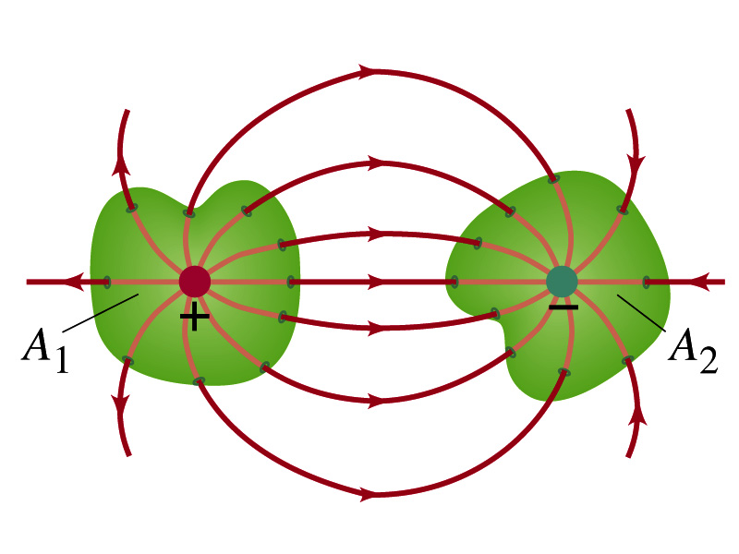
Gauss’ Law
Let’s consider the case in the figure below.
What are the results of the closed integral of the Gaussian surfaces A₁ and A₂? (poll 4)
For A₁
For A₂
q’
q

Slide 6
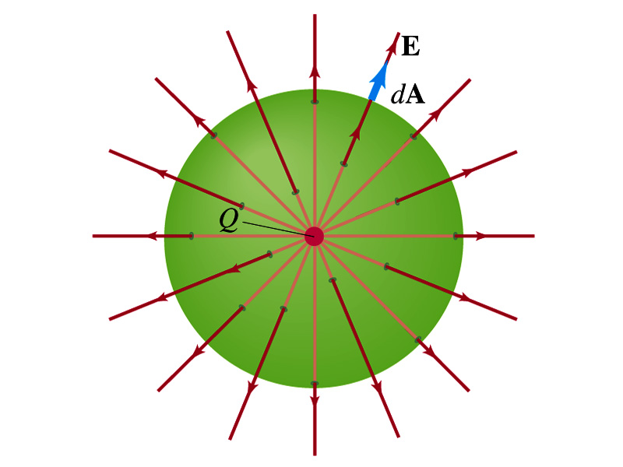
Coulomb’s Law from Gauss’ Law
Let’s consider a charge Q enclosed inside our imaginary Gaussian surface of sphere of radius r.
Since we can choose any surface enclosing the charge, we choose the simplest possible one! ☺
The surface is symmetric about the charge.
What does this tell us about the field E?
Have the same magnitude (uniform) at any point on the surface
Points radially outward parallel to the area vector dA.
The Gaussian integral can be written as
Solve
for E
Electric Field of
Coulomb’s Law

Slide 7
Gauss’ Law from Coulomb’s Law
Let’s consider a single static point charge Q surrounded by an imaginary spherical surface.
Coulomb’s law tells us that the electric field at a spherical surface of radius r is
Performing a closed integral over the surface, we obtain
Gauss’ Law

Slide 8
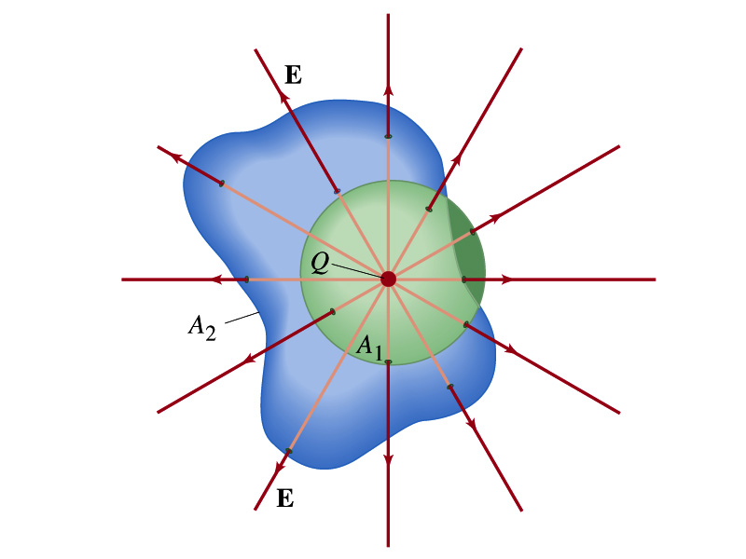
Gauss’ Law from Coulomb’s Law Irregular Surface
Let’s consider the same single static point charge Q surrounded by a symmetric spherical surface A₁ and a randomly shaped surface A₂.
What is the difference in the total number of field lines due to the charge Q, passing through the two surfaces?
None. What does this mean?
The total number of field lines passing through the surface is the same no matter what the shape of the enclosed surface is.
So we can write:
What does this mean?
The flux due to the given enclosed charge is the same independent of the shape of the surface enclosing it is. ➔ Gauss’ law, , is valid for any surface surrounding a single point charge Q.

Slide 9
Gauss’ Law w/ more than one charge
Let’s consider several charges inside a closed surface.
For each charge, Q_{i} inside the chosen closed surface,
What is ?
The electric field produced by Q_{i} alone!
Since electric fields can be added vectorially, following the superposition principle, the total field E is equal to the sum of the fields due to each charge and any external fields. So
The value of the flux depends only on the charge enclosed in the surface!! ➔ Gauss’ law.
What is Q_{encl}?
The total enclosed charge!

Slide 10
So what is Gauss’ Law good for?
Derivation of Gauss’ law from Coulomb’s law is only valid for static electric charge.
Electric field can also be produced by changing magnetic fields.
Coulomb’s law cannot describe this field while Gauss’ law is still valid
Gauss’ law is more general than Coulomb’s law.
Can be used to obtain electric field, forces or obtain charges
Gauss’ Law: Any differences between the input and output flux of the electric field over any enclosed surface is due to the charge inside that surface!!!

Slide 11
Solving problems with Gauss’ Law
Identify the symmetry of the charge distributions
Draw an appropriate Gaussian surface, making sure it passes through the point you want to know the electric field
Use the symmetry of charge distribution to determine the direction of E at the point of the Gaussian surface
Evaluate the flux
Calculate the enclosed charge by the Gaussian surface
Ignore all the charges outside the Gaussian surface
Equate the flux to the enclosed charge and solve for E

Slide 12
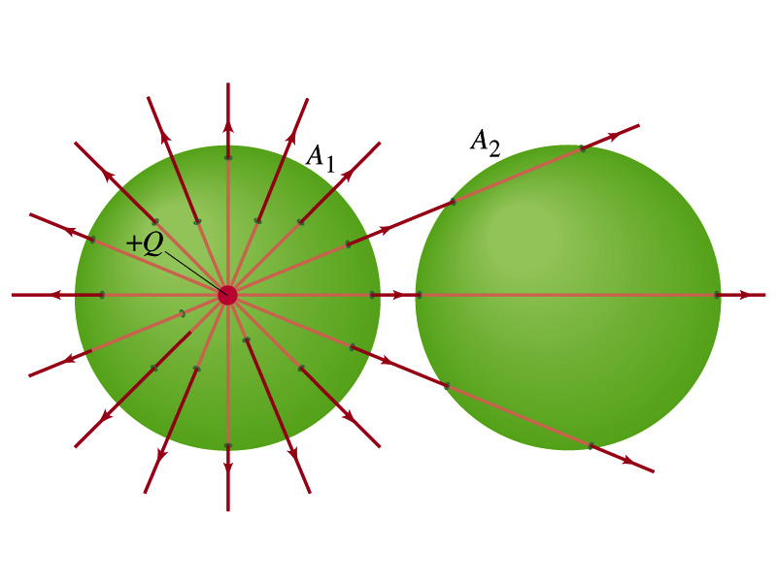
Example 22 – 2
Flux from Gauss’ Law: Consider two Gaussian surfaces, A₁ and A₂, shown in the figure. The only charge present is the charge +Q at the center of surface A₁. What is the net flux through each surface A₁ and A₂? (Poll 5)
The surface A₁ encloses the charge +Q, so from Gauss’ law we obtain the total net flux
The surface A₂ the charge, +Q, is outside the surface, so the total net flux is 0.

Slide 13
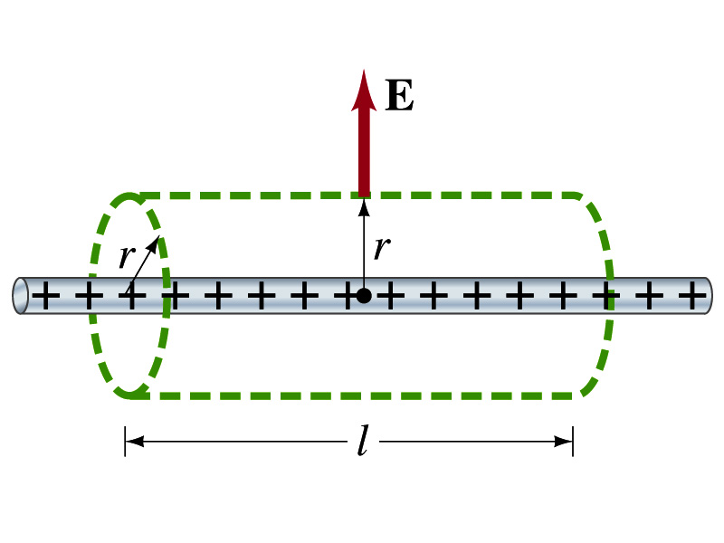
Example 22 – 6
Long uniform line of charge: A very long straight wire possesses a uniform positive charge per unit length, λ. Calculate the electric field a point near but outside the wire, far from the ends.
Which direction do you think the field due to the charge on the wire is?
Radially outward from the wire, the direction of the radial vector r.
Due to the cylindrical symmetry, the field is the same on the Gaussian surface of a cylinder surrounding the wire.
The end surfaces do not contribute to the flux at all. Why?
Because the field vector E is perpendicular to the surface vector dA.
From Gauss’ law
Solving for E

Slide 14
A Brain Teaser of Electric Flux
What would change the electric flux through a circle lying in the xz plane where the electric field is (10N/C)j? (poll 6)
Changing the magnitude of the electric field
Changing the surface area of the circle
Tipping the circle so that it lies on a plane off the xz plane
All of the above
None of the above

Slide 15
Gauss’ Law Summary
The precise relationship between flux and the enclosed charge is given by Gauss’ Law
ε₀ is the permittivity of free space in the Coulomb’s law
A few important points on Gauss’ Law
Freedom to choose!!
The surface integral is performed over the value of E on a closed surface of your choice in any given situation.
Test of existence of electrical charge!!
The charge Q_{encl} is the net charge enclosed by the arbitrary closed surface of your choice.
Universality of the law!
It does NOT matter where or how much charge is distributed inside the surface. Gauss’ law still applies!
The charge outside the surface does not contribute to Q_{encl}. Why?
The charge outside the surface might impact the field lines but not the total number of lines entering or leaving the surface.

Slide 16
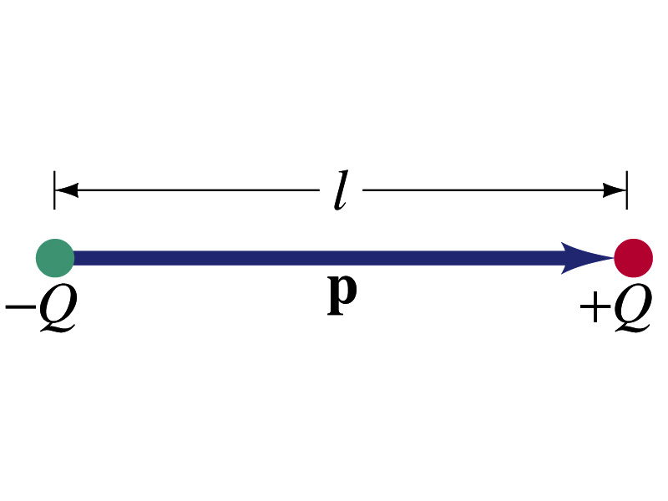
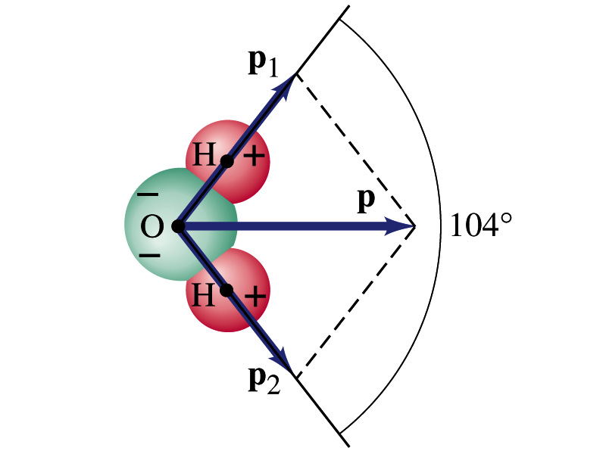
Electric Dipoles
An electric dipole is the combination of two equal charges of opposite signs, +Q and –Q, separated by a distance l, which behaves as one entity.
The quantity Ql is called the electric dipole moment and is represented by the symbol p.
The dipole moment is a vector quantity, p
The magnitude of the dipole moment is Ql. Unit?
Its direction is from the negative charge to the positive charge.
Many of diatomic molecules like CO have a dipole moment. ➔ These are referred as polar molecules.
Even if the molecule is electrically neutral, their sharing of electrons causes separation of charges
Symmetric diatomic molecules, such as O₂, do not have dipole moment.
C-m
The water molecule also has a dipole moment which is the vector sum of two dipole moments between Oxygen and each of Hydrogen atoms.

Slide 17
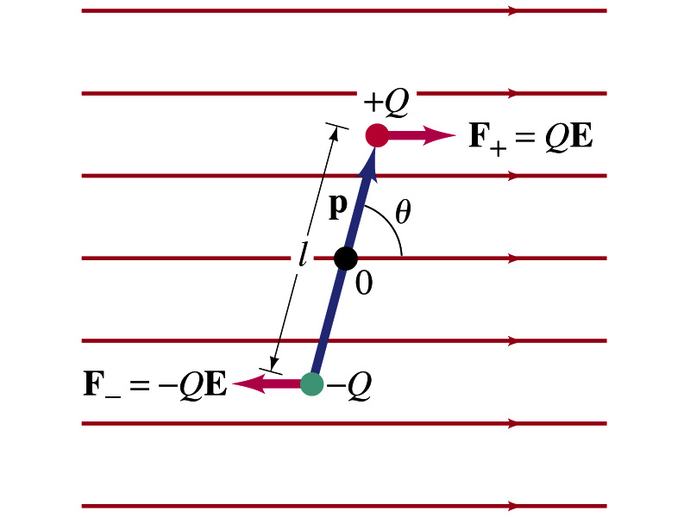
Dipoles in an External Field
Let’s consider a dipole placed in a uniform electric field E.
What do you think will happen to the dipole in the figure?
Force will be exerted on the charges.
The positive charge will get pushed toward right while the negative charge will get pulled toward left.
What is the net force acting on the dipole?
Zero
So will the dipole not move?
Yes, it will.
Why?
There is a torque applied on the dipole.

Slide 18
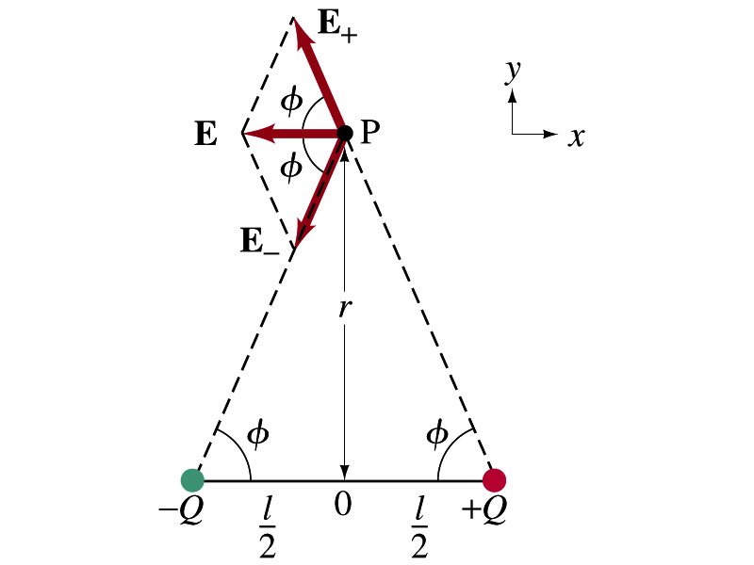
Electric Field by a Dipole
Let’s consider the case in the picture. (poll 7)
There are fields by both the charges. So the total electric field by the dipole is
The magnitudes of the two fields are equal
Now we must work out the x and y components of the total field.
Sum of the two y components is
Zero since they are the same but in opposite direction
So the magnitude of the total field is the same as the sum of the two x-components:

Slide 19
Dipole Electric Field from Afar
What happens when r>>l?.
Why does this make sense?
Since from a long distance, the two charges are very close so that the overall charge gets close to 0!!
This dependence works for the point not on the bisecting line as well

Slide 20
Electric Potential Energy
Concept of energy is very useful solving mechanical problems
Conservation of energy makes solving complex problems easier.
When can the potential energy be defined? (what quantity? Poll 1)
Only for a conservative force.
The work done by a conservative force is independent of the path. What does it only depend on??
The difference between the initial and final positions
Can you give me an example of a conservative force?
Gravitational force
Is the electrostatic force between two charges a conservative force?
Yes. Why?
The dependence of the force to the distance is identical to that of the gravitational force.
The only thing matters is the direct linear distance between the objects not the path.

Slide 21
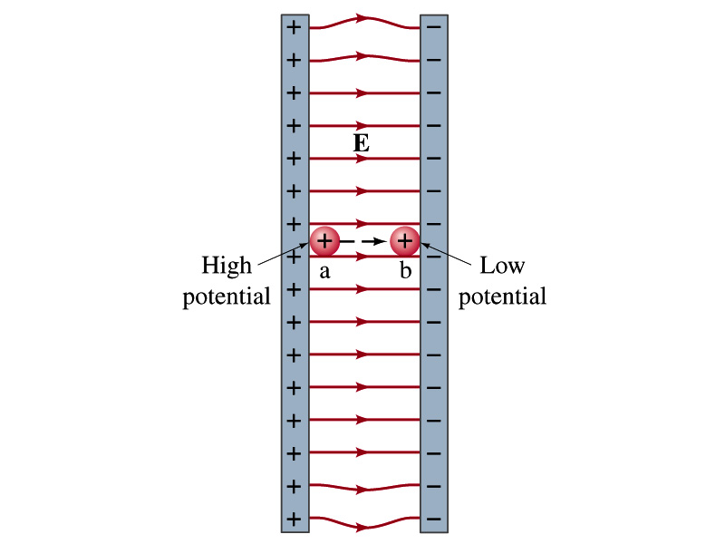
Electric Potential Energy
How would you define the change in electric potential energy U_{b} – U_{a}?
The potential to work gained by the charge as it moves from point a to point b.
The negative work done on the charge by the electric force to move it from a to b.
Let’s consider an electric field between two parallel plates w/ equal but opposite charges
The field between the plates is uniform since the gap is small and the plates are infinitely long…
What happens when we place a small charge, +q, on a point at the positive plate and let go?
The electric force will accelerate the charge toward the negative plate.
What kind of energy does this charged particle gain?
Kinetic energy

Slide 22
Electric Potential Energy
What does this mean in terms of energies?
The electric force is a conservative force.
Thus, the mechanical energy (K+U) is conserved under this force.
The positively charged object has only the electric potential energy (no KE) at the positive plate.
The electric potential energy decreases and
Turns into kinetic energy as the electric force works on the charged object, and the charged object gains speed.
Point of the greatest potential energy for
Positively charged object
Negatively charged object
PE=
U_{a}
0
KE=
0
K_{b}=(U_{a})
ME=
U_{a}
K_{b}=(U_{a})
U+K=(U_{a})

Slide 23
Electric Potential
How is the electric field defined?
Electric force per unit charge: F/q
We can define electric potential (potential) as
The electric potential energy per unit charge
This is same as the voltage of a battery…
Electric potential is written with the symbol V
If a positive test charge q has the potential energy U_{a} at the point a, the electric potential of the charge at that point is

Slide 24
Electric Potential, cont’d
Since only the difference in potential energy is meaningful, only the potential difference between two points is measurable
What happens when the electric force does a “positive work”?
The charge gains kinetic energy
Electric potential energy of the charge decreases
Thus the difference in potential energy is the same as the negative of the work, W_{ba}, done on the charge by the electric field to move the charge from point a to b.
The potential difference V_{ba} is
Electric potential is independent of the test charge!! Unit? (Poll 8)

Slide 25
A Few Things about the Electric Potential
What does the electric potential depend on?
Other charges that creates the field
What about the test charge?
No, the electric potential is independent of the test charge
Test charge gains potential energy by existing in the potential created by other charges
Which plate is at the higher potential?
Positive plate. Why?
Since positive charge has the greatest potential energy on it.
What happens to the positive charge if it is let go?
It moves from higher potential to lower potential
How about the negative charge?
Its potential energy is higher on the negative plate. Thus, it moves from negative plate to positive. Potential difference is still the same.
The unit of the electric potential is Volt (V).
From the definition, 1V = 1J/C.
Zero point of electric potential can be chosen arbitrarily.
Often the ground, a conductor connected to Earth, is zero.

Slide 26
Example 23 – 1
A negative charge: Suppose a negative charge, such as an electron, is placed at point b in the figure. If the electron is free to move, will its electric potential energy increase or decrease? How will the electric potential change?
An electron placed at point b will move toward the positive plate since it was released at its highest potential energy point.
It will gain kinetic energy as it moves toward left, decreasing its potential energy.
The electron, however, moves from the point b at a lower potential to point a at a higher potential. ΔV=V_{a} – V_{b}>0.
This is because the potential is generated by the charges on the plates not by the electron.

Slide 27
Electric Potential and Potential Energy
What is the definition of the electric potential?
The potential energy difference per unit charge
OK, then, how would you express the potential energy that a charge q would obtain when it is moved between point a and b with the potential difference V_{ba}?
In other words, if an object with charge q moves through a potential difference V_{ba}, its potential energy changes by qV_{ba}.
So based on this, how differently would you describe the electric potential in words?
A measure of how much energy an electric charge can acquire in a given situation
A measure of how much work a given charge can do.

Slide 28
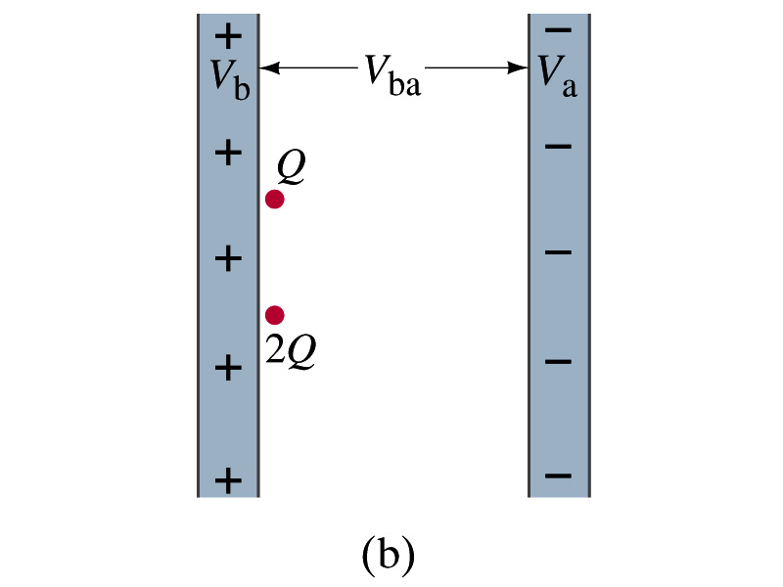
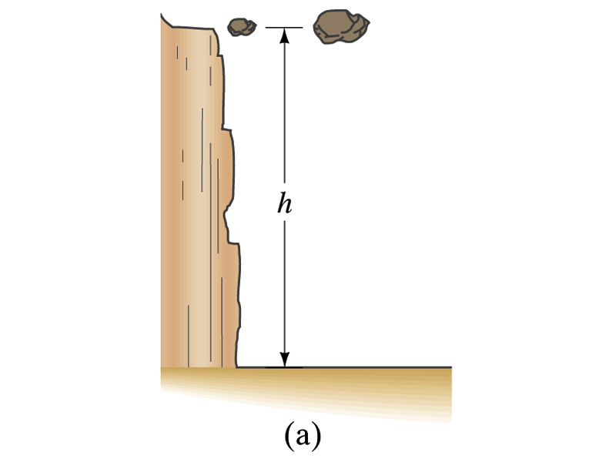
Comparisons of Potential Energies
Let’s compare gravitational and electric potential energies
m
2m
What are the potential energies of the rocks?
mgh and 2mgh
Which rock has a bigger potential energy?
The rock with a larger mass
Why?
It’s got a bigger mass.
What are the potential energies of the charges?
QV_{ba} and 2QV_{ba}
Which object has a bigger potential energy?
The object with a larger charge.
Why?
It’s got a bigger charge.
The potential is the same but the heavier rock or larger charge can do a greater work.

Slide 29
Electric Potential and Potential Energy
The electric potential difference gives potential energy or the possibility to perform work based on the charge of the object.
So what is happening in a battery or a generator?
They maintain a potential difference.
The actual amount of energy used or transformed depends on how much charge flows.
What is the potential difference maintained by a car’s battery?
12Volts
If for a given period, 5C charge flows through the headlight lamp, what is the total energy transformed?
E_{tot}=5C*12V=60 Umm… What is the unit?
If it is left on twice as long? E_{tot}=10C*12V=120J.
Joules

Slide 30
Some Typical Voltages
Sources | Approximate Voltage
Thundercloud to ground (~5km) | 10⁸ V
High-Voltage Power Lines | 10⁶ V
Power supply for TV tube | 10⁴ V
Automobile ignition | 10⁴ V
Household outlet | 10² V
Automobile battery | 12 V
Flashlight battery | 1.5 V
Resting potential across nerve membrane | 10⁻¹ V
Potential changes on skin (EKG and EEG) | 10⁻⁴ V
In a typical lightening strike, 15C of electrons are released in 500μs. What is the total kinetic energy of these electrons when they strike ground? What is the power released during this strike? What do you think will happen to a tree hit by this lightening?

Slide 31
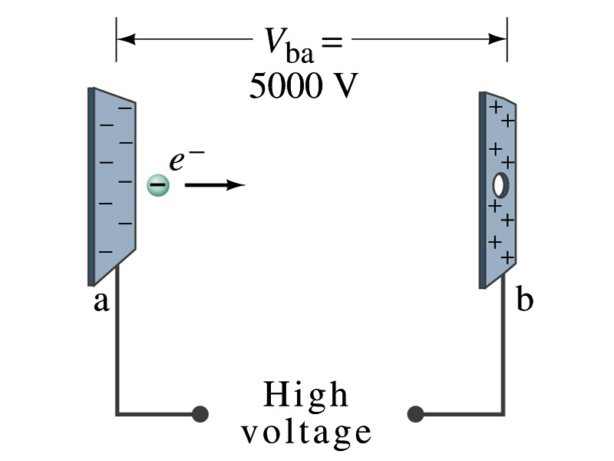
Example 23 – 2
Electrons in TV tube: Suppose an electron in the picture tube of a television set is accelerated from rest through a potential difference V_{ba}=+5000V. (a) What is the change in potential energy of the electron? (b) What is the speed of the electron (m=9.1x10⁻³¹kg) as a result of this acceleration? (c) Repeat for a proton (m=1.67x10⁻²⁷kg) that accelerates through a potential difference of V_{ba}=-5000V.
(a) What is the charge of an electron?
So what is the change of its potential energy?

Slide 32
Example 23 – 2
(b) Speed of the electron?
The entire potential energy of the electron turns to its kinetic energy. Thus the equation is
(C) Speed of the proton?

