Slide 1
PHYS 1441 – Section 001
Lecture #7
Wednesday, June 17, 2020
Dr. Jaehoon Yu
Chapter 23
  V due to Charge Distributions
  Equi-potential Lines and Surfaces
  Electric Potential Energy
Chapter 24 Capacitance etc..
  Capacitors
  Capacitors in Series or Parallel
Today’s homework is #4, due 11pm, Monday, June 22!!

Slide 2
Announcements
Online Quiz #2 on Quest
  Beginning of class tomorrow, Thursday, June 18
  Covers: CH22.1 through what we finish today
  BYOF: You may bring a one 8.5x11.5 sheet (front and back) of handwritten formulae and values of constants for the exam
  No derivations, word definitions or setups or solutions of any problems!
  No additional formulae or values of constants will be provided!
  Must send me the photos of front and back of the formula sheet, including the blank, no later than 10am Monday morning
    Once submitted, you cannot change, unless I ask you to delete some part of the sheet!
Online comprehensive Mid-term Exam on Quest
  In class, Tuesday, June 23
  Covers CH21.1 to what we finish Monday, June 22 + A1 - A8, math
  BYOF

Slide 3
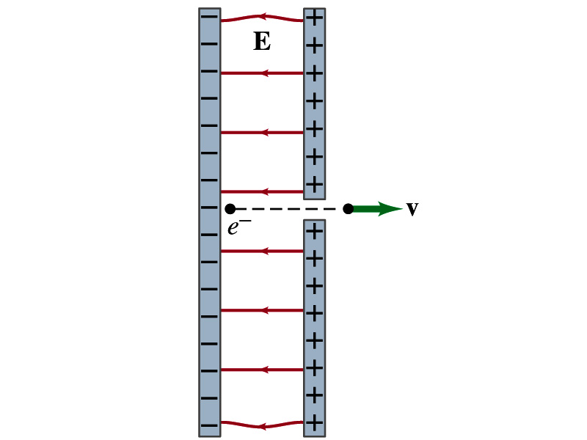
Special Project #3
Particle Accelerator. A charged particle of mass M with charge -Q is accelerated in the uniform field E between two parallel charged plates whose separation is D as shown in the figure on the right. The charged particle is accelerated from an initial speed v₀ near the negative plate and passes through a tiny hole in the positive plate.
  Derive the formula for the electric field E to accelerate the charged particle to a fraction f of the speed of light c. Express E in terms of M, Q, D, f, c and v₀.
  (a) Using the Coulomb force and the kinematic equations. (8 points)
  (b) Using the work-kinetic energy theorem. ( 8 points)
  (c) Using the formula above, evaluate the strength of the electric field E to accelerate an electron from 0.1% of the speed of light to 90% of the speed of light. You need to look up and write down the relevant constants, such as mass of the electron, charge of the electron and the speed of light. (5 points)
Must be handwritten and not copied from anyone else!
  Follow the SP naming convention: SP3-first-last-summer20.pdf which includes all pages in one file ➔ Be sure to write your name onto all pages of the project report!
Due beginning of the class Wednesday, June 24

Slide 4
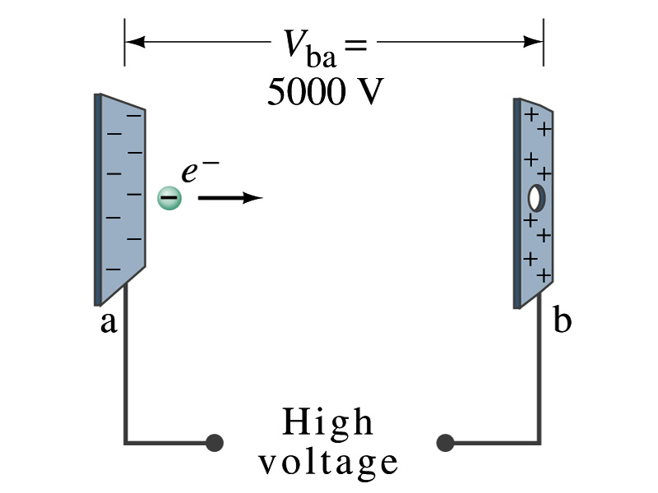
Example 23 – 2
Electrons in TV tube: Suppose an electron in the picture tube of a television set is accelerated from rest through a potential difference V_{ba}=+5000V. (a) What is the change in potential energy of the electron? (b) What is the speed of the electron (m=9.1x10⁻³¹kg) as a result of this acceleration? (c) Repeat for a proton (m=1.67x10⁻²⁷kg) that accelerates through a potential difference of V_{ba}=-5000V.
What formula should you use?
(a) What is the charge of an electron?
So what is the change of its potential energy?

Slide 5
Example 23 – 2
(b) Speed of the electron?
  The entire potential energy of the electron turns to its kinetic energy. Thus the equation is
(C) Speed of the proton?

Slide 6
Electric Potential and Electric Field
The effect of a charge distribution can be described in terms of electric field or electric potential.
  What kind of quantities are the electric field and the electric potential?
    Electric Field:
    Electric Potential:
  Since electric potential is a scalar quantity, it is often easier to handle.
Well other than the above, how are these two quantities related?
Vector
Scalar

Slide 7
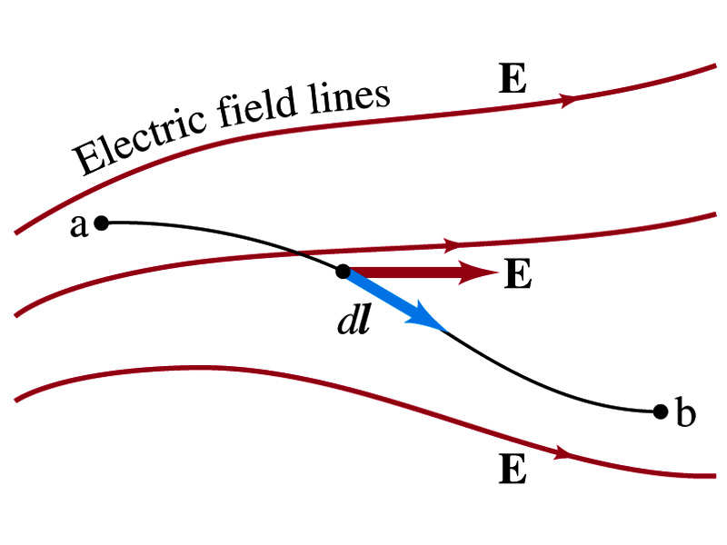
Electric Potential and Electric Field
Potential energy change is expressed in terms of a conservative force (point a at a higher potential)
For the electrical case, we are more interested in the potential difference:
  This formula can be used to determine V_{ba} when the electric field is given.
When the field is uniform
so
What does “-”sign mean?
The direction of E is along that of decreasing potential.
Unit of the electric field in terms of potential?
V/m
Can you derive this from N/C?

Slide 8
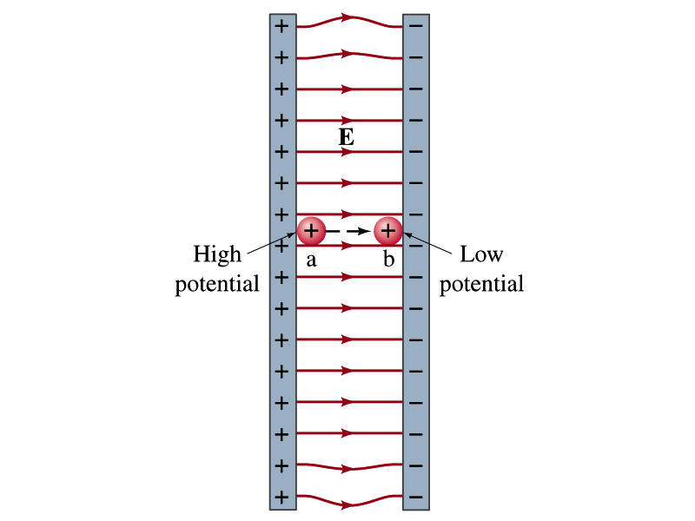
Example
Uniform electric field obtained from voltage: Two parallel plates are charged to a voltage of 50V. If the separation between the plates is 5.0cm, calculate the magnitude of the electric field between them, ignoring any fringe effect.
5cm
50V
What is the relationship between electric field and the potential for a uniform field?
Solving for E
Which direction is the field?
Direction of decreasing potential!

Slide 9
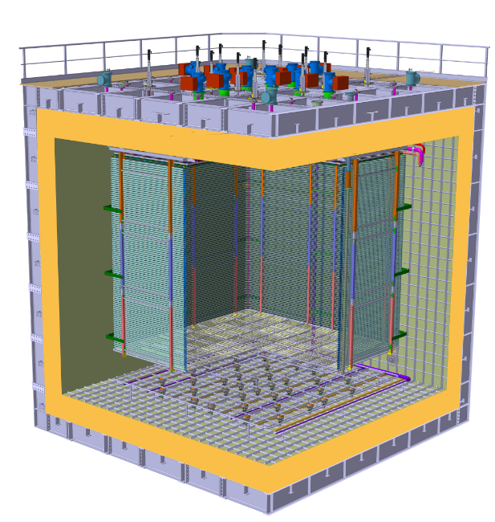
E Field in ProtoDUNE DP
What is the electric field between the cathode and the ground grid?
What do you need to know?
V_{cathode}= - 300kV
d= 70cm
Charge Readout Planes
6 m
Field Cage (common structural elements with SP)
Cathode
6 m
Ground Grid

Slide 10

DUNE Prototype Detector @ CERN
6m
6m

Slide 11
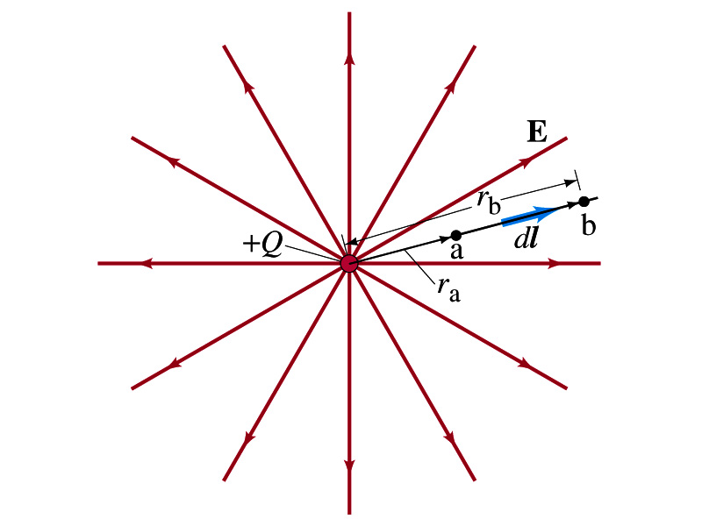
Electric Potential due to Point Charges
What is the electric field by a single point charge Q at a distance r?
Electric potential due to the field E for moving from point r_{a} to r_{b} in the radial direction away from the charge Q is (poll 9)

Slide 12
Electric Potential due to Point Charges
Since only the differences in potential have physical meaning, we can choose at .
The electrical potential V at a distance r from a single point charge Q is
So the absolute potential by a single point charge can be thought of the potential difference by a single point charge between r and infinity

Slide 13
Properties of the Electric Potential
What are the differences between the electric potential and the electric field?
  Electric potential
    Electric potential energy per unit charge
    Inversely proportional to the distance
    Simply add the potential by each of the source charges to obtain the total potential from multiple charges, since potential is a scalar quantity
  Electric field
    Electric force per unit charge
    Inversely proportional to the square of the distance
    Need vector sums to obtain the total field from multiple source charges
Potential due to a positive charge is a large positive near the charge and decreases towards 0 at the large distance.
Potential due to a negative charge is a large negative near the charge and increases towards 0 at a large distance.

Slide 14
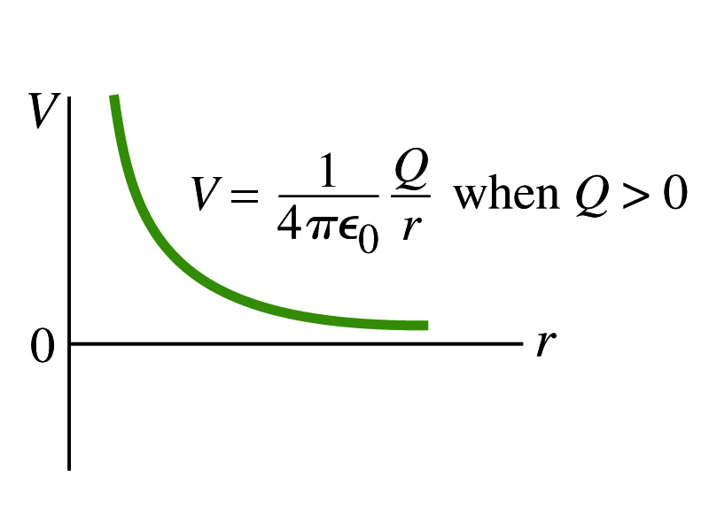
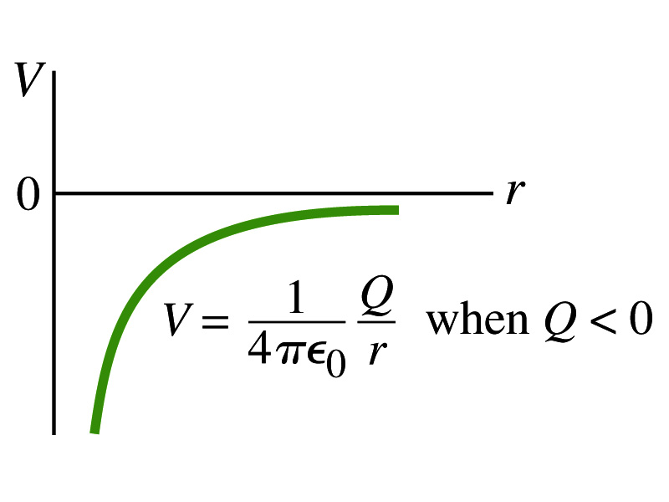
Shape of the Electric Potential
So, how does the electric potential look like as a function of distance?
  What is the formula for the potential by a single charge?
If Q is Positive
If Q is Negative
Uniformly charged sphere would have the potential the same as a single point charge.
What does this mean?
Uniformly charged sphere behaves like all the charge is on the single point in the center.

Slide 15
Example 23 – 6
Work to bring two positive charges close together: What is minimum work required by an external force to bring the charge q=+3.00μC from a great distance away (r=∞) to a point 0.500m from a charge Q=+20.0 μC?
What is the work done by the electric field in terms of potential energy and potential?
Since we obtain
Electric force does negative work. In other words, the external force must work +1.08J to bring the charge 3.00μC from infinity to 0.500m to the charge 20.0μC.

Slide 16
Electric Potential by Charge Distributions
Let’s consider the case of n individual point charges in a given space and V=0 at r=∞.
Then the potential V_{ia} due to the charge Q_{i} at point a, at a distance r_{ia} from Q_{i} is
Thus the total potential V_{a} by all n point charges is
For a continuous charge distribution, we obtain

Slide 17
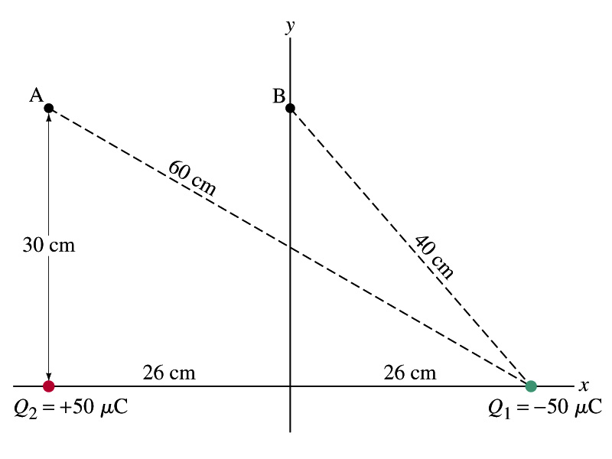
Example
Potential due to two charges: Calculate the electric potential (a) at point A in the figure due to the two charges shown, and (b) at point B.
Potential is a scalar quantity, so one adds the potential by each of the source charge, as if they are numbers.
(a) potential at A is
(b) How about potential at B?

Slide 18
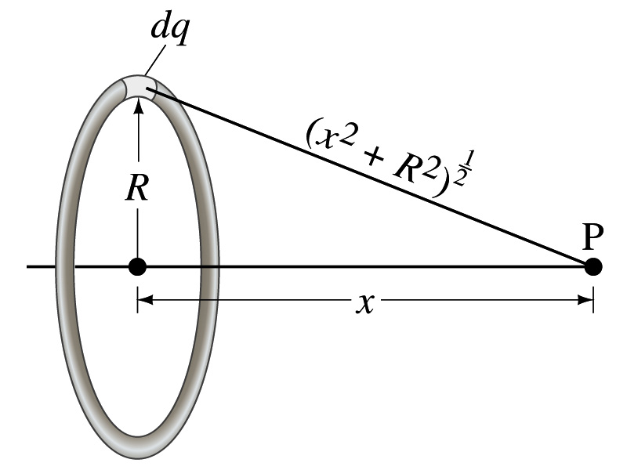
Example 23 – 8
Potential due to a ring of charge: A thin circular ring of radius R carries a uniformly distributed charge Q. Determine the electric potential at a point P on the axis of the ring a distance x from its center.
Each point on the ring is at the same distance from the point P. What is the distance?
So the potential at P is
What’s this?

Slide 19
Equi-potential Surfaces
Electric potential can be graphically shown using the equipotential lines in 2-D or the equipotential surfaces in 3-D
Any two points on the equipotential surfaces (lines) are at the same potential
What does this mean in terms of the potential difference?
  The potential difference between any two points on an equipotential surface is 0.
How about the potential energy difference?
  Also 0.
What does this mean in terms of the work to move a charge along the surface between these two points?
  No work is necessary to move a charge between these two points.

Slide 20
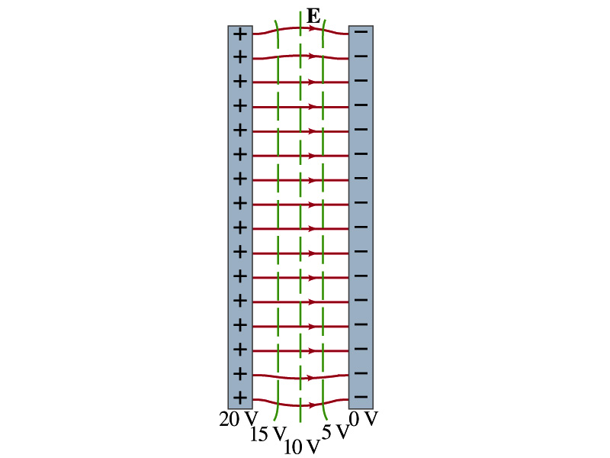
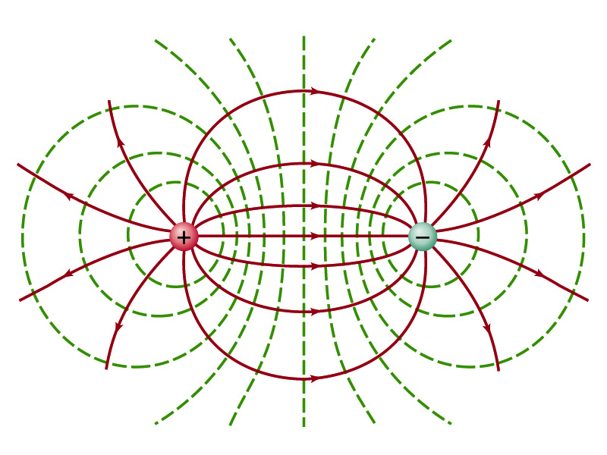

Equi-potential Surfaces
An equipotential surface (line) must be perpendicular to the electric field. Why?
  If there are any parallel components to the electric field, it would require work to move a charge along the surface.
Since the equipotential surface (line) is perpendicular to the electric field, we can draw these surfaces or lines easily.
Since there can be no electric field within a conductor in a static case, the entire volume of a conductor must be at the same potential.
So the electric field must be perpendicular to the conductor surface.
Parallel Plate
Point charges
Just like a topological map

Slide 21
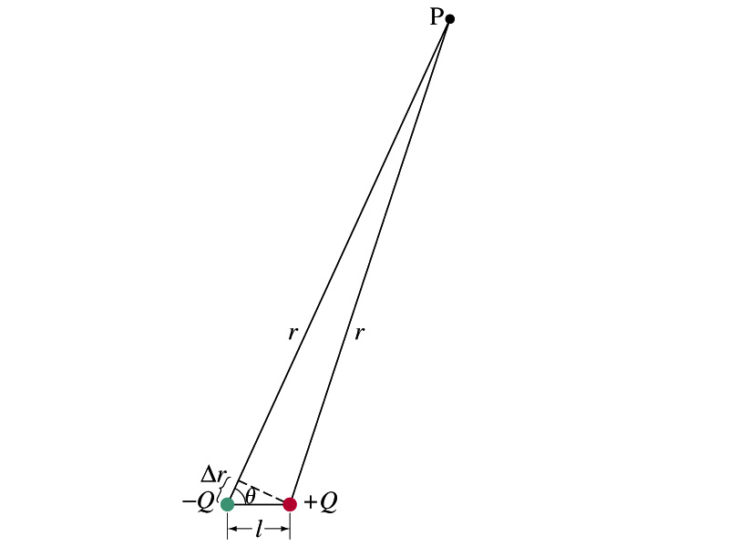
Electric Potential due to Electric Dipoles
What is an electric dipole?
  Two equal point charge Q of opposite signs separated by a distance l and behaves like one entity: p=Ql
For the electric potential due to a dipole at a point P
  We take V=0 at r=∞
The simple sum of the potential at P by the two charges is
Since Δr=lcosθ and if r>>l, r>>Δr, thus r+Δr ~r and
V by a dipole at a
distance r from
the dipole

Slide 22
E Determined from V
Potential difference between two points under an electric field is
So in a differential form, we can write
  What are dV and E_{l}?
    dV is the infinitesimal potential difference between the two points separated by a distance dl
    E_{l} is the field component along the direction of dl.
Thus we can write the field component E_{l} as
The component of the electric field in any direction is equal to the negative rate of change of the electric potential as a function of distance in that direction!!
Physical Meaning?

Slide 23
E Determined from V
The quantity dV/dl is called the gradient of V in a particular direction
  If no direction is specified, the term gradient refers to the direction in which V changes most rapidly and this would be the direction of the field vector E at that point.
  So if E and dl are parallel to each other,
If E is written as a function x, y and z, the l refers to x, y and z
is the “partial derivative” of V with respect to x, while y and z are held constant
In vector form,
is called del or the gradient operator and is a vector operator.

Slide 24
Electrostatic Potential Energy
Consider a case in which a point charge q is moved between points a and b where the electrostatic potential due to other charges in the system is V_{a} and V_{b}
The change in electrostatic potential energy of q in the field by other charges is
Now what is the electrostatic potential energy of a system of charges?
  Let’s choose V=0 at r=∞
  If there are no other charges around, single point charge Q₁ in isolation has no potential energy and is under no electric force

Slide 25
Electrostatic Potential Energy; Two charges
If the second point charge Q₂ is brought close to Q₁ at a distance r₁₂, the potential due to Q₁ at the position of Q₂ is
The potential energy of the two charges relative to V=0 at r= ∞ is
  This is the work that needs to be done by an external force to bring Q₂ from infinity to the distance r₁₂ from Q₁.
  It is also a negative of the work needed to separate them to infinity.

Slide 26
Electrostatic Potential Energy; Three Charges
So what do we do for three charges?
Work is needed to bring all three charges together
  Work needed to bring Q₁ to a certain location without the presence of any charge is 0.
  Work needed to bring Q₂ to a distance to Q₁ is
  Work need to bring Q₃ to certain distances to Q₁ and Q₂ is
So the total electrostatic potential energy of the three charge system is
  What about a four charge system or N charge system?

Slide 27
Electrostatic Potential Energy: electron Volt
What is the unit of the electrostatic potential energy? (poll 8)
  Joules
Joules is a very large unit in dealing with electrons, atoms, molecules or any atomic scale problems
For convenience a new unit, electron volt (eV), is defined
  1 eV is defined as the energy acquired by a particle carrying the magnitude of the charge equal to that of an electron (q=e) when it moves across a potential difference of 1V.
  How many Joules is 1 eV then?
Note that eV, however, is NOT a standard SI unit. You must convert the energy to Joules for computations.
What is the speed of an electron with kinetic energy 5000eV?

