Slide 1
PHYS 1441 – Section 001 Lecture #8
Thursday, June 18, 2020
Dr. Jaehoon Yu
Chapter 24 Capacitance etc..
Determination of Capacitance
Capacitors in Series or Parallel
Electric Energy Storage
Effect of Dielectric
Molecular description of Dielectric Material

Slide 2
Announcements
Online comprehensive Mid-term Exam on Quest
Beginning of class Tuesday, June 23
Covers: CH21.1 through what we finish Monday, June 22 + A1 - A8, math refresher
BYOF: You may bring a one 8.5x11.5 sheet (front and back) of handwritten formulae and values of constants for the exam
No derivations, word definitions, figures, pictures, arrows or setups or solutions of any problems!
No additional formulae or values of constants will be provided!
Must send me the photos of front and back of the formula sheet, including the blank, no later than 10am Tuesday morning
Once submitted, you cannot change, unless I ask you to delete some part of the sheet!

Slide 3
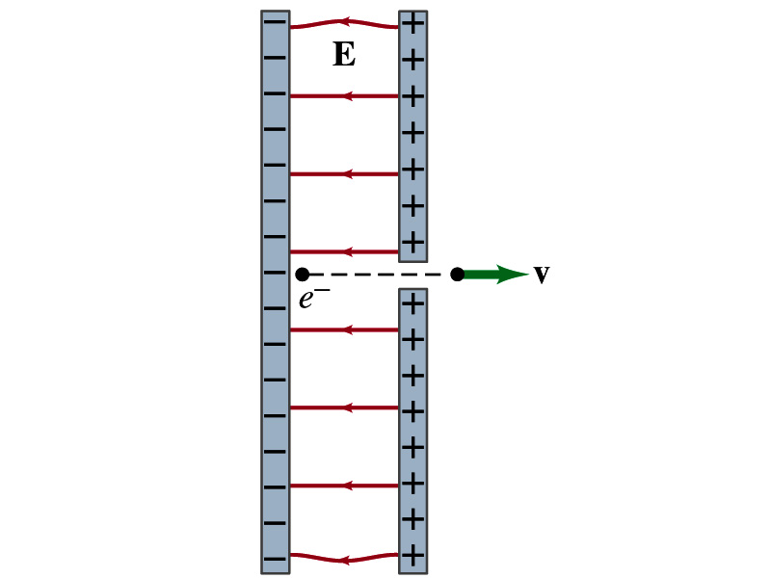
Reminder: Special Project #3
Particle Accelerator. A charged particle of mass M with charge -Q is accelerated in the uniform field E between two parallel charged plates whose separation is D as shown in the figure on the right. The charged particle is accelerated from an initial speed v₀ near the negative plate and passes through a tiny hole in the positive plate.
Derive the formula for the electric field E to accelerate the charged particle to a fraction f of the speed of light c. Express E in terms of M, Q, D, f, c and v₀.
(a) Using the Coulomb force and the kinematic equations. (8 points)
(b) Using the work-kinetic energy theorem. ( 8 points)
(c) Using the formula above, evaluate the strength of the electric field E to accelerate an electron from 0.1% of the speed of light to 90% of the speed of light. You need to look up and write down the relevant constants, such as mass of the electron, charge of the electron and the speed of light. (5 points)
Must be handwritten and not copied from anyone else!
Follow the SP naming convention: SP3-first-last-summer20.pdf which includes all pages in one file ➔ Be sure to write your name onto the project report!
Due beginning of the class Wednesday, June 24

Slide 4
Capacitors (or Condensers)
What is a capacitor?
A device that can store electric charge
But does not let them flow through
What does a capacitor consist of?
Usually consists of two conducting objects (plates or sheets) placed near each other without touching
Why can’t they touch each other?
The charge will neutralize…
Can you give some examples?
Camera flash, surge protectors, binary circuits, memory, etc…
How is the capacitor different than the battery?
Battery provides potential difference by storing energy (usually chemical energy) while the capacitor stores charges but very little energy.

Slide 5
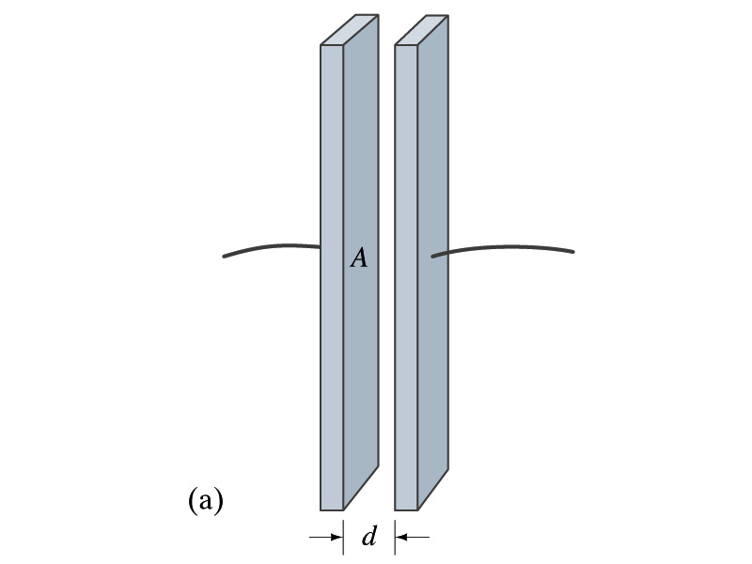
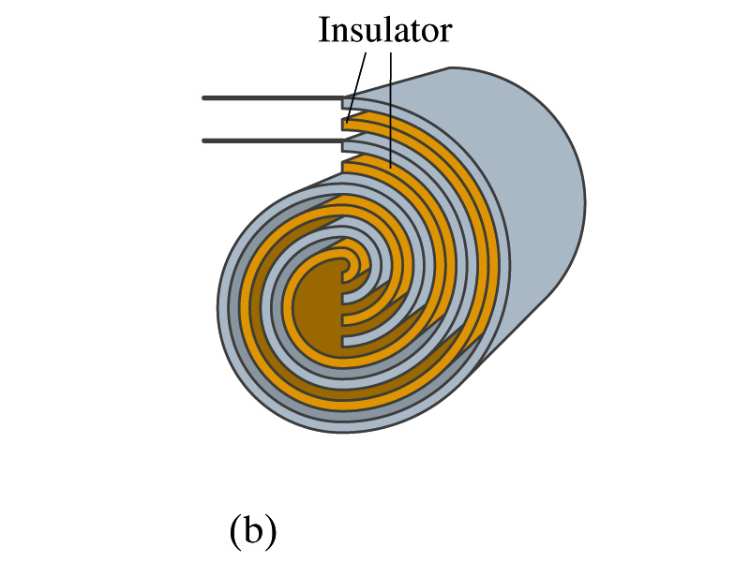
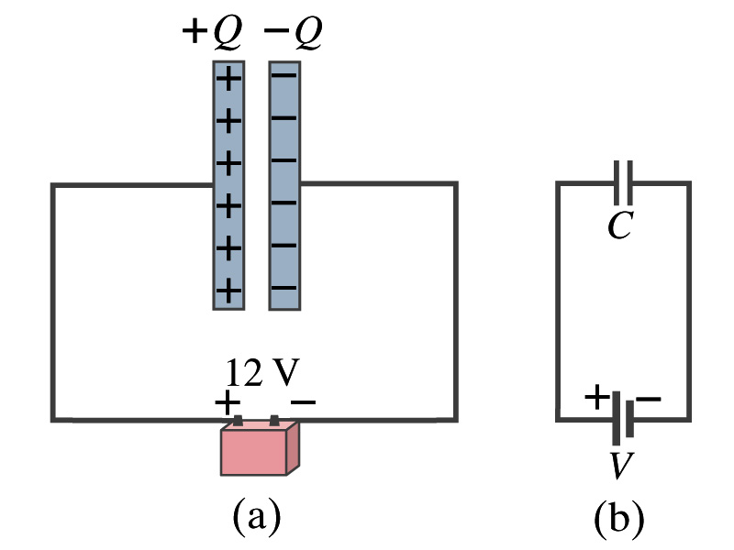
Capacitors
A simple capacitor consists of a pair of parallel plates of area A separated by a distance d.
A cylindrical capacitor is essentially parallel plates wrapped around as a cylinder.
How do you draw symbols for a capacitor and a battery in a circuit diagram?
Capacitor -||-
Battery (+) -|i- (-)
Circuit
Diagram

Slide 6
Capacitors
What do you think will happen if a battery is connected ( or the voltage is applied) to a capacitor?
The capacitor gets charged quickly, one plate positive and the other negative in equal amount.
The battery terminals, the wires and the plates are conductors. What does this mean?
All conductors are at the same potential. And?
So the full battery voltage is applied across the capacitor plates.
So for a given capacitor, the amount of charge stored on each capacitor plate is proportional to the potential difference V_{ba} between the plates. How would you write this formula?
C is a proportionality constant, called the capacitance of the device.
What is the unit?
C is the property of a capacitor so does not depend on Q or V.
C/V
or
Farad (F)
Normally use μF or pF.

Slide 7
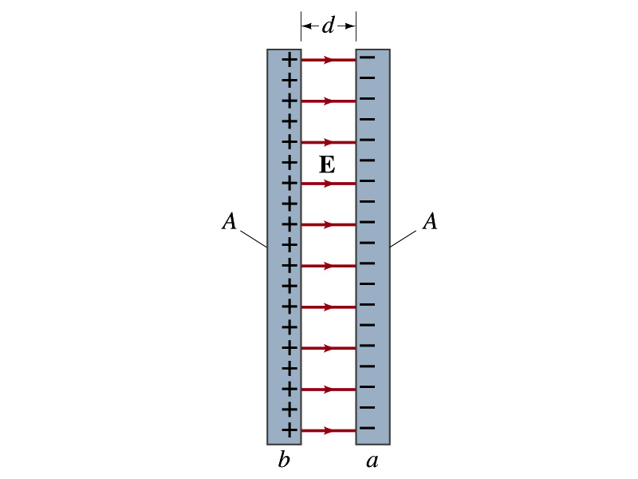
Determination of Capacitance
C, the capacitance can be determined analytically for a capacitor with a simple geometry and air in between.
Let’s consider a parallel plate capacitor.
Plates have area A each and separated by d.
d is smaller than the length, and so E is uniform.
E for parallel plates is E=σ/ε₀, σ=Q/A is the surface charge density.
E and V are related
Since we take the integral from the lower potential (a) to the higher potential (b) along the field line, we obtain
So from the formula:
What do you notice?
C only depends on the area and the distance of the plates and the permittivity of the medium between them.

Slide 8
Example 24 – 1
Capacitor calculations: (a) Calculate the capacitance of a capacitor whose plates are 20cmx3.0cm and are separated by a 1.0mm air gap. (b) What is the charge on each plate if the capacitor is connected to a 12-V battery? (c) What is the electric field between the plates? (d) Estimate the area of the plates needed to achieve a capacitance of 1F, given the same air gap.
(a) Using the formula for a parallel plate capacitor, we obtain
(b) From Q=CV, the charge on each plate is

Slide 9
Example 24 – 1
(C) Using the formula for the electric field in two parallel plates
Or, since
we can obtain
(d) Solving the capacitance formula for A, we obtain
Solve for A
About 40% the area of Arlington (256km²).

Slide 10
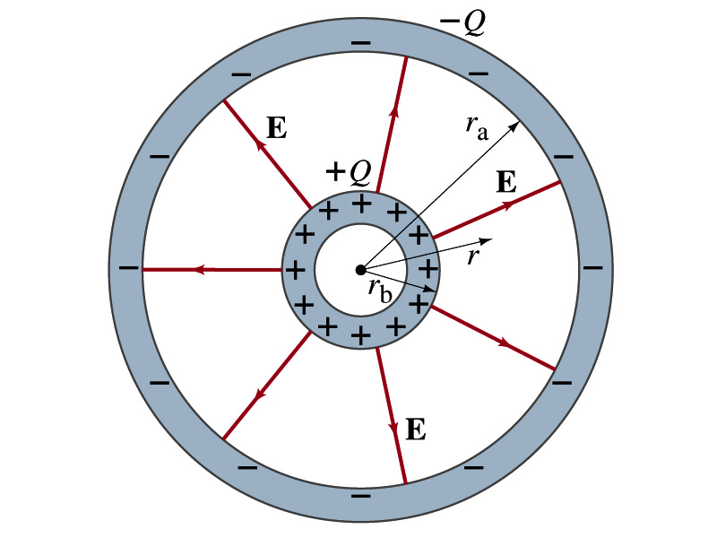
Example 24 – 3
Spherical capacitor: A spherical capacitor consists of two thin concentric spherical conducting shells, of radius r_{a} and r_{b}, as in the figure. The inner shell carries a uniformly distributed charge Q on its surface and the outer shell an equal but opposite charge –Q. Determine the capacitance of the two shells.
Using Gauss’ law, the electric field outside a uniformly charged conducting sphere is
So the potential difference between a and b is
Thus capacitance is

Slide 11
Capacitor Cont’d
A single isolated conductor can be said to have a capacitance, C.
C can still be defined as the ratio of the charge to the absolute potential V on the conductor.
So Q=CV.
The potential of a single conducting sphere of radius r_{b} can be obtained as
where
So its capacitance is

Slide 12
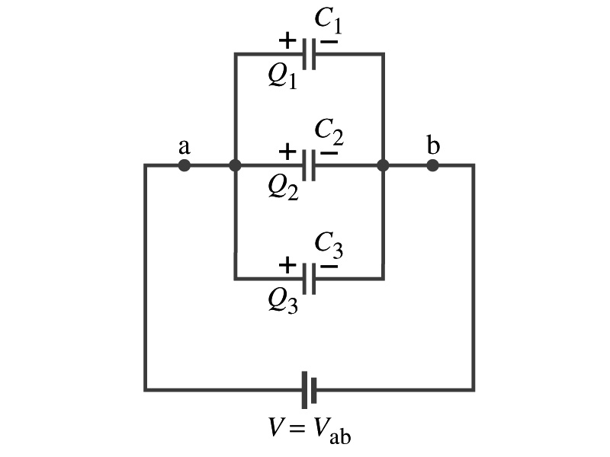
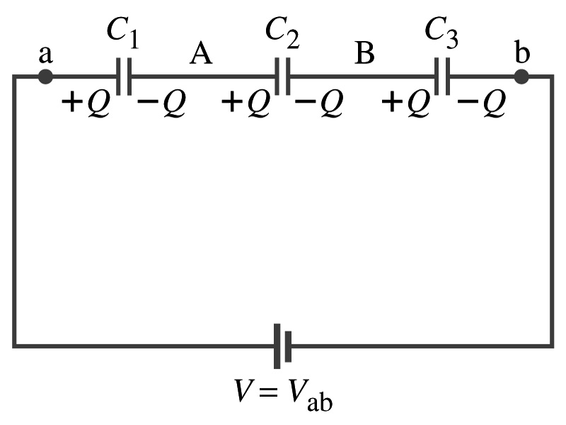
Capacitors in Series or Parallel
Capacitors may be used in electric circuits
What is an electric circuit?
A closed path of conductors, usually wires connecting capacitors and other electrical devices, in which
charges can flow
And includes a voltage source such as a battery
Capacitors can be connected in various ways.
In parallel, in series or in combination

Slide 13
Capacitors in Parallel
Parallel arrangement provides the same voltage across all the capacitors.
Left hand plates are at V_{a} and right hand plates are at V_{b}
So each capacitor plate acquires charges given by the formula
Q₁=C₁V, Q₂=C₂V, and Q₃=C₃V
The total charge Q that must leave the battery is then
Q=Q₁+Q₂+Q₃=V(C₁+C₂+C₃)
Consider that the three capacitors behave like an equivalent one
Q=C_{eq}V= V(C₁+C₂+C₃)
Thus the equivalent capacitance in parallel is
What is the net effect?
The capacitance increases!!!

Slide 14
Capacitors in Series
Series arrangement is more interesting
When the battery is connected, +Q flows to the left plate of C₁ and –Q flows to the right plate of C₃.
Since capacitors in between were originally neutral, charges get induced to neutralize the ones in the middle.
So the charge on each capacitor plate is the same value, Q. (Same charge)
Consider that the three capacitors behave like an equivalent one
Q=C_{eq}V
The total voltage V across the three capacitors in series must be equal to the sum of the voltages across each capacitor.
V=V₁+V₂+V₃=Q/C₁+Q/C₂+Q/C₃
Putting all these together, we obtain:
V=Q/C_{eq}=Q(1/C₁+1/C₂+1/C₃)
Thus the equivalent capacitance is
What is the net effect?
The capacitance smaller than the smallest C!!!

Slide 15
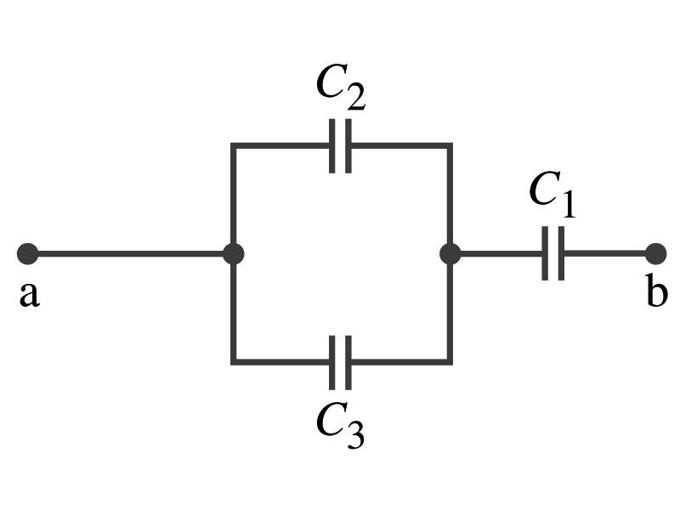
Example 24 – 5
Equivalent Capacitor: Determine the capacitance of a single capacitor that will have the same effect as the combination shown in the figure. Take C₁=C₂=C₃=C.
We should do these first!!
How?
These are in parallel so the equivalent capacitance is:
Now the equivalent capacitor is in series with C1.
Solve for C_{eq}

Slide 16
Electric Energy Storage
A charged capacitor stores energy.
The stored energy is the amount of the work done to charge it.
The net effect of charging a capacitor is removing one type of charge from one plate and put them on to the other.
Battery does this when it is connected to a capacitor.
Capacitors do not get charged immediately.
Initially when the capacitor is uncharged, no work is necessary to move the first bit of charge. Why?
Since there is no charge, there is no field that the external work needs to overcome.
When some charge is on each plate, it requires work to add more charge due to the electric repulsion.

Slide 17
Electric Energy Storage
The work needed to add a small amount of charge, dq, when a potential difference across the plate is V: dW=Vdq.
Since V=q/C, the work needed to store total charge Q is
Thus, the energy stored in a capacitor when the capacitor carries the charges +Q and –Q is
Since Q=CV, we can rewrite

Slide 18
Example 24 – 8
Energy store in a capacitor: A camera flash unit stores energy in a 150μF capacitor at 200V. How much electric energy can be stored?
Using the formula for stored energy.
Umm.. Which one?
What do we know from the problem?
C and V
So we use the one with C and V:
How do we get J from FV²?

Slide 19
Electric Energy Density
The energy stored in a capacitor can be considered as being stored in the electric field between the two plates
For a uniform field E between two plates, V=Ed and C=ε₀A/d
Thus the stored energy is
Since Ad is the gap volume V, we can obtain the energy density, stored energy per unit volume, as
Valid for any space that is vacuum
Electric energy stored per unit volume in any region of space is proportional to the square of E in that region.

