Slide 1
PHYS 1441 – Section 001 Lecture #9
Monday, June 22, 2020
Dr. Jaehoon Yu
Chapter 24 Capacitance etc..
Effect of Dielectric
Molecular description of Dielectric Material
Chapter 25
Electric Current and Resistance
The Battery
Ohm’s Law: Resistors
Resistivity
Today’s homework is homework #5, due 11pm, Thursday, June 25!!

Slide 2
Announcements
Online comprehensive Mid-term Exam on Quest
In class tomorrow, Tuesday, June 23 (please come by 10:20am for roll)
Covers: CH21.1 through CH25.4 + A1 - A8, the math refresher
BYOF: You may bring a one 8.5x11.5 sheet (front and back) of handwritten formulae and values of constants for the exam
No derivations, word definitions, figures, pictures, arrows or setups or solutions of any problems!
No additional formulae or values of constants will be provided!
Must send me the photos of front and back of the formula sheet, including the blank, no later than 10am tomorrow
Once submitted, you cannot change, unless I ask you to delete some part of the sheet!
Warning: Starting today, I will mark those of you still connected at the end of class but not answering to my call missing the class

Slide 3
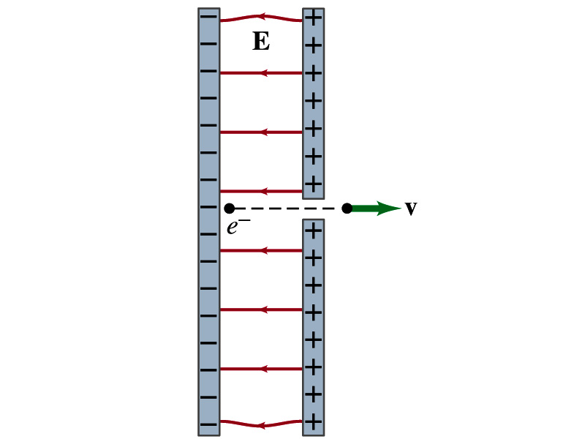
Reminder: Special Project #3
Particle Accelerator. A charged particle of mass M with charge -Q is accelerated in the uniform field E between two parallel charged plates whose separation is D as shown in the figure on the right. The charged particle is accelerated from an initial speed v₀ near the negative plate and passes through a tiny hole in the positive plate.
Derive the formula for the electric field E to accelerate the charged particle to a fraction f of the speed of light c. Express E in terms of M, Q, D, f, c and v₀.
(a) Using the Coulomb force and the kinematic equations. (8 points)
(b) Using the work-kinetic energy theorem. ( 8 points)
(c) Using the formula above, evaluate the strength of the electric field E to accelerate an electron from 0.1% of the speed of light to 90% of the speed of light. You need to look up and write down the relevant constants, such as mass of the electron, charge of the electron and the speed of light. (5 points)
Must be handwritten and not copied from anyone else!
Follow the SP naming convention: SP3-first-last-summer20.pdf which includes all pages in one file ➔ Be sure to write your name onto the project report!
Due beginning of the class this Wednesday, June 24

Slide 4
Dielectrics
Capacitors have an insulating sheet of material, called dielectric, between the plates to
Increase breakdown voltage greater than that in air (3MV/m)
Apply higher voltage to the gap without the charge passing across
Allow the plates get closer together without touching
Increases capacitance ( recall C=ε₀A/d)
Increase the capacitance by the dielectric constant
Where C₀ is the intrinsic capacitance when the gap is vacuum

Slide 5
Dielectrics
The value of dielectric constant K varies depending on the material (Table 24 – 1)
K for vacuum is 1.0000
K for air is 1.0006 (this is why the permittivity of air and vacuum are used interchangeably.)
K for paper is 3.7
Maximum electric field before breakdown occurs is called the dielectric strength. What is its unit?
V/m
The capacitance of a parallel plate capacitor with a dielectric (K) filling the gap is

Slide 6
Dielectrics
A new quantity of the permittivity of a dielectric material is defined as ε=Kε₀
The capacitance of a parallel plate capacitor with a dielectric medium filling the gap is
The energy density stored in an electric field E in a dielectric is
Valid for any space w/ dielectric w/ permittivity ε.
What is the stored energy in between ProtoDUNE cathode (-300kV) plate (6mx6m) and the cryostat wall (0V), d=1.5m, LAr K=1.5?

Slide 7
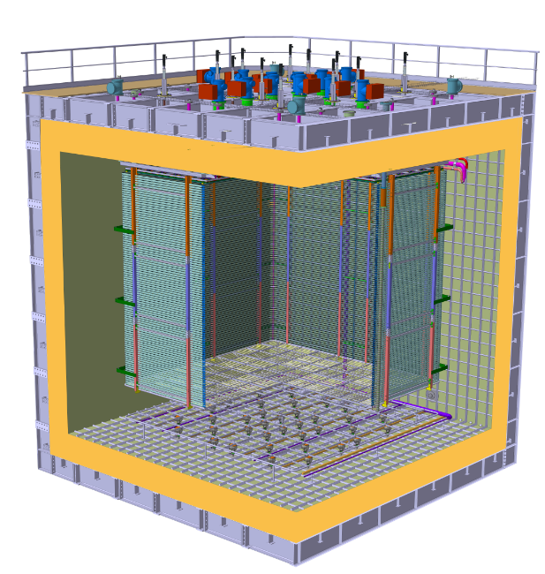
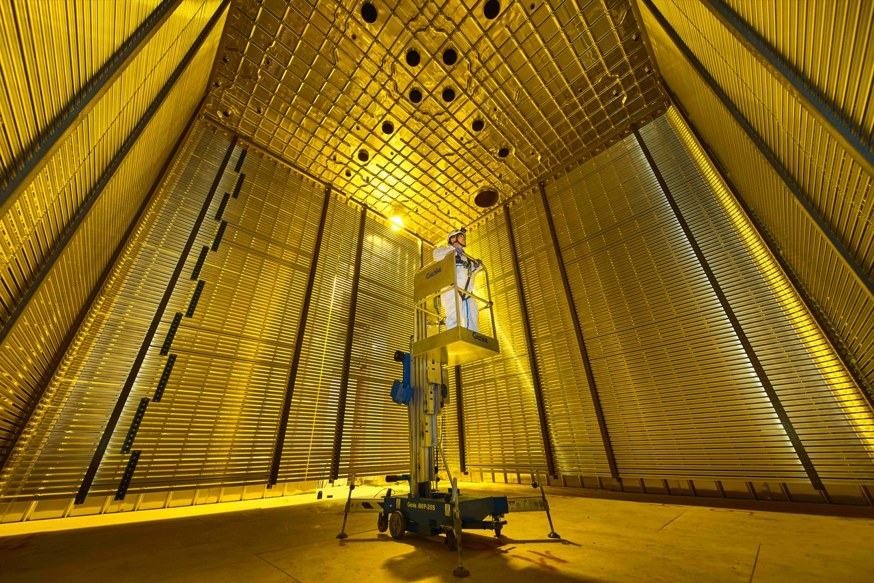
ProtoDUNE Dual Phase
Calculate the capacitance between each of the side wall to the FC & the cathode to the ground grid
Calculate the total energy stored in the capacitors
ε_{LAr} =1.5 ε₀
Charge Readout Planes
6 m
Field Cage (common structural elements with SP)
1 m
0.75 m
Cathode
6 m

Slide 8
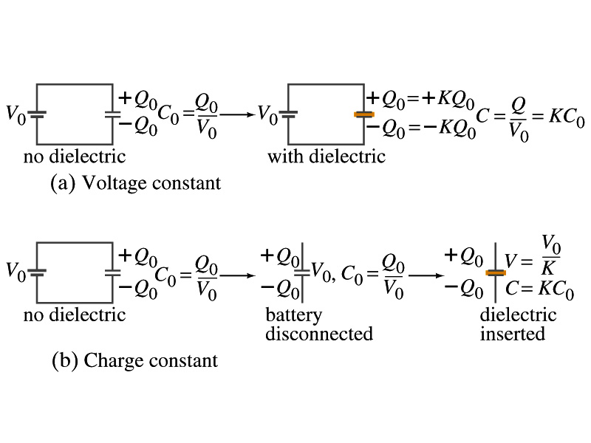
Effect of a Dielectric Material on Capacitance
Let’s consider the two cases below:
Case #1 : constant V
Case #2 : constant Q
Constant voltage: Experimentally observed that the total charge on each plate of the capacitor increases by K as a dielectric material is inserted between the gap ➔ Q=KQ₀
The capacitance increased to C=Q/V₀=KQ₀/V₀=KC₀
Constant charge: Voltage found to drop by a factor K ➔ V=V₀/K
The capacitance increased to C=Q₀/V=KQ₀/V₀=KC₀

Slide 9
Effect of a Dielectric Material on Field
What happens to the electric field within a dielectric?
Without a dielectric, the field is
What are V₀ and d?
V₀: Potential difference between the two plates
d: separation between the two plates
For the constant voltage, the electric field remains the same
For the constant charge: the voltage drops to V=V₀/K, thus the field in the dielectric is
The field in the dielectric is reduced.

Slide 10
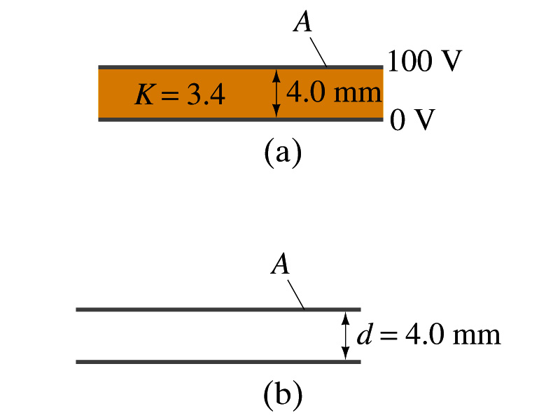
Example 24 – 11
Dielectric Removal: A parallel-plate capacitor, filled with the dielectric of K=3.4, is connected to a 100-V battery. After the capacitor is fully charged, the battery is disconnected. The plates have area A=4.0m², and are separated by d=4.0mm. (a) Find the capacitance, the charge on the capacitor, the electric field strength, and the energy stored in the capacitor. (b) The dielectric is carefully removed, without changing the plate separation nor does any charge leaving the capacitor. Find the new value of capacitance, electric field strength, voltage between the plates and the energy stored in the capacitor.
(a)

Slide 11
Example 24 – 11 cont’d
(b)
Since the dielectric has been removed, the effect of dielectric constant must be removed as well.
Since charge is the same ( ) before and after the removal of the dielectric, we obtain
Wrong!
Where did the extra energy come from?
The energy conservation law is violated in electricity???
Wrong!
Wrong!
An external force has done the work of 3.6x10⁻⁴J on the system to remove dielectric!!

Slide 12
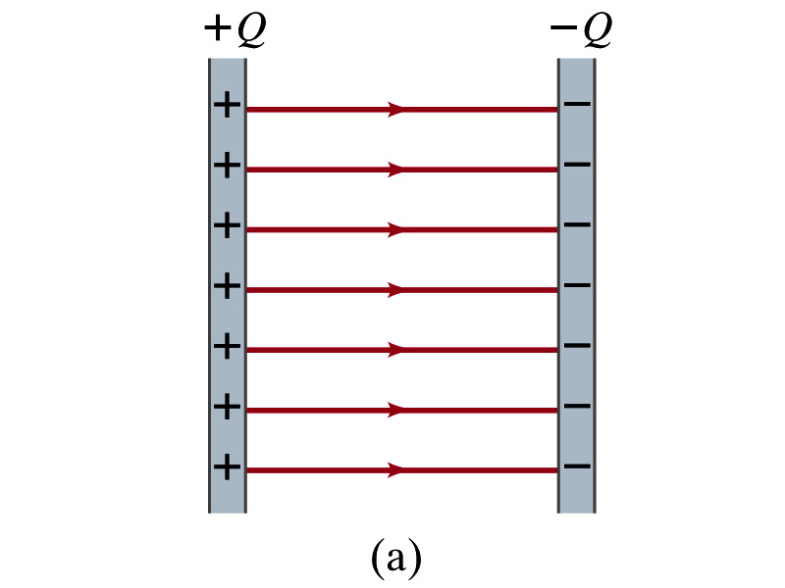
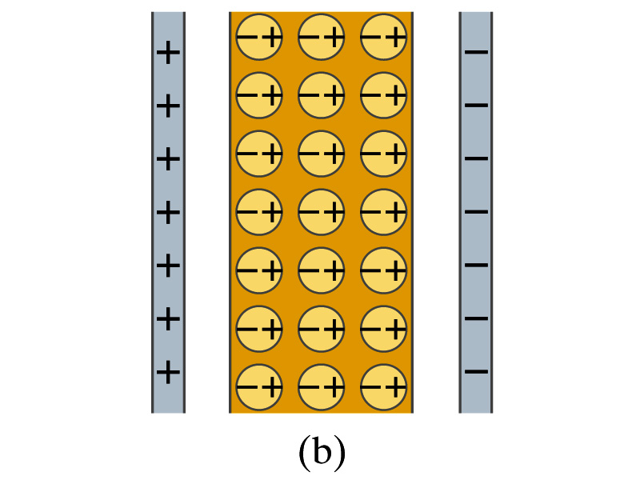
Molecular Description of Dielectric
So what in the world makes dielectrics behave the way they do?
We need to examine this in a microscopic scale.
Let’s consider a parallel plate capacitor that is charged up +Q(=C₀V₀) and –Q with air in between.
Assume there is no way any charge can flow in or out
Now insert a dielectric
Dielectric can be polar ➔ could have permanent dipole moment. What will happen?
Due to the electric field molecules will be aligned.

Slide 13
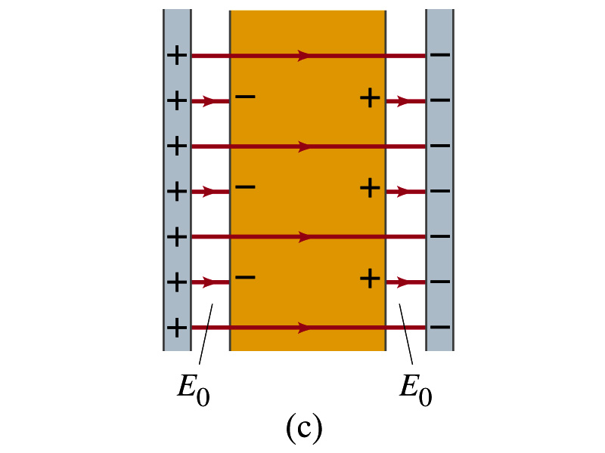
Molecular Description of Dielectric
OK. Then what happens?
Then effectively, there will be some negative charges close to the surface of the positive plate and positive charge on the negative plate
Some electric field do not pass through the whole dielectric but stops at the negative charge
So the field inside dielectric is smaller than in air
Since electric field is smaller, the force is smaller
The work need to move a test charge inside the dielectric is smaller
Thus the potential difference across the dielectric is smaller than across the air

Slide 14
Electric Current and Resistance
So far we have been studying static electricity
What is the static electricity?
The charges so far has not been moving but staying put at the location they are placed.
Now we will learn dynamics of electricity
What is the electric current?
A flow of electric charge
A few examples of the things that use electric current in everyday lives?
In an electrostatic situation, there is no electric field inside a conductor but when there is current, there is field inside a conductor. Why?
Electric field is needed to keep charges moving

Slide 15
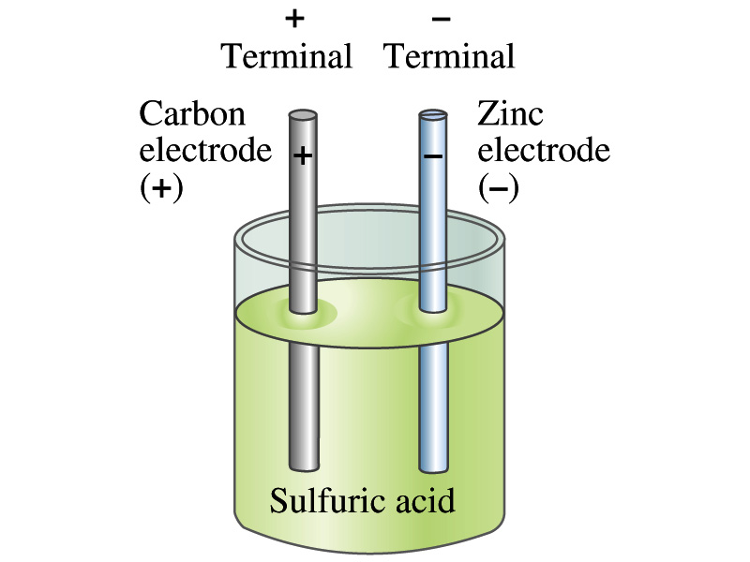
The Electric Battery
What is a battery?
A device that produces electrical energy from the stored chemical energy and produces electricity ➔ Maintains potential difference!
Electric battery was invented by Volta in late 1790s in Italy
It was made of disks of zinc and silver w/ salt-water soaked clothes based on his research that certain combinations of materials produce a greater electromotive force (emf), or potential, than others
Piles (or a battery) of these connected to make up the first battery!
Simplest batteries contain two plates made of dissimilar metals called electrodes
Electrodes are immersed in a solution, the electrolyte
This unit is called a cell and many of these form a battery
Zinc and Iron in the figure are called terminals

Slide 16
How does a battery work – I?
One of the electrodes in the figure is zinc and the other carbon
The acid electrolyte reacts with the zinc electrode and dissolves it.
Each zinc atom leaves two electrons in the electrode and enters into the solution as a positive ion ➔ zinc electrode acquires negative charge and the electrolyte (the solution) becomes positively charged
The carbon electrode picks up the positive charge
Since the two terminals are oppositely charged, there is a potential difference between them

Slide 17
How does a battery work – II?
When the terminals are not connected, only the necessary amount of zinc is dissolved into the solution.
How is the particular potential difference maintained?
If the terminals are not connected, as too many zinc ions get produced,
zinc electrode gets increasingly charged up negative
zinc ions get recombined with the electrons in zinc electrode
Why does battery go dead?
When the terminals are connected to a circuit, the negative charges will flow away from the zinc electrode
More zinc atoms dissolve into the electrolyte to produce more charge
One or more electrode get used up not producing any more charge.

Slide 18
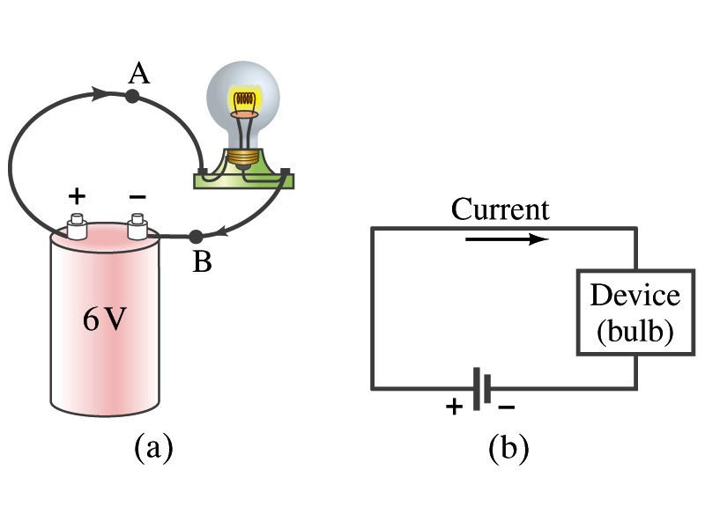
Electric Current
When a circuit is powered by a battery (or a source of emf) the charge can flow through the circuit.
Electric Current: Any flow of charge
Current can flow whenever there is a potential difference between the ends of a conductor (or when the two ends have opposite charges)
The current can flow even through the empty space under certain conditions
Electric current in a wire can be defined as the net amount of charge that passes through the wire’s full cross section at any point per unit time (just like the flow of water through a conduit.)
Average current is defined as:
The instantaneous current is:
What kind of a quantity is the current? (poll 1)
Unit (Poll10)?
C/s
1A=1C/s
Scalar
In a single circuit, conservation of electric charge guarantees that the current at one point of the circuit is the same as any other points on the circuit.

Slide 19
Example 25 – 1
Current is a flow of charge: A steady current of 2.5A flows in a wire for 4.0min. (a) How much charge passed by any point in the circuit? (b) How many electrons would this be?
Current is total amount charge flown through a circuit in a given time. So from we obtain
The total number of electrons passed through the circuit is

Slide 20
Example 25 – 1
Current is a flow of charge: A steady current of 2.5A flows in a wire for 4.0min. (a) How much charge passed by any point in the circuit? (b) How many electrons would this be?
Current is total amount charge flown through a circuit in a given time. So from we obtain
The total number of electrons passed through the circuit is

Slide 21
Direction of the Electric Current
What do conductors have in abundance?
Free electrons
What happens if a continuous loop of conducting wire is connected to the terminals of a battery?
Electrons start flowing through the wire continuously as soon as both the terminals are connected to the wire. Why?
The potential difference between the battery terminals sets up an electric field inside the wire and in the direction parallel to it
Free electrons in the conducting wire get attracted to the positive terminal
The electrons leaving negative terminal flow through the wire and arrive at the positive terminal
Electrons flow from negative to positive terminal
Due to historical convention, the direction of the current is opposite to the direction of flow of electrons ➔ Conventional Current

Slide 22
Ohm’s Law: Resistance and Resistors
What do we need to produce electric current?
Potential difference
Georg S. Ohm experimentally established that the current is proportional to the potential difference ( )
If we connect a wire to a 12V battery, the current flowing through the wire is twice that of 6V, three times that of 4V and four times that of a 3V battery.
What happens if we reverse the sign of the voltage?
It changes the direction of the current flow
Does not change the magnitude of the current
Just as in water flow case, if the height difference is large the flow rate is large ➔ If the potential difference is large, the current is large.

Slide 23
Ohm’s Law: Resistance
The exact amount of current flow in a wire depends on
The voltage
The resistance of the wire to the flow of electrons
Just like the gunk in water pipe slows down water flow
Electrons are slowed down due to interactions with the atoms of the wire
The higher the resistance the less the current for the given potential difference V
So how would you define resistance?
Such that current is inversely proportional to the resistance
Often it is rewritten as
What does this mean?
The metal conductor’s resistance R is a constant independent of V.
This linear relationship is not valid for some materials like diodes, vacuum tubes, transistors etc. ➔ These are called non-ohmic
Unit?
Ohm’s Law
ohms

Slide 24
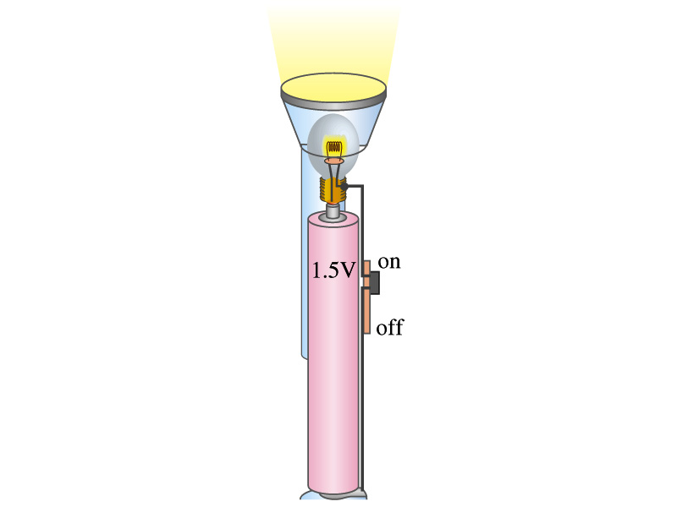
Example 25 – 4
Flashlight bulb resistance: A small flashlight bulb draws 300mA from its 1.5V battery. (a) What is the resistance of the bulb? (b) If the voltage drops to 1.2V, how would the current change?
From Ohm’s law, we obtain
Would the current increase or decrease, if the voltage reduces to 1.2V?
If the resistance did not change, the current is

Slide 25
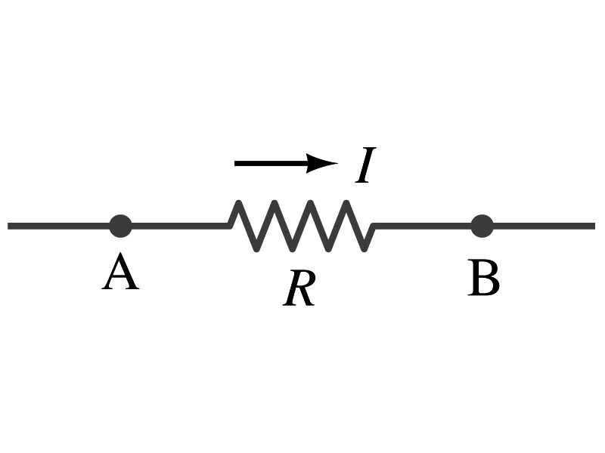
Ohm’s Law: Resistors
All electric devices offer a resistance to the flow of current.
Filaments of light bulbs or heaters are wires with high resistance to cause electrons to lose their energy in the wire
In general connecting wires have low resistance compared to other devices on the circuit
In circuits, resistors are used to control the amount of current
Resistors offer resistance of less than one ohm to millions of ohms
Main types are
“wire-wound” resistors which consists of a coil of fine wire
“composition” resistors which are usually made of semiconductor carbon
thin metal films
When drawn in the circuit, the symbol for a resistor is:
Wires are drawn simply as straight lines

Slide 26
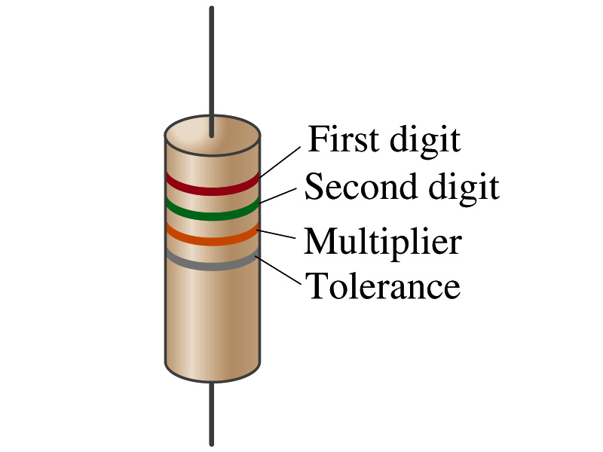
Ohm’s Law: Resistor Values
Resistors have its resistance color-coded on its body
The color-coding follows the convention below:
Color | Number | Multiplier | Tolerance
Black | 0 | 1=10⁰
Brown | 1 | 10¹
Red | 2 | 10²
Orange | 3 | 10³
Yellow | 4 | 10⁴
Green | 5 | 10⁵
Blue | 6 | 10⁶
Violet | 7 | 10⁷
Gray | 8 | 10⁸
White | 9 | 10⁹
Gold |  | 10-¹ | 5%
Silver |  | 10⁻² | 10%
None |  |  | 20%
What is the resistance of the resistor in this figure?

Slide 27
Resistivity
It is experimentally found that the resistance R of a metal wire is directly proportional to its length l and inversely proportional to its cross-sectional area A
How would you formularize this?
The proportionality constant ρ is called the resistivity and depends on the material used. What is the unit of this constant?
ohm-m or Ω−m
The values depends on purity, heat treatment, temperature, etc
How would you interpret the resistivity?
The higher the resistivity the higher the resistance
The lower the resistivity the lower the resistance and the higher the conductivity ➔ Silver has the lowest resistivity.
So the silver is the best conductor
The reciprocal of the resistivity is called the conductivity, σ,
A
l

Slide 28
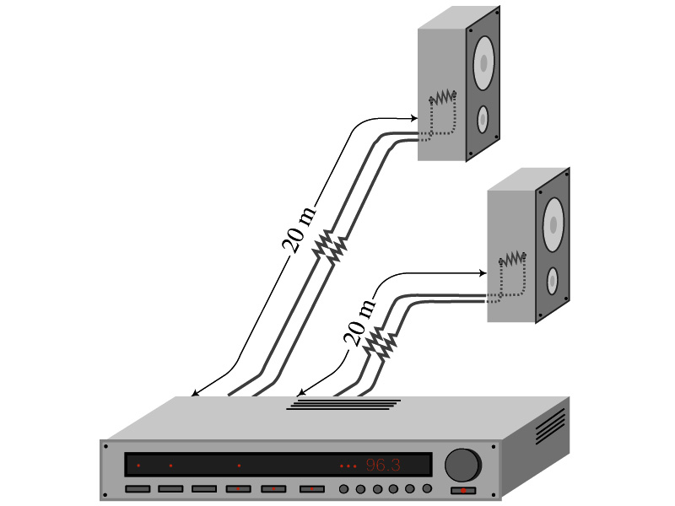
Example 25 – 5
Speaker wires: Suppose you want to connect your stereo to remote speakers. (a) If each wire must be 20m long, what diameter copper wire should you use to keep the resistance less than 0.1-Ω per wire? (b) If the current on each speaker is 4.0A, what is the voltage drop across each wire?
The resistivity of a copper is
Table 25.1
From the formula for resistance, we can obtain the formula for area
Solve for A
Solve for d
From Ohm’s law, V=IR, we obtain

Slide 29
Example 25 – 6
Stretching changes resistance: A wire of resistance R is stretched uniformly until it is twice its original length. What happens to its resistance?
What is the constant quantity in this problem?
The volume!
What is the volume of a cylinder of length L and radius r?
What happens to A if L increases factor two, L’=2L?
The cross-sectional area, A, halves. A’=A/2
The original resistance is
The new resistance is
The resistance of the wire increases by a factor of four if the length increases twice.

Slide 30
Temperature Dependence of Resistivity
Do you think the resistivity depends on temperature?
Yes
Would it increase or decrease with the temperature?
Increase
Why?
Because the atoms are vibrating more rapidly as temperature increases and are arranged in a less orderly fashion. So?
They interfere more with the flow of electrons.
If the temperature change is not too large, the resistivity of metals usually increase nearly linearly w/ temperature
α is the temperature coefficient of resistivity
α of some semiconductors can be negative due to increased number of freed electrons.

