Slide 1
PHYS 1441 – Section 001 Lecture #10
Tuesday, June 23, 2020
Dr. Jaehoon Yu
Chapter 25
Electric Power
Alternating Current
Microscopic View of Electric Current
Ohm’s Law in Microscopic View
EMF and Terminal Voltage

Slide 2
Announcements
We will have a mid-term grade discussion Thursday, June 25. We will have a class till 11:30am, followed by the discussion on zoom➔ Need to figure out how to do this in a sufficiently private manner
Last name A – K:11:30 – 12:00
Last name L – Y: 12:00 – 12:30
Warning: I will mark those of you still connected at the end of the class but not answering to my call missing the class

Slide 3
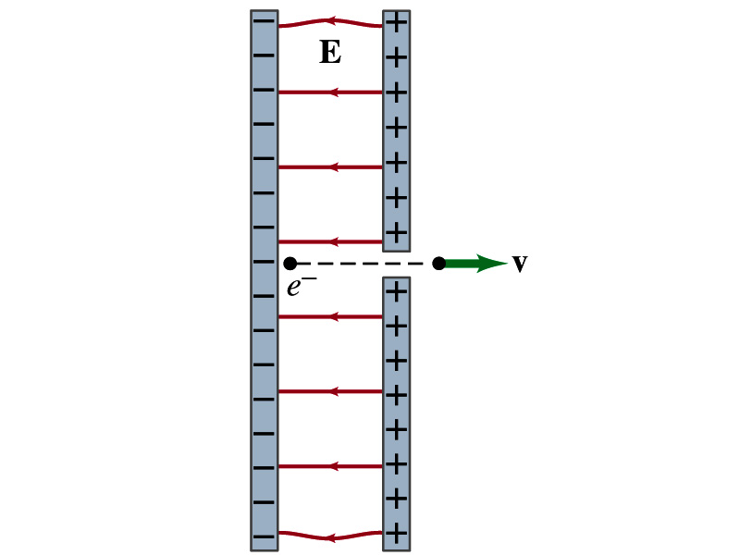
Reminder: Special Project #3
Particle Accelerator. A charged particle of mass M with charge -Q is accelerated in the uniform field E between two parallel charged plates whose separation is D as shown in the figure on the right. The charged particle is accelerated from an initial speed v₀ near the negative plate and passes through a tiny hole in the positive plate.
Derive the formula for the electric field E to accelerate the charged particle to a fraction f of the speed of light c. Express E in terms of M, Q, D, f, c and v₀.
(a) Using the Coulomb force and the kinematic equations. (8 points)
(b) Using the work-kinetic energy theorem. ( 8 points)
(c) Using the formula above, evaluate the strength of the electric field E to accelerate an electron from 0.1% of the speed of light to 90% of the speed of light. You need to look up and write down the relevant constants, such as mass of the electron, charge of the electron and the speed of light. (5 points)
Must be handwritten and not copied from anyone else!
Follow the SP naming convention: SP3-first-last-summer20.pdf which includes all pages in one file ➔ Be sure to write your name onto the project report!
Due beginning of the class tomorrow, Wednesday, June 24

Slide 4
Special Project #4
Make a list of the power consumption and the resistance of all electric and electronic devices at your home and compile them in a table. (10 points total for the first 10 items and 0.5 points each additional item.)
Estimate the cost of electricity for each of the items on the table using your own electric cost per kWh (if you don’t find your own, use $0.12/kWh) and put them in the relevant column. (5 points total for the first 10 items and 0.2 points each additional items)
Estimate the the total amount of energy in Joules and the total electricity cost per day, per month and per year for your home. (8 points)
Due: Beginning of the class Tuesday, June 30
Scan all pages of your special project into the pdf format
Save all pages into one file with the filename SP4-YourLastName-YourFirstName.pdf
Send me the file in an email with the subject SP4 Submission

Slide 5
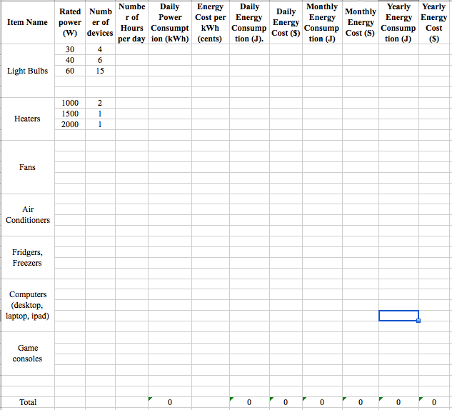

Slide 6
Temperature Dependence of Resistivity
Do you think the resistivity depends on temperature?
Yes
Would it increase or decrease with the temperature? (Poll 11)
Increase
Why?
Because the atoms are vibrating more rapidly as temperature increases and are arranged in a less orderly fashion. So?
They interfere more with the flow of electrons.
If the temperature change is not too large, the resistivity of metals usually increase nearly linearly w/ temperature
α is the temperature coefficient of resistivity
α of some semiconductors can be negative due to increased number of freed electrons.

Slide 7
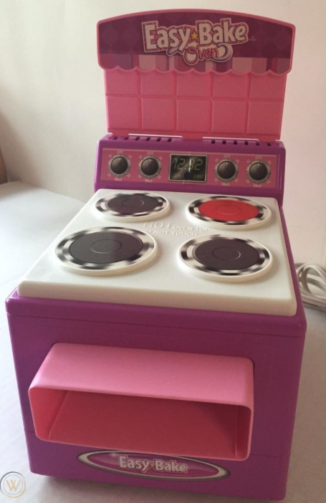
Electric Power
Why is the electric energy useful?
It can transform into different forms of energy easily.
Motors, pumps, etc, transform electric energy to mechanical energy
Heaters, dryers, cook-tops, etc, transforms electricity to thermal energy
Incandescent light bulb filament transforms electric energy to light
Only about 10% of the energy turns to light and the 90% lost via heat
Typical household light bulb and heating elements have resistance of order a few ohms to a few hundred ohms
How does electric energy transforms to thermal energy?
Flowing electrons collide with the vibrating atoms of the wire.
In each collision, part of electron’s kinetic energy is transferred to the atom it collides with.
The kinetic energy of wire’s atoms increases, and thus the temperature of the wire increases.
The increased thermal energy can be transferred as heat through conduction and convection to the air in a heater or to food on a pan, through radiation to bread in a toaster or radiated as light.

Slide 8
Electric Power
How do we find out the power transformed by an electric device?
What is definition of the power?
The rate at which work is done or the energy is transformed
What is the energy transformed when an infinitesimal charge dq moves through a potential difference V?
dU=Vdq
If dt is the time required for an amount of charge dq to move through the potential difference V, the power P is
Thus, we obtain .
What is the unit? (Poll 10)
What kind of quantity is the electrical power? (Poll 1)
Scalar
P=IV can apply to any devices while the formula with resistance can only apply to devices that have resistance.
What is this?
In terms of resistance
Watts = J/s

Slide 9
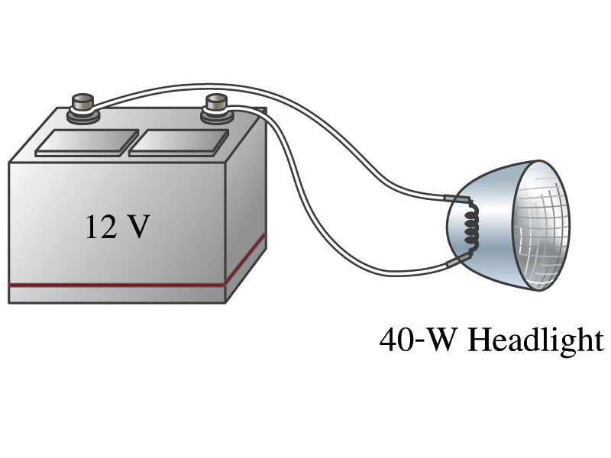
Example 25 – 8
Headlights: Calculate the resistance of a 40-W automobile headlight designed for 12V.
Since the power is 40W and the voltage is 12V, we use the formula with V and R.
Solve for R

Slide 10
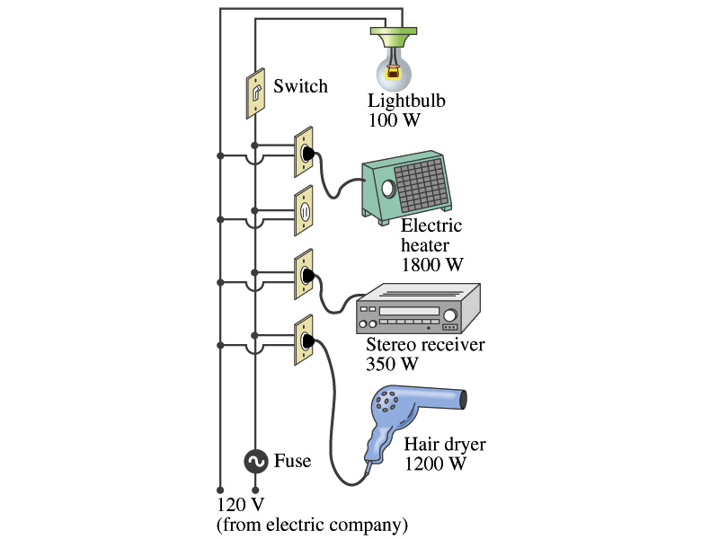
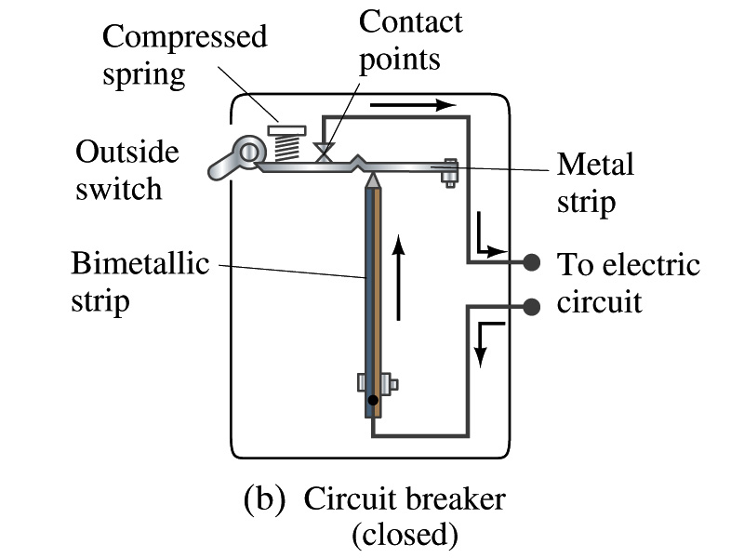
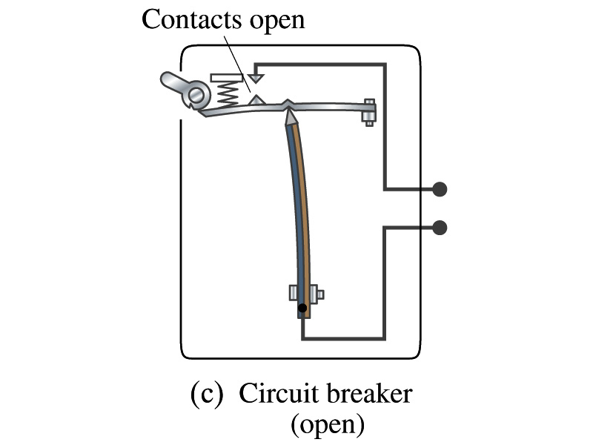
Power in Household Circuits
Household devices usually have small resistance
But since they draw current, if they become large enough, wires can heat up (overloaded)
Why is using thicker wires safer?
Thicker wire has less resistance, lower heat
Overloaded wire can set off a fire at home
How do we prevent this?
Put in a switch that would disconnect the circuit when overloaded
Fuse or circuit breakers
They open up the circuit when the current is over certain value
Overload

Slide 11
Example 25 – 11
Will the fuse blow?: Determine the total current drawn by all the devices in the circuit in the figure.
The total current is the sum of current drawn by individual device.
Solve for I
Bulb
Heater
Stereo
Dryer
Total current
What is the total power?

