Slide 1
PHYS 1441 – Section 001 Lecture #11
Wednesday, June 24, 2020
Dr. Jaehoon Yu
Chapter 25
Alternating Current
Microscopic View of Electric Current
Ohm’s Law in Microscopic View
CH 26
EMF and Terminal Voltage
Resistors in Series and Parallel
Today’s homework is homework #6, due 11pm, Monday, June 29!!

Slide 2
Announcements
We will have a mid-term grade discussion tomorrow, Thursday, June 25. We will have a class till 11:30am, followed by the discussion on zoom
Will use breakout rooms, one student in each room (must stay connected to zoom!)
Last name A – K:11:30 – 12:00
Last name L – Y: 12:00 – 12:30
Quiz #3 on Quest
Beginning of the class coming Monday, June 29
Covers CH25.4 – what we finish tomorrow
BYOF
Mid-term exam results
Class average: 55.2/102
Equivalent to 54.1/100 (Term 1: 63.4/100)
Top score: 102/102
Warning: I will mark those of you still connected at the end of the class but not answering to my call missing the class

Slide 3
Reminder: Special Project #4
Make a list of the power consumption and the resistance of all electric and electronic devices at your home and compile them in a table. (10 points total for the first 10 items and 0.5 points each additional item.)
Estimate the cost of electricity for each of the items on the table using your own electric cost per kWh (if you don’t find your own, use $0.12/kWh) and put them in the relevant column. (5 points total for the first 10 items and 0.2 points each additional items)
Estimate the the total amount of energy in Joules and the total electricity cost per day, per month and per year for your home. (8 points)
Due: Beginning of the class Tuesday, June 30
Scan all pages of your special project into the pdf format
Save all pages into one file with the filename SP4-YourLastName-YourFirstName.pdf
Send me the file in an email with the subject SP4 Submission

Slide 4
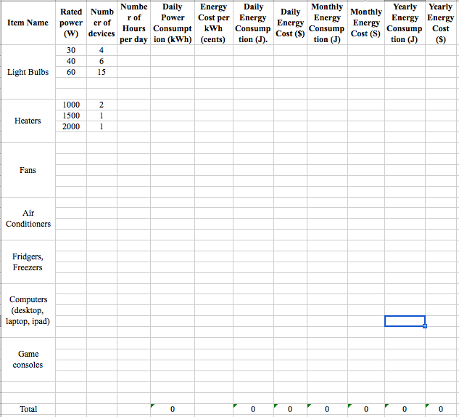

Slide 5
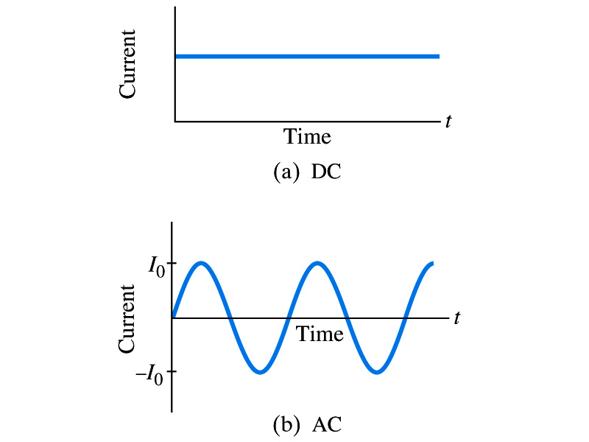
Alternating Current
Does the direction of the flow of current change while a battery is connected to a circuit?
No. Why?
Because its source of potential difference stays put.
This kind of current is called the Direct Current (DC), and it does not change its direction of flow while the battery is connected.
How would DC look as a function of time? (poll 12)
A straight line
Electric generators at electric power plant produce alternating current (AC)
AC reverses direction many times a second (poll 12)
AC is sinusoidal as a function of time
Most the currents supplied to homes and business are AC.

Slide 6
The Alternating Current
The voltage produced by an AC electric generator is sinusoidal (whose law? Poll 13)
This is why the current is sinusoidal
Voltage produced can be written as
What are the maximum and minimum voltages?
V₀ (–V₀) and 0
The potential oscillates between +V₀ and –V₀, the peak voltages or amplitude
What is f?
The frequency, the number of complete oscillations made per second. What is the unit of f? What is the normal size of f in the US?
f=60Hz in the US and Canada.
Many European countries have f=50Hz.
ω=2πf

Slide 7
Alternating Current
Since V=IR, if a voltage V exists across a resistance R, the current I is (poll 13)
What are the maximum and minimum currents?
I₀ (–I₀) and 0.
The current oscillates between +I₀ and –I₀, the peak currents or amplitude. The current is positive when electron flows to one direction and negative when they flow opposite.
AC is as many times positive as negative. What’s the average current?
Zero. So there is no power and no heat is produced in a heater?
Yes there is! The electrons actually flow back and forth, so power is delivered.
What is this?

Slide 8
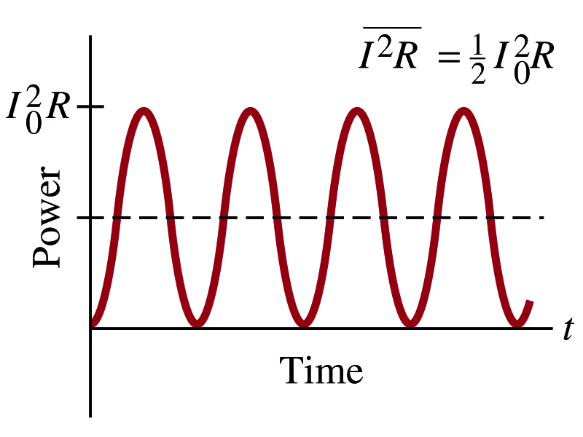
Power Delivered by Alternating Current
AC power delivered to a resistance is:
Since the current is squared, the power is always positive
The average power delivered is
Since the power is also P=V²/R, we can obtain
The average of the square of current and voltage are important in calculating power:
Average power

Slide 9
Power Delivered by Alternating Current
The square root of each of these are called root-mean-square, or rms:
rms values are sometimes called the effective values
These are useful quantities since they can substitute current and voltage directly in power, as if they are in DC
In other words, an AC of peak voltage V₀ or peak current I₀ produces as much power as DC voltage of V_{rms} or DC current I_{rms}.
So normally, rms values in AC are specified or measured.
US uses 115V rms voltage. What is the peak voltage?
Europe uses 240V

Slide 10
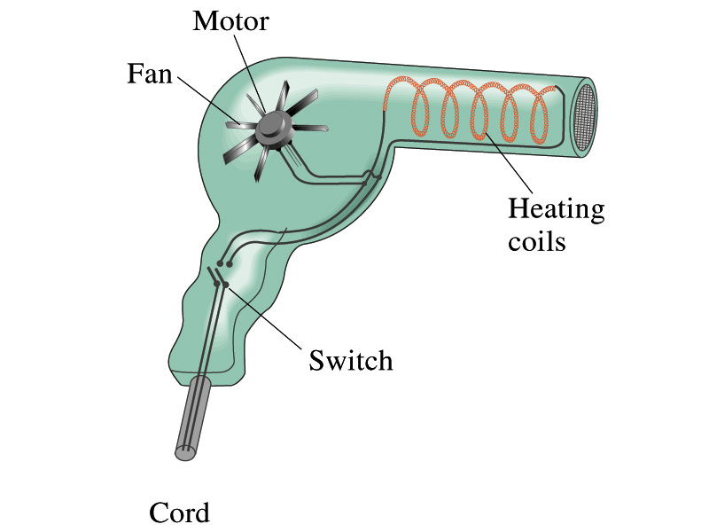
Example 25 – 13
Hair Dryer. (a) Calculate the resistance and the peak current in a 1000-W hair dryer connected to a 120-V AC line. (b) What happens if it is connected to a 240-V line in Britain?
The rms current is:
The peak current is:
Thus the resistance is:
(b) If connected to 240V in Britain …
The average power provide by the AC in UK is
So?
The heating coils in the dryer will melt!

Slide 11
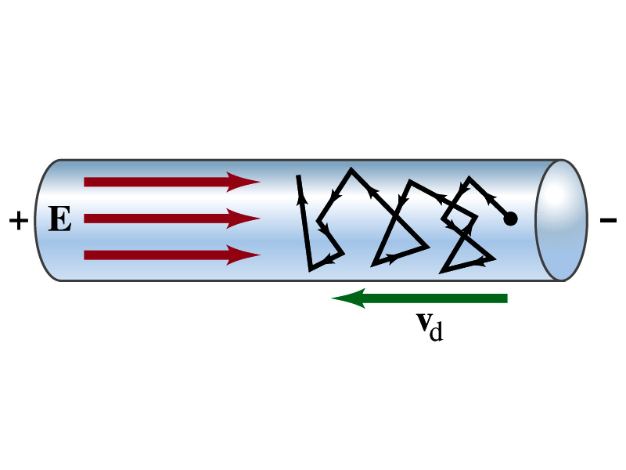
Microscopic View of Electric Current
When voltage is applied across the ends of a wire
Electric field is generated by the potential difference
Electrons feel the force and get accelerated
Electrons soon reach to a steady average speed due to collisions with atoms in the wire, called drift velocity, v_{d}
The drift velocity is normally much smaller than electrons’ average random speed.

Slide 12
Microscopic View of Electric Current
The drift velocity of electrons in a wire is only about 0.05mm/s. How could we get light turned on immediately then?
While the electrons in the wire travels slow, the electric field travels essentially at the speed of light. Then what is all the talk about electrons flowing through?
It is just like water. When you turn on the facet, water flows right off the facet despite the fact that the water travels slow.
Electricity is the same. Electrons fill the conductor wire and when the switch is flipped on or a potential difference is applied, the electrons close to the positive terminal flows into the bulb.
Interesting, isn’t it? Why is the field travel at the speed of light then?

Slide 13
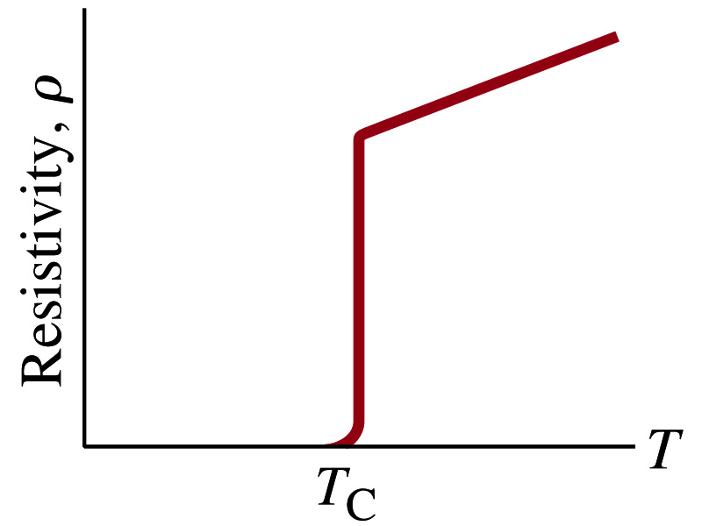
Superconductivity
At the temperature near absolute 0K, resistivity of certain material becomes 0.
This state is called the “superconducting” state.
Observed in 1911 by H. K. Onnes when he cooled mercury to 4.2K (-269ºC).
Resistance of mercury suddenly dropped to 0.
In general superconducting materials become superconducting below a transition temperature (T_{c}).
The highest temperature superconductivity seen is 160K
First observation above the boiling temperature of liquid nitrogen is in 1987 at 90k observed from a compound of yttrium, barium, copper and oxygen.
Since much smaller amount of material can carry just as much current more efficiently, superconductivity can make electric cars more practical, computers faster, and capacitors store higher energy

Slide 14
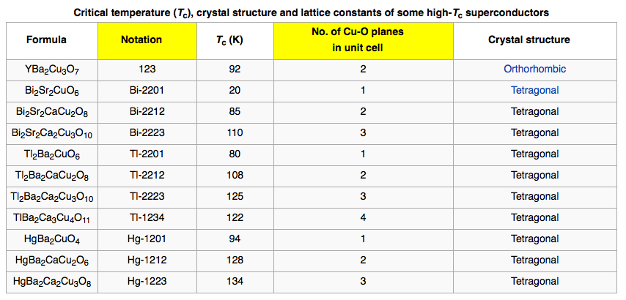
Critical Temperature of Superconductors

Slide 15
Electric Hazards: Leakage Currents
How does one feel shock by electricity?
Electric current stimulates nerves and muscles, and we feel a shock
The severity of the shock depends on the amount of current, how long it acts and through what part of the body it passes
Electric current heats the tissue and can cause burns
Currents above 70mA on a torso for a second or more is fatal, causing heart to function irregularly, “ventricular fibrillation”.
A dry human body between two points on the opposite side of the body is about 10⁴ to 10⁶ Ω.
But when wet, it could be 10³Ω.
A person in good contact with the ground who touches 120V DC line with wet hands can get the current:
Could be lethal

Slide 16
EMF and Terminal Voltage
What do we need to have current in an electric circuit?
A device that provides a potential difference, such as a battery or a generator
They normally convert some types of energy into the electric energy
These devices are called source of electromotive force (emf)
This is does NOT refer to a real “force”.
Potential difference between terminals of an emf source, when no current flows to an external circuit, is called the emf (E) of the source.
The battery itself has some internal resistance (r) due to the flow of charges in the electrolyte
Why does the headlight dim when you start the car?
The starter needs a large amount of current but the battery cannot provide charge fast enough to supply current to both the starter and the headlight

Slide 17
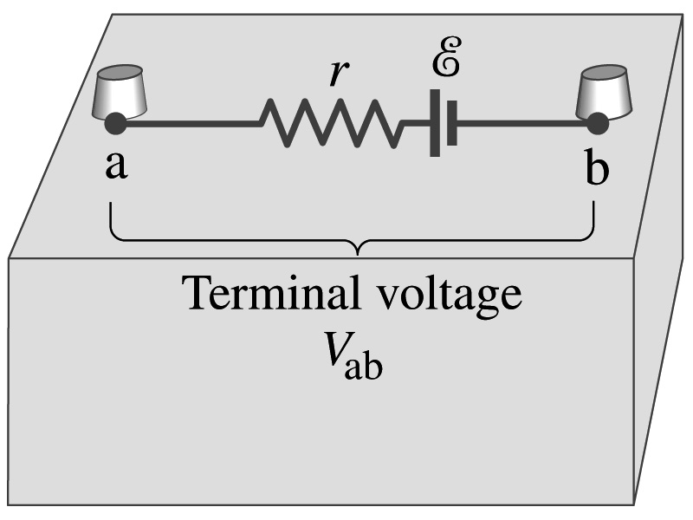
EMF and Terminal Voltage
Since the internal resistance is inside the battery, we can never separate them out.
So the terminal voltage difference is V_{ab}=V_{a}-V_{b}.
When no current is drawn from the battery, the terminal voltage equals the emf which is determined by the chemical reaction; V_{ab}= E.
However when the current I flows naturally from the battery, there is a voltage drop due to the internal resistance which is equal to Ir. Thus the actual delivered terminal voltage is

Slide 18
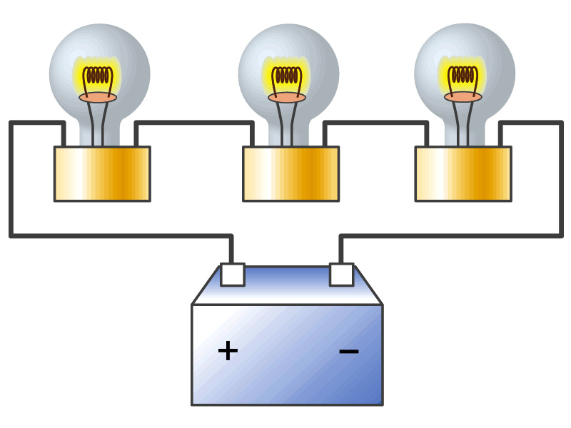
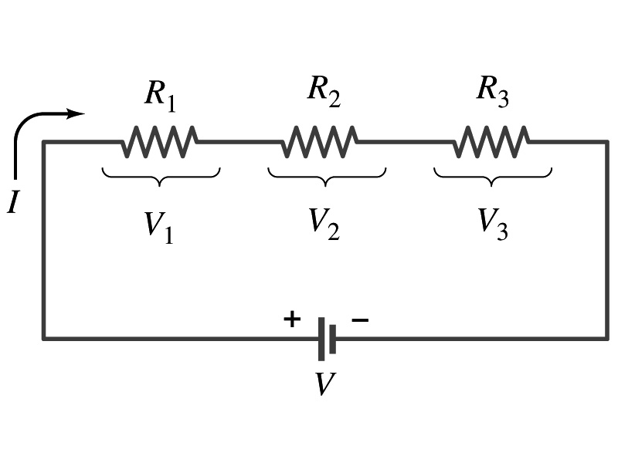
Resistors in Series
Resistors are in series when two or more resistors are connected end to end
These resistors represent simple resistors in circuit or electrical devices, such as light bulbs, heaters, dryers, etc
What is common in a circuit connected in series?
Current is the same through all the elements in series
Potential difference across every element in the circuit is
V₁=IR₁, V₂=IR₂ and V₃=IR₃
Since the total potential difference is V, we obtain
V=IR_{eq}=V₁+V₂+V₃=I(R₁+R₂+R₃)
Thus, R_{eq}=R₁+R₂+R₃
Resistors in series
When resistors are connected in series, the total resistance increases and the current decreases.

Slide 19
Energy Losses in Resistors
Why is it true that V=V₁+V₂+V₃?
What is the potential energy loss when charge q passes through resistors R₁, R₂ and R₃
ΔU₁=qV₁, ΔU₂=qV₂, ΔU₃=qV₃
Since the total energy loss should be the same as the total energy provided to the system, we obtain
ΔU=qV=ΔU₁+ΔU₂+ΔU₃=q(V₁+V₂+V₃)
Thus, V=V₁+V₂+V₃

Slide 20
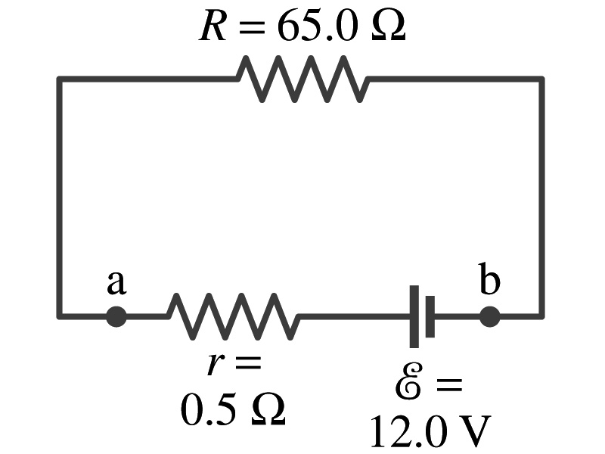
Example 26 – 1
Battery with internal resistance. A 65.0-Ω resistor is connected to the terminals of a battery whose emf is 12.0V and whose internal resistance is 0.5-Ω. Calculate (a) the current in the circuit, (b) the terminal voltage of the battery, V_{ab}, and (c) the power dissipated in the resistor R and in the battery’s internal resistor.
(a) Since
We obtain
What is this?
Solve for I
A battery or a source of emf.
(b) The terminal voltage V_{ab} is
(c) The power dissipated in R and r are

Slide 21
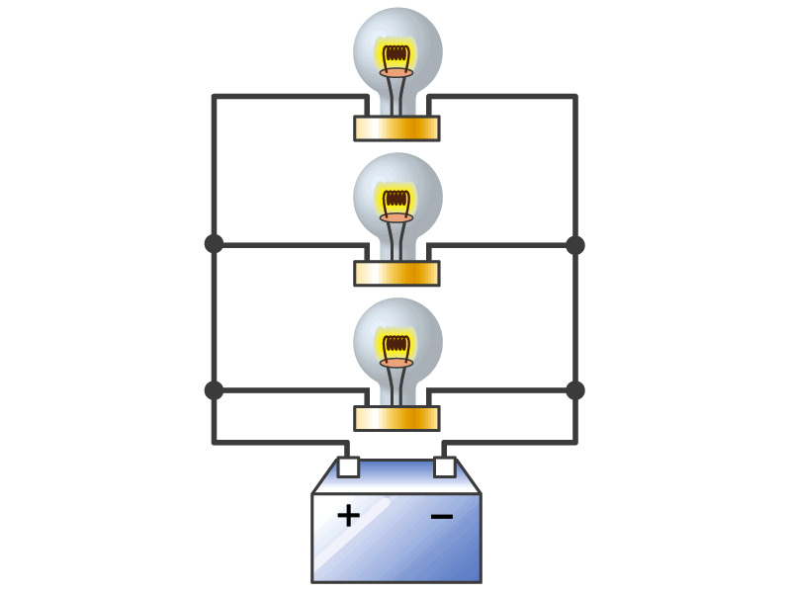
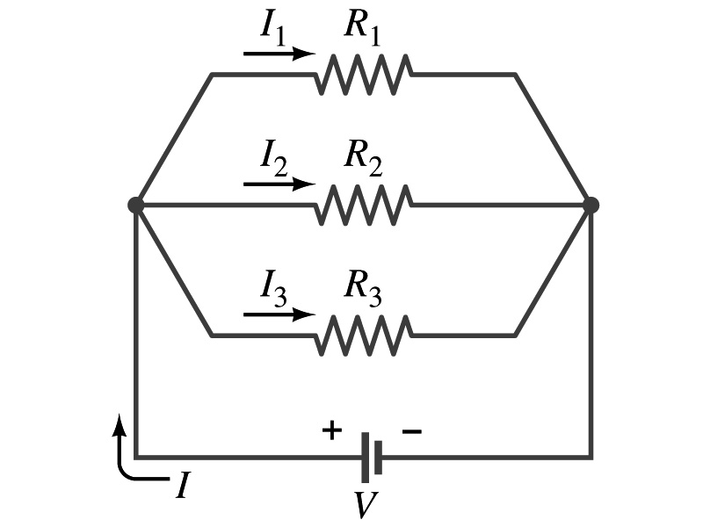
Resistors in Parallel
Resistors are in parallel when two or more resistors are connected in separate branches
Most the house and building wirings are arranged this way.
What is common in a circuit connected in parallel?
The voltage is the same across all the resistors.
The total current that leaves the battery, is however, split.
The current that passes through every element is
I₁=V/R₁, I₂=V/R₂, I₃=V/R₃
Since the total current is I, we obtain
I=V/R_{eq}=I₁+I₂+I₃=V(1/R₁+1/R₂+1/R₃)
Thus, 1/R_{eq}=1/R₁+1/R₂+1/R₃
resistors in parallel
When resistors are connected in parallel, the total resistance decreases and the current increases.

Slide 22
Resistor and Capacitor Arrangements
Parallel Capacitor arrangements
Parallel Resistor arrangements
Series Capacitor arrangements
Series Resistor arrangements

Slide 23
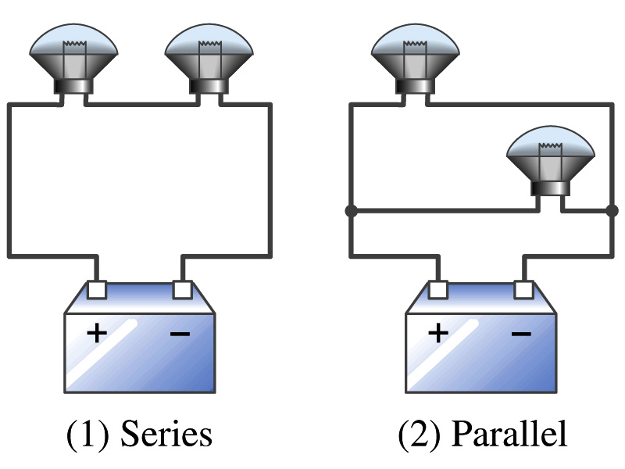
Example 26 – 2
Series or parallel? (a) The light bulbs in the figure are identical and have identical resistance R. Which configuration produces more light? (b) Which way do you think the headlights of a car are wired?
(a) What are the equivalent resistances for the two cases?
Series
Parallel
So
The bulbs get brighter when the total power transformed is larger.
series
parallel
So parallel circuit provides brighter lighting.
(b) Car’s headlights are in parallel to provide brighter lighting and also to prevent both lights going out at the same time when one burns out.
So what is bad about parallel circuits?
Uses more energy in a given time.

Slide 24
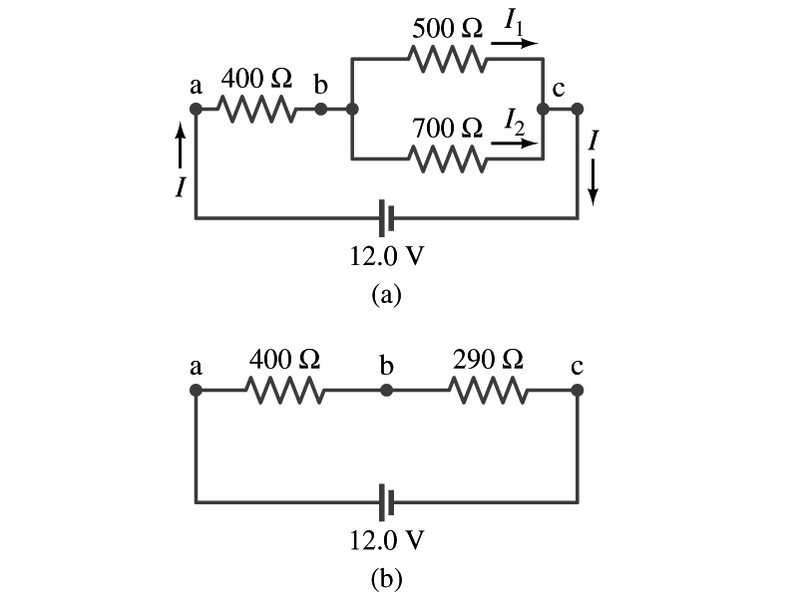
Example 26 – 5
Current in one branch. What is the current flowing through the 500-Ω resistor in the figure?
We need to find the total current.
What do we need to find first?
To do that we need to compute the equivalent resistance.
R_{eq} of the small parallel branch is:
R_{eq} of the circuit is:
Thus the total current in the circuit is
The voltage drop across the parallel branch is
The current flowing across 500-Ω resistor is therefore
What is the current flowing 700-Ω resistor?

