Slide 1
PHYS 1441 – Section 001 Lecture #12
Thursday, June 25, 2020
Dr. Jaehoon Yu
CH 26
That one example problem!
Kirchhoff’s Rules
EMFs in Series and Parallel
RC Circuits
CH 27: Magnetism and Magnetic Field
Electric Current and Magnetism
Magnetic Forces on Electric Current
About Magnetic Field

Slide 2
Announcements
We will have a mid-term grade discussion today ➔ We will have a class till 11:30am, followed by the discussion on zoom
Will use breakout rooms, one student in each room (must stay connected to zoom!)
Last name A – K:11:30 – 12:00
Last name L – Z: 12:00 – 12:30
Quiz #3 on Quest
Beginning of the class coming Monday, June 29
Covers CH25.4 – what we finish today (CH26.5?)
BYOF: You may bring a one 8.5x11.5 sheet (front and back) of handwritten formulae and values of constants for the exam
No derivations, word definitions, figures, pictures, arrows, or setups or solutions of any problems!
No additional formulae or values of constants will be provided!
Must send me the photos of front and back of the formula sheet, including the blank, no later than 10am tomorrow
Once submitted, you cannot change, unless I ask you to delete some part of the sheet!

Slide 3
Reminder: Special Project #4
Make a list of the power consumption and the resistance of all electric and electronic devices at your home and compile them in a table. (10 points total for the first 10 items and 0.5 points each additional item.)
Estimate the cost of electricity for each of the items on the table using your own electric cost per kWh (if you don’t find your own, use $0.12/kWh) and put them in the relevant column. (5 points total for the first 10 items and 0.2 points each additional items)
Estimate the the total amount of energy in Joules and the total electricity cost per day, per month and per year for your home. (8 points)
Due: Beginning of the class Tuesday, June 30
Scan all pages of your special project into the pdf format
Save all pages into one file with the filename SP4-YourLastName-YourFirstName.pdf
Send me the file in an email with the subject SP4 Submission

Slide 4
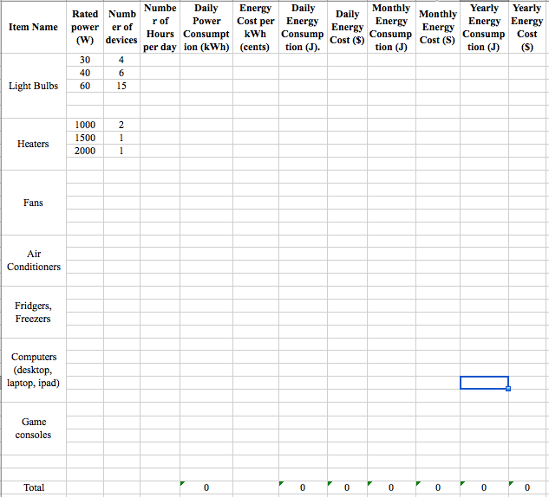

Slide 5
Resistor and Capacitor Arrangements
Parallel Capacitor arrangements
Parallel Resistor arrangements
Series Capacitor arrangements
Series Resistor arrangements

Slide 6
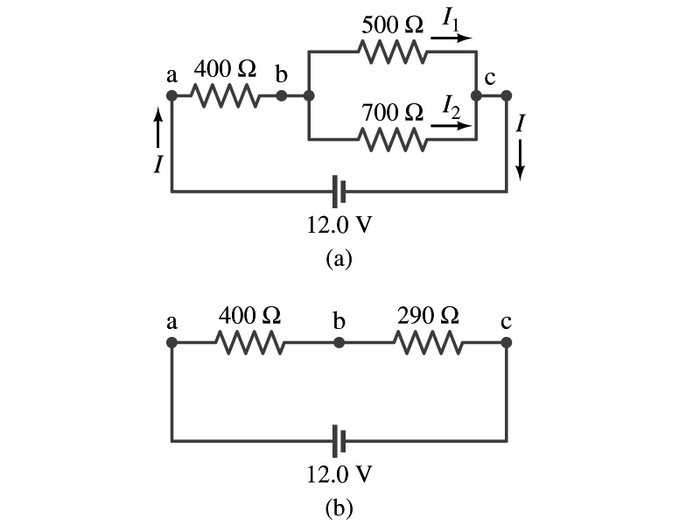
Example 26 – 5
Current in one branch. What is the current flowing through the 500-Ω resistor in the figure?
We need to find the total current.
What do we need to find first?
To do that we need to compute the equivalent resistance.
R_{eq} of the small parallel branch is:
R_{eq} of the circuit is:
Thus the total current in the circuit is
The voltage drop across the parallel branch is
The current flowing across 500-Ω resistor is therefore
What is the current flowing 700-Ω resistor?

Slide 7
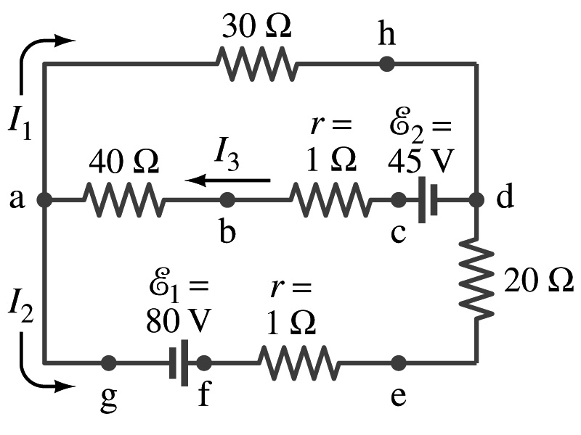
Kirchhoff’s Rules – the 1st Rule
Some circuits are very complicated to do the analysis using the simple combinations of resistors
G. R. Kirchhoff devised two rules to deal with complicated circuits.
Kirchhoff’s rules are based on conservation of charge and energy
Kirchhoff’s 1st rule: The junction rule, charge conservation.
At any junction point, the sum of all currents entering the junction must equal to the sum of all currents leaving the junction.
In other words, what goes in must come out.
At junction a in the figure, I₃ comes into the junction while I₁ and I₂ leaves: I₃ = I₁+ I₂

Slide 8
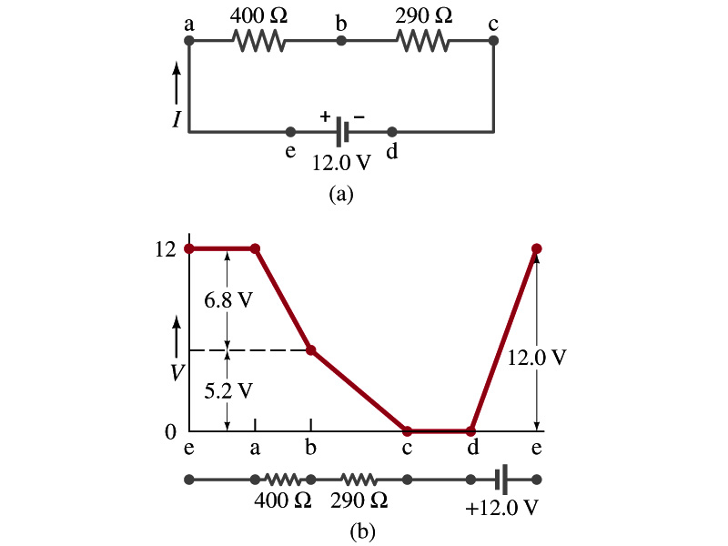
Kirchhoff’s Rules – the 2nd Rule
Kirchoff’s 2nd rule: The loop rule, Conservation of energy. (poll13)
The sum of the changes in potential in any closed path of a circuit must be zero.
I=12/690=0.017A
The current in the circuit in the figure is .
Point e is the high potential point while point d is the lowest potential.
When the test charge starts at e and returns to e, the total potential change is 0.
Between point e and a, no potential change since there is no source of potential nor any resistance.
Between a and b, there is a 400Ω resistance, causing drop.
Between b and c, there is a 290Ω resistance, causing drop.
Since these are voltage drops, we use negative sign for these, -6.8V and -5.2V.
No change between c and d while from d to e there is +12V change.
Thus the total change of the voltage through the loop is: .
IR=0.017*400=6.8V
IR=0.017*290=5.2V
-6.8V-5.2V+12V=0V

Slide 9
Using Kirchhoff’s Rules
Determine direction of the flow of currents at the junctions and label each and everyone of the currents.
It does not matter which direction, you decide but keep it!
If the value of the current after completing the calculations are negative, you just need to flip the direction of the current flow.
Write down the current equation based on Kirchhoff’s 1st rule at various junctions.
Be sure to see if any of equations are the same.
Choose closed loops in the circuit
Write down the potential in each interval of the junctions, keeping the sign properly.
Write down the potential equations for each loop.
Solve the equations for unknowns.

Slide 10
Example 26 – 9
Use Kirchhoff’s rules. Calculate the currents I₁, I₂ and I₃ in each of the branches of the circuit in the figure.
The directions of the current through the circuit is not known a priori but since the current tends to move away from the positive terminal of a battery, we arbitrarily choose the direction of the currents as shown.
We have three unknowns so we need three equations.
Using Kirchhoff’s junction rule at point a, we obtain
This is the same for junction d as well, so no additional information.
Now the second rule on the loop ahdcba.
The total voltage change in the loop ahdcba is.

Slide 11
Example 26 – 9, cnt’d
Now the second rule on the other loop agfedcba.
The total voltage change in loop agfedcba is.
So the three equations become
We can obtain the three current by solving these equations for I₁, I₂ and I₃.
Do this yourselves!!

