Slide 1
PHYS 1441 – Section 001 Lecture #13
Monday, June 29, 2020
Dr. Jaehoon Yu
CH 26
EMFs in Series and Parallel
RC Circuits
CH 27: Magnetism and Magnetic Field
Electric Current and Magnetism
Magnetic Forces on Electric Current
About Magnetic Field
Today’s homework is homework #7, due 11pm, Thursday, July 2!!

Slide 2
Announcements
2nd Non-comprehensive term exam
Beginning of the class this Wednesday, July 1
Covers CH25.1 – what we finish tomorrow
BYOF: You may bring a one 8.5x11.5 sheet (front and back) of handwritten formulae and values of constants for the exam
No derivations, word definitions, figures, pictures, arrows, or setups or solutions of any problems!
No additional formulae or values of constants will be provided!
Must send me the photos of front and back of the formula sheet, including the blank, no later than 10am Wednesday
Once submitted, you cannot change, unless I ask you to delete some part of the sheet!
Special seminar on COVID–19 extra credit Monday, July 6
Dr. Linda Lee, a frontline doctor

Slide 3
Reminder: Special Project #4
Make a list of the power consumption and the resistance of all electric and electronic devices at your home and compile them in a table. (10 points total for the first 10 items and 0.5 points each additional item.)
Estimate the cost of electricity for each of the items on the table using your own electric cost per kWh (if you don’t find your own, use $0.12/kWh) and put them in the relevant column. (5 points total for the first 10 items and 0.2 points each additional items)
Estimate the the total amount of energy in Joules and the total electricity cost per day, per month and per year for your home. (8 points)
Due: Beginning of the class Tuesday, June 30
Scan all pages of your special project into the pdf format
Save all pages into one file with the filename SP4-YourLastName-YourFirstName.pdf
Send me the file in an email with the subject SP4 Submission

Slide 4
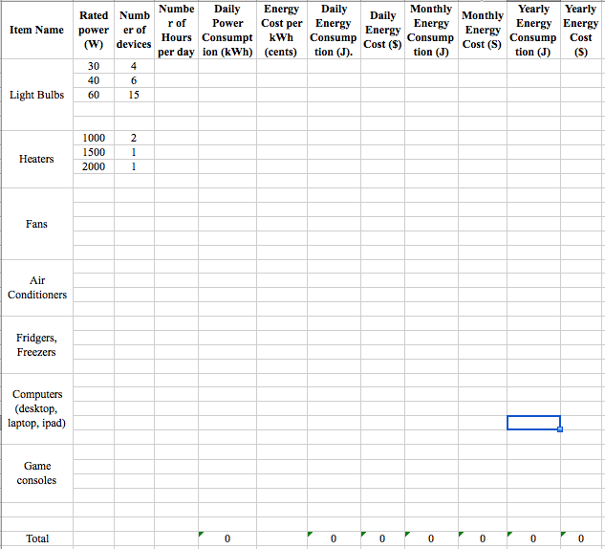

Slide 5
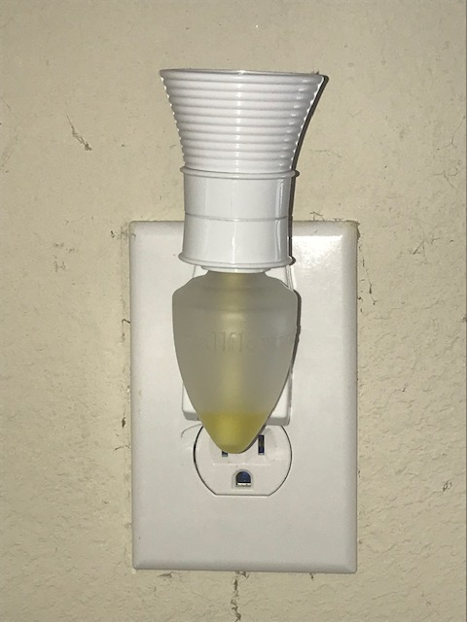
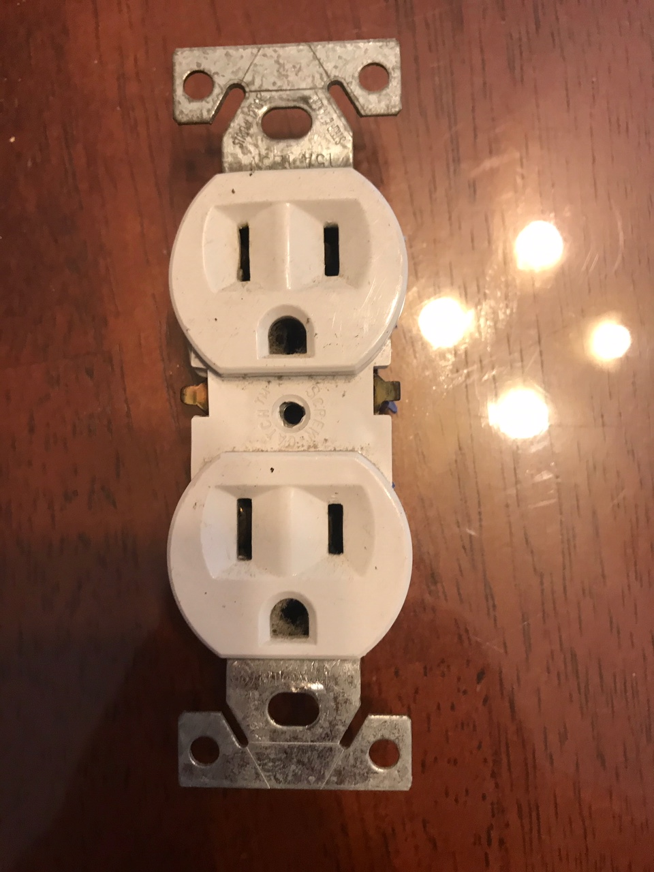
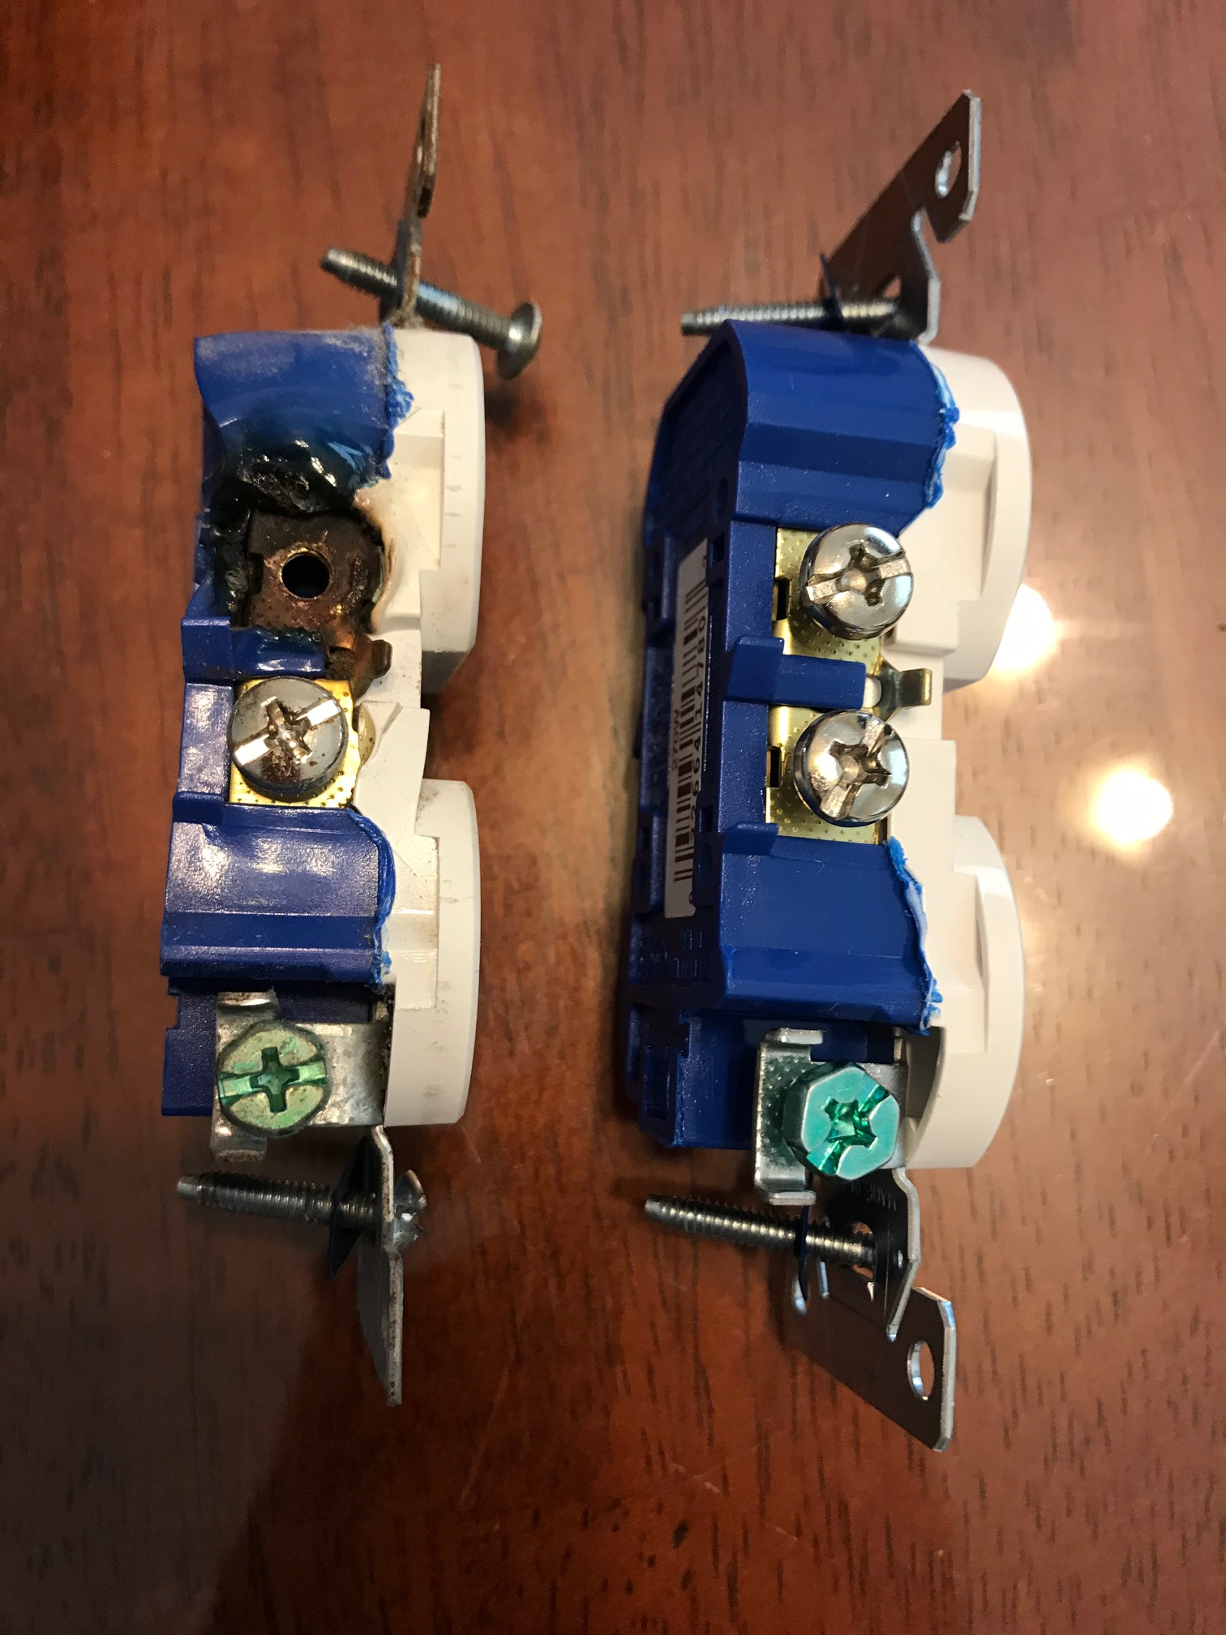
A Bad Receptacle Story!
What do you see?
What’s the big Q?
Why did this connection burnt in the first place?

Slide 6
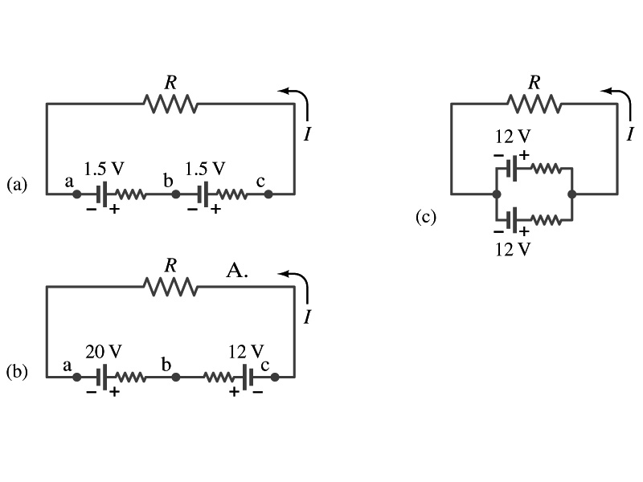
EMFs in Series and Parallel: Charging a Battery
When two or more sources of emfs, such as batteries, are connected in series
The total voltage is the algebraic sum of their voltages, if their direction is the same
V_{ab}= in figure (a).
If the batteries are arranged in the opposite direction, the total voltage is the difference between them
1.5+1.5=3.0V
Parallel arrangements (c) are used only to increase currents. An example?
V_{ac}= in figure (b)
Connecting batteries in opposite direction is wasteful.
This, however, is the way a battery charger works.
Since the 20V battery is at a higher voltage, it forces charges into 12V battery
Some battery are rechargeable since their chemical reactions are reversible but most the batteries do not reverse their chemical reactions
20 – 12 =8.0V

Slide 7
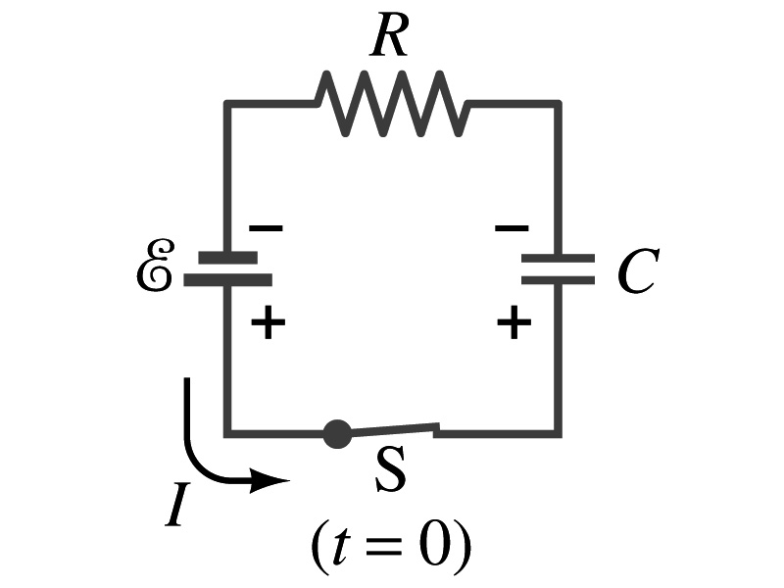
RC Circuits
Circuits containing both resistors and capacitors
RC circuits are used commonly in everyday life
Control windshield wiper
Timing of traffic light from red to green
Camera flashes and heart pacemakers
How does an RC circuit look?
There should be a source of emf, capacitors and resisters
What happens when the switch S is closed?
Current immediately starts flowing through the circuit.
Electrons flow out of negative terminal of the emf source, through the resister R and accumulates on the upper plate of the capacitor.
The electrons from the bottom plate of the capacitor will flow into the positive terminal of the battery, leaving only the positive charge on the bottom plate.
As the charge accumulates on the capacitor, the potential difference across it increases
The current reduces gradually to 0 till the voltage across the capacitor is the same as the emf.
The charge on the capacitor increases till it reaches to its maximum CE.

Slide 8
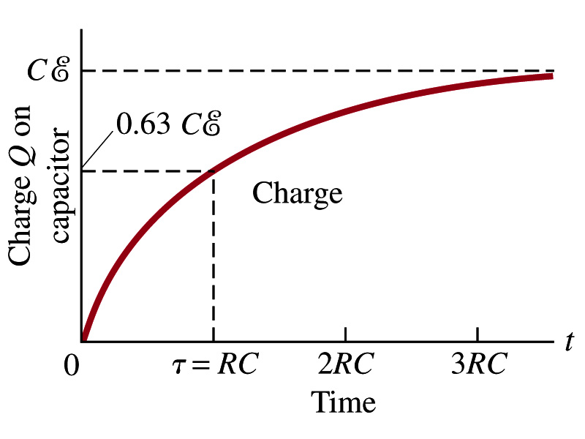
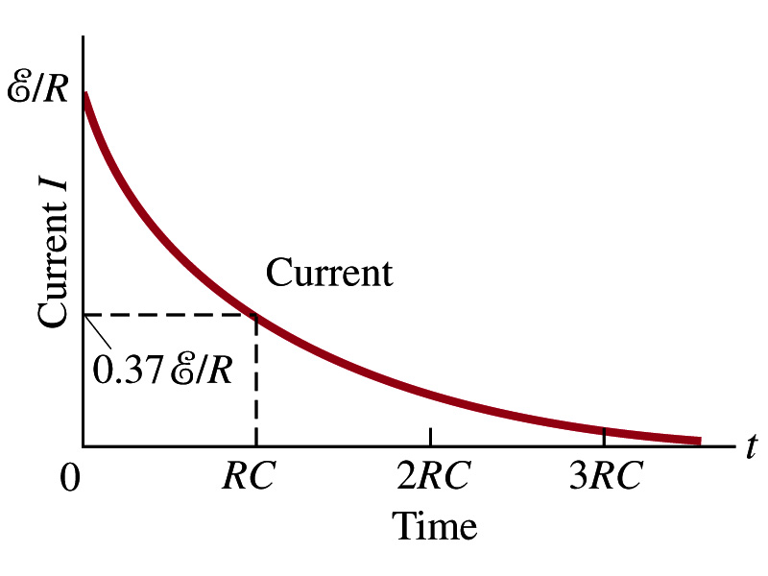
RC Circuits
How does all this look like in graphs?
The charge and the current on the capacitor as a function of time
From energy conservation (Kirchhoff’s 2nd rule), the emf E must be equal to the sum of voltage drop across the capacitor and the resister
E=IR+Q/C
R includes all resistance in the circuit, including the internal resistance of the battery, I is the current in the circuit at any instance, and Q is the charge of the capacitor at that same instance.

Slide 9
Analysis of RC Circuits
In an RC circuit and
What can we see from the above equations?
Q and V_{C} increase from 0 at t=0 to maximum value Q_{max}=CE and V_{C}= E.
In how much time?
The quantity RC is called the time constant of the circuit, τ
τ=RC, What is the unit?
What is the physical meaning?
The time required for the capacitor to reach (1 - e⁻¹)=0.63 or 63% of the full charge
The current is
Sec.

Slide 10
Example 26 – 12
RC circuit, with emf. The capacitance in the circuit of the figure is C=0.30μF, the total resistance is 20kΩ, and the battery emf is 12V. Determine (a) the time constant, (b) the maximum charge the capacitor could acquire, (c) the time it takes for the charge to reach 99% of this value, (d) the current I when the charge Q is half its maximum value, (e) the maximum current, and (f) the charge Q when, the current I is 0.20 its maximum value.
(a) Since
We obtain
(b) Maximum charge is
(c) Since
For 99% we obtain
(d) Since
We obtain
The current when Q is 0.5Q_{max}
(e) When is I maximum?
when Q=0:
(f) What is Q when I=120mA?

Slide 11
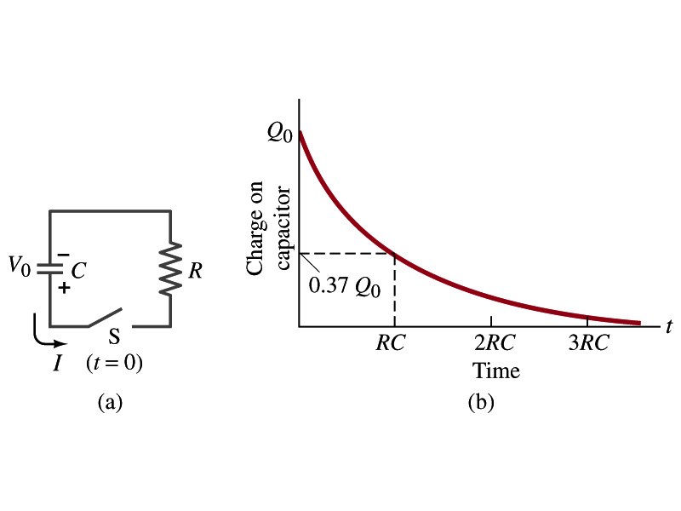
Discharging RC Circuits
When a capacitor is already charged, it is allowed to discharge through a resistance R.
When the switch S is closed, the voltage across the resistor at any instant equals that across the capacitor. Thus IR=Q/C.
The rate at which the charge leaves the capacitor equals the negative of the current flows through the resistor
I= - dQ/dt
This is because the current is leaving the capacitor
Thus the voltage equation becomes a differential equation
Rearrange terms

Slide 12
Discharging RC Circuits
Now, let’s integrate from t=0 when the charge is Q₀ to t when the charge is Q
The result is
Thus, we obtain
What does this tell you about the charge on the capacitor?
It decreases exponentially w/ time at the time constant RC
Just like the case of charging
The current is:
The current also decreases exponentially w/ time w/ the time constant RC
What is this?

Slide 13
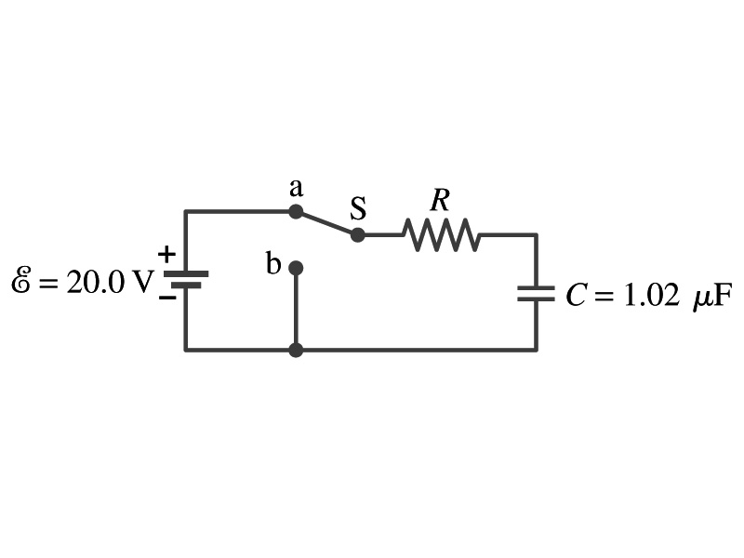
Example 26 – 13
Discharging RC circuit. In the RC circuit shown in the figure the battery has fully charged the capacitor, so Q₀=CE. Then at t=0, the switch is thrown from position a to b. The battery emf is 20.0V, and the capacitance C=1.02μF. The current I is observed to decrease to
0.50 of its initial value in 40μs. (a) what is the value of R? (b) What is the value of Q, the charge on the capacitor, at t=0? (c) What is Q at t=60μs?
(a) Since the current reaches to 0.5 of its initial value in 40μs, we can obtain
For 0.5I₀
Rearrange terms
Solve for R
(b) The value of Q at t=0 is
(c) What do we need to know first for the value of Q at t=60μs?
The RC time
Thus

Slide 14
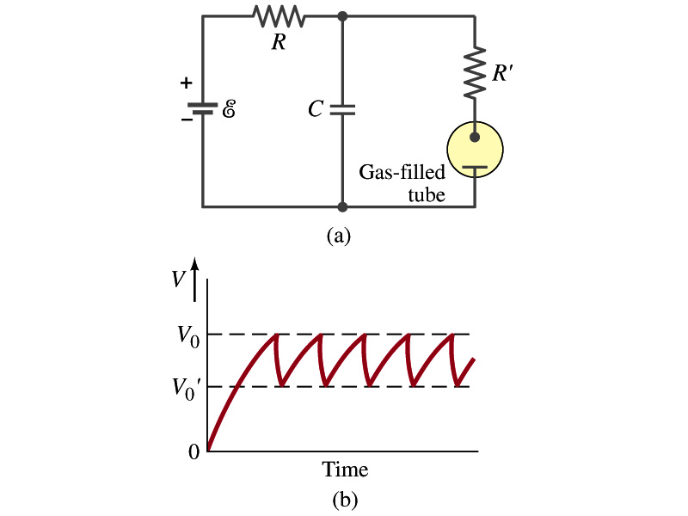
Application of RC Circuits
What do you think the charging and discharging characteristics of RC circuits can be used for?
To produce voltage pulses at a regular frequency
How?
The capacitor charges up to a particular voltage and discharges
A simple way of doing this is to use breakdown of voltage in a gas filled tube
The discharge occurs when the voltage breaks down at V₀
After the completion of discharge, the tube no longer conducts
Then the voltage is at V₀’ and it starts charging up
How do you think the voltage as a function of time look?
A sawtooth shape
Pace maker, intermittent windshield wiper, etc

Slide 15
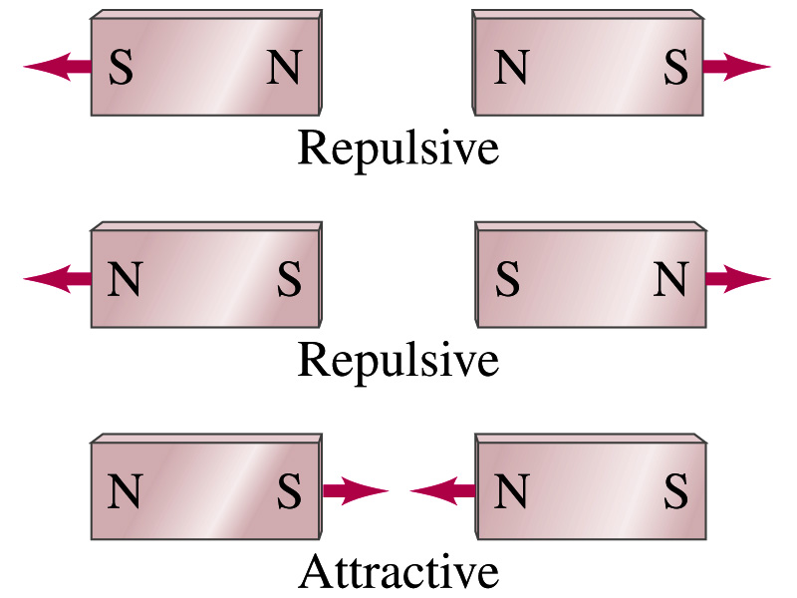
Magnetism
What are magnets?
Objects with two poles, North and South poles
The pole that points to the geographical North is the North pole and the other is the South pole
Principle of compass
These are called the magnet due to the name of the region, Magnesia, where the rocks that attract each other were found
What happens when two magnets are brought to each other?
They exert force onto each other
What kind?
Both repulsive and attractive forces depending on the configurations
Like poles repel each other while the unlike poles attract

Slide 16
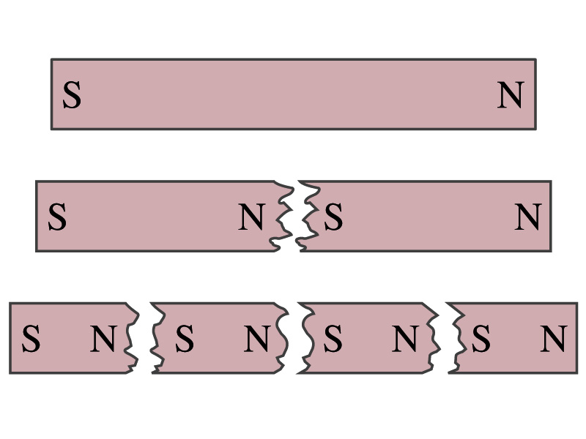
Magnetism
So the magnetic poles are the same as the electric charge?
No. Why not?
While the electric charges (positive and negative) can be isolated, the magnetic poles cannot be isolated.
So what happens when a magnet is cut?
If a magnet is cut, two magnets are made.
The more they get cut, the more magnets are made
Single pole magnets are called the monopole but it has not been seen yet
Ferromagnetic materials: Materials that show strong magnetic effects
Iron, cobalt, nickel, gadolinium and certain alloys
Other materials show very weak magnetic effects

Slide 17
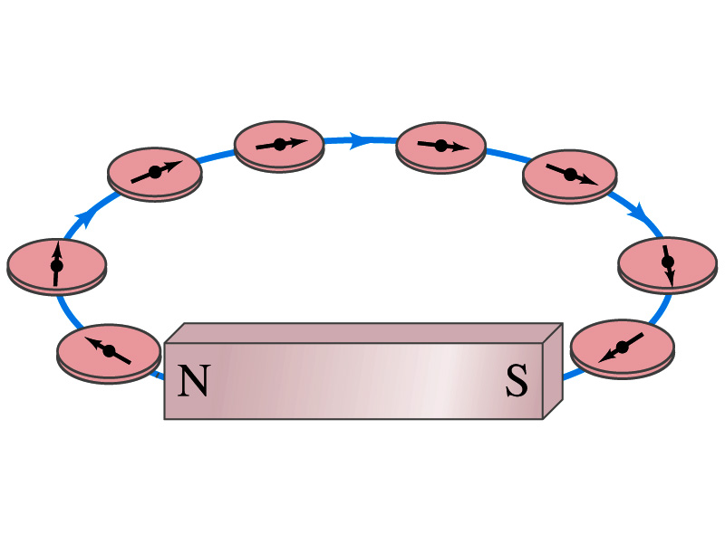
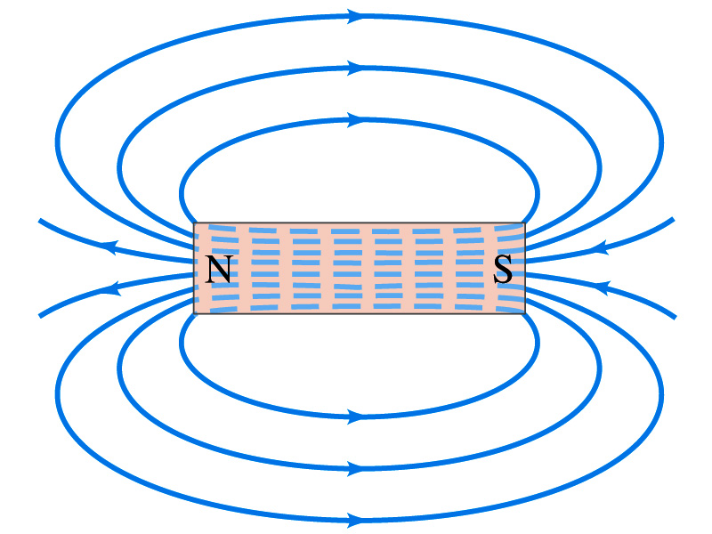
Magnetic Field
Just like the electric field that surrounds electric charge, a magnetic field surrounds a magnet
What does this mean?
Magnetic force is also a field force
The force one magnet exerts onto another can be viewed as the interaction between the magnet and the magnetic field produced by the other magnet
What kind of quantity is the magnetic field? Vector or Scalar?
So one can draw magnetic field lines, too.
Vector
The direction of the magnetic field is tangential to the field line at any point
The direction of the field is the direction the north pole of a compass would point to; out of N and into S
The number of lines per unit area is proportional to the strength of the magnetic field
Magnetic field lines continue inside the magnet
Since magnets always have both the poles, magnetic field lines form closed loops unlike electric field lines

Slide 18
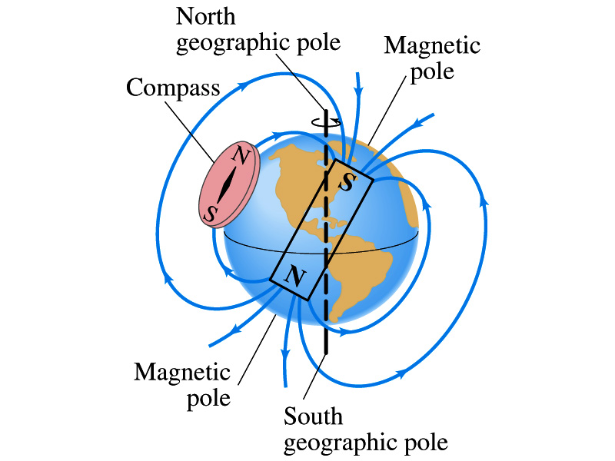
Earth’s Magnetic Field
What magnetic pole does the geographic North pole has to have?
Magnetic South pole. What? How do you know that?
Since the magnetic North pole points to the geographic North, the geographic north must have magnetic south pole
The pole in the North is still called geomagnetic North pole just because it is in the North
Similarly, South pole has magnetic North pole
The Earth’s magnetic poles do not coincide with the geographic poles ➔ magnetic declination
Geomagnetic North pole is in Northern Canada, some 900km off the true North pole
Earth’s magnetic field line is not tangent to the earth’s surface at all points
The angle the Earth’s field makes to the horizontal line is called the angle dip

