Slide 1
PHYS 1441 – Section 001 Lecture #14
Tuesday, June 30, 2020
Dr. Jaehoon Yu
CH 27: Magnetism and Magnetic Field
Magnetic Force on Electric Current
Magnetic Force on a Moving Charge
Charged Particle Path in a Magnetic Field
Cyclotron Frequency
Torque on a Current Loop
Magnetic Dipole Moment
CH 28: Sources of Magnetic Field
Sources of Magnetic Field

Slide 2
Announcements
Reading Assignments: CH27.6 – 8 and CH28.6 – 10
2nd Non-comprehensive term exam
Beginning of the class tomorrow, Wednesday, July 1 (roll call starts at 10:20am!)
Covers CH25.1 – end of CH27.4
BYOF: You may bring a one 8.5x11.5 sheet (front and back) of handwritten formulae and values of constants for the exam
No derivations, word definitions, figures, pictures, arrows, or setups or solutions of any problems!
No additional formulae or values of constants will be provided!
Must send me the photos of front and back of the formula sheet, including the blank, no later than 10am!
Once submitted, you cannot change, unless I ask you to delete some part of the sheet!
Special seminar on COVID–19 extra credit Monday, July 6
Dr. Linda Lee, a frontline doctor
Quiz 3 results
Class average: 42.1/70 ➔ equivalent to 60.1/100
Previous quizzes: 61/100 and 53.8/100
Top score: 70/70

Slide 3
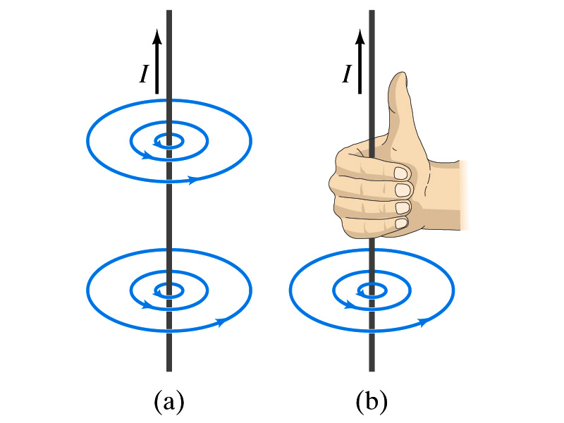
Electric Current and Magnetism
In 1820, Oersted found that when a compass needle is placed near an electric wire, the needle deflects as soon as the wire is connected to a battery and the current flows
Electric current produces a magnetic field (poll 1)
The first indication that electricity and magnetism are of the same origin
What about a stationary electric charge and magnet?
They don’t affect each other.
The magnetic field lines produced by a current in a straight wire is in the form of circles following the “right-hand” rule
The field lines follow right-hand fingers wrapped around the wire when the thumb points to the direction of the electric current

Slide 4
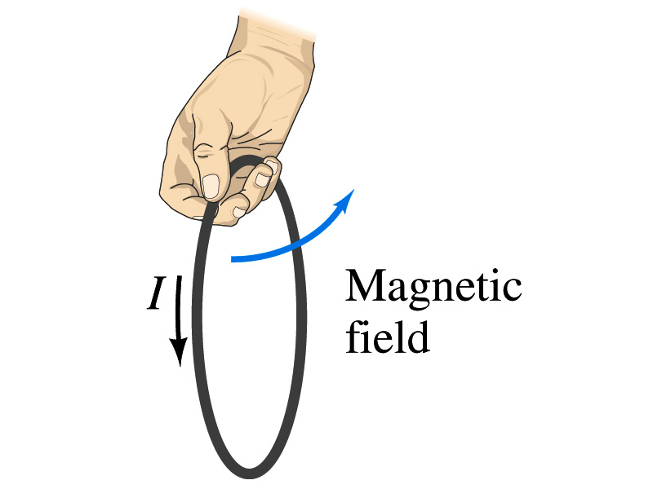
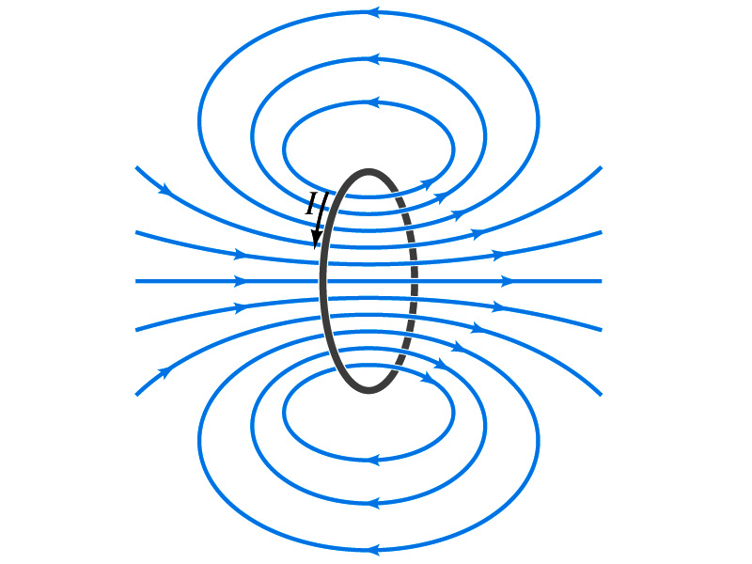
Directions in a Circular Wire?
OK, then what is the direction of the magnetic field generated by the current flowing through a circular loop?

Slide 5
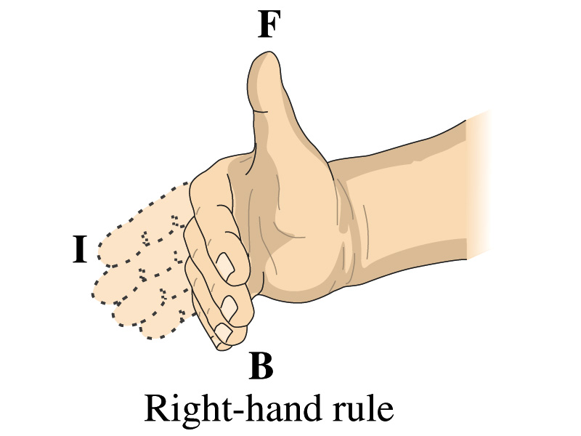
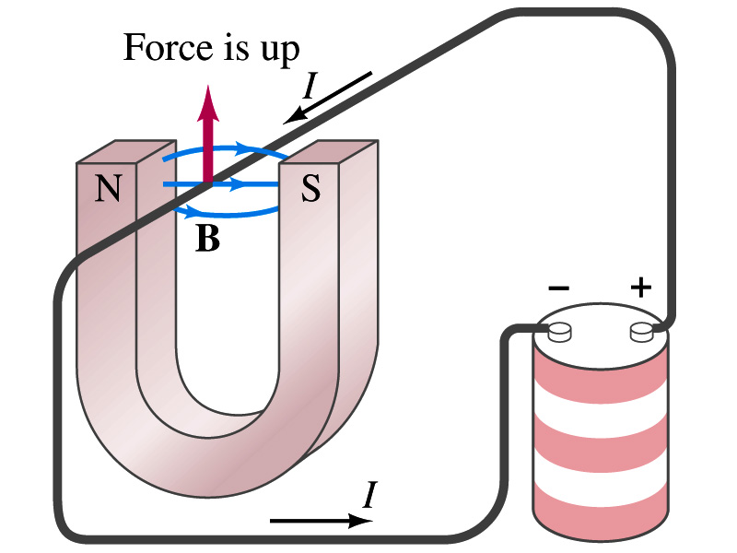
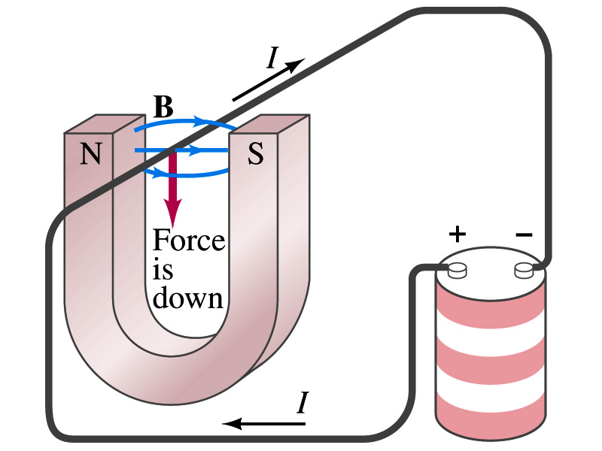
Magnetic Forces on Electric Current
Since the electric current exerts force on a magnet, the magnet should also exert force on the electric current
Which law justifies this? (poll 13)
Newton’s 3rd law
This was also discovered by Oersted
Direction of the force is always
perpendicular to the direction of the current
perpendicular to the direction of the magnetic field, B
Experimentally the direction of the force is given by another right-hand rule ➔ When the fingers of the right-hand points to the direction of the current and the finger tips bent to the direction of magnetic field B, the direction of thumb points to the direction of the force (poll 15)

Slide 6
Magnetic Forces on Electric Current
OK, we are set for the direction but what about the magnitude?
It is found that the magnitude of the force is directly proportional (poll 16)
To the current in the wire
To the length of the wire in the magnetic field (if the field is uniform)
To the strength of the magnetic field
The force also depends on the angle θ between the directions of the current and the magnetic field
When the wire is perpendicular to the field, the force is the strongest
When the wire is parallel to the field, there is no force at all
Thus the force on current I in the wire w/ length l in a uniform field B is

Slide 7
Magnetic Forces on Electric Current
Magnetic field strength B can be defined using the proportionality relationship w/ the constant 1. (poll 17)
if θ=90º, and if θ=0º
So the magnitude of the magnetic field B can be defined as
where F_{max} is the magnitude of the force on a straight length l of the wire carrying the current I when the wire is perpendicular to B
The relationship between F, B and I can be written in a vector formula:
l is the vector whose magnitude is the length of the wire in B and its direction is along the wire in the direction of the conventional current
This formula works only if B is uniform.
If B is not uniform or l does not form the same angle with B everywhere, the infinitesimal force acting on a differential length dl is

Slide 8
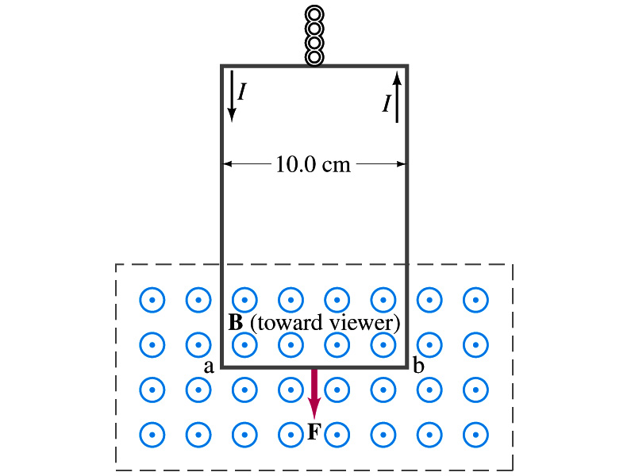
Example 27 – 2
Measuring a magnetic field. A rectangular loop of wire hangs vertically as shown in the figure. A magnetic field B is directed horizontally perpendicular to the wire, and points out of the page. The magnetic field B is very nearly uniform along the horizontal portion of wire ab (length l=10.0cm) which is near the center of a large magnet producing the field. The top portion of the wire loop is free of the field. The loop hangs from a balance which measures a downward force ( in addition to the gravitational force) of F=3.48x10⁻²N when the wire carries a current I=0.245A. What is the magnitude of the magnetic field B at the center of the magnet?
Magnetic force exerted on the wire due to the uniform field is
Since
Magnitude of the force is
SI unit of B field is Tesla or T
Solving for B
1 T = 10⁴ gauss
Something is not right! What happened to the forces on the loop on the side?
The two forces cancel out since they are in opposite direction with the same magnitude.

Slide 9
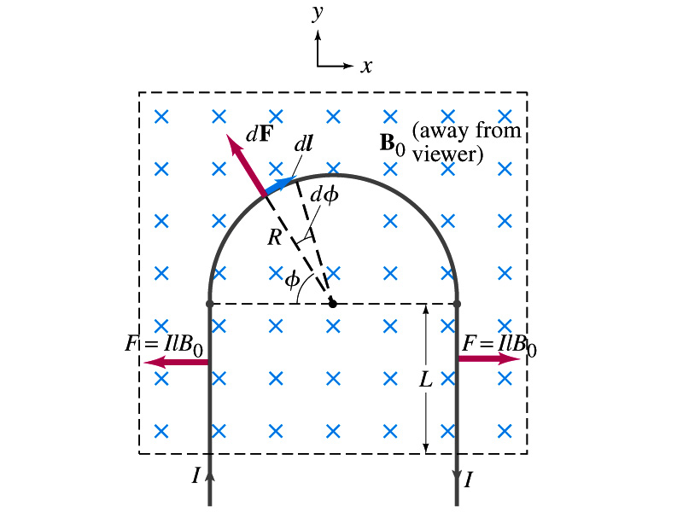
Example 27 – 3
Magnetic force on a semi-circular wire. A rigid wire, carrying the current I, consists of a semicircle of radius R and two straight portions as shown in the figure. The wire lies in a plane perpendicular to the uniform magnetic field B₀. The straight portions each has length l within the field. Determine the net force on the wire due to the magnetic field B₀.
As in the previous example, the forces on the straight sections of the wire is equal and in opposite direction. Thus they cancel.
What do we use to figure out the net force on the semicircle?
We divide the semicircle into infinitesimal straight sections.
What is the net x component of the force exerting on the circular section?
0
Why?
Because the forces on left and the right-hand sides of the semicircle balance.
Since
Y-component of the force dF is
Integrating over ϕ=0 - π
Which direction?
Vertically upward direction. The wire will be pulled deeper into the field.

Slide 10
Magnetic Forces on a Moving Charge
Will moving charge in a magnetic field experience force?
Yes
Why?
Since a wire carrying electric current (moving charge) experiences force in a magnetic field, a freely moving charge must feel the same kind of force…☺
OK, then how much force would it experience?
Let’s consider N moving particles with charge q each, and they pass by a given point in a time interval t.
What is the current?
Let t be the time for a charge q to travel a distance l in the magnetic field B
Then, the length vector l becomes
Where v is the velocity of the particle
Thus the force on N particles by the field is
The force on one particle with charge q,

Slide 11
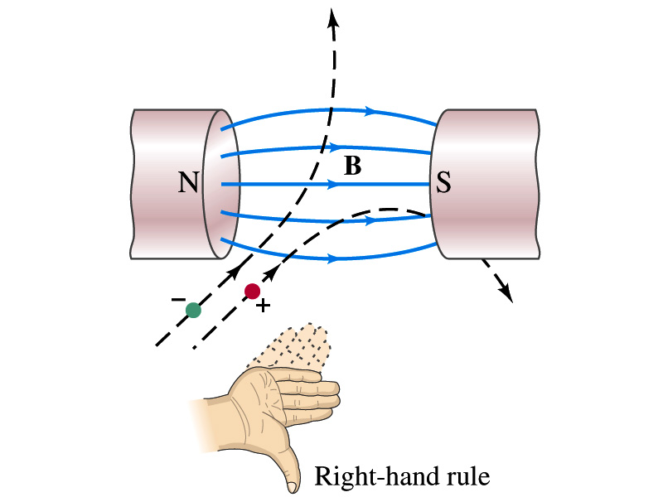
Magnetic Forces on a Moving Charge
This can be an alternative way of defining the magnetic field.
How?
The magnitude of the force on a particle with charge q moving with a velocity v in a field B is
What is the angle θ?
The angle between the magnetic field and the direction of particle’s movement
When is the force maximum?
When the B field and the velocity vector are perpendicular to each other.
➔
The direction of the force follows the right-hand-rule and is perpendicular to the direction of the magnetic field (p 15)

Slide 12
Example 27 – 5
Magnetic force on a proton. A proton having a speed of 5x10⁶m/s in a magnetic field feels a force of F=8.0x10⁻¹⁴N toward West when it moves vertically upward. When moving horizontally in a northerly direction, it feels zero force. What is the magnitude and the direction of the magnetic field in this region?
What is the charge of a proton?
What does the fact that the proton does not feel any force in a northerly direction tell you about the magnetic field?
The field is along the north-south direction.
Why?
Because the particle does not feel any magnetic force when it is moving along the direction of the field.
Since the particle feels force toward West, the field should be pointing to?
North
Using the formula for the magnitude of the field B, we obtain
We can use magnetic field to measure the momentum of a particle. How?

Slide 13
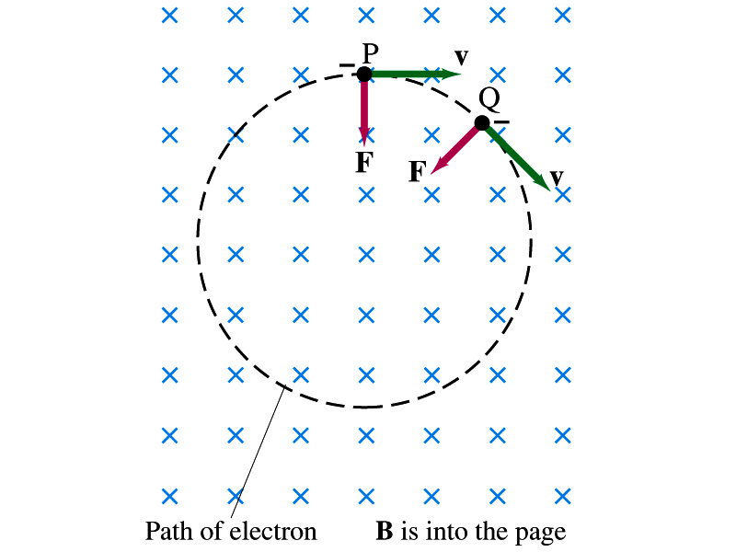
Charged Particle’s Path in Magnetic Field
What shape do you think is the path of a charged particle on a plane perpendicular to a uniform magnetic field?
Circle!! Why?
An electron moving to right at the point P in the figure will be pulled downward
At a later time, the force is still perpendicular to the velocity
Since the force is always perpendicular to the velocity, the magnitude of the velocity (the speed) is constant
The direction of the force follows the right-hand-rule and is perpendicular to the direction of the magnetic field
Thus, the electron moves on a circular path with a centripetal force F.

Slide 14
Example 27 – 7
Electron’s path in a uniform magnetic field. An electron travels at the speed of 2.0x10⁷m/s in a plane perpendicular to a 0.010-T magnetic field. What is the radius of the electron’s path?
What is formula for the centripetal force?
Since the magnetic field is perpendicular to the motion of the electron, the magnitude of the magnetic force is
Since the magnetic force provides the centripetal force, we can establish an equation with the two forces
Solving for r

Slide 15
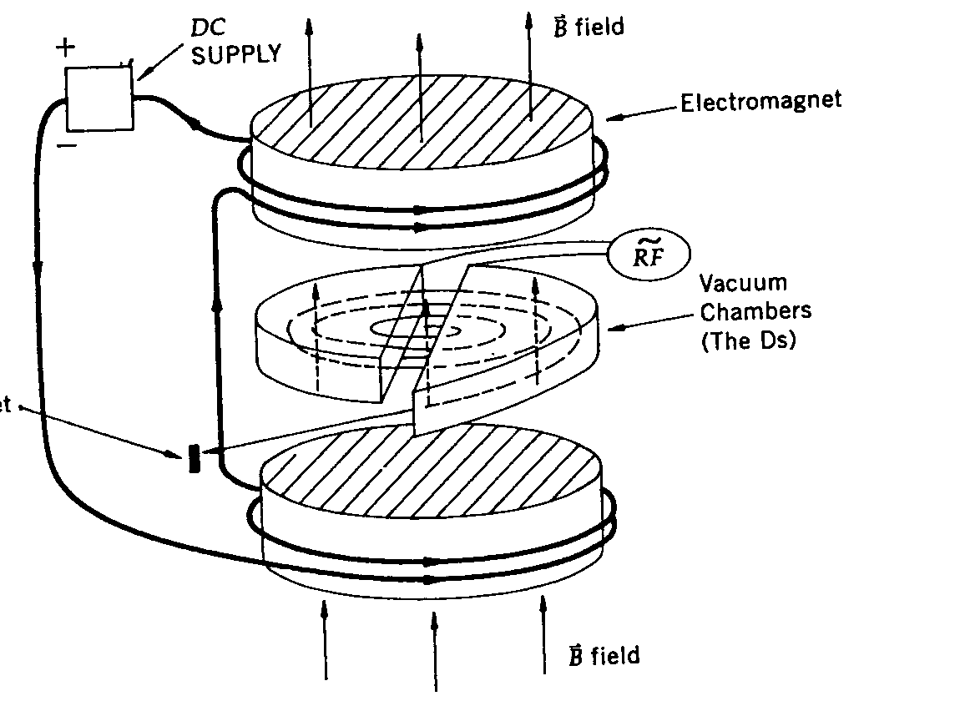
Cyclotron Frequency
The time required for a particle of charge q moving w/ a constant speed v to make one circular revolution in a uniform magnetic field, , is
Since T is the period of rotation, the frequency of the rotation is
This is the cyclotron frequency, the frequency of a particle with charge q in a cyclotron accelerator
While r depends on v, the frequency is independent of v and r.

