Slide 1
PHYS 1441 – Section 001
Lecture #15
Wednesday, July 1, 2020
Dr. Jaehoon Yu
CH 27: Magnetism and Magnetic Field
  Torque on a Current Loop
  Magnetic Dipole Moment
  The Hall Effect
CH 28: Sources of Magnetic Field
  Sources of Magnetic Field
Today’s homework is homework #8, due 11pm, Monday, July 6!!

Slide 2
Announcements
Reading Assignments: CH27.6 – 8 and CH28.6 – 10
Course feedback survey
  Starts today and continues to July 8
  Please fill in the survey ASAP!
Special seminar on COVID–19 Monday, July 6
  Dr. Linda Lee, a frontline doctor
  The second hour of the class (11:30 – 12:30)
    Extra credit for attending the seminar
  Questions will earn additional extra credit points

Slide 3
Reminder: Special Project #5 – COVID-19
Make comparisons of COVID-19 statistics between the U.S., South Korea, Italy and Texas from https://coronaboard.com on spreadsheet
  Total 36 points: 1 point for each of the top 20 cells and 2 points for each of the 8 cells for testing
What are the 3 fundamental requirements for opening up (2 points each, total 6 points)?
  Must be quantitative! (e.g. how many tests per capita per day for the present situation of pandemic)
Assess the readiness of the three fundamental requirements U.S. (2 point each, total 6 points; do NOT just take politician’s words!). Must provide the independent scientific entity’s reference you took the information from.
Evaluate quantitatively the success/failure of the US responses to COVID-19 in 5 sentences. Must provide quantitative reasons behind your conclusion! (10 points)
Assess quantitatively the effectiveness of wearing masks (4 points) and at least 4 reasons for it being effective (1 point each, 0.5 point extra after the first 4).
Due: the beginning of the class Tuesday, July 7
  Scan all pages of your special project into the pdf format, including the spreadsheet
  Save all pages into one file with the filename SP5-YourLastName-YourFirstName.pdf
Spreadsheet has been posted on the class web page. Download ASAP.

Slide 4
SP5 spreadsheet

Slide 5
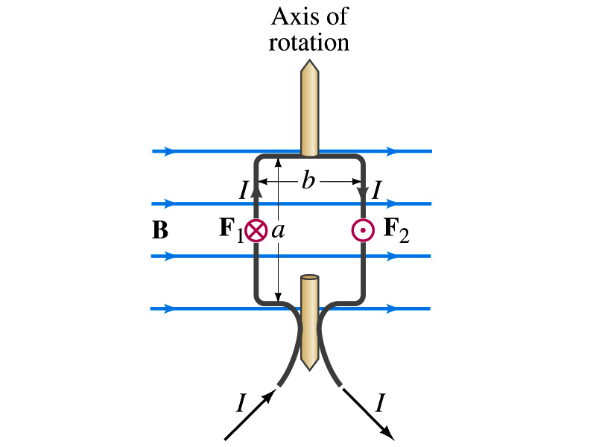
Torque on a Current Loop
What do you think will happen to a closed rectangular loop of wire with an electric current as shown in the figure?
  It will rotate! Why?
  The magnetic field exerts force on both vertical sections of wire.
  Where is this principle used in?
    Ammeters, motors, volt-meters, speedometers, etc
The two forces on the different sections of the wire exerts net torque in the same direction about the rotational axis along the symmetry axis of the wire.
What happens when the wire turns 90 degrees?
  It will not turn unless the direction of the current changes

Slide 6
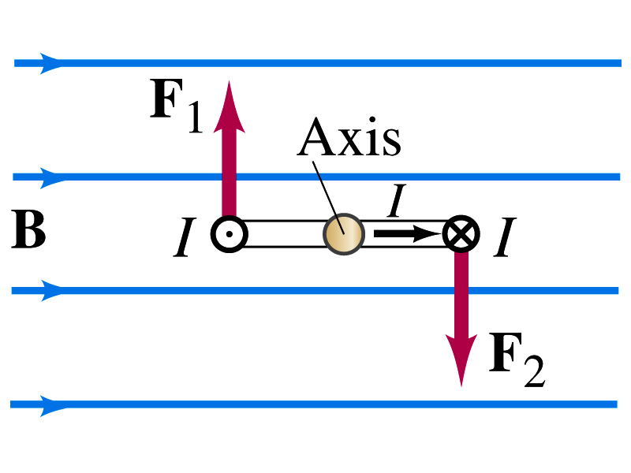
Torque on a Current Loop
So what would be the magnitude of this torque?
  What is the magnitude of the force on the section of the wire with length a?
    F_{a}=IaB
    The moment arm of the coil is b/2
  So the total torque is the sum of the torques by each of the forces
    Where A=ab is the area of the coil loop
  What is the total net torque if the coil consists of N loops of wire?
  If the coil makes an angle θ w/ the field

Slide 7
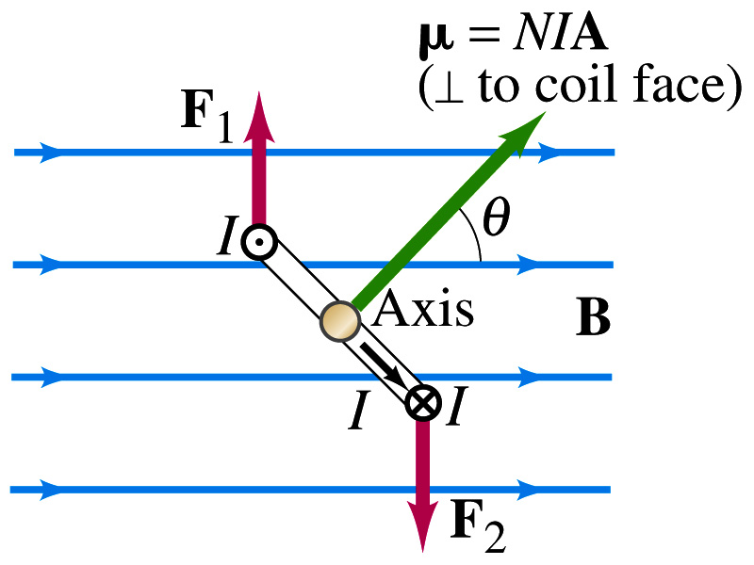
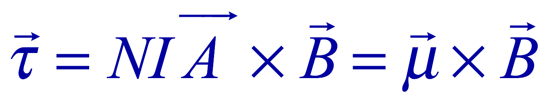
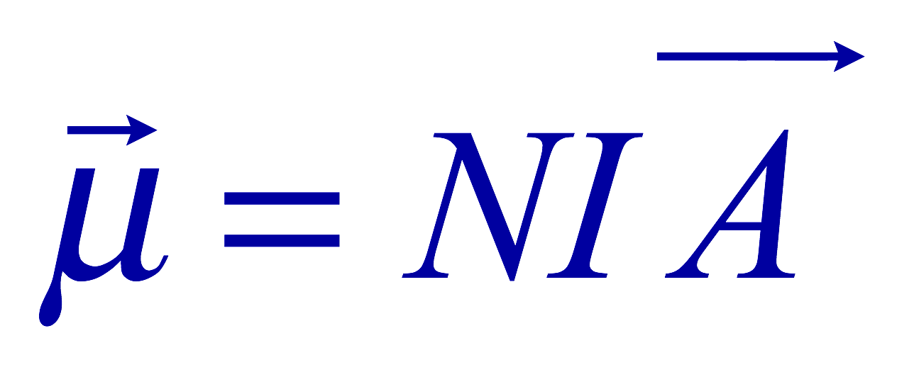
Magnetic Dipole Moment
The formula derived in the previous page for a rectangular coil is valid for any shape of the coil
The quantity NIA is called the magnetic dipole moment of the coil
  It is a vector quantity (Poll 1)
    Its direction is the same as that of the area vector A and is perpendicular to the plane of the coil consistent with the right-hand rule
      Your thumb points to the direction of the magnetic moment when your fingers cup around the loop in the same direction of the current
  The tendency of an object to interact with an external magnetic field
  Using the definition of magnetic moment, the torque can be rewritten in vector form

Slide 8
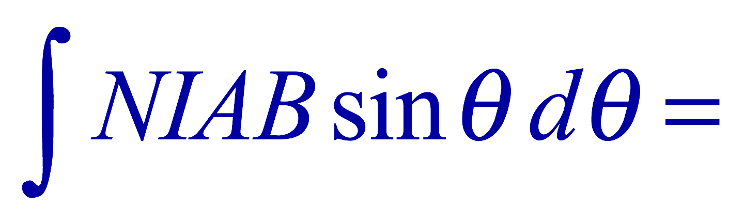
Magnetic Dipole Potential Energy
Where else did you see the same form of the torque?
  Remember the torque due to electric field on an electric dipole?
  The potential energy of the electric dipole is
How about the potential energy of a magnetic dipole?
  The work done by the torque is
  If we chose U=0 at θ=π/2, then C=0
  Thus the potential energy is
    Very similar to the electric dipole

Slide 9
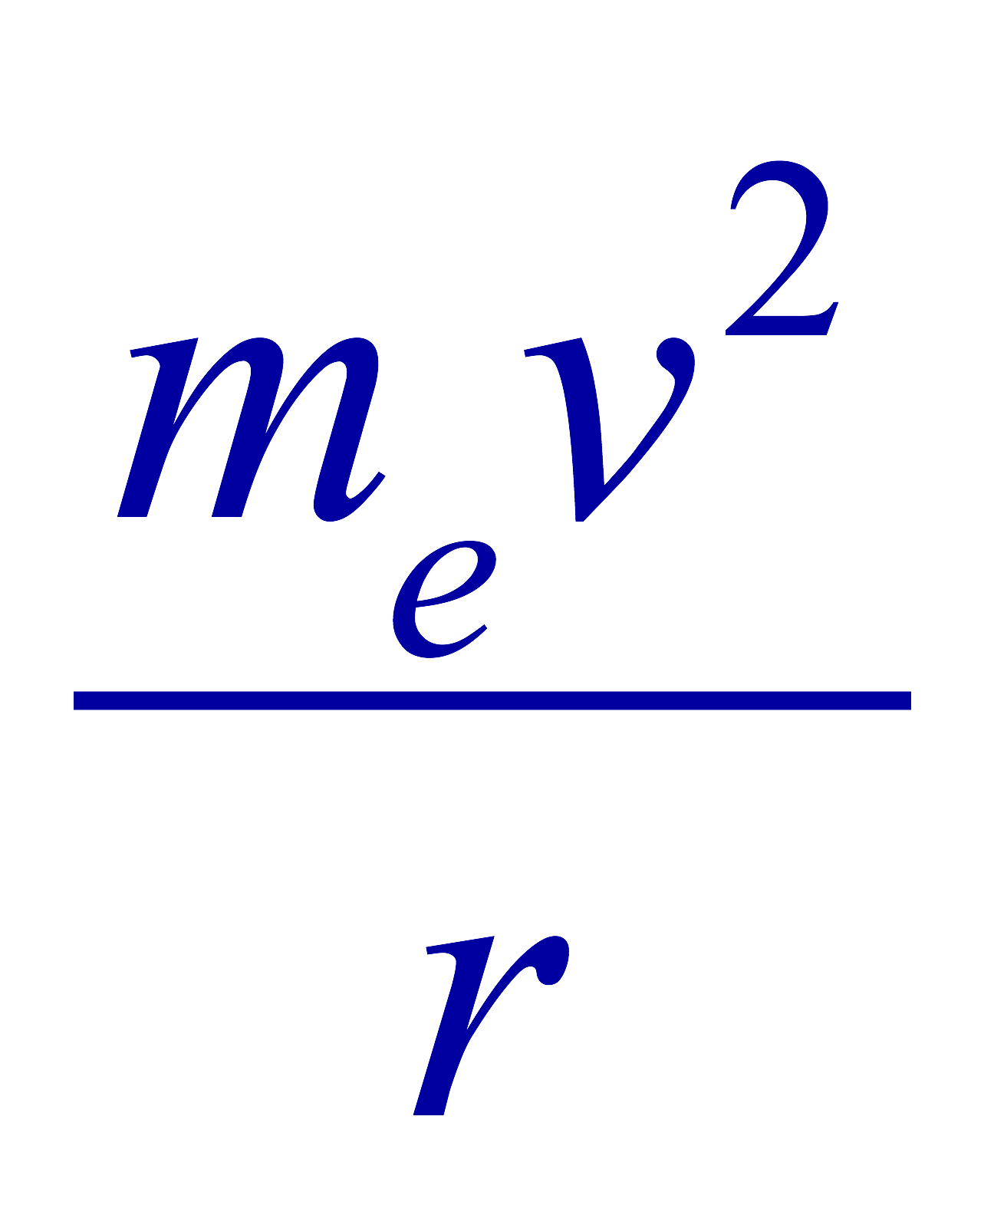



Example 27 – 12
Magnetic moment of a hydrogen atom. Determine the magnetic dipole moment of the electron orbiting the proton of a hydrogen atom, assuming (in the Bohr model) it is in its ground state with a circular orbit of radius 0.529x10⁻¹⁰m.
What provides the centripetal force?
The Coulomb force
So we can obtain the speed of the electron from
Solving for v
Since the electric current is the charge that passes through the given point per unit time, we can obtain the current
Since the area of the orbit is A=πr², we obtain the hydrogen magnetic moment

Slide 10
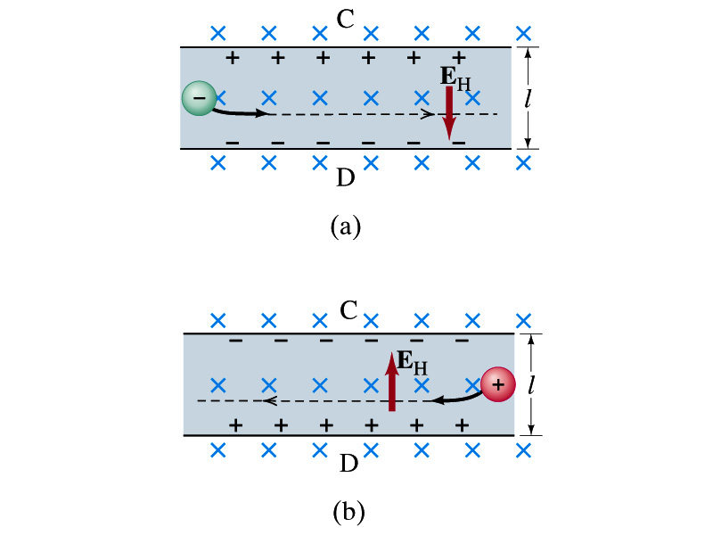
The Hall Effect
What do you think will happen to the electrons flowing through a conductor immersed in a magnetic field?
  Magnetic force will push the electrons toward one side of the conductor. Then what happens?
  A potential difference will be created due to continued accumulation of electrons on one side. Till when? Forever?
  Nope. Till the electric force inside the conductor is equal and opposite to the magnetic force
This is called the Hall Effect
  The potential difference produced is called
    The Hall emf
  The electric field due to the separation of charge is called the Hall field, E_{H}, and it points to the direction opposite to the magnetic force

Slide 11
The Hall Effect
In an equilibrium, the force due to Hall field is balanced by the magnetic force ev_{d}B, so we obtain
and
The Hall emf is then
  Where l is the width of the conductor
What do we use the Hall effect for?
  The current of negative charge moving to right is equivalent to the positive charge moving to the left
  The Hall effect can distinguish these since the direction of the Hall field or direction of the Hall emf is opposite
  Since the magnitude of the Hall emf is proportional to the magnetic field strength ➔ can measure the B-field strength
    Hall probe

