Slide 1
PHYS 1441 – Section 001
Lecture #16
Thursday, July 2, 2020
Dr. Jaehoon Yu
CH 28: Sources of Magnetic Field
  Sources of Magnetic Field
  Magnetic Field Due to Straight Wire
  Magnetic Materials
  Hysteresis
Chapter 29:EM Induction & Faraday’s Law
  Induced EMF and EM Induction

Slide 2
Announcements
Reading Assignments: CH27.6 – 8 and CH28.6 – 10
Course feedback survey
  Let’s take 10 min to fill the survey now
Special seminar on COVID–19 Monday, July 6
  Dr. Linda Lee, a frontline doctor
  The second hour of the class (11:30 – 12:30)
    Extra credit for attending the seminar
  Questions will earn additional extra credit points
Term 2 results
  Class average: 67/102 ➔ Equivalent to: 65.6/100
    Previous results: 63.6/100 and 54.2/100
  Top score: 102/102

Slide 3
Reminder: Special Project #5 – COVID-19
Make comparisons of COVID-19 statistics between the U.S., South Korea, Italy and Texas from https://coronaboard.com on spreadsheet
  Total 36 points: 1 point for each of the top 20 cells and 2 points for each of the 8 cells for testing
What are the 3 fundamental requirements for opening up (2 points each, total 6 points)?
  Must be quantitative! (e.g. how many tests per capita per day for the present situation of pandemic)
Assess the readiness of the three fundamental requirements U.S. (2 point each, total 6 points; do NOT just take politician’s words!). Must provide the independent scientific entity’s reference you took the information from.
Evaluate quantitatively the success/failure of the US responses to COVID-19 in 5 sentences. Must provide quantitative reasons behind your conclusion! (10 points)
Assess quantitatively the effectiveness of wearing masks (4 points) and at least 4 reasons for it being effective (1 point each, 0.5 point extra after the first 4).
Due: the beginning of the class Tuesday, July 7
  Scan all pages of your special project into the pdf format, including the spreadsheet
  Save all pages into one file with the filename SP5-YourLastName-YourFirstName.pdf
Spreadsheet has been posted on the class web page. Download ASAP.

Slide 4
SP5 spreadsheet

Slide 5
Sources of Magnetic Field
We have learned so far about the effects of magnetic field on the electric current and the moving charge
We will now learn about the dynamics of magnetism
  How do we determine magnetic field strengths in certain situations?
  How do two wires with electric current interact?
  What is the general approach to finding the connection between current and magnetic field?

Slide 6
Magnetic Field due to a Straight Wire
The magnetic field due to the current flowing through a straight wire forms a circular pattern around the wire
  What do you imagine the strength of the field is as a function of the distance from the wire? (poll 11)
    It must be weaker as the distance increases
  How about as a function of current? (poll 11)
    Directly proportional to the current
  Indeed, the above are experimentally verified
    This is valid as long as r << the length of the wire
  The proportionality constant is μ₀/2π, thus the field strength becomes
  μ₀ is the permeability of free space

Slide 7
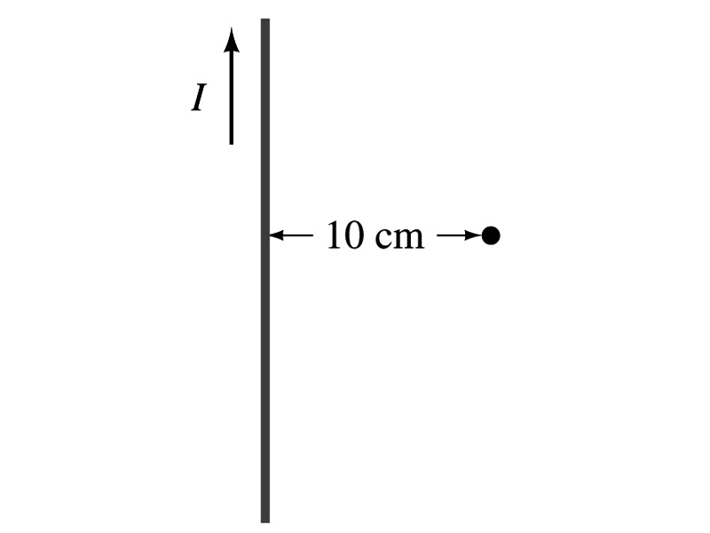
Example 28 – 1
Calculation of B near a wire. A vertical electric wire in the wall of a building carries a DC current of 25A upward. What is the magnetic field at a point 10cm due East of this wire?
Using the formula for the magnetic field near a straight wire
So we can obtain the magnetic field at 10cm away as

Slide 8
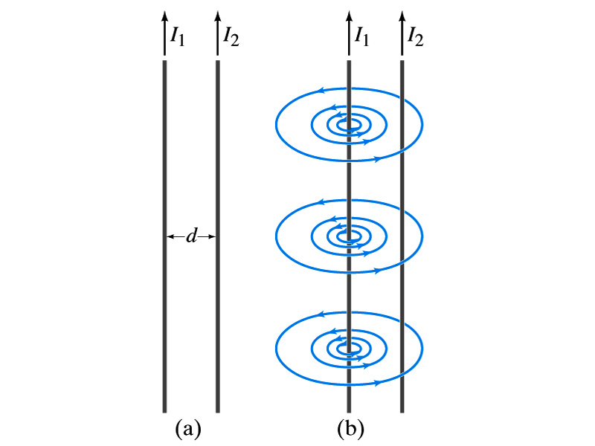
Force Between Two Parallel Wires
We have learned that a wire carrying the electric current produces magnetic field
Now what do you think will happen if we place two current carrying wires next to each other?
  They will exert force onto each other. Repel or attract?
  Depending on the direction of the currents
This was first pointed out by Ampére.
Let’s consider two long parallel conductors separated by a distance d, carrying currents I₁ and I₂.
At the location of the second conductor, the magnitude of the magnetic field produced by I₁ is

Slide 9
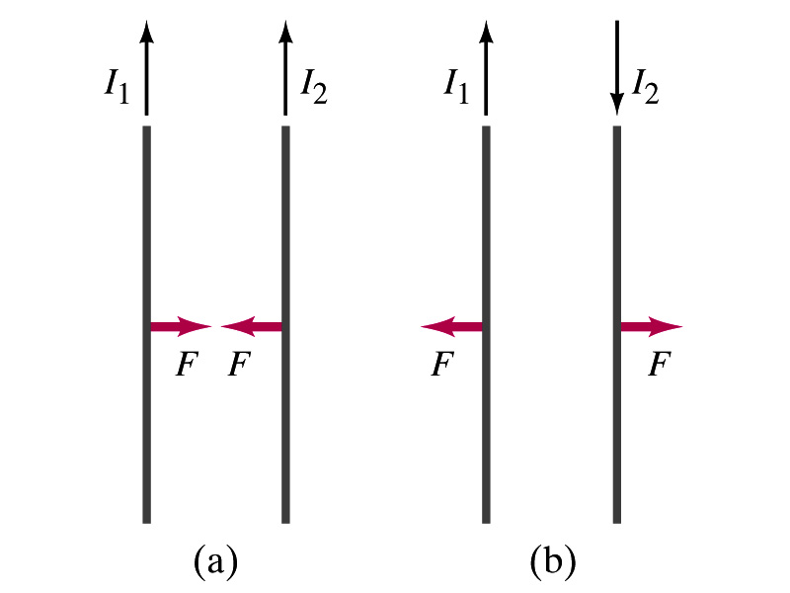
Force Between Two Parallel Wires
The force F by a magnetic field B₁ on a wire of length l, carrying the current I₂ when the field and the current are perpendicular to each other is:
  So the force per unit length is
  This force is only due to the magnetic field generated by the wire carrying the current I₁
    There is the force exerted on the wire carrying the current I₁ by the wire carrying current I₂ of the same magnitude but in opposite direction (poll 13)
So the force per unit length is
How about the direction of the force?
If the currents are in the same direction, the attractive force. If opposite, repulsive.

Slide 10
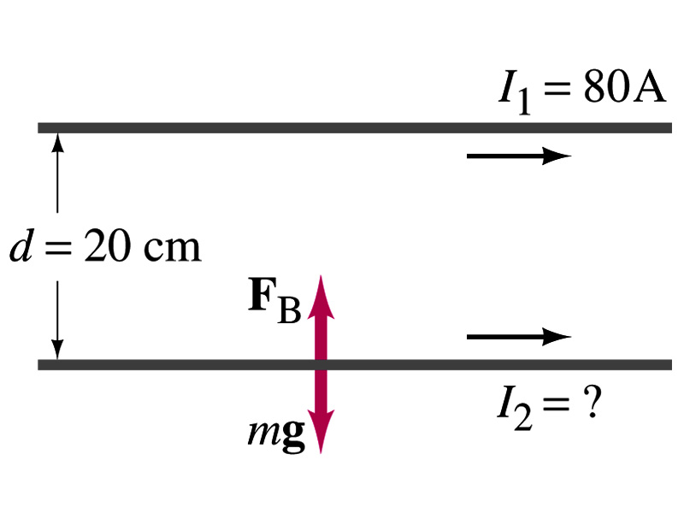
Example 28 – 5
Suspending a wire with current. A horizontal wire carries a current I₁=80A DC. A second parallel wire 20cm below it must carry how much current I₂ so that it doesn’t fall due to the gravity? The lower has a mass of 0.12g per meter of length.
Which direction is the gravitational force? (poll 15)
Down to the center of the Earth
This force must be balanced by the magnetic force exerted on the wire by the first wire.
Solving for I₂

Slide 11
Operational Definition of Units: Ampere and Coulomb
The permeability of free space is defined to be exactly
The unit of the current, ampere, is defined using the definition of the force between two wires each carrying 1A of current and separated by 1m
  So 1A is defined as: the current flowing each of two long parallel conductors 1m apart, which results in a force of exactly 2x10⁻⁷N/m.
Coulomb is then defined as exactly 1C=1A s.
We do it this way since the electric current can be measured more accurately and controlled more easily than the charge.

Slide 12
Ampére’s Law
What is the relationship between the magnetic field strength and the current?
  Does this work in all cases?
    Nope!
    OK, then when?
    Only valid for a long straight wire
Then what would be the more generalized relationship between the current and the magnetic field for any shapes of the wire?
  French scientist André Marie Ampére proposed such a relationship soon after Oersted’s discovery

Slide 13
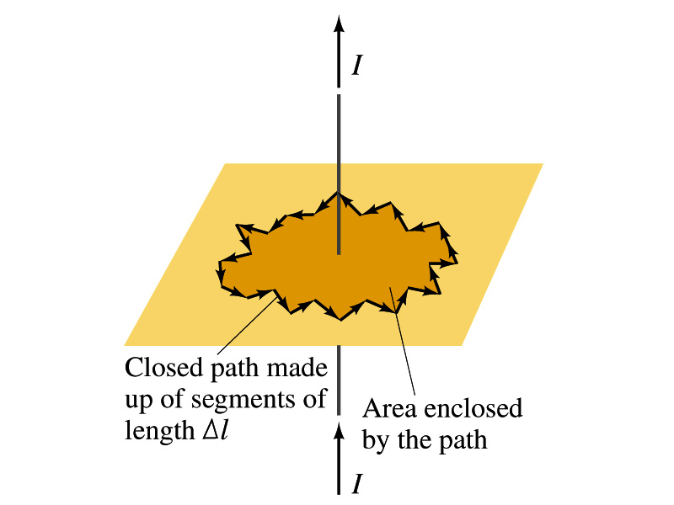
Ampére’s Law
Let’s consider an arbitrary closed path around the current as shown in the figure.
  Let’s split this path in small segments each of Δl long.
  The sum of all the products of the length of each segment and the component of B parallel to that segment is equal to μ₀ times the net current I_{encl} that passes through the surface enclosed by the path
  In the limit Δl →0, this relation becomes
Ampére’s Law
Looks very similar to a law in the electricity. Which law is it? (Poll13)
Gauss’ Law

Slide 14
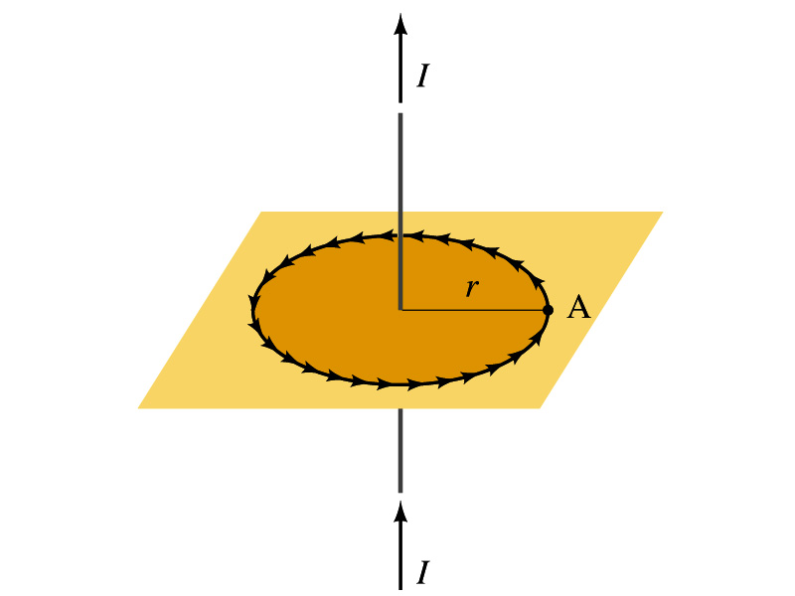
Verification of Ampére’s Law
Let’s find the magnitude of B at a distance r away from a long straight wire w/ current I
  This is a verification of Ampere’s Law
  We can apply Ampere’s law to a circular path of radius r.
Solving for B
  We just verified that Ampere’s law works in a simple case
  Experiments verified that it works for other cases too
  The importance of this formula, however, is that it provides means to relate magnetic field to current

Slide 15
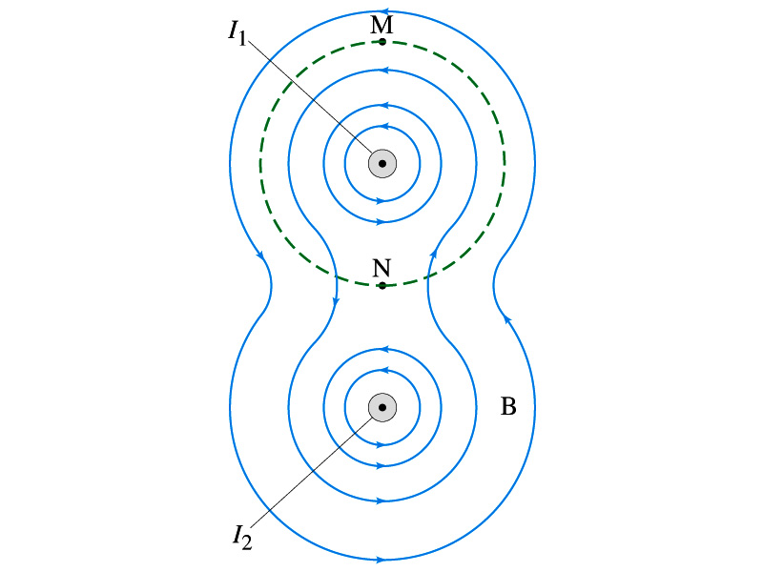
Verification of Ampére’s Law
Since Ampere’s law is valid in general, B in Ampere’s law is not just due to the current I_{encl}.
B is the field at each point in space along the chosen path due to all sources
  Including the current I enclosed by the path but also due to any other sources
  How do you obtain B in the figure at any point?
    Vector sum of the field by the two currents
  The result of the closed path integral in Ampere’s law for green dashed path is still μ₀I₁. Why?
  While B in each point along the path varies, the integral over the closed path still comes out the same whether there is the second wire or not.

Slide 16
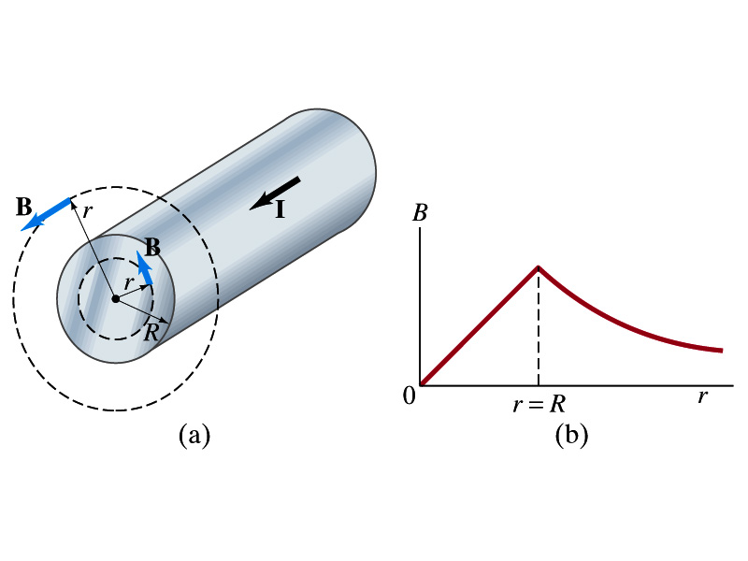
Example 28 – 6
Field inside and outside a wire. A long straight cylindrical wire conductor of radius R carries current I of uniform density in the conductor. Determine the magnetic field at (a) points outside the conductor (r>R) and (b) points inside the conductor (r<R). Assume that r, the radial distance from the axis, is much less than the length of the wire. (c) If R=2.0mm and I=60A, what is B at r=1.0mm, r=2.0mm and r=3.0mm?
Since the wire is long, straight and symmetric, the field should be the same at any point the same distance from the center of the wire.
Since B must be tangential to circles around the wire, let’s choose a circular path of the closed-path integral outside the wire (r>R). What is I_{encl}?
So using Ampere’s law
Solving for B

Slide 17
Example 28 – 6 cont’d
For r<R, the current inside the closed path is less than I. How much is it?
So using Ampere’s law
Solving for B
What does this mean?
The field is 0 at r=0 and increases linearly as a function of the distance from the center of the wire up to r=R then decreases as 1/r beyond the radius of the conductor.

Slide 18
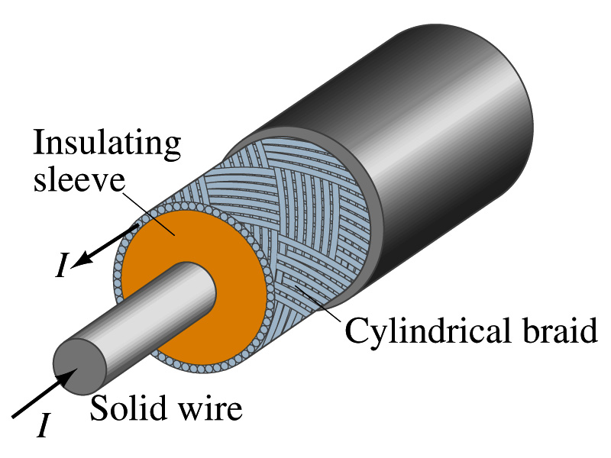
Example 28 – 7
Coaxial cable. A coaxial cable is a single wire surrounded by a cylindrical metallic braid, as shown in the figure. The two conductors are separated by an insulator. The central wire carries current to the other end of the cable, and the outer braid carries the return current and is usually considered ground. Describe the magnetic field (a) in the space between the conductors and (b) outside the cable.
(a) The magnetic field between the conductors is the same as the long, straight wire case since the current in the outer conductor does not impact the enclosed current.
(b) Outside the cable, we can draw a similar circular path, since we expect the field to have a circular symmetry. What is the sum of the total current inside the closed path?
So there is no magnetic field outside a coaxial cable. In other words, the coaxial cable self-shields. The outer conductor also shields against an external electric field. Cleaner signal and less noise.

