Slide 1
PHYS 1441 – Section 001
Lecture #17
Monday, July 6, 2020
Dr. Jaehoon Yu
CH 28: Sources of Magnetic Field
  Ampere’s Law
  Solenoid
  Magnetic Materials
  Hysteresis
Chapter 29:EM Induction & Faraday’s Law
  Induced EMF and EM Induction

Slide 2
Announcements
Reading Assignments: CH28.6 – 10
Course feedback survey ➔ Check the course evaluation tab in Canvas
Special seminar on COVID–19 today, July 6
  Dr. Linda Lee, a frontline doctor
  The second hour of the class (11:30 – 12:30)
    Extra credit for attending the seminar
  Questions will earn additional extra credit points
Online quiz 4 beginning of the class tomorrow (roll call at 10:20am)
  Covers CH27.4 to what we finish today
  BYOF You may bring a one 8.5x11.5 sheet (front and back) of handwritten formulae and values of constants for the exam
  No derivations, word definitions, figures, pictures, arrows, or setups or solutions of any problems! No additional formulae or values of constants will be provided!
  Must send me the photos of front and back of the formula sheet, including the blank, no later than 10am tomorrow!
    Once submitted, you cannot change, unless I ask you to delete some part of the sheet!

Slide 3
Reminder: Special Project #5 – COVID-19
Make comparisons of COVID-19 statistics between the U.S., South Korea, Italy and Texas from https://coronaboard.com on spreadsheet
  Total 36 points: 1 point for each of the top 20 cells and 2 points for each of the 8 cells for testing
What are the 3 fundamental requirements for opening up (2 points each, total 6 points)?
  Must be quantitative! (e.g. how many tests per capita per day for the present situation of pandemic)
Assess the readiness of the three fundamental requirements U.S. (2 point each, total 6 points; do NOT just take politician’s words!). Must provide the independent scientific entity’s reference you took the information from.
Evaluate quantitatively the success/failure of the US responses to COVID-19 in 5 sentences. Must provide quantitative reasons behind your conclusion! (10 points)
Assess quantitatively the effectiveness of wearing masks (4 points) and at least 4 reasons for it being effective (1 point each, 0.5 point extra after the first 4).
Due: the beginning of the class Tuesday, July 7
  Scan all pages of your special project into the pdf format, including the spreadsheet
  Save all pages into one file with the filename SP5-YourLastName-YourFirstName.pdf
Spreadsheet has been posted on the class web page. Download ASAP.

Slide 4
SP5 spreadsheet

Slide 5
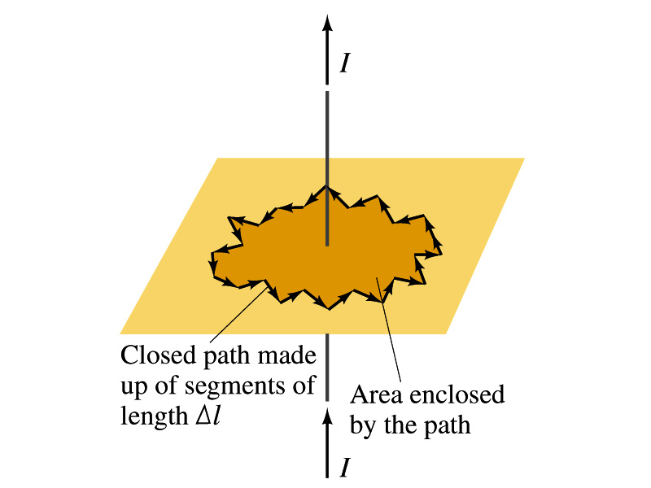
Ampére’s Law
Let’s consider an arbitrary closed path around the current as shown in the figure.
  Let’s split this path in small segments each of Δl long.
  The sum of all the products of the length of each segment and the component of B parallel to that segment is equal to μ₀ times the net current I_{encl} that passes through the surface enclosed by the path
  In the limit Δl →0, this relation becomes
Ampére’s Law
Looks very similar to a law in the electricity. Which law is it? (Poll13)
Gauss’ Law

Slide 6
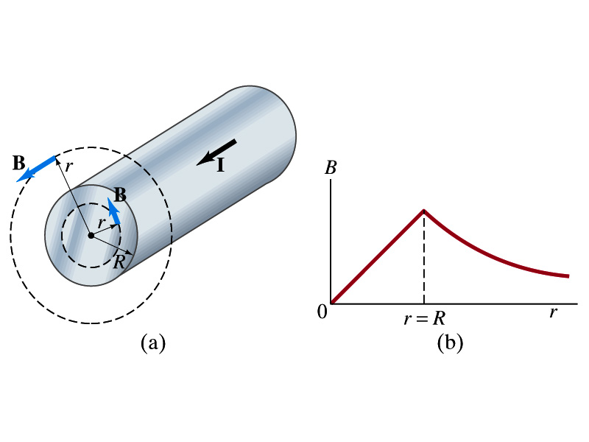
Example 28 – 6
Field inside and outside a wire. A long straight cylindrical wire conductor of radius R carries current I of uniform density in the conductor. Determine the magnetic field at (a) points outside the conductor (r>R) and (b) points inside the conductor (r<R). Assume that r, the radial distance from the axis, is much less than the length of the wire. (c) If R=2.0mm and I=60A, what is B at r=1.0mm, r=2.0mm and r=3.0mm?
Since the wire is long, straight and symmetric, the field should be the same at any point the same distance from the center of the wire.
Since B must be tangential to circles around the wire, let’s choose a circular path of the closed-path integral outside the wire (r>R). What is I_{encl}?
So using Ampere’s law
Solving for B

Slide 7
Example 28 – 6 cont’d
For r<R, the current inside the closed path is less than I. How much is it?
So using Ampere’s law
Solving for B
What does this mean?
The field is 0 at r=0 and increases linearly as a function of the distance from the center of the wire up to r=R then decreases as 1/r beyond the radius of the conductor.

Slide 8
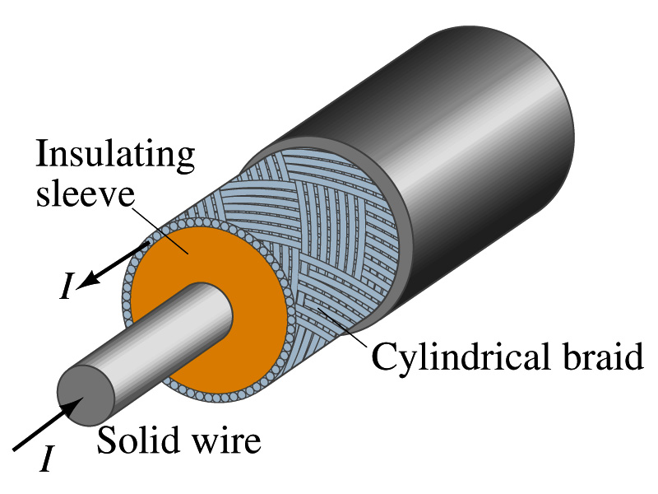
Example 28 – 7
Coaxial cable. A coaxial cable is a single wire surrounded by a cylindrical metallic braid, as shown in the figure. The two conductors are separated by an insulator. The central wire carries current to the other end of the cable, and the outer braid carries the return current and is usually considered ground. Describe the magnetic field (a) in the space between the conductors and (b) outside the cable.
(a) The magnetic field between the conductors is the same as the long, straight wire case since the current in the outer conductor does not impact the enclosed current.
(b) Outside the cable, we can draw a similar circular path, since we expect the field to have a circular symmetry. What is the sum of the total current inside the closed path?
So there is no magnetic field outside a coaxial cable. In other words, the coaxial cable self-shields. The outer conductor also shields against an external electric field. Cleaner signal and less noise.

Slide 9
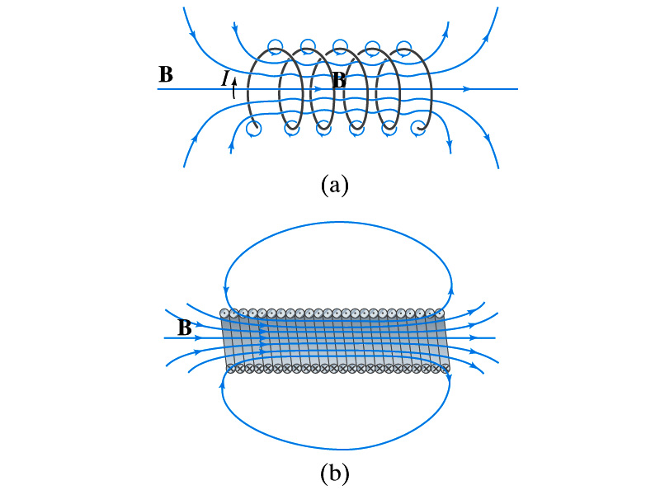
Solenoid and Its Magnetic Field
What is a solenoid?
  A long coil of wire consisting of many loops
  If the space between loops are wide
    The field near the wires are nearly circular
    Between any two wires, the fields due to each loop cancel
    Toward the center of the solenoid, the fields add up to give a field that can be fairly large and uniform
  For a long, densely packed loops
    The field is nearly uniform and parallel to the solenoid axes within the entire cross section
    The field outside the solenoid is very small compared to the field inside, except the ends
      The same number of field lines spread out to an open space
Solenoid Axis

Slide 10
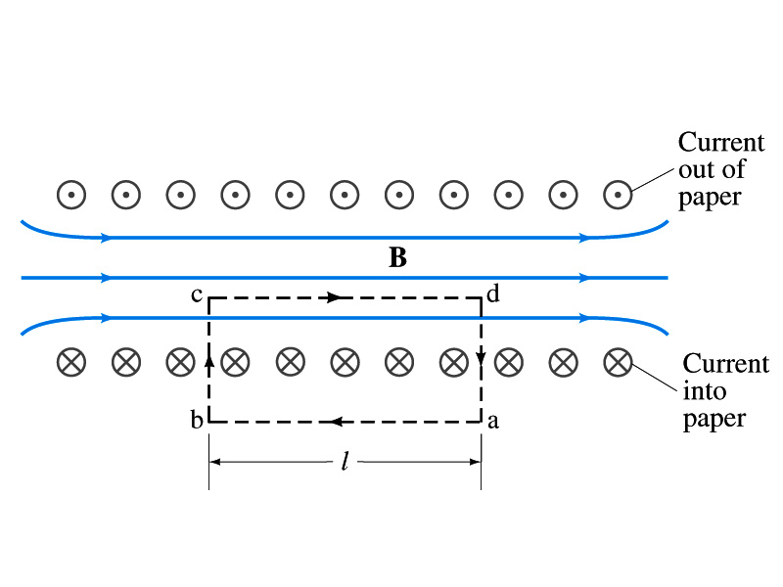
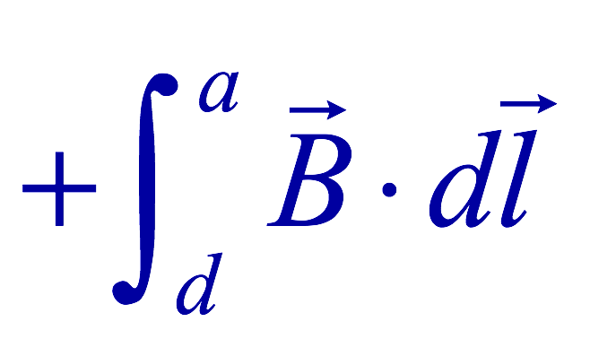
Solenoid Magnetic Field
Now let’s use Ampere’s law to determine the magnetic field inside a very long, densely packed solenoid
Let’s choose the path abcd, far away from the ends
  We can consider four segments of the loop for integral
  The field outside the solenoid is negligible. So the integral on a→b is 0.
  Now the field B is perpendicular to the bc and da segments. So these integrals become 0, also.

Slide 11
Solenoid Magnetic Field
  So the sum becomes:
  If the current I flows in the wire of the solenoid, the total current enclosed by the closed path is NI
    Where N is the number of loops (or turns of the coil) enclosed
  Thus Ampere’s law gives us
  If we let n=N/l be the number of loops per unit length, the magnitude of the magnetic field within the solenoid becomes
    B depends on the number of loops per unit length, n, and the current I
      Does not depend on the position within the solenoid but uniform inside it, like a bar magnet

Slide 12
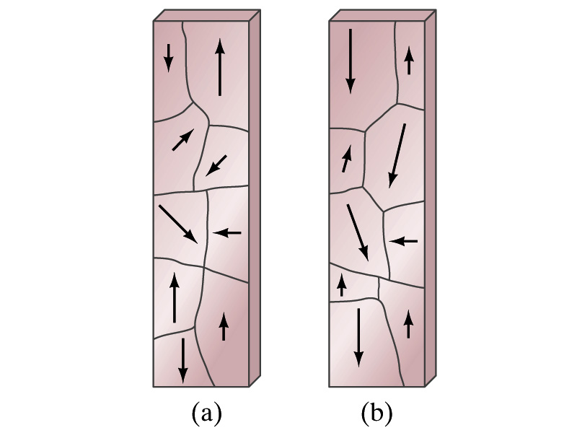
Magnetic Materials - Ferromagnetism
Iron is a material that can turn into a strong magnet
  This kind of material is called the ferromagnetic material
In a microscopic sense, ferromagnetic materials consist of many tiny regions called domains
  Domains are like little magnets usually smaller than 1mm in length or width
What do you think the alignment of domains are like when they are not magnetized?
  Randomly arranged
What if they are magnetized?
  The size of the domains aligned with the external magnetic field direction grows while those of the domains not aligned reduce
  This gives magnetization to the material
How do we demagnetize a bar magnet?
  Hit the magnet hard or heat it over the Curie temperature

Slide 13
B in Magnetic Materials
What is the magnetic field inside a solenoid?
  Magnetic field in a long solenoid is directly proportional to the current.
  This is valid only if air is inside the coil
What do you think will happen to B if we have something other than the air inside the solenoid?
  It will be increased dramatically, when the current flows
    Especially if a ferromagnetic material such as an iron is put inside, the field could increase by several orders of magnitude
Why?
  Since the domains in the iron aligns permanently by the external field.
  The resulting magnetic field is the sum of that due to current and due to the iron

Slide 14
B in Magnetic Materials
It is sometimes convenient to write the total field as the sum of two terms
  B₀ is the field due only to the current in the wire, namely the external field
    The field that would be present without a ferromagnetic material
  B_{M} is the additional field due to the ferromagnetic material itself; often B_{M}>>B₀
The total field in this case can be written by replacing μ₀ with another proportionality constant μ, the magnetic permeability of the material
  μ is a property of a magnetic material
  μ is not a constant but varies with the external field

Slide 15
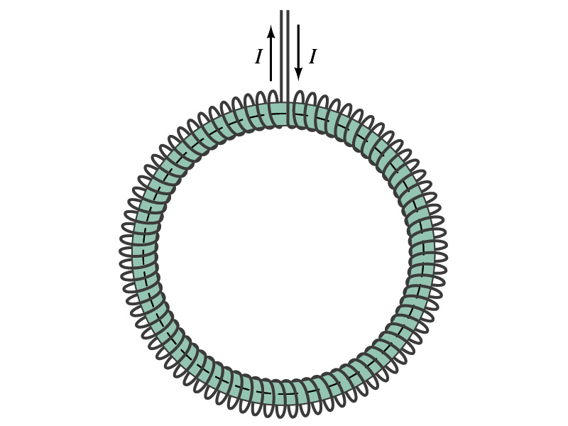
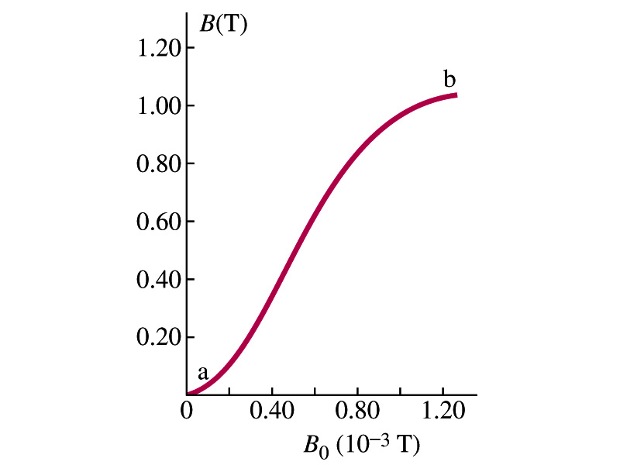
Hysteresis
Iron Core Toroid
What is a toroid?
  A solenoid bent into a shape
Toroid can be used for magnetic field measurement
  Why?
  Since it does not leak magnetic field outside of itself, it fully contains all the magnetic field created within it.
Consider an un-magnetized iron core toroid, without any current flowing in the wire
  What do you think will happen if the current slowly increases?
  B₀ increases linearly with the current.
  And B increases also but follows the curved line shown in the graph
  As B₀ increases, the domains become more aligned until nearly all are aligned (point b on the graph)
    The iron is said to be approaching saturation
    Point b is typically at 70% of the max

Slide 16
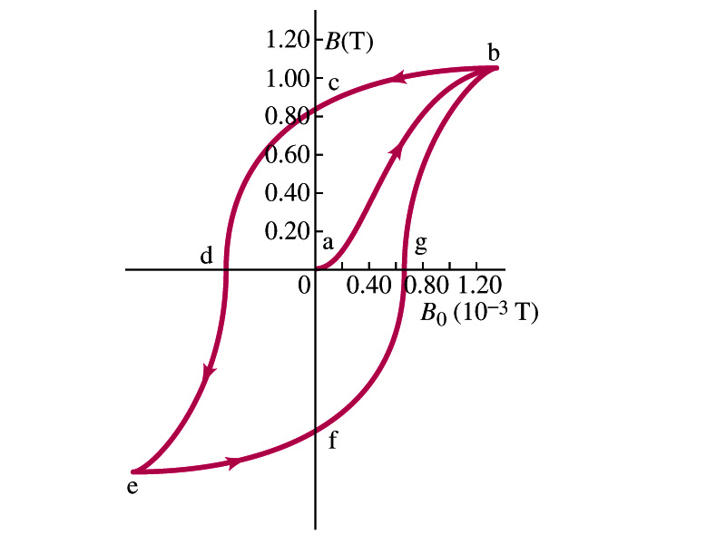
Hysteresis
What do you think will happen to B if the external field B₀ is reduced to 0 by decreasing the current in the coil?
  Of course it goes to 0!!
  Wrong! Wrong! Wrong! They do not go to 0. Why not?
  The domains do not completely return to the random alignment state
Now if the current direction is reversed, the external magnetic field direction is reversed, causing the total field B pass 0, and the direction reverses to the opposite side
  If the current is reversed again, the total field B will increase but never goes through the origin
This kind of curve whose path does not retrace themselves and does not go through the origin is called the Hysteresis.

Slide 17
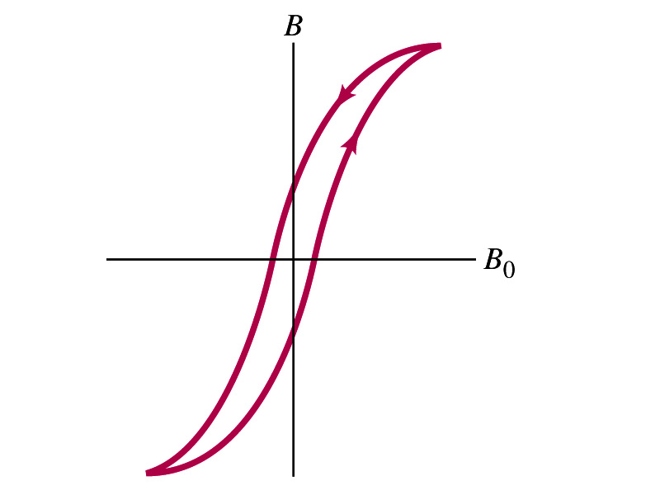
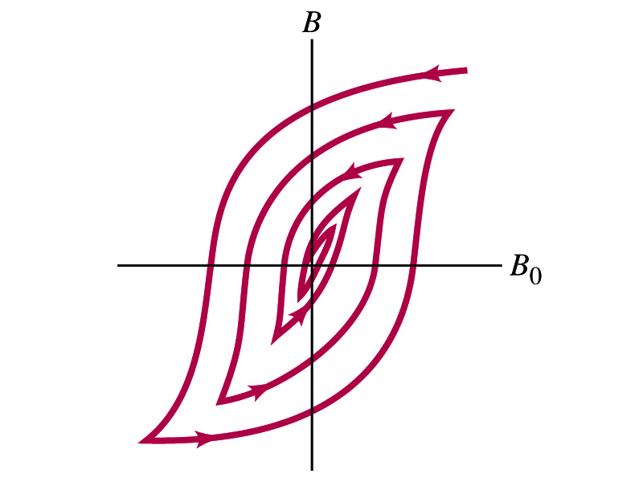
Magnetically Soft Material
In a hysteresis cycle, much energy is transformed to thermal energy. Why?
  Due to the microscopic friction between domains as they change directions to align with the external field
The energy dissipated in the hysteresis cycle is proportional to the area of the hysteresis loop
Ferromagnetic material with large hysteresis area is called magnetically hard while the small ones are called soft
  Which one do you think are preferred in electromagnets or transformers?
    Soft. Why?
    Since the energy loss is small and much easier to switch off the field
Then how do we demagnetize a ferromagnetic material?
  Keep repeating the Hysteresis loop, reducing the range of B₀.

