Slide 1
PHYS 1441 – Section 001
Lecture #19
Wednesday, July 8, 2020
Dr. Jaehoon Yu
CH 29:EM Induction & Faraday’s Law
  Electric Field due to Magnetic Flux
Chapter 30: Inductance
  Mutual and Self Inductance
  Energy Stored in Magnetic Field
Chapter 31: Maxwell’s Equations
  Expansion of Ampere’s Law
  Gauss’ Law for Magnetism
  Production of EM Waves

Slide 2
Announcements
Reading Assignments: CH9.8, CH30.7 – 30.11 and CH31.4
Course feedback survey ➔ Deadline today!
Online Final Exam in class tomorrow, Thursday, July 9 (roll call at 10:20am)
  Covers CH21.1 – CH31.4 plus the math refresher
  BYOF You may bring a one 8.5x11.5 sheet (front and back) of handwritten formulae and values of constants for the exam
  No derivations, word definitions, figures, pictures, arrows, or setups or solutions of any problems!
  No additional formulae or values of constants will be provided!
  Must send me the photos of front and back of the formula sheet, including the blank, no later than 10am tomorrow!
    Once submitted, you cannot change, unless I ask you to delete some part of the sheet!
Quiz 4 results
  Class average: 34.2/60 equivalent to 57/100
    Previous results: 61/100, 54/100 and 60/100
  Top score: 60/60

Slide 3
Power Transmission – Why HV?
Transmission lines. An average of 120kW of electric power is sent to a small town from a power plant 10km away. The transmission lines have a total resistance of 0.4Ω. Calculate the power loss if the power is transmitted at (a) 240V and (b) 24,000V.
We cannot use P=V²/R since we do not know the voltage along the transmission line. We, however, can use P=I²R.
(a) If 120kW is sent at 240V, the total current is
Thus the power loss due to transmission line is
(b) If 120kW is sent at 24,000V, the total current is
Thus the power loss due to transmission line is
The higher the transmission voltage, the smaller the current, causing less loss of energy. This is why power is transmitted w/ HV, as high as 170kV.

Slide 4
Electric Field due to Magnetic Flux Change
When the electric current flows through a wire, there is an electric field in the wire that moves electrons
We saw, however, that changing magnetic flux induces a current in the wire. What does this mean?
  There must be an electric field induced by the changing magnetic flux.
In other words, a changing magnetic flux produces an electric field
This results apply not just to wires but to any conductor or any region in space

Slide 5
Generalized Form of Faraday’s Law
Recall the relationship between the electric field and the potential difference
Induced emf in a circuit is equal to the work done per unit charge by the electric field
So we obtain
The integral is taken around a path enclosing the area through which the magnetic flux Φ_{Β} is changing.

Slide 6
Inductance
Changing magnetic flux through a circuit induce an emf in that circuit (Poll 13)
An electric current produces a magnetic field
From these, we can deduce
  A changing current in one circuit must induce an emf in a nearby circuit ➔ Mutual inductance
  and induce an emf in itself ➔ Self inductance

Slide 7
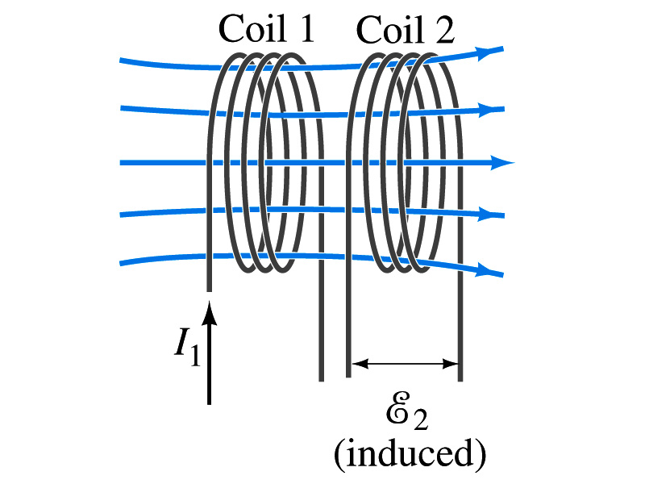
Mutual Inductance
If two coils of wire are placed near each other, a changing current in one will induce an emf in the other.
What is the induced emf, ε₂, in coil2 proportional to?
  Rate of the change of the magnetic flux passing through it
This flux is due to current I₁ in coil 1
If Φ₂₁ is the magnetic flux in each loop of coil2 created by coil1 and N₂ is the number of closely packed loops in coil2, then N₂Φ₂₁ is the total flux passing through coil2.
If the two coils are fixed in space, N₂Φ₂₁ is proportional to the current I₁ in coil 1, .
The proportionality constant for this is called the Mutual Inductance and defined as .
The emf induced in coil2 due to the changing current in coil1 is

Slide 8
Mutual Inductance
The mutual induction of coil2 with respect to coil1, M₂₁,
  is a constant and does not depend on I₁.
  depends only on “geometric” factors such as the size, shape, number of turns and relative position of the two coils, and whether a ferromagnetic material is present
    The farther apart the two coils are the less flux can pass through coil, 2, so M₂₁ will be less.
  In most cases the mutual inductance is determined experimentally
Conversely, the changing current in coil2 will induce an emf in coil1
  M₁₂ is the mutual inductance of coil1 with respect to coil2 and M₁₂ = M₂₁
  We can put M=M₁₂=M₂₁ and obtain
  SI unit for mutual inductance is henry (H)
What? Does this make sense?

Slide 9
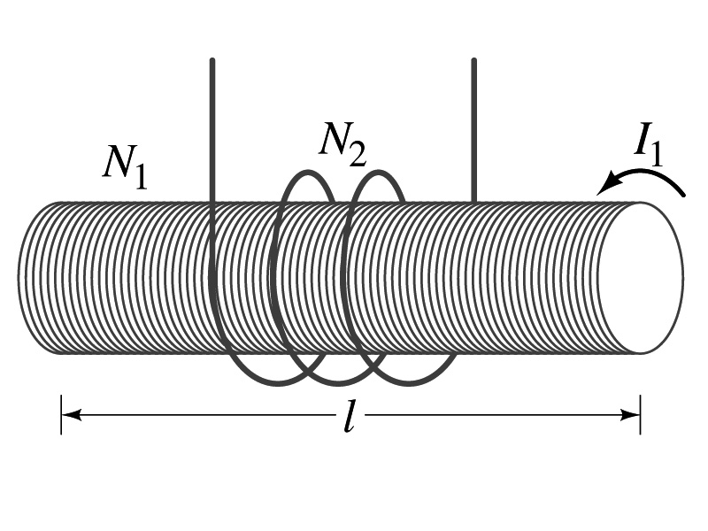
Example 30 – 1
Solenoid and coil. A long thin solenoid of length l and cross-sectional area A contains N₁ closely packed turns of wire. Wrapped around it is an insulated coil of N₂ turns. Assuming all the flux from coil 1 (the solenoid) passes through coil 2, calculate the mutual inductance.
First we need to determine the flux produced by the solenoid.
What is the magnetic field inside the solenoid?
Since the solenoid is closely packed, we can assume that the field lines are perpendicular to the surface area of the coils. Thus the flux through coil 2 is
Thus the mutual inductance of coil 2 is
Note that M₂₁ only depends on geometric factors!

Slide 10
Self Inductance
The concept of inductance applies to a single isolated coil of N turns. How does this happen?
  When a changing current passes through a coil
  A changing magnetic flux is produced inside the coil
  The changing magnetic flux in turn induces an emf in the same coil
  This emf opposes the change in flux. Whose law is this? (Poll 13, 14)
    Lenz’s law
What would this do?
  When the current through the coil is increasing?
    The increasing magnetic flux induces an emf that opposes the original current
    This tends to impedes its increase, trying to maintain the original current
  When the current through the coil is decreasing?
    The decreasing flux induces an emf in the same direction as the current
    This tends to increase the flux, trying to maintain the original current

Slide 11
Self Inductance
Since the magnetic flux Φ_{B} passing through an N turn coil is proportional to current I in the coil,
We define self-inductance, L:
The induced emf in a coil of self-inductance L is
  What is the unit for self-inductance?
What does magnitude of L depend on?
  Geometry and the presence of a ferromagnetic material
Self inductance can be defined for any circuit or part of a circuit
Self Inductance

Slide 12
So what in the world is the Inductance?
It is an impediment onto the electrical current due to the existence of changing flux
So what?
In other words, it behaves like a resistance to the varying current, such as AC, that causes the constant change of flux
But it also provides means to store energy, just like the capacitance

Slide 13
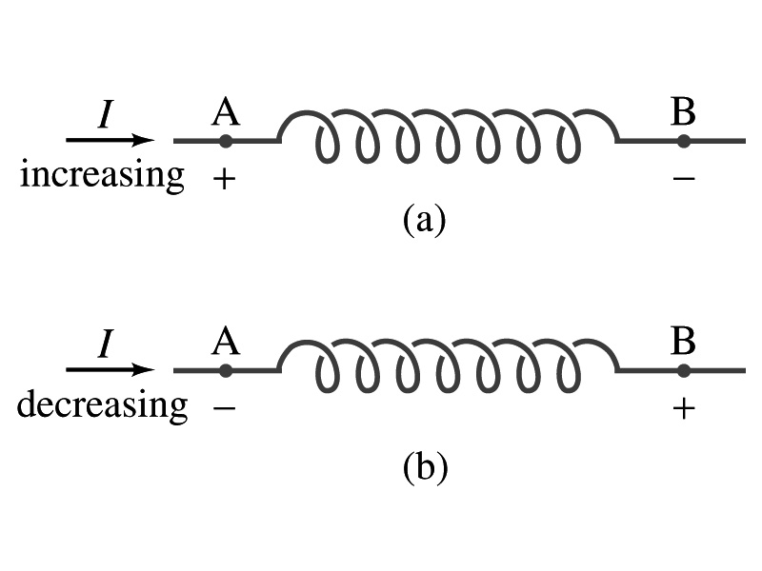
Inductor
An electrical circuit always contains some inductance but is normally negligibly small
  If a circuit contains a coil of many turns, it could have large inductance
A coil that has significant inductance, L, is called an inductor and is express with the symbol
  Precision resisters are normally wire wound
    Would have both resistance and inductance
    The inductance can be minimized by winding the wire back on itself in the opposite direction to cancel the magnetic flux
    This is called a “non-inductive winding”
If an inductor has negligible resistance, inductance controls the changing current
For an AC current, the greater the inductance the less the AC current
  An inductor thus acts like a resistor to impede the flow of alternating current (not to DC, though. Why?)
  The quality of an inductor is indicated by the term reactance or impedance

Slide 14
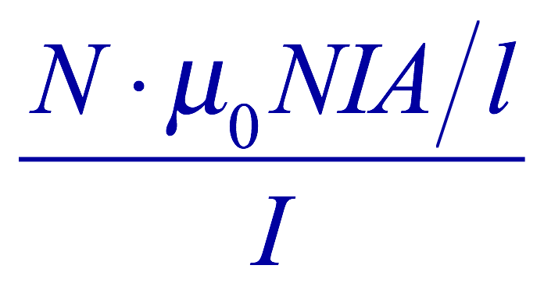
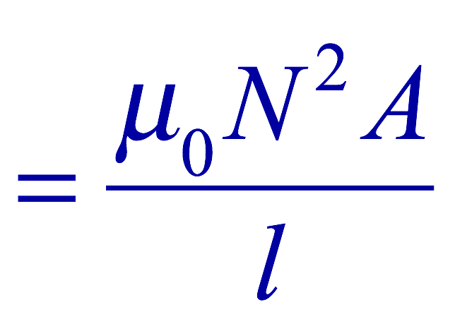
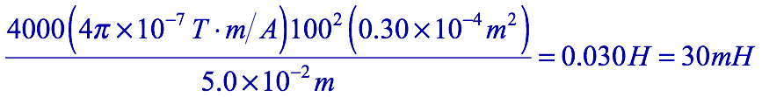
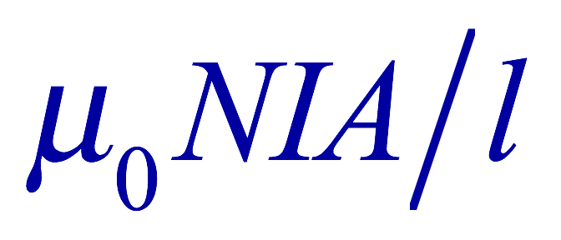
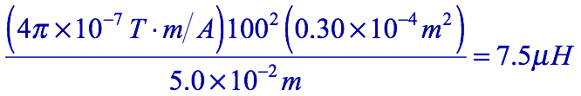
Example 30 – 3
Solenoid inductance. (a) Determine the formula for the self inductance L of a tightly wrapped solenoid ( a long coil) containing N turns of wire in its length l and whose cross-sectional area is A. (b) Calculate the value of L if N=100, l=5.0cm, A=0.30cm² and the solenoid is air filled. (c) calculate L if the solenoid has an iron core with μ=4000μ₀.
What is the magnetic field inside a solenoid?
The flux is, therefore,
Using the formula for self inductance:
(b) Using the formula above
(c) The magnetic field with an iron core solenoid is

Slide 15
Energy Stored in the Magnetic Field
When an inductor of inductance L is carrying current I which is changing at a rate dI/dt, energy is supplied to the inductor at a rate
What is the work needed to increase the current in an inductor from 0 to I?
  The work, dW, done in time dt is
  Thus the total work needed to bring the current from 0 to I in an inductor is

Slide 16
Energy Stored in the Magnetic Field
The work done to the system is the same as the energy stored in the inductor when it is carrying current I
  This is compared to the energy stored in a capacitor, C, when the potential difference across it is V:
  Just like the energy stored in a capacitor is considered to reside in the electric field between its plates
  The energy in an inductor can be considered to be stored in its magnetic field
Energy Stored in a magnetic field inside an inductor

Slide 17
Stored Energy in terms of B
So how is the stored energy written in terms of magnetic field B?
  Inductance of an ideal solenoid without a fringe effect
  The magnetic field in a solenoid is
  Thus the energy stored in an inductor is
  Thus the energy density is
  This formula is valid in any region of space
  If a ferromagnetic material is present, μ₀ becomes μ.
E
What is this?
E density
Volume V
What volume does Al represent?
The volume inside a solenoid!!

Slide 18
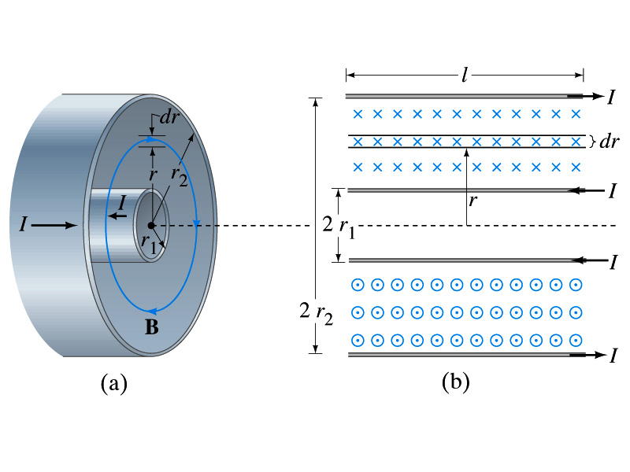
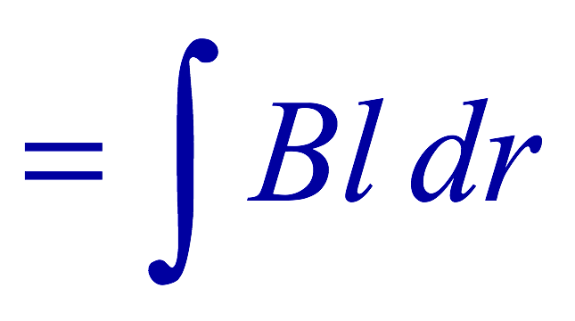
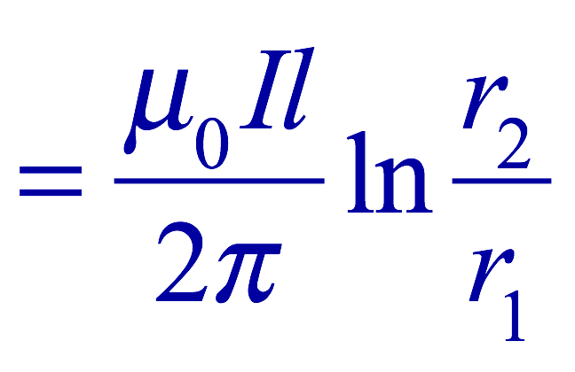

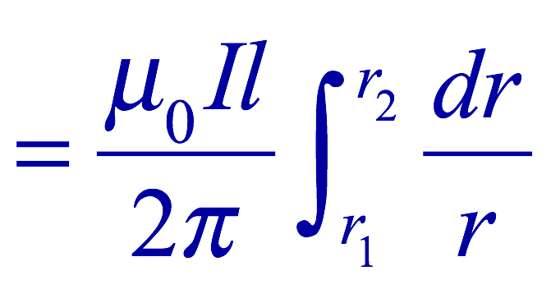
Example 30 – 5
Energy stored in a coaxial cable. (a) How much energy is being stored per unit length in a coaxial cable whose conductors have radii r₁ and r₂ and which carry a current I? (b) Where is the energy density highest?
(a) The total flux through l of the cable is
Thus inductance per unit length for a coaxial cable is
Thus the energy stored per unit length is
(b) Since the magnetic field is
The energy density is highest where B is highest. Since B is highest close to r=r₁, near the surface of the inner conductor.
And the energy density is

Slide 19
Example 30 – 9
Reactance of a coil. A coil has a resistance R=1.00Ω and an inductance of 0.300H. Determine the current in the coil if (a) 120 V DC is applied to it; (b) 120 V AC (rms) at 60.0Hz is applied.
Is there a reactance for DC?
Nope. Why not?
Since ω=0,
So for DC power, the current is from Kirchhoff’s rule
For an AC power with f =60Hz, the reactance is
Since the resistance can be ignored compared to the reactance, the rms current is

Slide 20
Maxwell’s Equations
The development of EM theory by Oersted, Ampere and others was not done in terms of EM fields
  The idea of fields was introduced somewhat by Faraday
Scottish physicist James C. Maxwell unified all the phenomena of electricity and magnetism in one theory with only four equations (Maxwell’s Equations) using the concept of fields
  This theory provided the prediction of EM waves
  As important as Newton’s law since it provides dynamics of electromagnetism
  This theory is also in agreement with Einstein’s special relativity
The biggest achievement of 19th century electromagnetic theory is the prediction and experimental verifications that the electromagnetic waves can travel through the empty space
  What do you think this accomplishment did?
    Open a new world of communication
    It also yielded the prediction that the light is an EM wave
Since all of Electromagnetism is contained in the four Maxwell’s equations, this is considered as one of the greatest achievements of human intellect

Slide 21
Ampere’s Law
Do you remember the mathematical expression of Oersted discovery of a magnetic field produced by an electric current, given by Ampere?
We’ve learned that a varying magnetic field produces an electric field
Then can the reverse phenomena, that a changing electric field producing a magnetic field, possible?
  If this is the case, it would demonstrate a beautiful symmetry in nature between electricity and magnetism

Slide 22
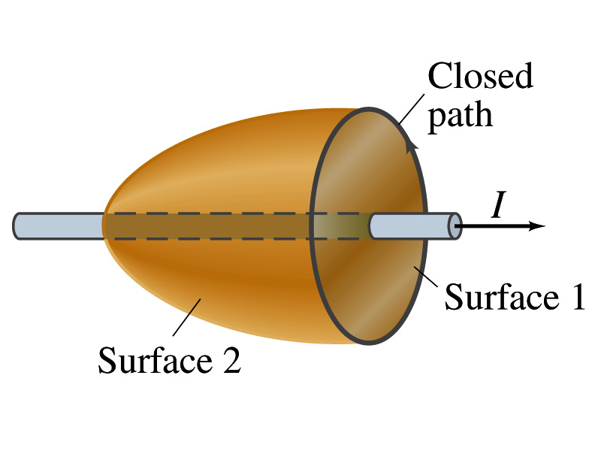
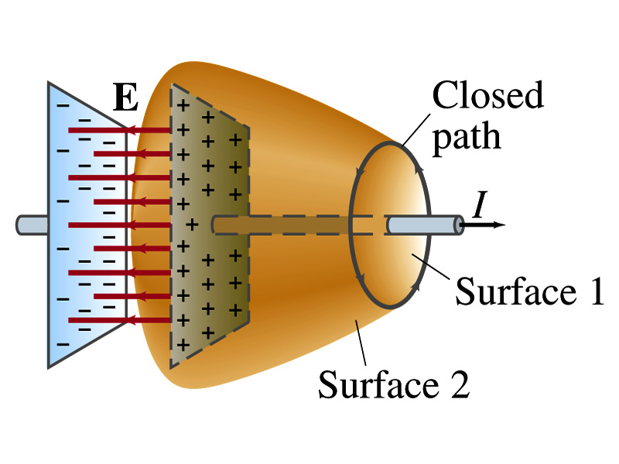
Expanding Ampere’s Law
Let’s consider a wire carrying current Ι
  The current that is enclosed in the loop passes through the surface # 1 in the figure
  We could imagine a different surface # 2 that shares the same enclosed path but cuts through the wire in a different location. What is the current that passes through the surface?
    Still Ι.
  So the Ampere’s law still works
We could then consider a capacitor being charged up or being discharged.
  The current Ι enclosed in the loop passes through the surface #1
  However the surface #2 that shares the same closed loop do not have any current passing through it.
    There is magnetic field present since there is current ➔ In other words there is a changing electric field in between the plates
    Maxwell resolved this by adding an additional term to Ampere’s law involving the changing electric field

Slide 23
Modifying Ampere’s Law
To determine what the extra term should be, we first have to figure out what the electric field between the two plates is
  The charge Q on the capacitor with capacitance C is Q=CV
    Where V is the potential difference between the plates
  Since V=Ed
    Where E is the uniform field between the plates, and d is the separation of the plates
  And for parallel plate capacitor C=ε₀A/d
  We obtain

Slide 24
Modifying Ampere’s Law
  If the charge on the plate changes with time, we can write
  Using the relationship between the current and charge we obtain
    Where Φ_{Ε}=EA is the electric flux through the surface between the plates
  So in order to make Ampere’s law work for the surface 2 in the figure, we must write it in the following form
  This equation represents the general form of Ampere’s law
    This means that a magnetic field can be caused not only by an ordinary electric current but also by a changing electric flux
Extra term by Maxwell

Slide 25
Example 31 – 1
Charging capacitor. A 30-pF air-gap capacitor has circular plates of area A=100cm². It is charged by a 70-V battery through a 2.0-Ω resistor. At the instance the battery is connected, the electric field between the plates is changing most rapidly. At this instance, calculate (a) the current into the plates, and (b) the rate of change of electric field between the plates. (c) Determine the magnetic field induced between the plates. Assume E is uniform between the plates at any instant and is zero at all points beyond the edges of the plates.
Since this is an RC circuit, the charge on the plates is:
For the initial current (t=0), we differentiate the charge with respect to time.
The electric field is
Change of the electric field is

Slide 26
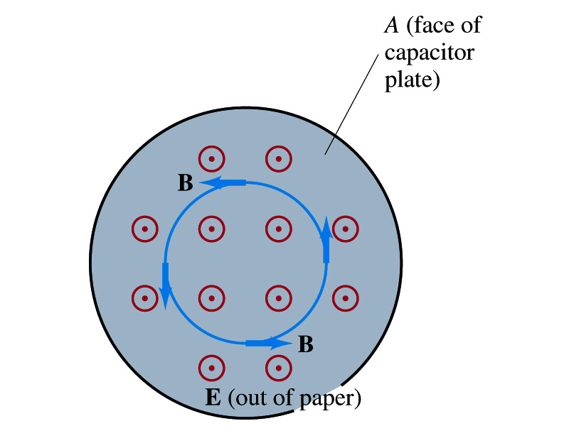
Example 31 – 1
(c) Determine the magnetic field induced between the plates. Assume E is uniform between the plates at any instant and is zero at all points beyond the edges of the plates.
The magnetic field lines generated by changing electric field is perpendicular to E and is circular due to symmetry
Whose law can we use to determine B?
Extended Ampere’s Law w/ Ι_{encl}=0!
We choose a circular path of radius r, centered at the center of the plane, following the B.
For r<r_{plate}, the electric flux is
since E is uniform throughout the plate
So from Ampere’s law, we obtain
Solving for B
For r<r_{plate}
Since we assume E=0 for r>r_{plate}, the electric flux beyond the plate is fully contained inside the surface.
So from Ampere’s law, we obtain
Solving for B
For r>r_{plate}

Slide 27
Displacement Current
Maxwell interpreted the second term in the generalized Ampere’s law equivalent to an electric current
  He called this term as the displacement current, Ι_{D}
  While the other term is called as the conduction current, Ι
Ampere’s law then can be written as
  Where
  While it is in effect equivalent to an electric current, a flow of electric charge, this actually does not have anything to do with the flow itself

Slide 28
Gauss’ Law for Magnetism
If there is a symmetry between electricity and magnetism, there must be an equivalent law in magnetism as the Gauss’ Law in electricity
For a magnetic field B, the magnetic flux Φ_{B} through the surface is defined as
  Where the integration is over the area of either an open or a closed surface
The magnetic flux through a closed surface which completely encloses a volume is
What was the Gauss’ law in the electric case?
  The electric flux through a closed surface is equal to the total net charge Q enclosed by the surface divided by ε₀.
Similarly, we can write Gauss’ law for magnetism as
Why is result of the integral zero?
  There is no isolated magnetic poles, the magnetic equivalent of single electric charges
Gauss’ Law for electricity
Gauss’ Law for magnetism

Slide 29
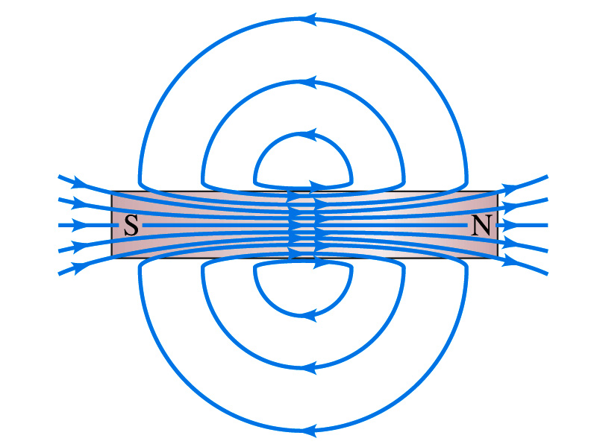
Gauss’ Law for Magnetism
What does the Gauss’ law in magnetism mean physically?
  There are as many magnetic flux lines that enter the enclosed volume as leave it
  If magnetic monopole does not exist, there is no starting or stopping point of the flux lines
    Electricity do have the source and the sink
  Magnetic field lines must be continuous
  Even for bar magnets, the field lines exist both insides and outside of the magnet

Slide 30
Maxwell’s Equations
In the absence of dielectric or magnetic materials, the four equations developed by Maxwell are:
Gauss’ Law for electricity
A generalized form of Coulomb’s law relating electric field to its sources, the electric charge
Gauss’ Law for magnetism
A magnetic equivalent of Coulomb’s law relating magnetic field to its sources. This says there are no magnetic monopoles.
Faraday’s Law
An electric field is produced by a changing magnetic field
Ampére’s Law
A magnetic field is produced by an electric current or by a changing electric field

Slide 31
Maxwell’s Amazing Leap of Faith
According to Maxwell, a magnetic field will be produced even in an empty space if there is a changing electric field
  He then took this concept one step further and concluded that
    If a changing magnetic field produces an electric field, the electric field is also changing in time.
    This changing electric field in turn produces the magnetic field that also changes.
    This changing magnetic field then in turn produces the electric field that changes.
    This process continues.
  With the manipulation of the equations, Maxwell found that the net result of this interacting changing fields is a wave of electric and magnetic fields that can actually propagate (travel) through the space

