Slide 1
PHYS 1444 – Section 003
Lecture #6
Thursday Sep. 13, 2012
Dr. Andrew Brandt
Chapter 23:
Electric Potential

Slide 2
Electric Potential Energy
Concept of energy is very useful solving mechanical problems
Conservation of energy makes solving complex problems easier.
When can the potential energy be defined?
  Only for a conservative force.
  The work done by a conservative force is independent of the path. What does it only depend on??
    The difference between the initial and final positions
  Can you give me an example of a conservative force?
    Gravitational force
Is the electrostatic force between two charges a conservative force?
  Yes. Why?
  The dependence of the force on distance is identical to that of the gravitational force.
    The only thing matters is the direct linear distance between the object not the path.

Slide 3
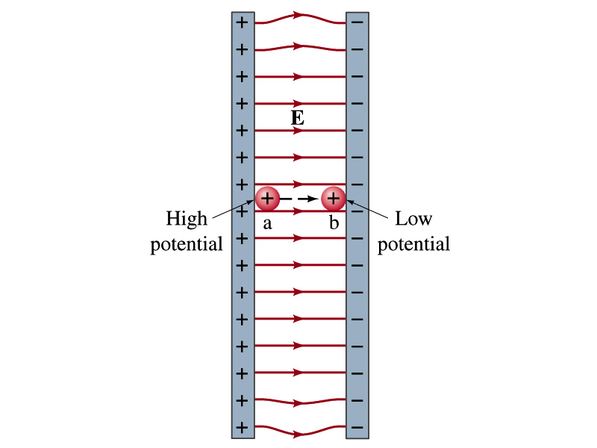
Electric Potential Energy
What is the definition of change in electric potential energy U_{b} –U_{a}?
  The gain (or loss) of potential energy as the charge moves from point a to point b.
  The negative work done on the charge by the electric force to move it from a to b.
Let’s consider an electric field between two parallel plates w/ equal but opposite charges
  The field between the plates is uniform since the gap is small and the plates are infinitely long…
What happens when we place a small charge, +q, on a point at the positive plate and let go?
  The electric force will accelerate the charge toward negative plate.
  What kind of energy does the charged particle gain?
    Kinetic energy

Slide 4
Electric Potential Energy
What does this mean in terms of energies?
  The electric force is a conservative force.
  Thus, the mechanical energy (K+U) is conserved under this force.
  The charged object has only electric potential energy at the positive plate.
  The electric potential energy decreases and
  Turns into kinetic energy as the electric force works on the charged object and the charged object gains speed.
Point of greatest potential energy for
  Positively charged object
  Negatively charged object
PE=
U
0
KE=
0
K
ME=
U
K
U+K=const

Slide 5
Electric Potential
How is the electric field defined?
  Electric force per unit charge: F/q
We can define electric potential (potential) as
  The electric potential energy per unit charge
  This is like the voltage of a battery…
Electric potential is written with a symbol V
  If a positive test charge q has potential energy U_{a} at a point a, the electric potential of the charge at that point is

Slide 6
Electric Potential
Since only the difference in potential energy is meaningful, only the potential difference between two points is measurable
What happens when the electric force does “positive work”?
  The charge gains kinetic energy
  Electric potential energy of the charge decreases
Thus the difference in potential energy is the same as the negative of the work, W_{ba}, done on the charge by the electric field to move the charge from point a to b.
The potential difference V_{ba} is

Slide 7
A Few Things about Electric Potential
What does the electric potential depend on?
  Other charges that create an electric field
  What about the test charge?
    No, the electric potential is independent of the test charge
    Test charge gains potential energy by existing in the potential created by other charges
Which plate is at a higher potential?
  Positive plate. Why?
    Since positive charge has the greatest potential energy.
  What happens to the positive charge if it is let go?
    It moves from higher potential to lower potential
  How about a negative charge?
    Its potential energy is higher on the negative plate. Thus, it moves from negative plate to positive. Potential difference is the same for
    a negative charge at the negative plate as a positive
    charge at the positive plate.
The unit of the electric potential is Volt (V).
From the definition, 1V = 1J/C.
Zero point of electric potential can be chosen arbitrarily.
Often the ground, a conductor connected to Earth is zero.

Slide 8
Example 23 – 1
A negative charge: Suppose a negative charge, such as an electron, is placed at point b in the figure. If the electron is free to move, will its electric potential energy increase or decrease? How will the electric potential change?
e-
An electron placed at point b will move toward the positive plate since it was released at its highest potential energy point.
It will gain kinetic energy as it moves toward left, decreasing its potential energy.
Note the electron is moving from point b at a lower potential to point a at a higher potential. ΔV=V_{a}-V_{b}>0.
This is because the potential is generated by the charges on the plates not by the electron.

Slide 9
Electric Potential and Potential Energy
What is the definition of the electric potential?
  The potential energy difference per unit charge
How would you express the potential energy that a charge q would obtain when it is moved between point a and b with the potential difference V_{ba}?
  In other words, if an object with charge q moves through a potential difference V_{ba}, its potential energy changes by qV_{ba}.
So electric potential is
  A measure of how much energy an electric charge can acquire in a given situation
  related to how much work a given charge can do.

Slide 10
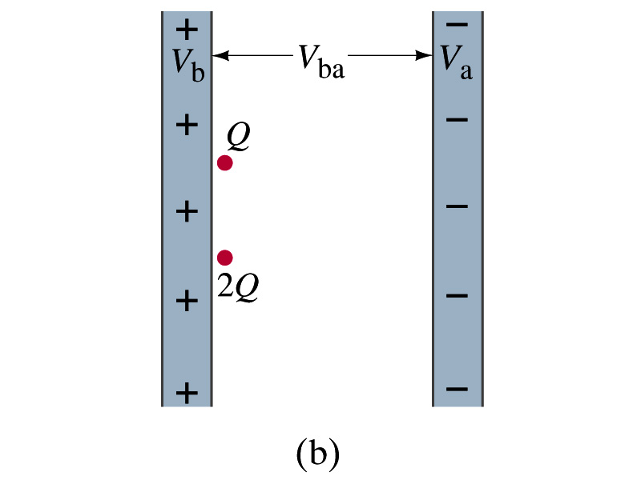
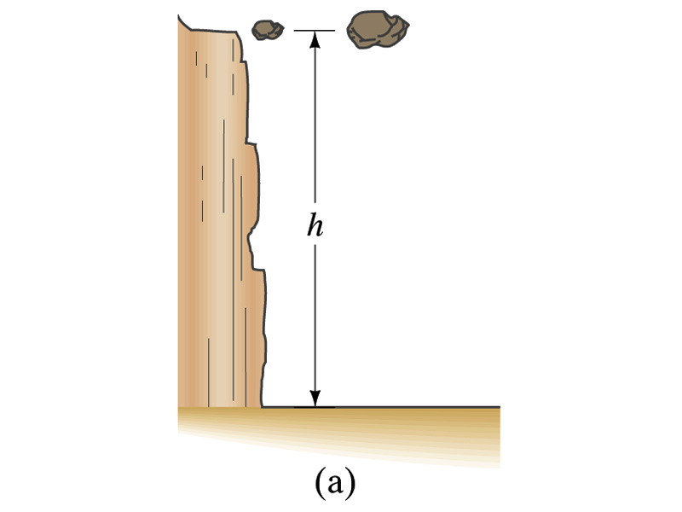
Comparisons of Potential Energies
Let’s compare gravitational and electric potential energies
m
2m
What is the potential energy of each rock?
  mgh and 2mgh
Which rock has a bigger potential energy?
  The rock with a larger mass
Why?
  It’s got a bigger mass.
What is the potential energy of each charge?
  +QV_{ba} and +2QV_{ba}
Which object has a bigger potential energy?
  The object with a larger charge.
Why?
  It’s got a bigger charge.
The “potential” is the same but the heavier rock or larger charge can do a greater work.

Slide 11
Some Typical Voltages
Sources | Approximate Voltage
Thundercloud to ground | 10⁸ V
High-Voltage Power Lines | 10⁶ V
Power supply for TV tube | 10⁴ V
Automobile ignition | 10⁴ V
Household outlet | 10² V
Automobile battery | 12 V
Flashlight battery | 1.5 V
Resting potential across nerve membrane | 10⁻¹ V
Potential changes on skin (EKG and EEG) | 10⁻⁴ V

Slide 12
Electric Potential and Potential Energy
The electric potential difference gives potential energy (or the possibility to do work) based on the charge of the object.
So what is happening in batteries or generators?
  They maintain a potential difference.
  The actual amount of energy used or transformed depends on how much charge flows.
  How much is the potential difference maintained by a car’s battery?
    12Volts
  If for a given period, 5C charge flows through the headlight lamp, what is the total energy transformed?
    E_{tot}=5C*12V=60 What is the unit?
  If it is left on twice as long? E_{tot}=10C*12V=120J.
C*J/C=J (Joules)

Slide 13
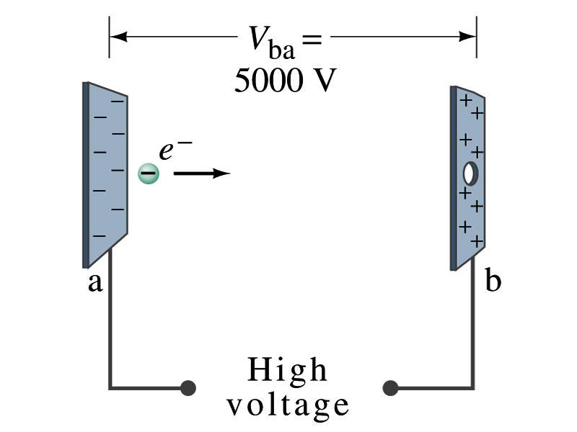
Example 23 – 2
Electrons in a TV tube: Suppose an electron in the picture tube of a television set is accelerated from rest through a potential difference V_{ba}=+5000V. (a) What is the change in potential energy of the electron? (b) What is the speed of the electron (m=9.1x10⁻³¹kg) as a result of this acceleration? (c) Repeat for a proton (m=1.67x10⁻²⁷kg) that accelerates through a potential difference of V_{ba}=-5000V.
(a) What is the charge of an electron?
So what is the change of its potential energy?

Slide 14
Example 23 – 2
(b) Speed of the electron?
  The entire potential energy of the electron is transformed into kinetic energy. Thus the equation is
(c) Speed of a proton that accelerates through V=-5000V?

Slide 15
Electric Potential and Electric Field
The effect of a charge distribution can be described in terms of electric field or electric potential.
  What kind of quantities are the electric field and the electric potential?
    Electric Field:
    Electric Potential:
  Since electric potential is a scalar quantity, it often can make problem solving easier.
Vector
Scalar

Slide 16
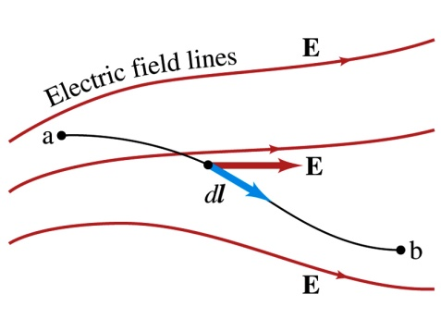
Electric Potential and Electric Field
The potential energy is an (independent of path) function expressed in terms of a (conservative) force.
The potential difference is the potential energy difference per unit charge
  This formula can be used to determine V_{ba} when the electric field is given.
When the field is uniform
or
Unit of the electric field in terms of potential?
V/m
Can you derive this from N/C?

Slide 17
Example 23 – 3
Uniform electric field obtained from voltage: Two parallel plates are charged to a voltage of 50 V. If the separation between the plates is 5.0 cm, calculate the magnitude of the electric field between them, ignoring any fringe effects.
5cm
50V
What is the relationship between electric field and the potential for a uniform field?
Solving for E

