Slide 1
PHYS 1444 – Section 003
Lecture #7
Tuesday Sept. 18, 2012
Ian Howley
Chapter 23:
Electric Potential due to Point Charges
Shape of the Electric Potential
V due to Charge Distributions
Equi-potential Lines and Surfaces
Electric Potential Due to Electric Dipole
E determined from V

Slide 2
The Plan
HW on Ch 23 and 24 due Tues 9/25 at 9pm, available this afternoon
I will lecture again on Thursday
Finish Ch 23 today, Ch 24 on Thursday

Slide 3
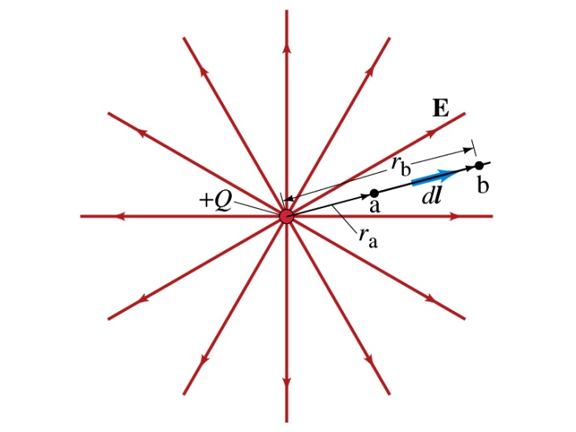
Electric Potential due to Point Charges
What is the electric field due to a point charge Q at a distance r?
Electric potential due to the field E for moving from point r_{a} to r_{b} away from the charge Q is
Notice how the integral is carried out in the radial direction.

Slide 4
Electric Potential due to Point Charges
Since only the differences in potential have physical meaning, we can choose at .
The electrical potential V at a distance r from a single point charge is
So the absolute potential from a single point charge depends only on the magnitude of the point charge and the distance from it

Slide 5
Properties of the Electric Potential
What are the differences between the electric potential and the electric field?
  Electric potential
    Electric potential energy per unit charge
    Inversely proportional to the distance
    Simply add the potential from each of the charges to obtain the total potential from multiple charges, since potential is a scalar quantity
  Electric field
    Electric force per unit charge
    Inversely proportional to the square of the distance
    Need vector sums to obtain the total field from multiple charges
Potential for a positive charge is large near the charge and decreases to 0 at large distances.
Potential for the negative charge is small (large magnitude but negative) near the charge and increases with distance to 0

Slide 6
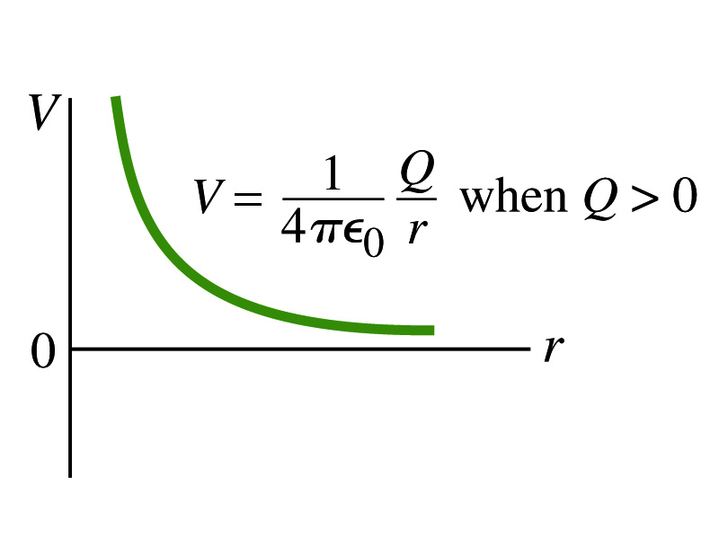
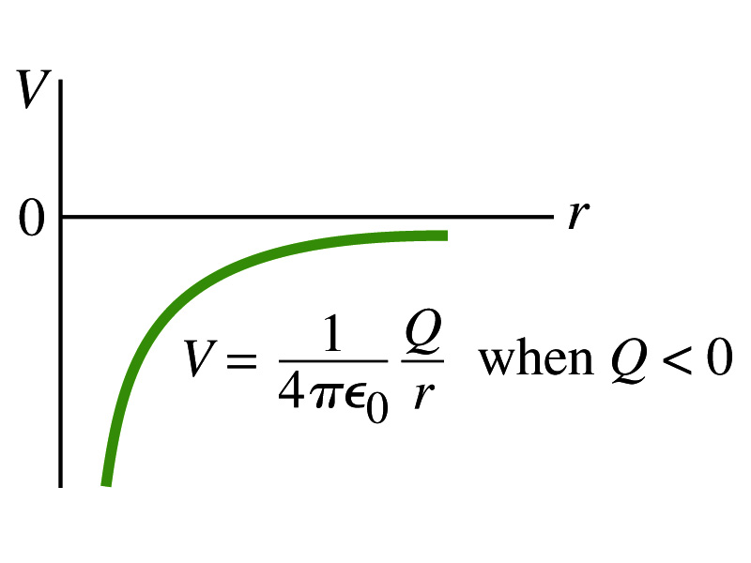
Shape of the Electric Potential
So, how does the electric potential look as a function of distance?
  What is the formula for the potential by a single charge?
Positive Charge
Negative Charge
A uniformly charged sphere would have the same potential as a single point charge.
What does this mean?
Uniformly charged sphere behaves like all the charge is on the single point in the center.

Slide 7
Example 23 – 6
Work to bring two positive charges close together: What minimum work is required by an external force to bring a charge q=3.00 μC from a great distance away ( ) to a point 0.500 m from a charge Q=20.0 μC?
What is the work done by the electric field in terms of potential energy and potential?
Since we obtain
In other words, the external force must input work of +1.08J to bring the charge 3.00μC from infinity to 0.500m from the 20.0μC charge.

Slide 8
Electrostatic Potential Energy: Two charges
What is the electrostatic potential energy of a configuration of charges? (Choose V=0 at r=∞)
  If there are no other charges around, a single point charge Q₁ in isolation has no potential energy and feels no electric force
If a second point charge Q₂ is to a distance r₁₂ from Q₁ ,the potential at the position of Q₂ is
The potential energy of the two charges relative to V=0 at r= ∞ is
  This is the work that needs to be done by an external force to bring Q₂ from infinity to a distance r₁₂ from Q₁.
  It is also a negative of the work needed to separate them to infinity.

Slide 9
Electrostatic Potential Energy: Three Charges
So what do we do for three charges?
Work is needed to bring all three charges together
  There is no work needed to bring Q₁ to a certain place without the presence of any other charge
  The work needed to bring Q₂ to a distance to Q₁ is
  The work need to bring Q₃ to a distance to Q₁ and Q₂ is
So the total electrostatic potential of the three charge system is

Slide 10
Electric Potential from Charge Distributions
Let’s consider that there are n individual point charges in a given space and V=0 at
Then the potential due to the charge Q_{i} at a point a, distance r_{ia} from Q_{i} is
Thus the total potential V_{a} by all n point charges is
For a continuous charge distribution, we obtain

Slide 11
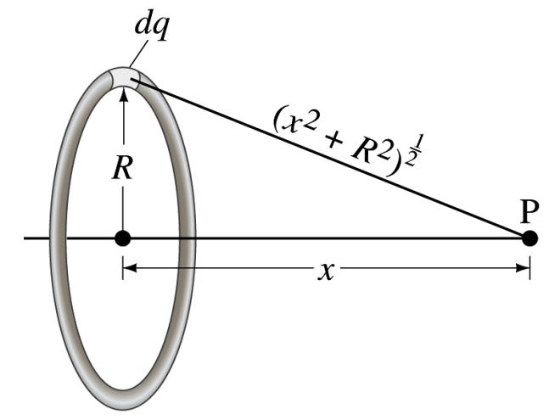
Example 23 – 8
Potential due to a ring of charge: A thin circular ring of radius R carries a uniformly distributed charge Q. Determine the electric potential at a point P on the axis of the ring a distance x from its center.
Each point on the ring is at the same distance from the point P. What is the distance?
So the potential at P is
What’s this?

Slide 12
Equi-potential Surfaces
Electric potential can be visualized using equipotential lines in 2-D or equipotential surfaces in 3-D
Any two points on equipotential surfaces (lines) have the same potential
What does this mean in terms of the potential difference?
  The potential difference between the two points on an equipotential surface is 0.
How about the potential energy difference?
  Also 0.
What does this mean in terms of the work to move a charge along the surface between these two points?
  No work is necessary to move a charge between these two points.

Slide 13
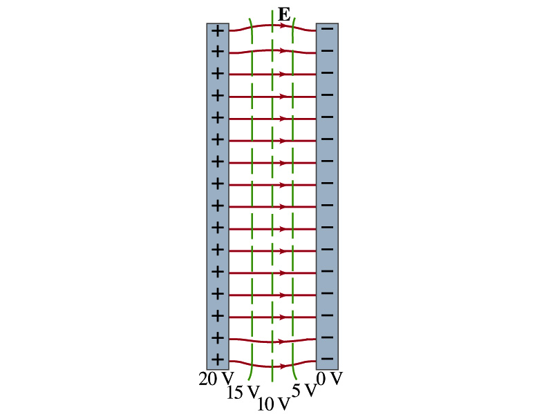
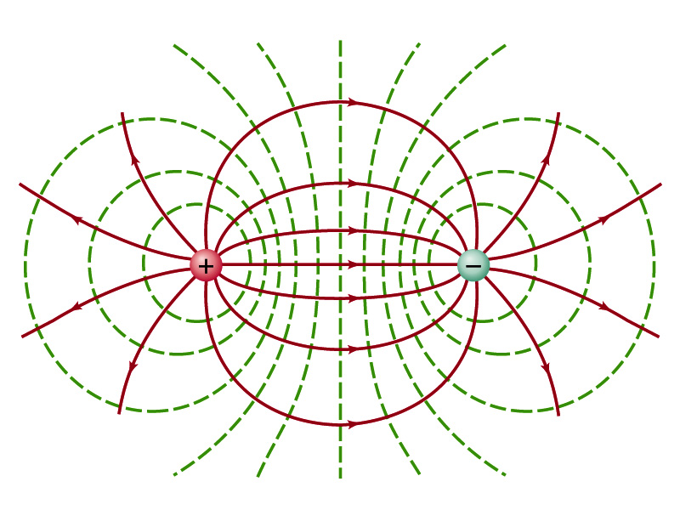

Equi-potential Surfaces
An equipotential surface (line) must be perpendicular to the electric field. Why?
  If there are any parallel components to the electric field, it would require work to move a charge along the surface.
Since the equipotential surface (line) is perpendicular to the electric field, we can draw these surfaces or lines easily.
There can be no electric field inside a conductor in static case, thus the entire volume of a conductor must be at the same potential.
So the electric field must be perpendicular to the conductor surface.
Parallel Plate
Point charges
Just like a topographic map

Slide 14
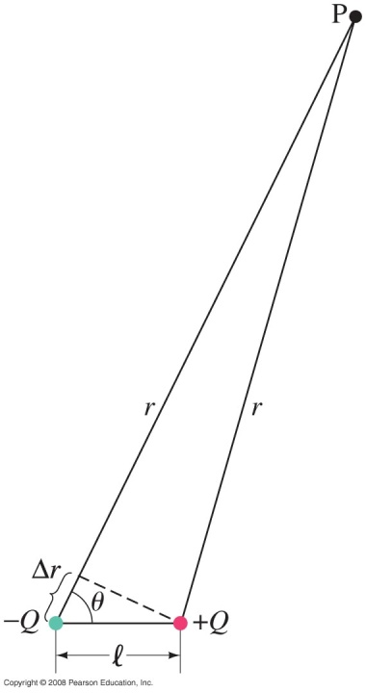
Potential due to Electric Dipoles
Δr=lcosθ
V due to dipole a
distance r from
the dipole

Slide 15
E Determined from V
Potential difference between two points is
So we can write
  What are dV and E_{l}?
    dV is the infinitesimal potential difference between two points separated by the distance dl
    E_{l} is the field component along the direction of dl.

Slide 16
Electrostatic Potential Energy: electron Volt
What is the unit of electrostatic potential energy?
  Joules
Joules is a very large unit in dealing with electrons, atoms or molecules
For convenience a new unit, electron volt (eV), is defined
  1 eV is defined as the energy acquired by a particle carrying the charge equal to that of an electron (q=e) when it moves across a potential difference of 1V.
  How many Joules is 1 eV then?
eV however is not a standard SI unit. You must convert the energy to Joules for computations.

