Slide 1
PHYS 1443 – Section 004
Lecture #17
Thursday, Oct. 23, 2014
Dr. Jaehoon Yu
Torque & Vector product
Moment of Inertia
Calculation of Moment of Inertia
Parallel Axis Theorem
Torque and Angular Acceleration
Rolling Motion and Rotational Kinetic Energy
Today’s homework is homework #9, due 11pm, Thursday, Oct. 30!!

Slide 2
Announcements
Mid-term grade discussion
  Coming Tuesday, Oct. 28
  Will have 40min of class followed by a 45min grade discussion
  In my office, CPB342

Slide 3
Torque
Torque is the tendency of a force to rotate an object about an axis. Torque, τ, is a vector quantity.
F
Consider an object pivoting about the point P by the force F being exerted at a distance r from P.
φ
r
The line of Action
The line that extends out of the tail of the force vector is called the line of action.
P
l₂
l₁
The perpendicular distance from the pivoting point P to the line of action is called the moment arm.
F₂
Moment arm
Magnitude of torque is defined as the product of the force exerted on the object to rotate it and the moment arm.
When there are more than one force being exerted on certain points of the object, one can sum up the torque generated by each force vectorially. The convention for sign of the torque is positive if rotation is in counter-clockwise and negative if clockwise.
Unit?

Slide 4
Ex. Torque
A one piece cylinder is shaped as in the figure with core section protruding from the larger drum. The cylinder is free to rotate around the central axis shown in the picture. A rope wrapped around the drum whose radius is R₁ exerts force F₁ to the right on the cylinder, and another force exerts F₂ on the core whose radius is R₂ downward on the cylinder. A) What is the net torque acting on the cylinder about the rotation axis?
R₁
F₁
The torque due to F₁
and due to F₂
R₂
So the total torque acting on the system by the forces is
F₂
Suppose F₁=5.0 N, R₁=1.0 m, F₂= 15.0 N, and R₂=0.50 m. What is the net torque about the rotation axis and which way does the cylinder rotate from the rest?
Using the above result
The cylinder rotates in counter-clockwise.

Slide 5
Torque and Vector Product
z
Let’s consider a disk fixed onto the origin O and the force F exerts on the point p. What happens?
τ=rxF
The disk will start rotating counter clockwise about the Z axis
O
y
r
p
The magnitude of the torque given to the disk by the force F is
θ
F
x
But torque is a vector quantity, what is the direction? How is torque expressed mathematically?
What is the direction?
The direction of the torque follows the right-hand rule!!
The above operation is called the Vector product or Cross product
What is the result of a vector product?
What is another vector operation we’ve learned?
Another vector
Scalar product
Result? A scalar

Slide 6
Properties of Vector Product
Vector Product is Non-commutative
What does this mean?
If the order of operation changes the result changes
Following the right-hand rule, the direction changes
Vector Product of two parallel vectors is 0.
Thus,
If two vectors are perpendicular to each other
Vector product follows distribution law
The derivative of a Vector product with respect to a scalar variable is

Slide 7
More Properties of Vector Product
The relationship between unit vectors,
Vector product of two vectors can be expressed in the following determinant form

Slide 8
Moment of Inertia
Rotational Inertia:
The measure of resistance of an object to changes in its rotational motion. Equivalent to mass in linear motion.
For a group of particles
For a rigid body
What are the dimension and unit of Moment of Inertia?
Determining Moment of Inertia is extremely important for computing equilibrium of a rigid body, such as a building.
Dependent on the axis of rotation!!!

Slide 9
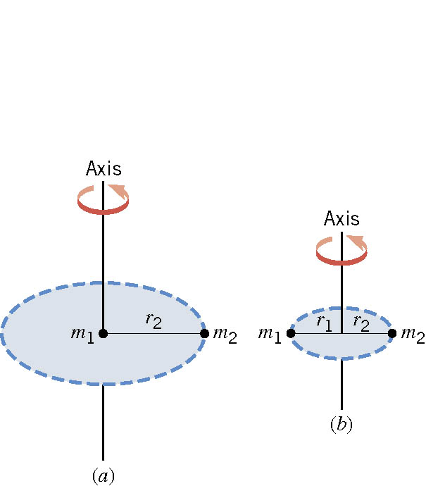
Ex. The Moment of Inertia Depends on Where the Axis Is.
Two particles each have mass m₁ and m₂ and are fixed at the ends of a thin rigid rod. The length of the rod is L. Find the moment of inertia when this object rotates relative to an axis that is perpendicular to the rod at (a) one end and (b) the center.
(a)
Which case is easier to spin?
(b)
Case (b)
Why?
Because the moment of inertia is smaller

Slide 10
Rotational Kinetic Energy
y
v_{i}
What do you think the kinetic energy of a rigid object that is undergoing a circular motion is?
m_{i}
r_{i}
θ
Kinetic energy of a masslet, m_{i}, moving at a tangential speed, v_{i}, is
O
x
Since a rigid body is a collection of masslets, the total kinetic energy of the rigid object is
Since moment of Inertia, I, is defined as
The above expression is simplified as

Slide 11
Example for Moment of Inertia
In a system of four small spheres as shown in the figure, assuming the radii are negligible and the rods connecting the particles are massless, compute the moment of inertia and the rotational kinetic energy when the system rotates about the y-axis at angular speed ω.
y
m
Since the rotation is about y axis, the moment of inertia about y axis, I_{y}, is
b
l
l
M
O
M
x
b
This is because the rotation is done about y axis, and the radii of the spheres are negligible.
Why are some 0s?
m
Thus, the rotational kinetic energy is
Find the moment of inertia and rotational kinetic energy when the system rotates on the x-y plane about the z-axis that goes through the origin O.

Slide 12
Calculation of Moments of Inertia
Moments of inertia for large rigid objects can be computed, if we assume the object consists of small volume elements with mass, Δm_{i}.
The moment of inertia for the large rigid object is
It is sometimes easier to compute moments of inertia in terms of volume of the elements rather than their mass
How can we do this?
Using the volume density, ρ, replace dm in the above equation with dV.
The moments of inertia becomes
Example: Find the moment of inertia of a uniform hoop of mass M and radius R about an axis perpendicular to the plane of the hoop and passing through its center.
y
The moment of inertia is
dm
O
R
The moment of inertia for this object is the same as that of a point of mass M at the distance R.
x
What do you notice from this result?

Slide 13
Ex. Rigid Body Moment of Inertia
Calculate the moment of inertia of a uniform rigid rod of length L and mass M about an axis perpendicular to the rod and passing through its center of mass.
y
The line density of the rod is
so the mass of a masslet is
dx
x
The moment of inertia is
x
L
What is the moment of inertia when the rotational axis is at one end of the rod.
Will this be the same as the above. Why or why not?
Since the moment of inertia is resistance to motion, it makes perfect sense for it to be harder to move when it is rotating about the axis at one end.

Slide 14
Parallel Axis Theorem
Moments of inertia for a highly symmetric object is easy to compute if the rotational axis is the same as the axis of symmetry. However if the axis of rotation does not coincide with axis of symmetry, the calculation can still be done in a simple manner using the parallel-axis theorem.
y
Moment of inertia is defined as
(x,y)
Since x and y are
One can substitute x and y in Eq. 1 to obtain
y’
r
y
CM
(x_{CM,}y_{CM})
y_{CM}
D
Since x’ and y’ are the distance from CM, by definition
x_{CM}
x’
x
Therefore, the parallel-axis theorem
x
What does this theorem tell you?
Moment of inertia of any object about any arbitrary axis are the same as the sum of moment of inertia for a rotation about the CM and that of the CM about the rotation axis.

Slide 15
Example for Parallel Axis Theorem
Calculate the moment of inertia of a uniform rigid rod of length L and mass M about an axis that goes through one end of the rod, using parallel-axis theorem.
y
The line density of the rod is
so the mass of a masslet is
CM
dx
x
The moment of inertia about the CM
x
L
Using the parallel axis theorem
The result is the same as using the definition of moment of inertia.
Parallel-axis theorem is useful to compute moment of inertia of a rotation of a rigid object with complicated shape about an arbitrary axis

Slide 16
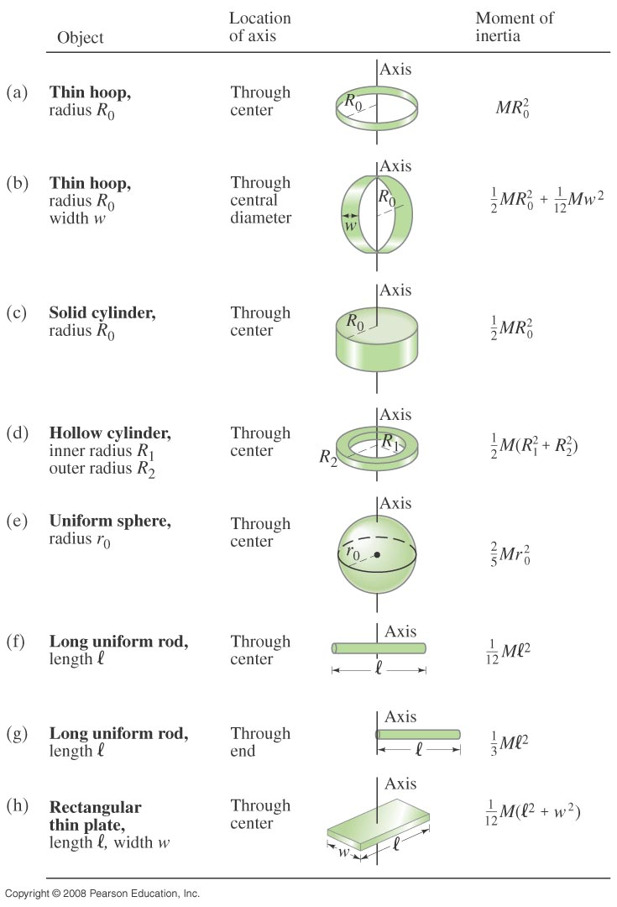
Check out Table 10 – 2 for moment of inertia for various shaped objects

